Slide 1
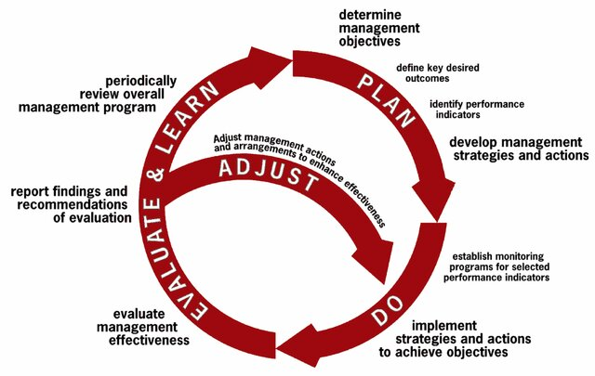
1. Define objectives
2. Define data to assess/adjusts policies
4. Balance historical and contemporary access
6. Ensure opportunities for new entrants
5. Quota transfers facilitate rapid adaptation
7. Allocate for research
3. Conduct regular reviews
2. Collect data to assess/adjusts policies
8. Reduce impacts

