Slide 1

8. Conduct regular reviews of allocation policies
1. Define clear and measurable management objectives
Define management objectives
2. Define and collect data required to assess and adjust allocation policies
Identify performance indicators
Periodically review overall program
3. Facilitate quota transfers between regions, sectors, and individuals
Adjust management strategies to increase effectiveness
Develop management strategies
4. Balance historical and contemporary resource access in setting allocations
Report findings and recommendations
5. Ensure opportunities for new entrants
Establish monitoring programs
6. Allocate quota for research and experimentation
Evaluate effectiveness
Implement management strategies
7. Reduce impacts of changes to allocation policies on stakeholders

Slide 2
1. Define clear and measurable management objectives
Define management objectives
3. Define and collect data required to assess and adjust allocation policies
Identify performance indicators
Periodically review overall program
4. Balance historical and contemporary resource access in setting allocations
Adjust management strategies to increase effectiveness
Develop management strategies
7. Allocate quota for research and experimentation
5. Facilitate quota transfers between regions, sectors, and individuals
Report findings and recommendations
Establish monitoring programs
6. Ensure opportunities for new entrants
2. Conduct regular reviews of allocation policies
Evaluate effectiveness
Implement management strategies
8. Reduce impacts of changes to allocation policies on stakeholders

Slide 3
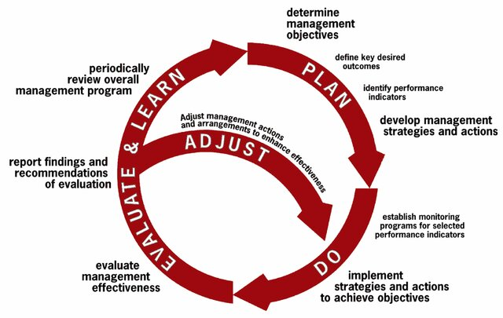
1. Define objectives
2. Define data to assess/adjusts policies
4. Balance historical and contemporary access
6. Ensure opportunities for new entrants
5. Quota transfers facilitate rapid adaptation
7. Allocate for research
3. Conduct regular reviews
2. Collect data to assess/adjusts policies
8. Reduce impacts

Slide 4


Slide 5
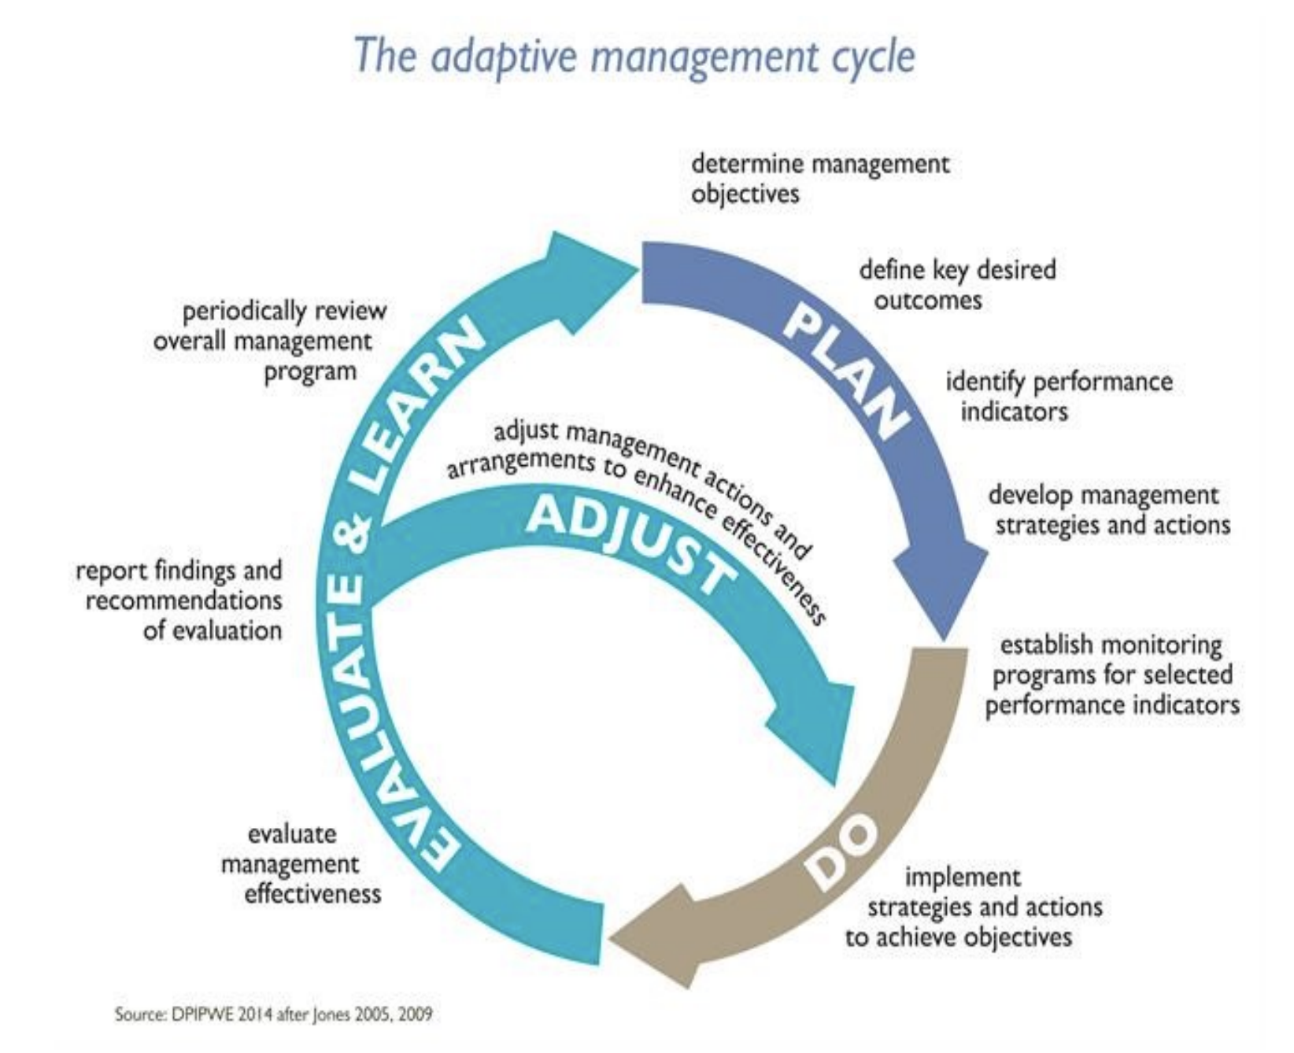

Slide 6
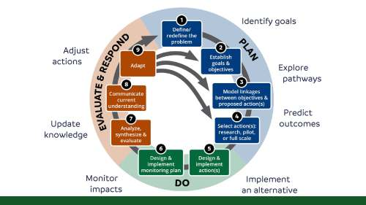

Slide 7
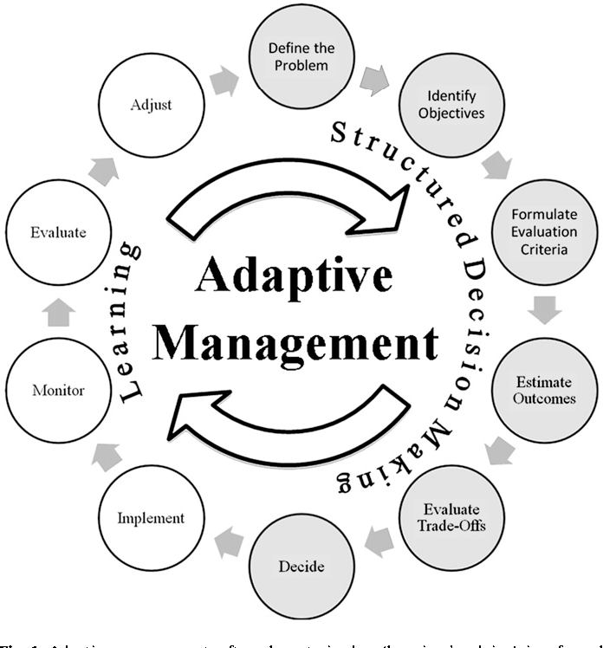

Slide 8
