Slide 1
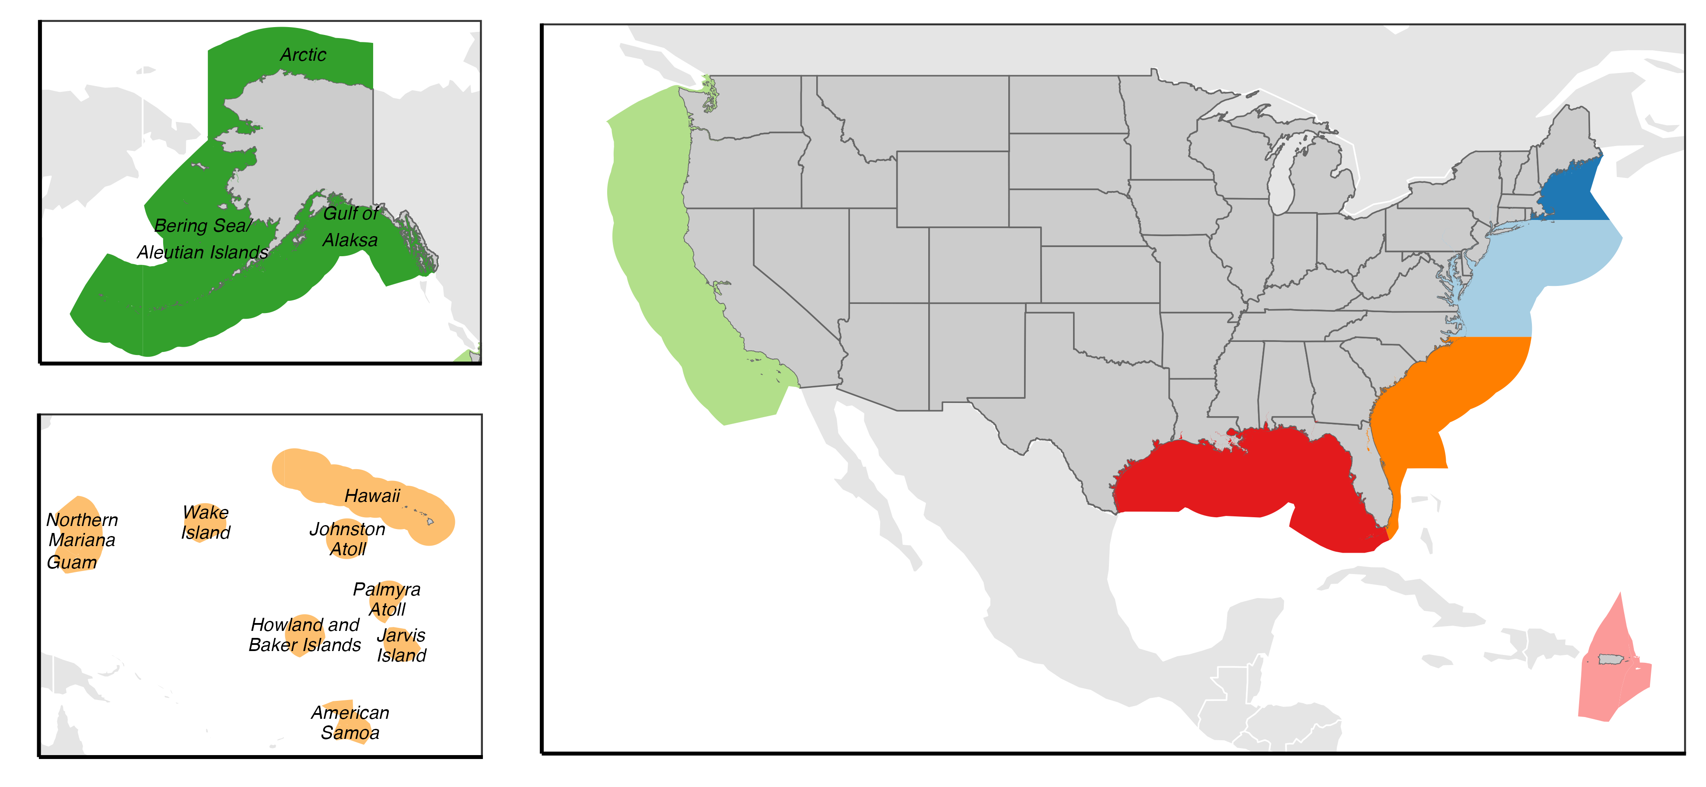
North Pacific
6 FMPs,
61 stocks
New England
9 FMPs, 38 stocks
(HMS: +38 stocks)
Mid-Atlantic
5 FMPs,
14 stocks
Pacific
3 FMPs, 133 stocks
(HMS: +18 stocks)
South Atlantic
6 FMPs, 48 stocks
Gulf of Mexico
3 FMPs, 28 stocks
Western Pacific
5 FEPs, 39 stocks
Caribbean
3 FMPs, 74 stocks

Slide 2
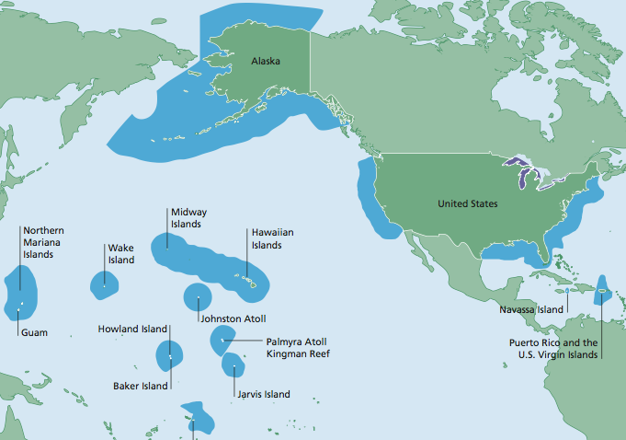
Arctic
North Pacific
6 FMPs, X stocks
Bering Sea / Aleutian Islands
Gulf of Alaska
New England
9 FMPs, X stocks
Pacific
4 FMPs, X stocks
Western Pacific
5 FEPs, X stocks
Mid-Atlantic
5 FMPs, X stocks
South Atlantic
6 FMPs, X stocks
Hawaii
Gulf of Mexico
3 FMPs, X stocks
Caribbean
X FMPs, X stocks
Mariana (Guam)
Pacific Remote Islands
American Samoa

