Slide 1
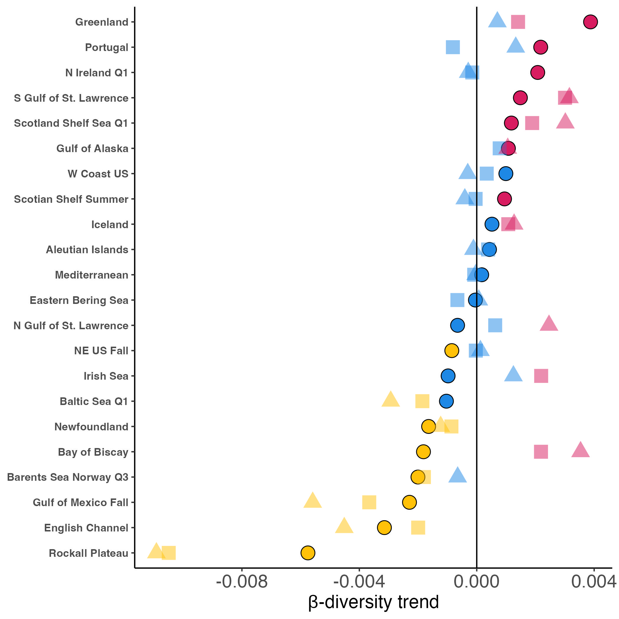
Trend
Differentiation
Homogenization
No β-diversity trend
Dissimilarity metric
Jaccard (occurrence)
Bray-Curtis (raw abundance)
Bray-Curtis (relative abundance)

