Slide 1
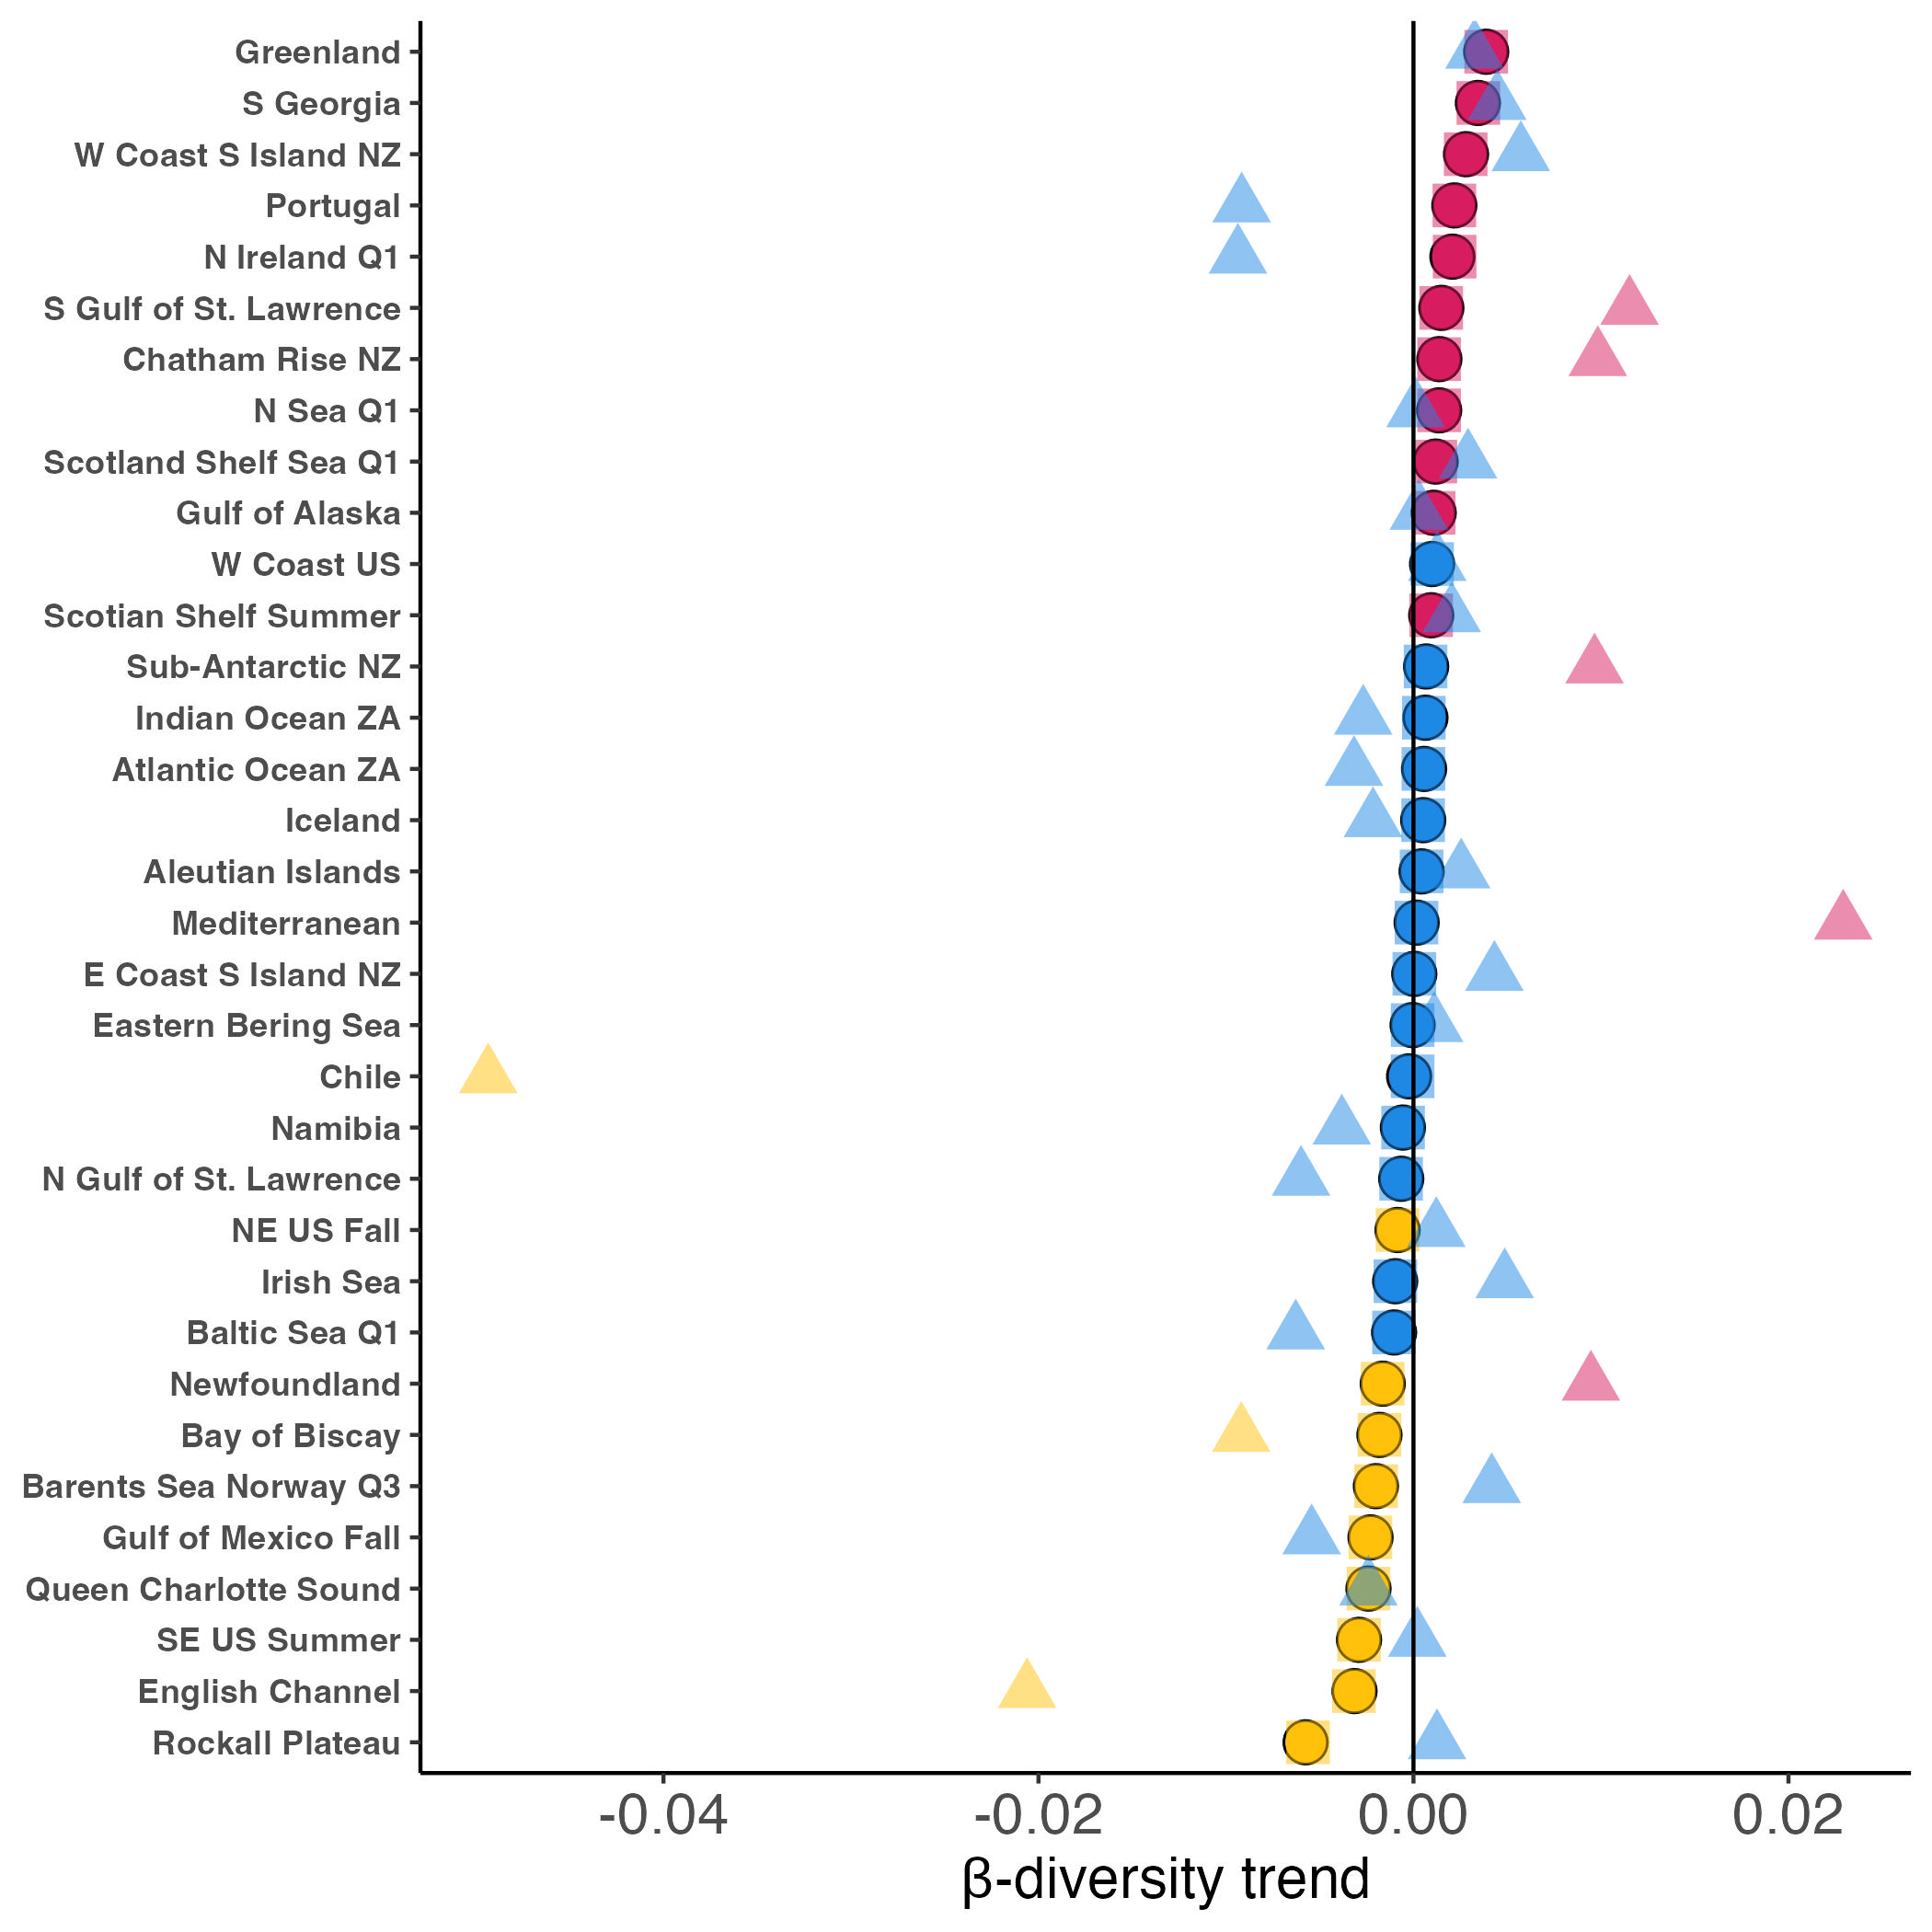
Trend
Differentiation
Homogenization
No β-diversity trend
Species inclusion criteria
Full species set
Least common 15% of species per region dropped
Species present in fewer than 1/3 of all years of regional survey dropped

Slide 2
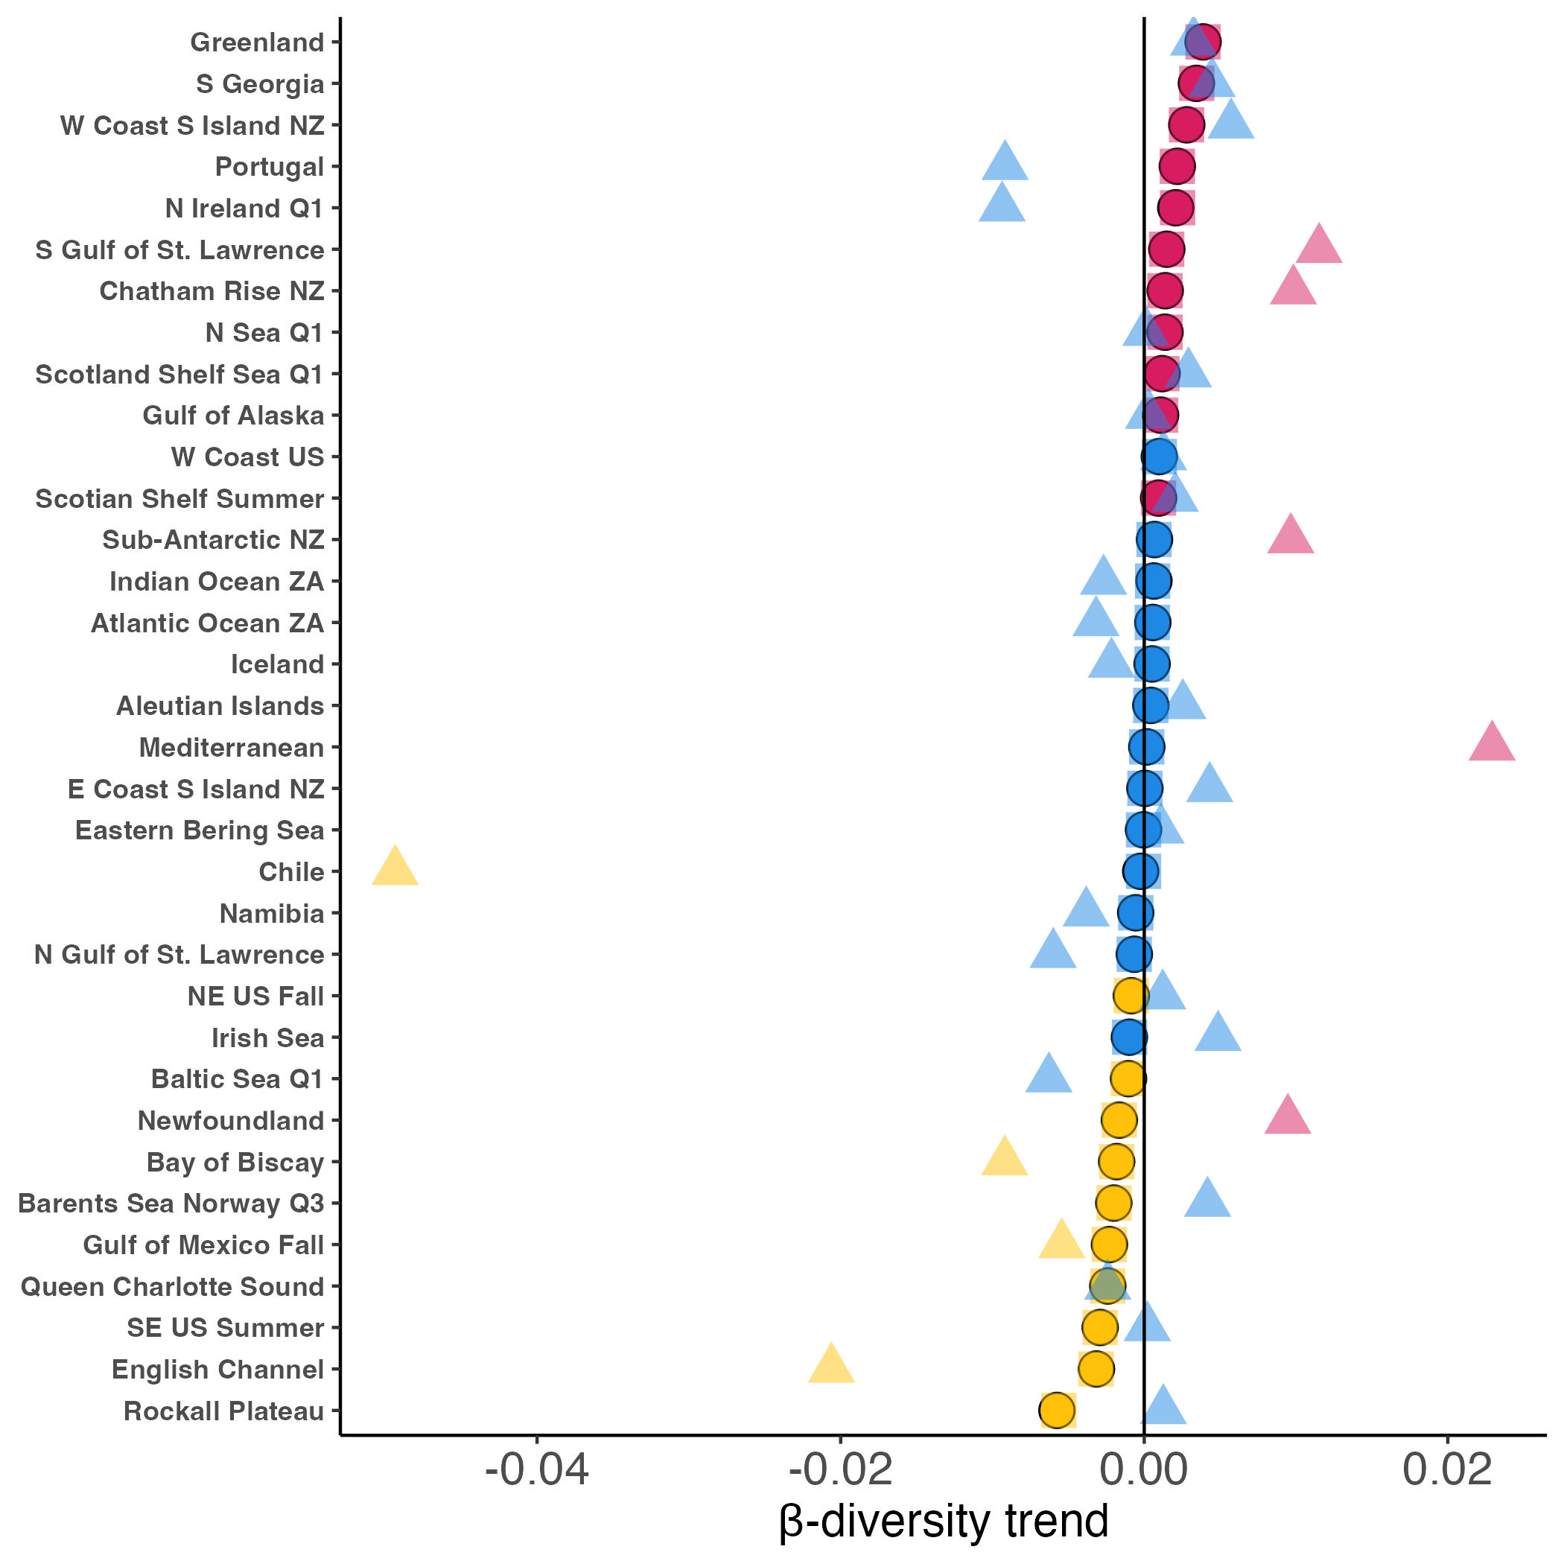
Trend
Differentiation
Homogenization
No β-diversity trend
Species inclusion criteria
Full species set
Least common 15% of species per region dropped
Species present in fewer than 1/3 of all years of regional survey dropped
Notes:
NOW JACCARD BINARY DISSIMILARITY INDEX

