Slide 1
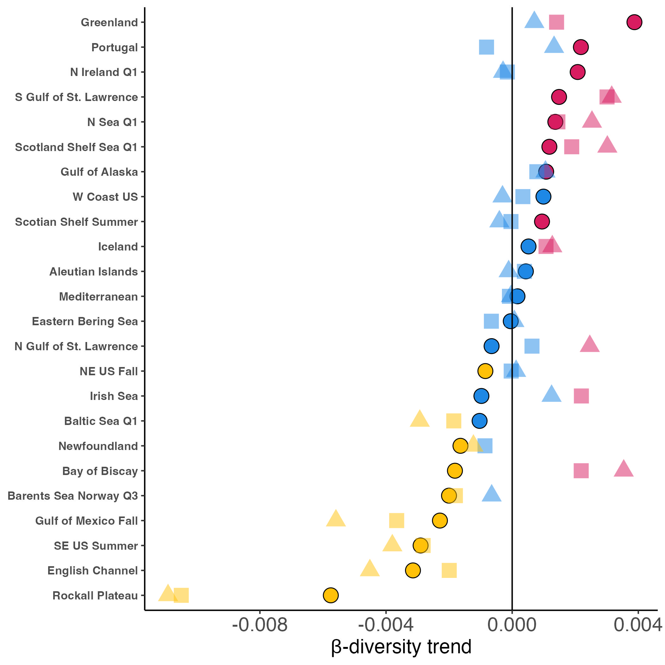
Trend
Differentiation
Homogenization
No β-diversity trend
Dissimilarity metric
Jaccard (occurrence)
Bray-Curtis (raw abundance)
Bray-Curtis (relative abundance)

Slide 2
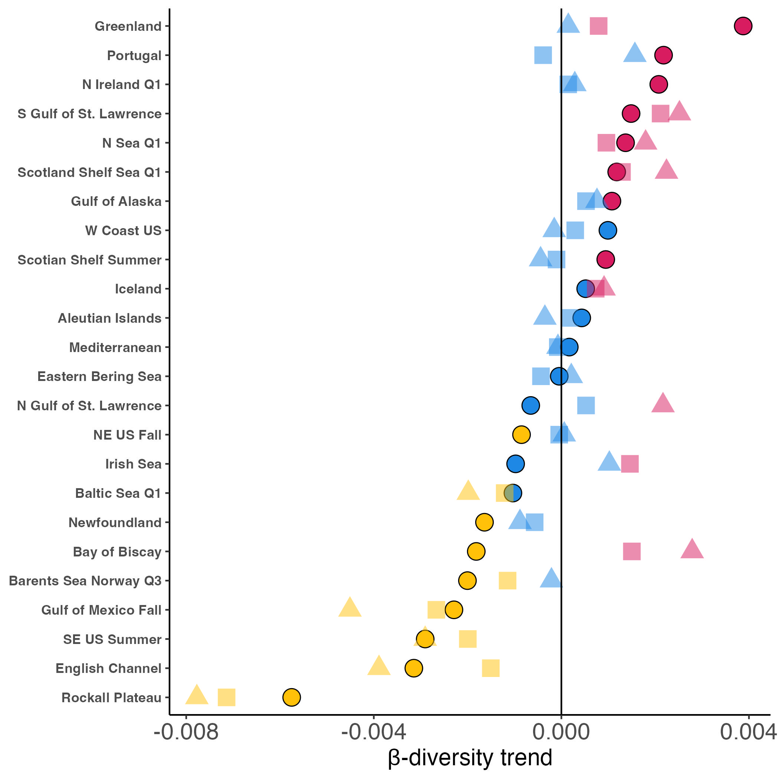
Trend
Differentiation
Homogenization
No β-diversity trend
Dissimilarity metric
Jaccard occurrence
Abundance-based Jaccard
Relative abundance-based Jaccard
Notes:
JACCARD

Slide 3
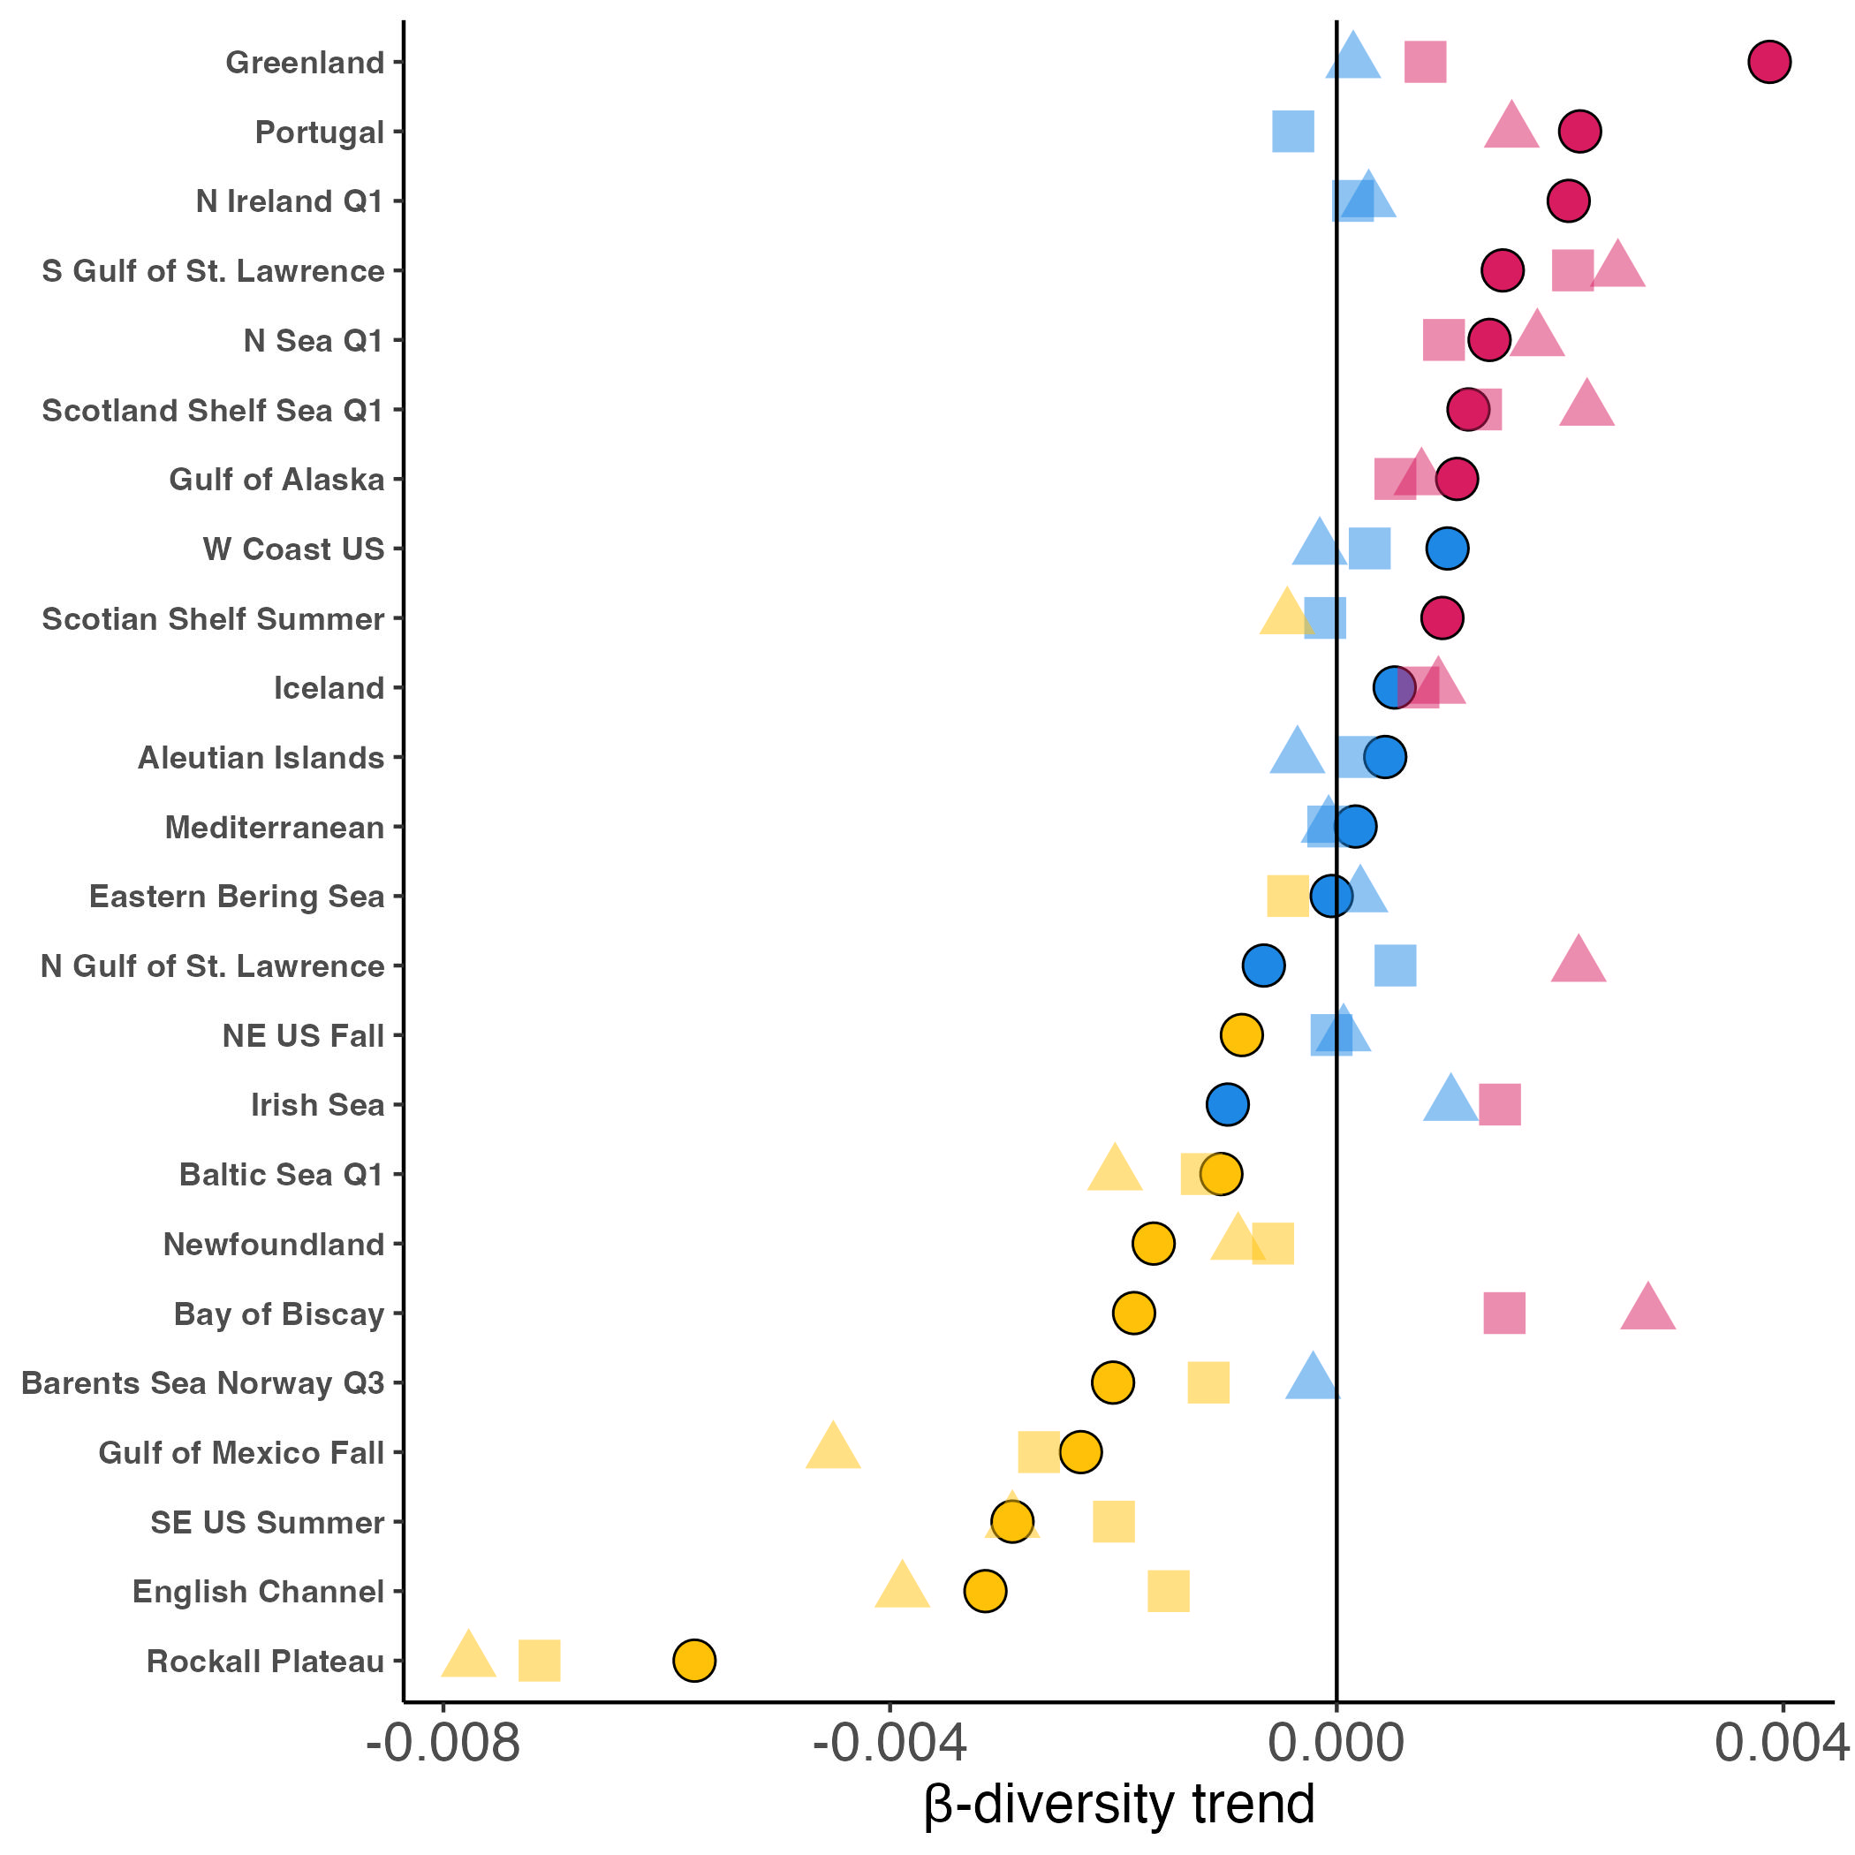
Trend
Differentiation
Homogenization
No β-diversity trend
Dissimilarity metric
Jaccard occurrence
Abundance-based Jaccard
Relative abundance-
based Jaccard

