Slide 1

Is Bigfoot an Alien?
Data Integration Project Step 1: Preparation
Julian Trösser
Zoe Chiying Lai

Slide 2
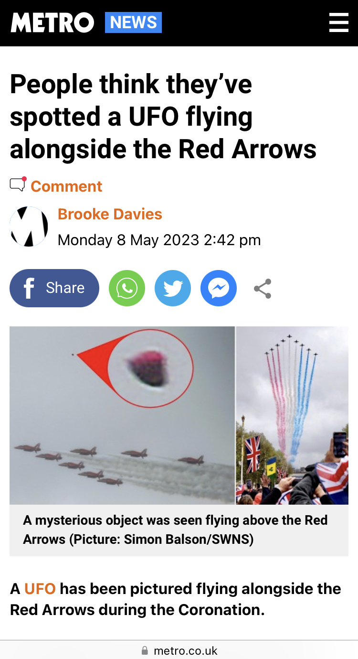
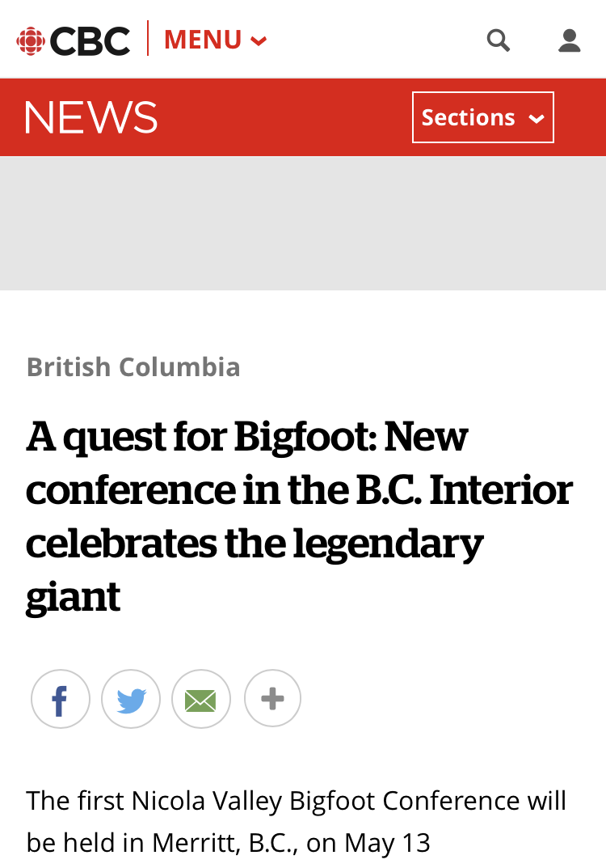
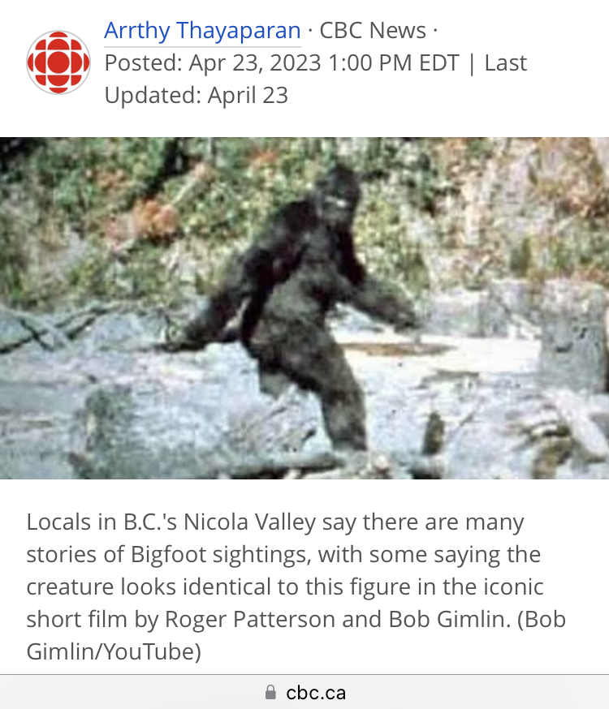
From time to time, there are Bigfoot and UFO Sightings on the news. Do you believe it?
Background
…

Slide 3

Showcase
Is Bigfoot an Alien?
Are there any patterns of their appearance?
When and where
Weather conditions

Slide 4
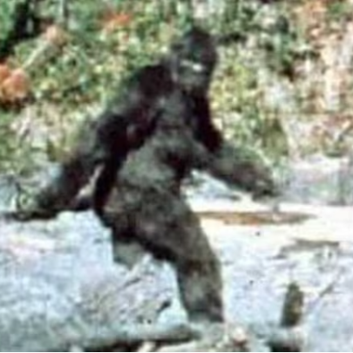
Source datasets: Bigfoot
1. Bigfoot Sightings Data
2. Bigfoot Sightings
reports.csv
contains both Bigfoot reports and media articles, may not be entirely clean right now
https://www.kaggle.com/datasets/josephvm/bigfoot-sightings-data
bfro_locations.csv, bfro_reports.json & bfro_reports_geocoded.csv
Full text and geocoded sighting reports from the Bigfoot Field Researchers Organization (BFRO).
https://data.world/timothyrenner/bfro-sightings-data
3. Bigfoot Sightings
4. BFRO Bigfoot Sighting Report
bigfoot_Sightings.csv
Approximate locations of Bigfoot sightings.
https://hub.arcgis.com/datasets/d0afc5b29e4346cc9a4cf8e43bcaaed0_0/explore?location=32.184092%2C-115.796850%2C3.88
DataDNA Dataset Challenge - February 2023.xlsx
At what weather conditions do most BigFoot sightings occur?
https://www.kaggle.com/datasets/sridharstreaks/datadna-dataset-challenge-feb-bigfoot-sightings

Slide 5
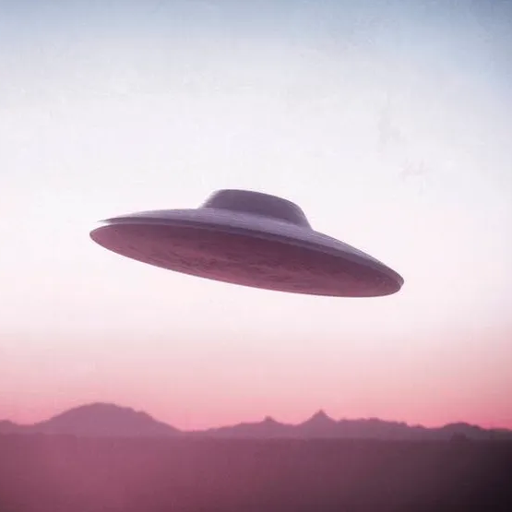
Source datasets: UFO
1. UFO Sightings
nuforc_reports.csv & nuforc_reports.json
Full text and geocoded UFO sighting reports from the National UFO Research Center (NUFORC).
https://data.world/timothyrenner/ufo-sightings
2. UFO Sightings around the world
ufo_sighting_data.csv
80,000+ documented close encounters from the past 70 years
https://www.kaggle.com/datasets/camnugent/ufo-sightings-around-the-world
3. UFO Sightings (Location & Time)
nuforc_reports.csv
records of reported UFO sightings from North America, including detailed information about the time, location, duration, shape and more for each sighting
https://www.kaggle.com/datasets/thedevastator/uncovering-mysterious-unexplained-ufo-sightings

Slide 6
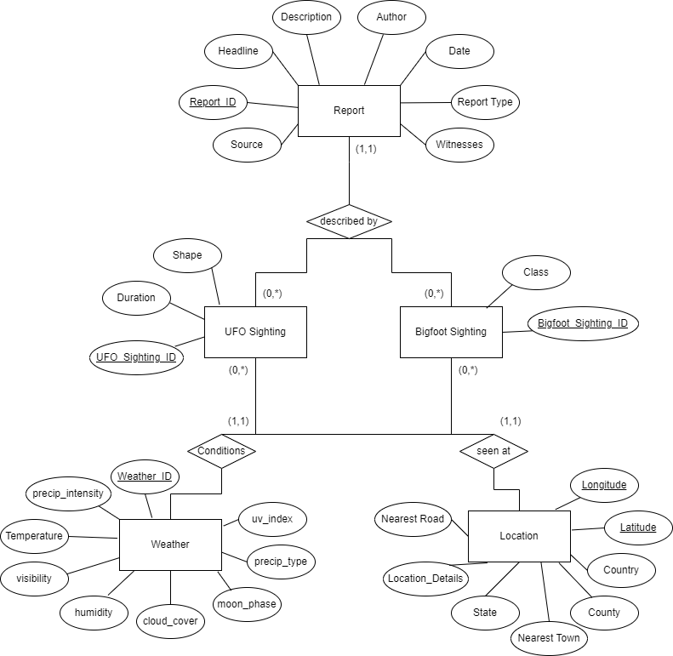
Draft of our ER-Model

Slide 7
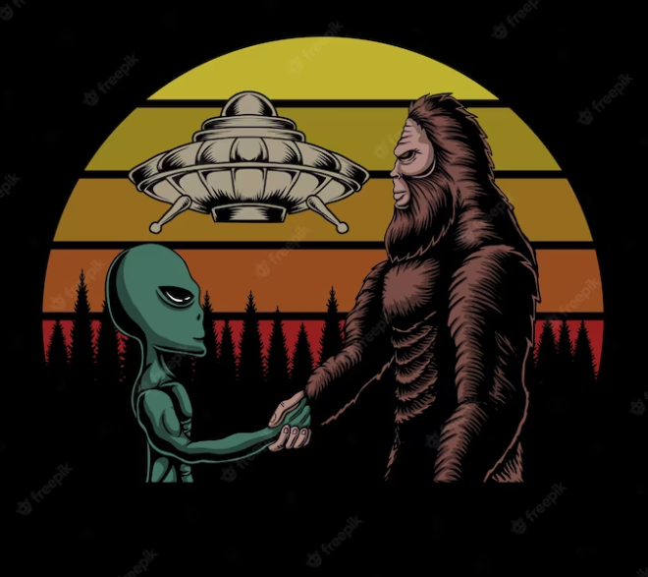
Thank you

