Slide 1
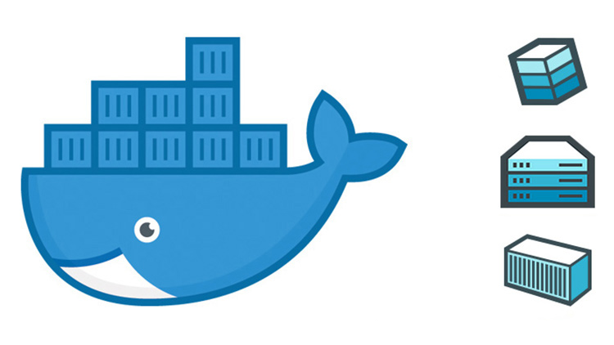
Docker - Introduction

Slide 2
Agenda:
Content
What are containers?
What problem do they solve? Why should i use them?
Architecture
Labs
Installing Docker
Container deployment
Container lifecycle management
Connecting multiple containers
Container creation
Registries and Repos
What’s next?

Slide 3
What is a container?
A container is a way of capturing an isolated view of your application with all its dependencies
Next level of abstraction from a Virtual machine. Where VM’s virtualize the hardware, a container virtualizes the Operating system.
Containers share the same OS Kernel

Slide 4
Solves the “It ran fine on my machine” problem.

Slide 5
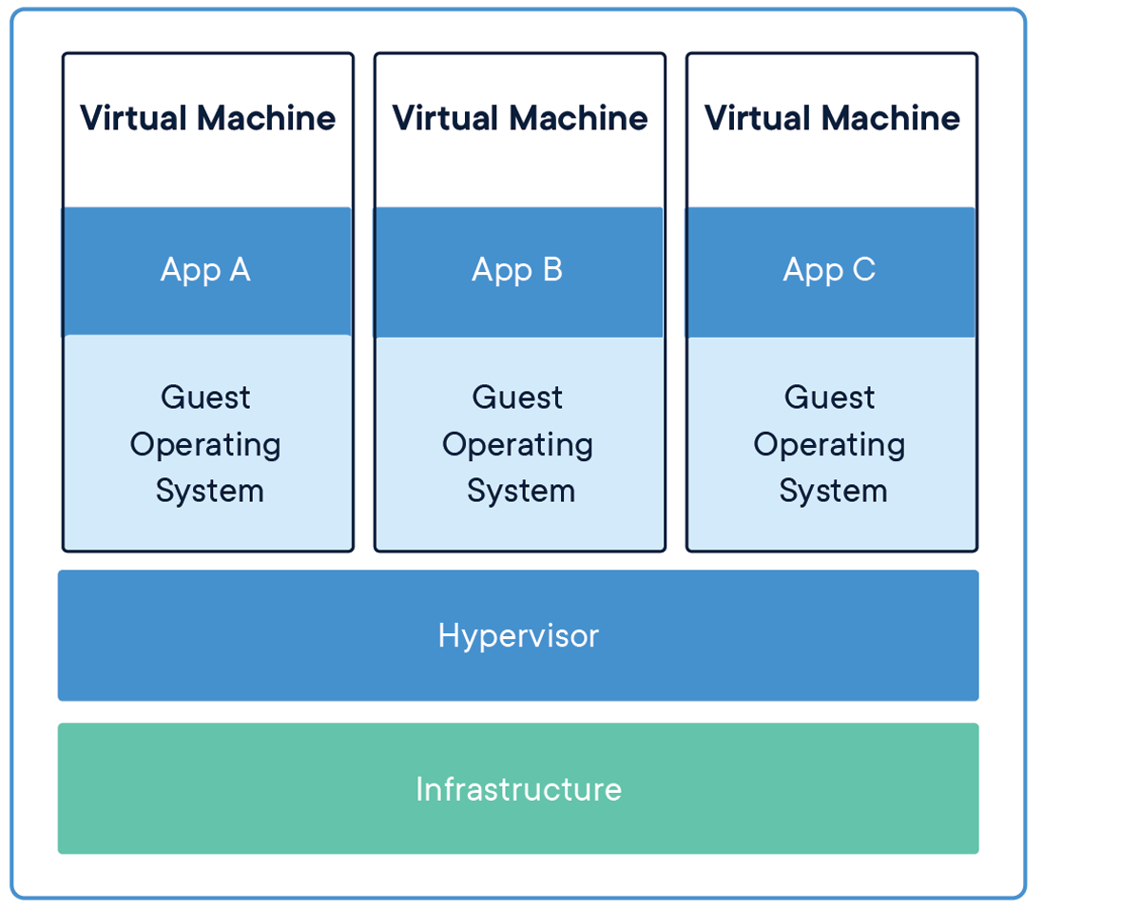

Slide 6
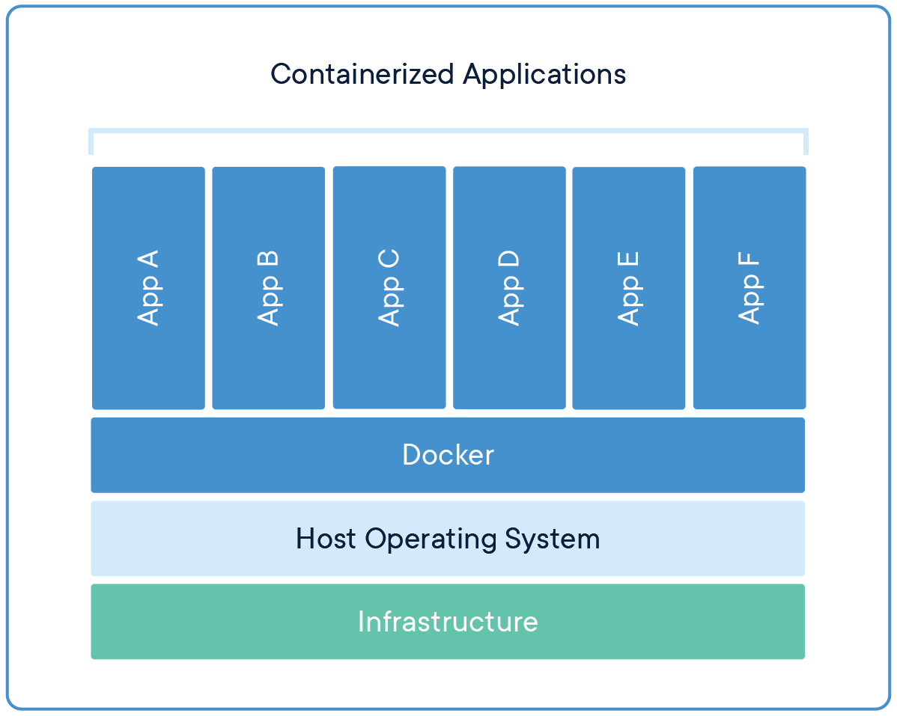

Slide 7
What is Docker
A tool built for managing the lifecycle of containers. Docker allows you to Create, update, deploy and delete containers.

Slide 8
Benefits
Fast consistent delivery of software
Isolation
Highly scalable
Portable – If there is a Docker engine on a host, my container will run there (with limits!)
Facilitates and integrates neatly within the Devops culture. Can snap into CI/CD pipelines
Smaller than a VM (Skinny)
Starts very fast + Rapid deployment
Mainstream, has become ubiquitous
Isolation – can add and remove containers without disturbing other containers around it
Take up less space than a VM
Can be deployed as a highly available, multi container service stack (Requires Docker / Kubernetes)

Slide 9
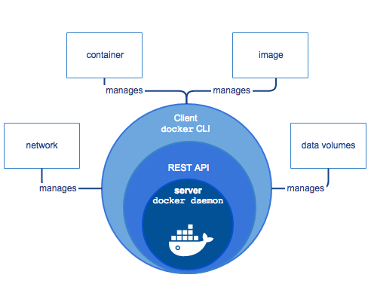
Architecture

Slide 10
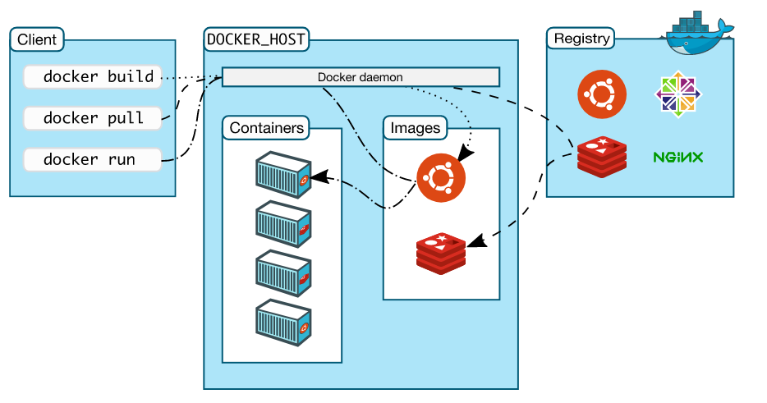

Slide 11
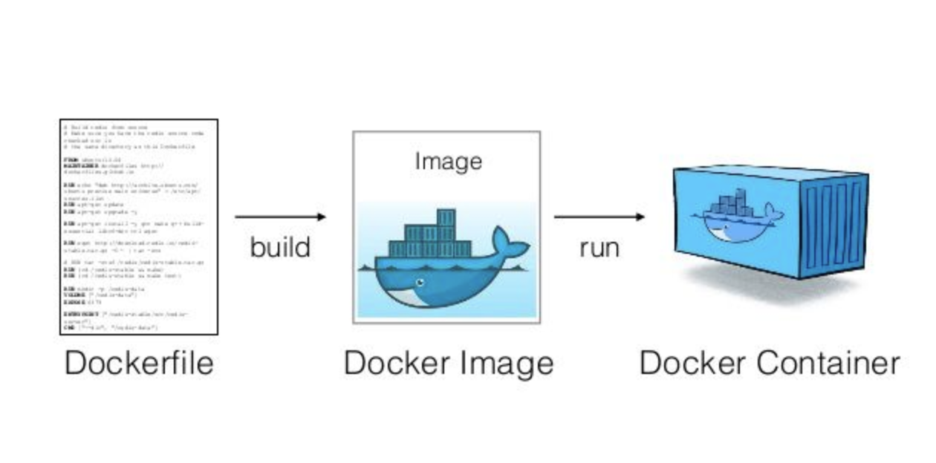
Images
The starting point of all containers. All containers are built from some image.
An image is built from a dockerfile

Slide 12
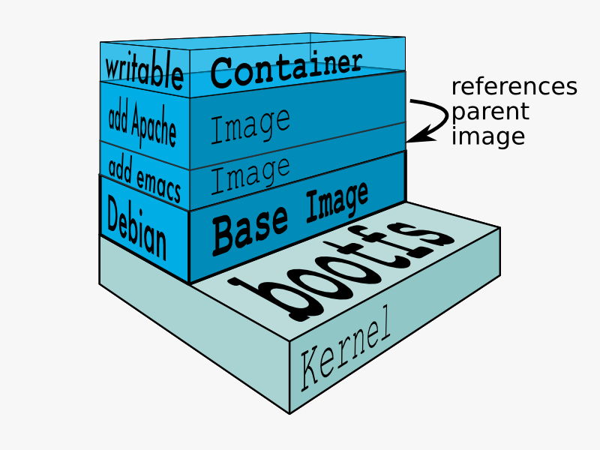
Containers
Running instance of an Image

Slide 13
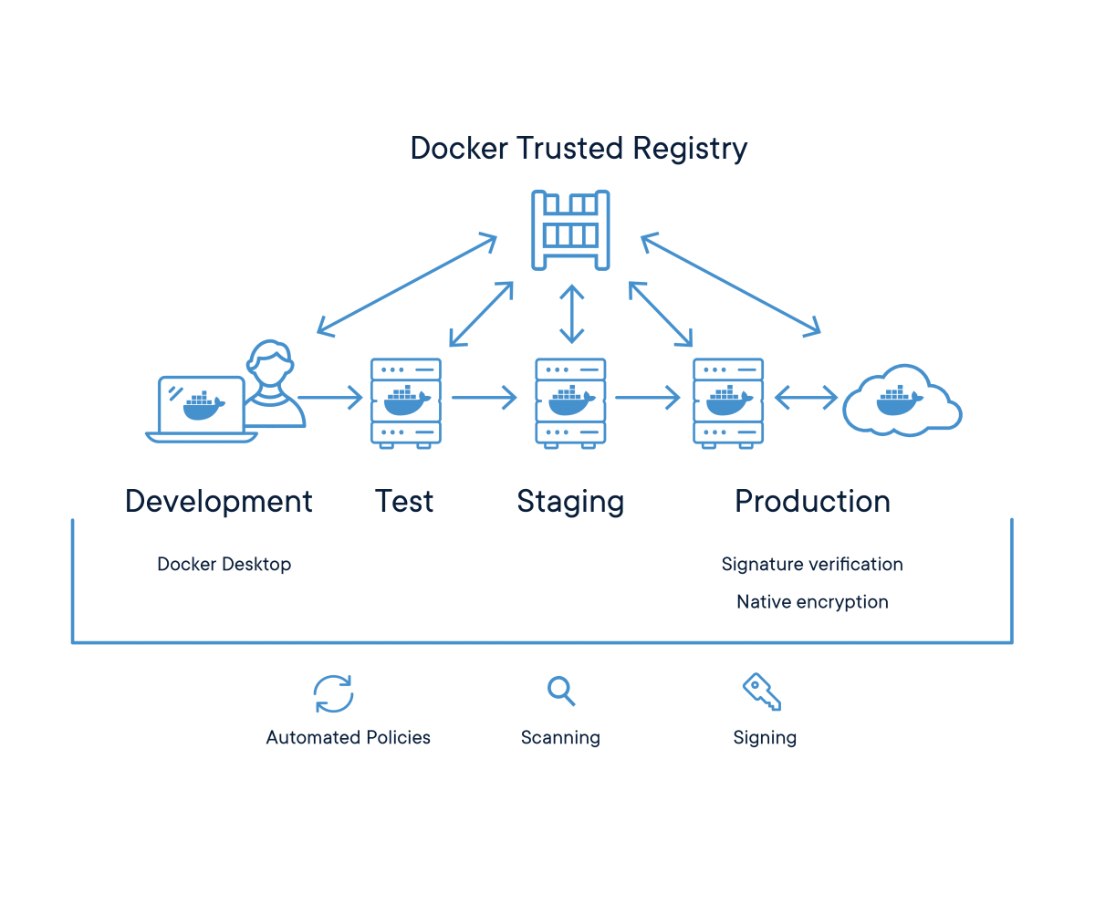
Registry
Images are stored in a registry in a repository

Slide 14

LABS

Slide 15
Private Registry info
FQDN:
zoecontainerreg.azurecr.io
Username:
zoecontainerreg
Password:
TLCj2xrtLjR8ajml0UN=OeXuMdL8kxYH

Slide 16
Resource Location:
https://github.com/zoenurel/Containers-Temp
Private Docker Registry Info:
Username:
Teacontainerlab001
Password:
TkxH=AFxYPs8p+MZA9M2FEoxljFtm4Ye
FQDN:
teacontainerlab001.azurecr.io
LAB VM Credentials:
Username:
Dockeradmin
Password:
!@Password

