Slide 1
A Forecasting Tool for New Jersey Train Delay

Slide 3
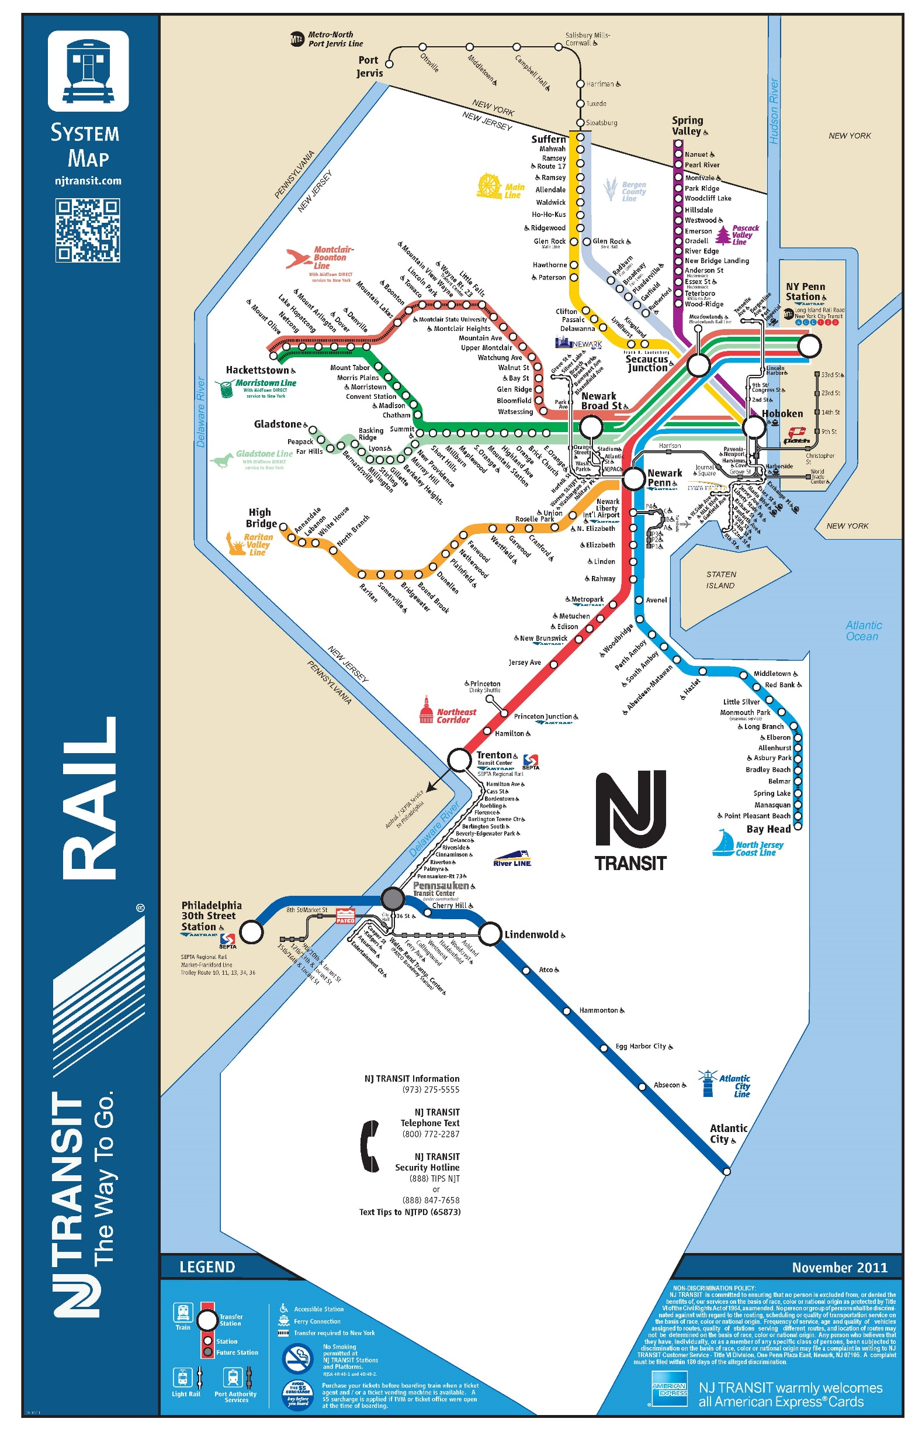

Slide 8
Data Structure
What is in the data
What else we draw

Slide 9
Regression Model
Independent Variables

Slide 11
Comparing Accuracy

Slide 12
Cross Validation

