Slide 1
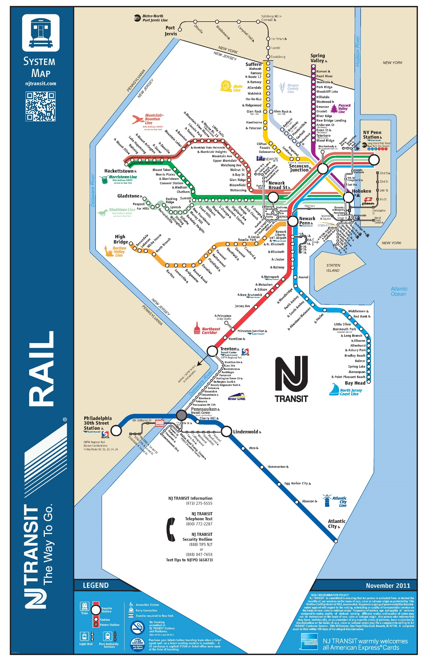
Delay Estimator
A Forecasting Tool for New Jersey Train Delay

Slide 2
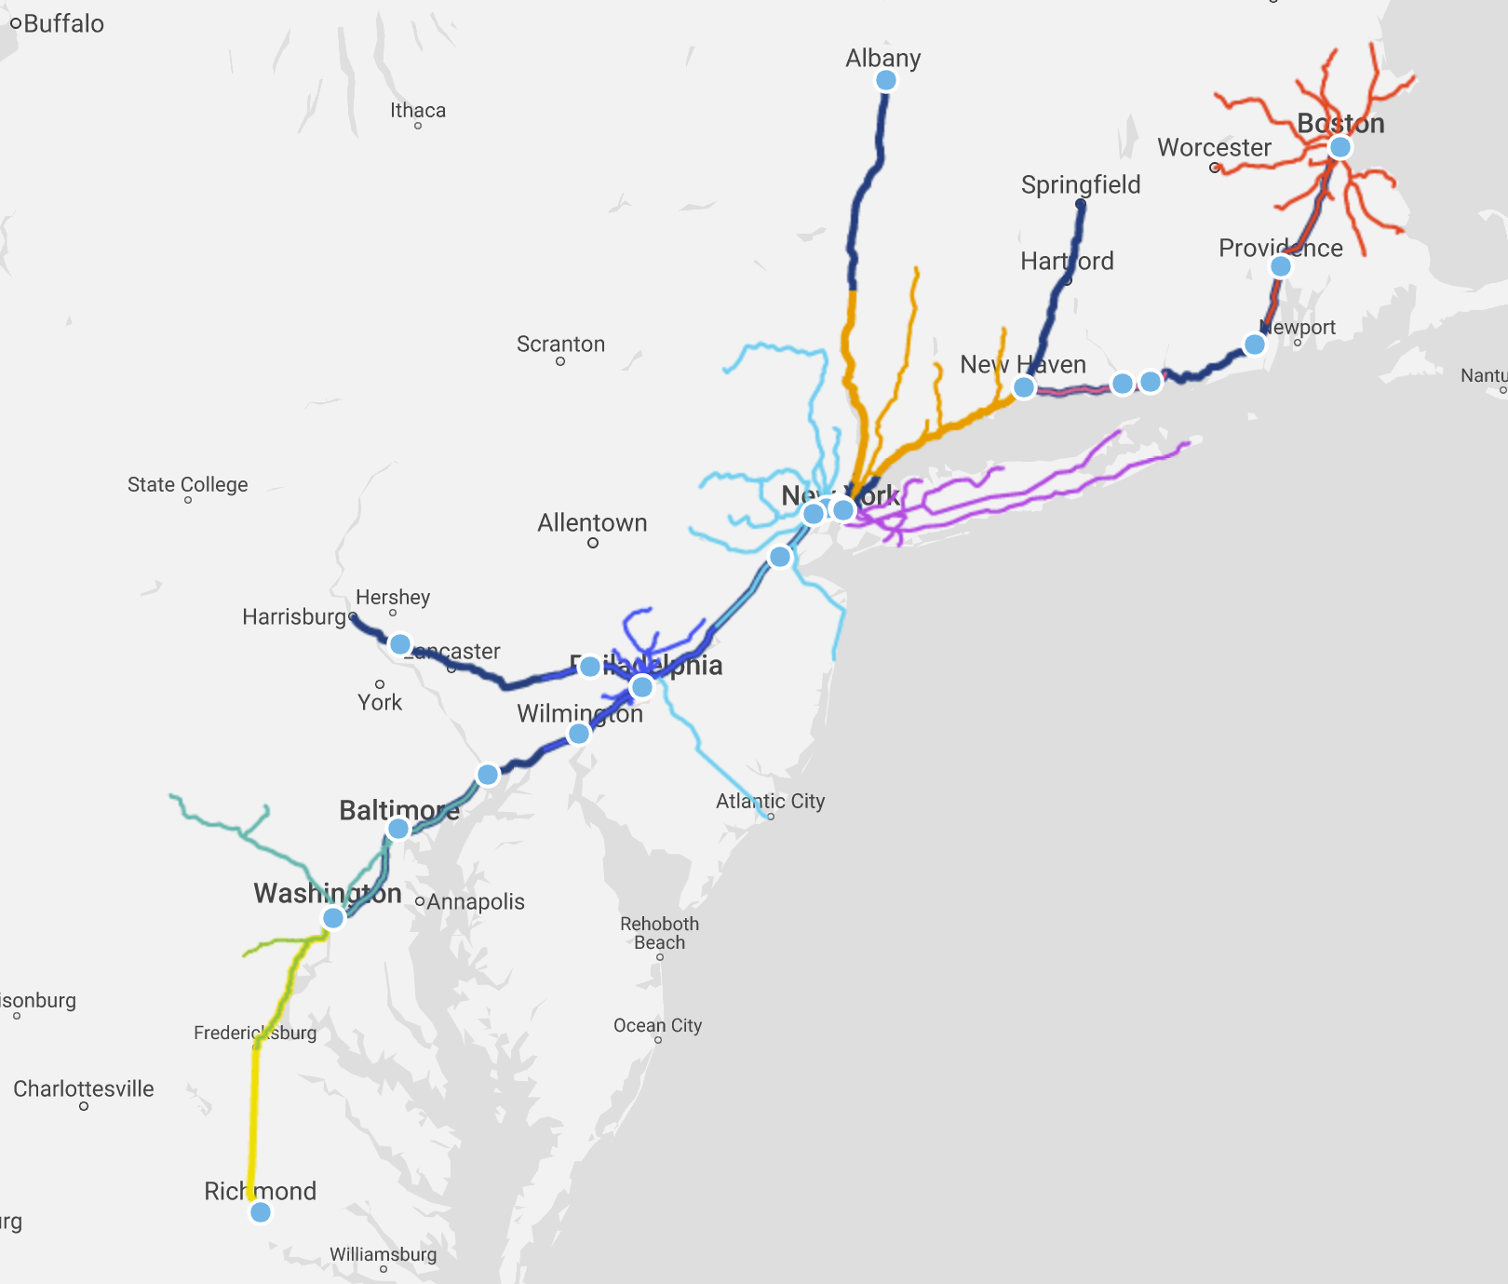
Data Structure
What is in the data
What else we draw
Photo source: Amtrak “The Northeast Corridor”

Slide 3
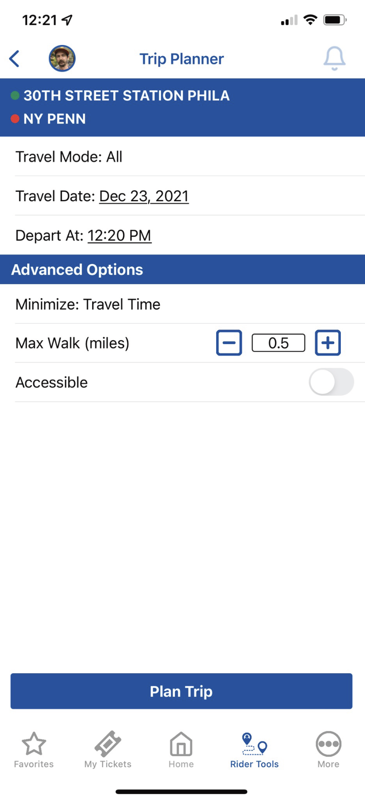
Initial idea to
Integrate the tool into the current NJ Transit App’s Trip Planner

Slide 4
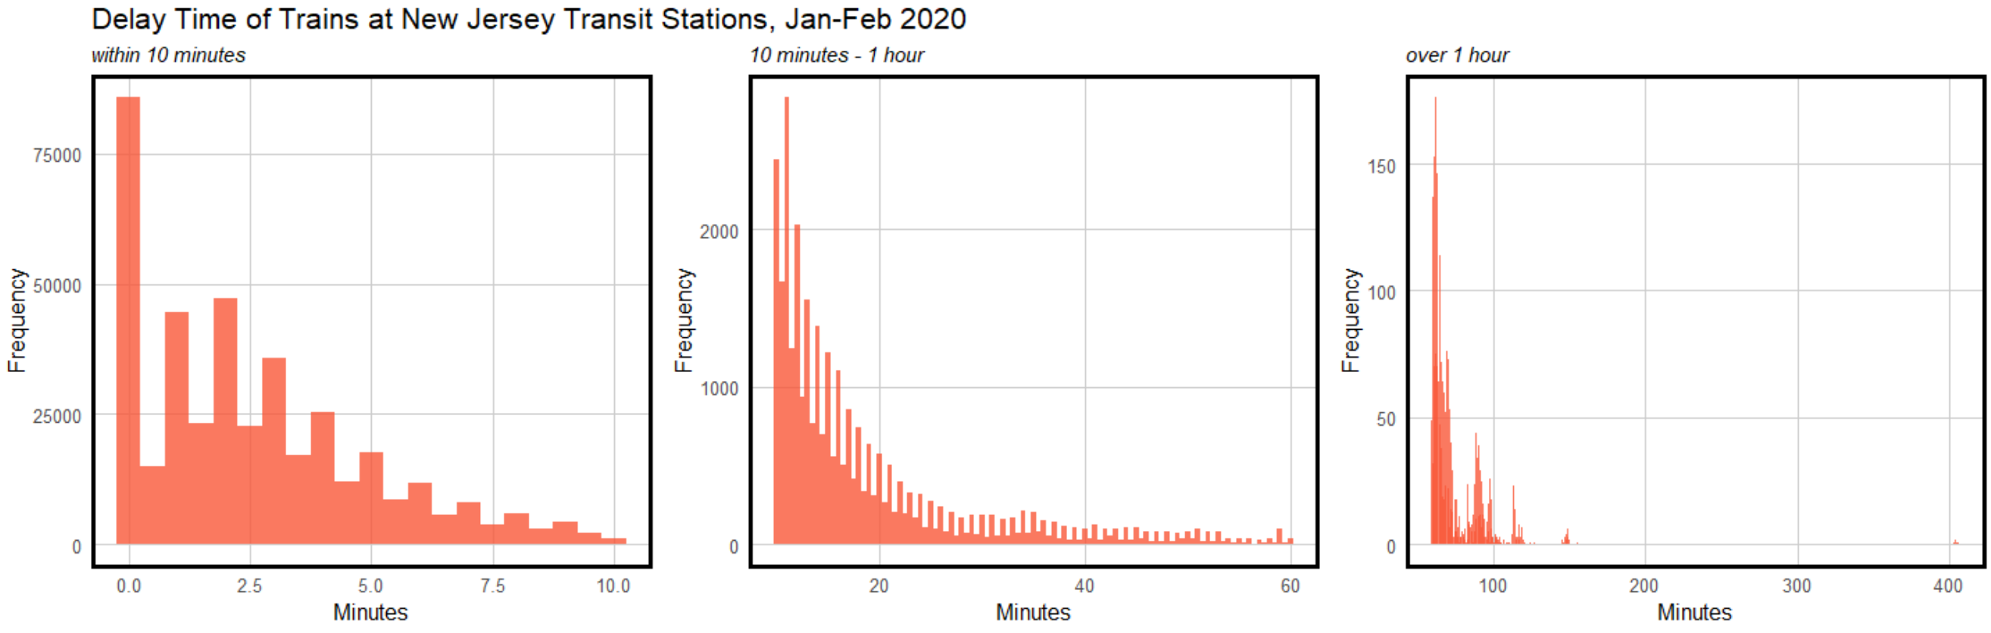
Reviewing the Data

Slide 5
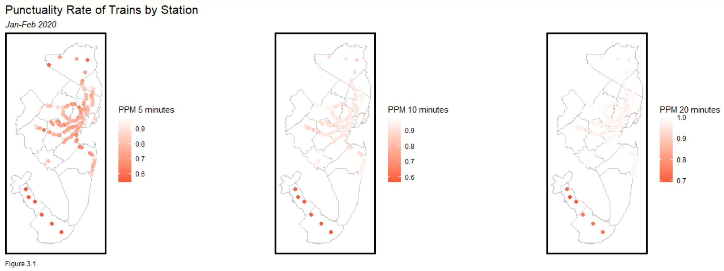
Reviewing the Data
Public performance measure (PPM): % of trains arriving at their destination within 5 minutes of schedule
On time: % of trains arriving at the scheduled time at each station stop on a journey
Definition source: Southern Railway, “Train service punctuality and reliability”

Slide 6
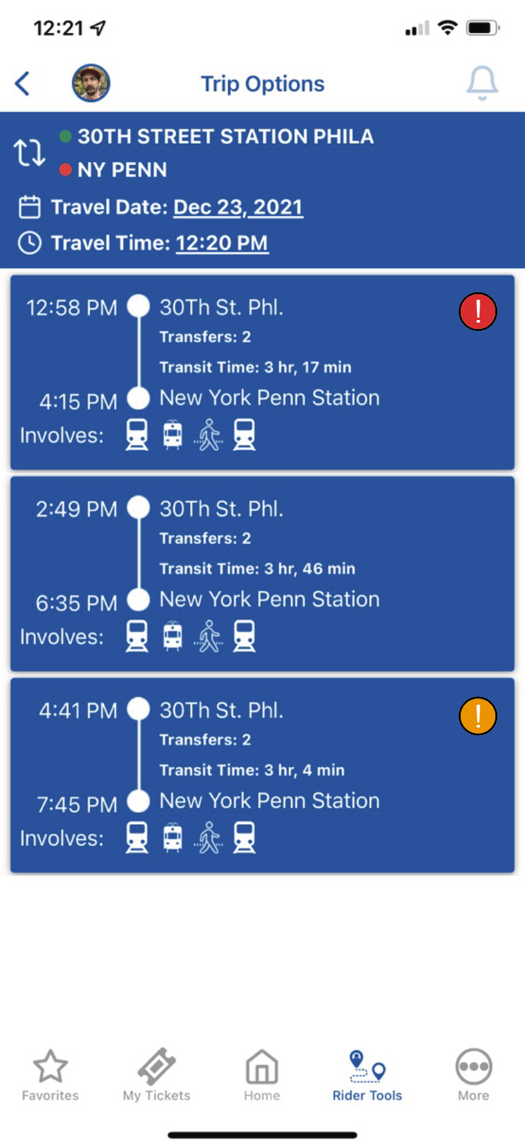




App
Red = >30 minutes combined predicted delay
Orange = 20-30 minutes combined predicted delay
Yellow = 10-20 minutes combined predicted delay

Slide 7
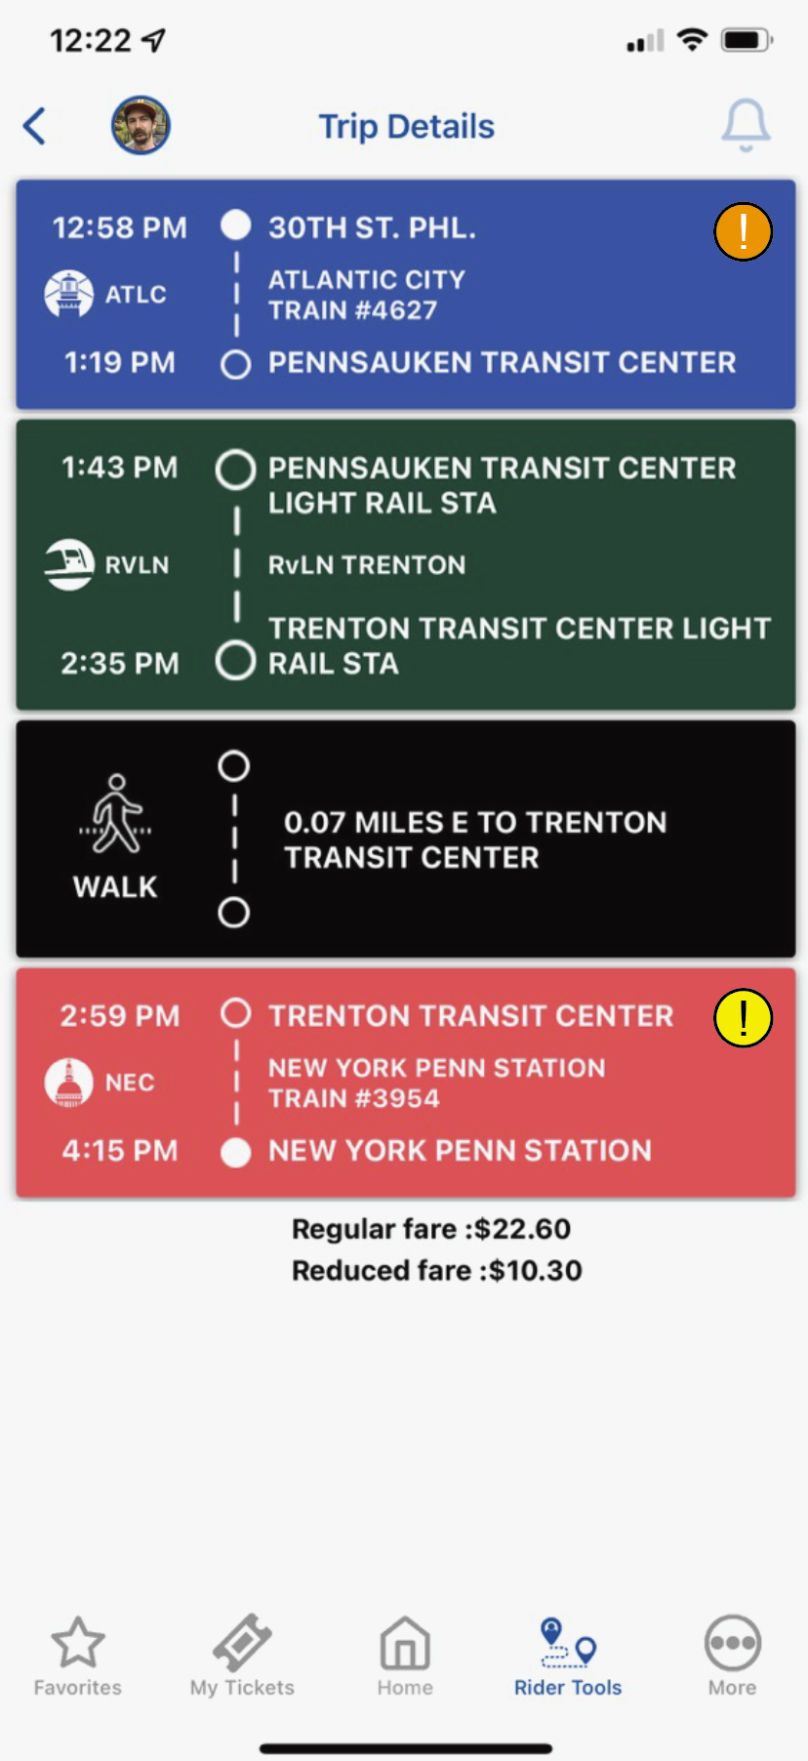


Slide 8
Regression Model
Independent Variables

Slide 9
Results

Slide 10
Comparing Accuracy

Slide 11
Cross Validation

Slide 12
Further Steps
It is possible that

