Slide 1
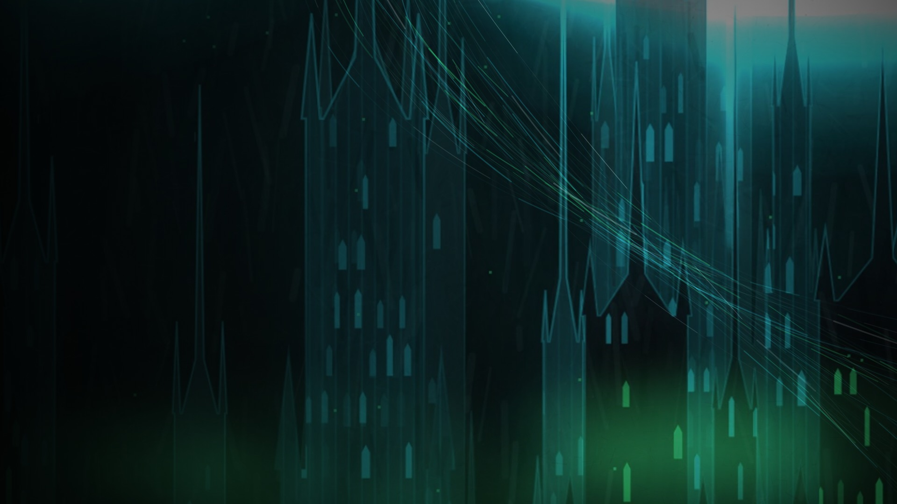

AMD CREATIVE PATHWAYS · FINAL PITCH
SUBSTRATE
EVERY CITY RUNS ON SOMETHING.
ZOE SCHULDENFREI · NICHOLAS MOFFATT · MICHAEL BADILLO-SANCHEZ · ARNOLDO GARZA CORTES
Notes:
0:00–0:20. Open on the title. "Every city runs on something." Introduce the team.

Slide 2
THE ORIGINAL
“AMD Powers What’s Next”
FORMAT
One 2-minute corporate brand video
CONTENT
Exec interviews, offices, beauty shots, stock AI imagery
AUDIENCE
Everyone at once
VOICE
Inspirational music, confident voice-over
CTA
“Visit AMD.com”
SUCCESS
Views, engagement, sentiment
Notes:
0:20–0:45. The brief was polished and optimistic, but swap the logo and it could be any tech company.

Slide 3

Polished. Optimistic. Forgettable.
WHAT WAS WRONG
01
02
03
SPEAKS TO EVERYONE
TELLS, DOESN’T SHOW
LOOKS LIKE EVERY TECH AD
So it speaks to no one in particular.
Claims about innovation instead of a story people care about.
Execs, offices and glowing chips are the category default.
04
05
06
WRONG LENGTH
PASSIVE CTA
VANITY METRICS
Too long for social, too generic for events.
“Visit AMD.com” gives no reason to act.
Views, not affinity or recall.
Notes:
0:45–1:20. Say three out loud: audience, tell-don’t-show, CTA. AMD’s strength is that it’s invisible; the original tried to fix that by talking louder.

Slide 4
THE TURN
Stop telling people what AMD powers.
Show them the ground they’re standing on.
Notes:
1:20–1:40. So we stopped making an ad about AMD. We built a place that runs on AMD.

Slide 5
SUBSTRATE
THE NEW CONCEPT
A gothic-futuristic city whose people have no idea what their world really is. Every reel ends with the camera pulling back until we realize the entire city is built on a processor.
THE SKYLINE
THE RIVERS OF LIGHT
THE PULLBACK
IS CIRCUITRY
→
ARE DATA
→
REVEALS THE CHIP
Towers are the chip’s architecture.
Photons pouring between the spires.
…and the AMD logo. The brand reveal is the payoff.
Notes:
1:40–2:30. Arcane’s cinematic characters meet Roku City’s hidden world inside your tech. AMD never narrates: AMD is the ground the city stands on.

Slide 6
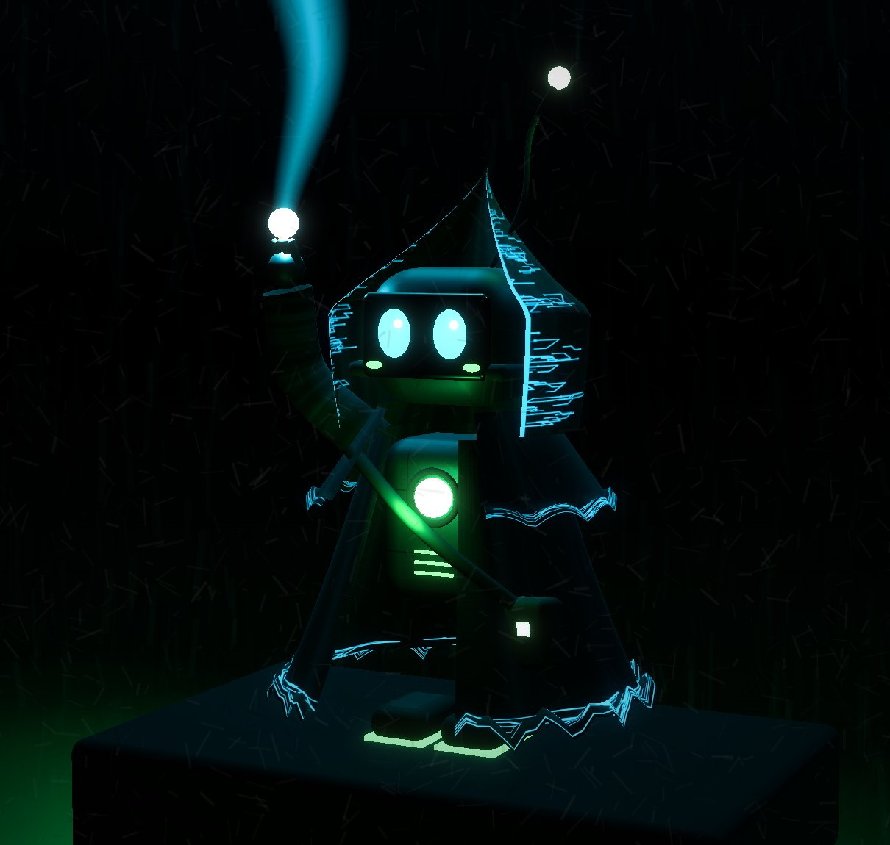
MEET THE HERO
SUBSTER
THE HOODED COURIER
SEES THE CURRENT
A courier from the Underlayer who can see the light and data no one else notices.
SMALL AGAINST THE CITY
Always tiny, always looking up. The audience’s way into the world.
CARRIES THE SEED
The new core that decides which half of the city grows, delivered to the Gate.
Notes:
Meet Subster, the Hooded Courier: an Underlayer robot who can see the current. Always tiny against the city, and the audience’s way into the world.

Slide 7
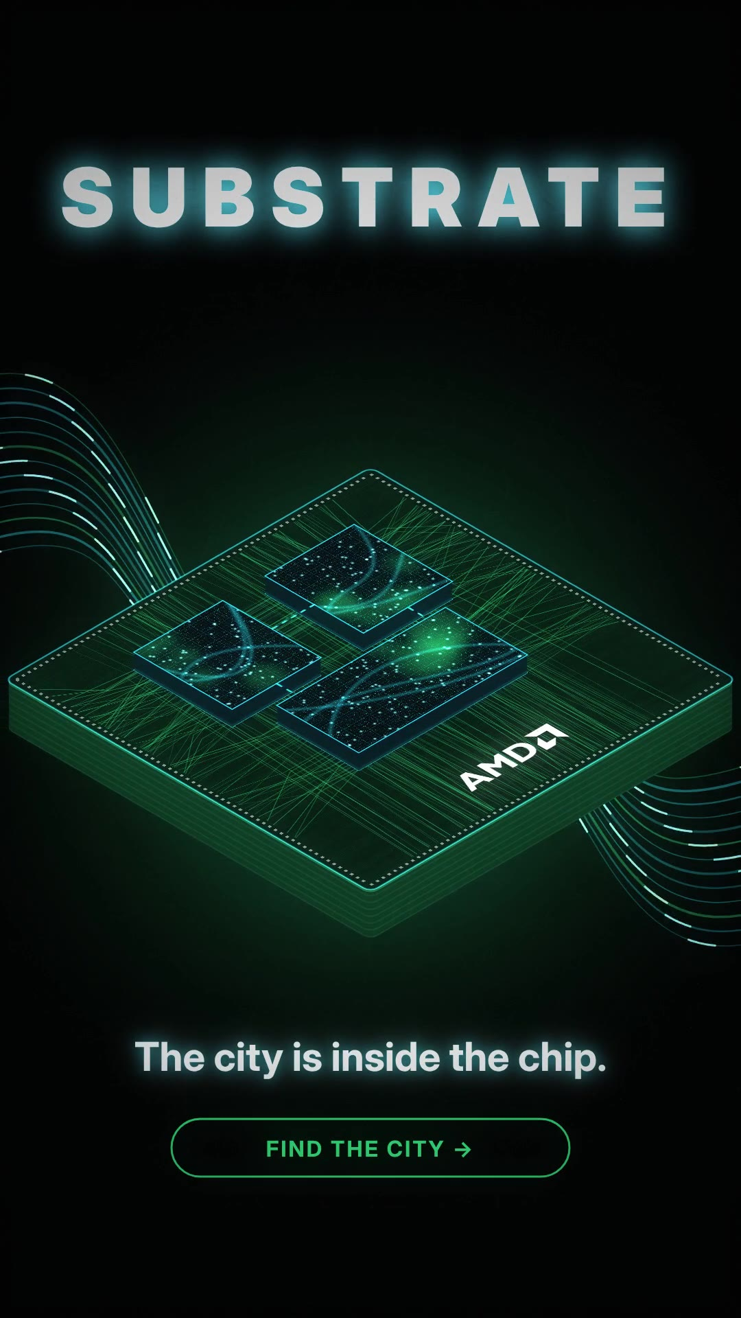
Story first. The chip last.
THE REELS · 20–45S · TIKTOK, REELS, SHORTS
01
Every city runs on something.
Subster runs the Underlayer rooftops. Hero teaser.
02
The Current.
Subster sees the light rivers for the first time. Pure spectacle.
03
The Seed.
The orb is stolen: a chase through the Spires.
04
The Gate.
Subster before the ring vault. Cliffhanger + series title.
Every one ends the same way: pull back → city is a chip → AMD.
Notes:
2:55–3:10. The reels aren’t trailers. Each one stands alone: one district, one character, one hook in the first second. The reel plays with sound.

Slide 8
AUDIENCE TAKEAWAY
“AMD isn’t a logo at the end of an ad.
It’s the ground the whole city stands on.”
AUDIENCE
Gen Z gamers, animation fans, creators. Narrow on purpose.
WHERE
TikTok, Instagram Reels, YouTube Shorts, gaming streams, events
CTA
“Find the city” easter eggs + a streamer competition set inside SUBSTRATE
The brand reveal is the story’s payoff, so remembering the story means remembering AMD.
SUCCESS
Watch-through, shares, follows, creator participation, brand recall
Notes:
3:10–4:00. Ask someone afterwards "What does AMD power?" and they say "the whole city". That’s measurable with a brand-lift study.

Slide 9
WHAT’S NEXT
The reels are the base.
Creators build the city.
NOW · THE BASE
NEXT · CREATORS ENTER
FUTURE · CREATORS IN CANON
SIZZLE REELS
THE STREAMER COMPETITION
AMBASSADORS IN THE CITY
Build the world and the hook. Every reel ends on the same reveal: the city is the chip, and the chip is AMD.
Streamers compete inside SUBSTRATE: race the rooftops, hunt the hidden chips
Their runs become a short-form vertical series
“Find the city” easter eggs pull fans in with them
Famous streamers who already play on AMD, animated as characters in the series
Their audiences discover the city through someone they trust
The audience stops watching the city and starts living in it
→
→
Notes:
We built the base. The real goal is to hand the city to creators: a streamer competition, a vertical series of their runs, and eventually AMD streamer ambassadors animated into the show.

Slide 10
Program Lessons
WHAT CHANGED OUR THINKING
01
AMD is already inside everything; you just can’t see it
Week 1 intros: learning AMD chips power healthcare, aerospace, robotics, gaming, and entertainment, from Pixar’s RenderMan to The Game Awards and the CES keynote
02
Creativity exists to solve a real problem
The creative director session: the Air Force made a comedy web series about bowling leagues to boost morale, proof that entertainment can do serious work
03
If it isn’t relatable, it doesn’t resonate
Session 3 with HunterLamin: every great brand project starts with “how does this connect with the audience?” and solves a business problem through strategy, social, and culture
Notes:
4:00–4:40. One sentence per lesson, with the moment it came from.

Slide 11
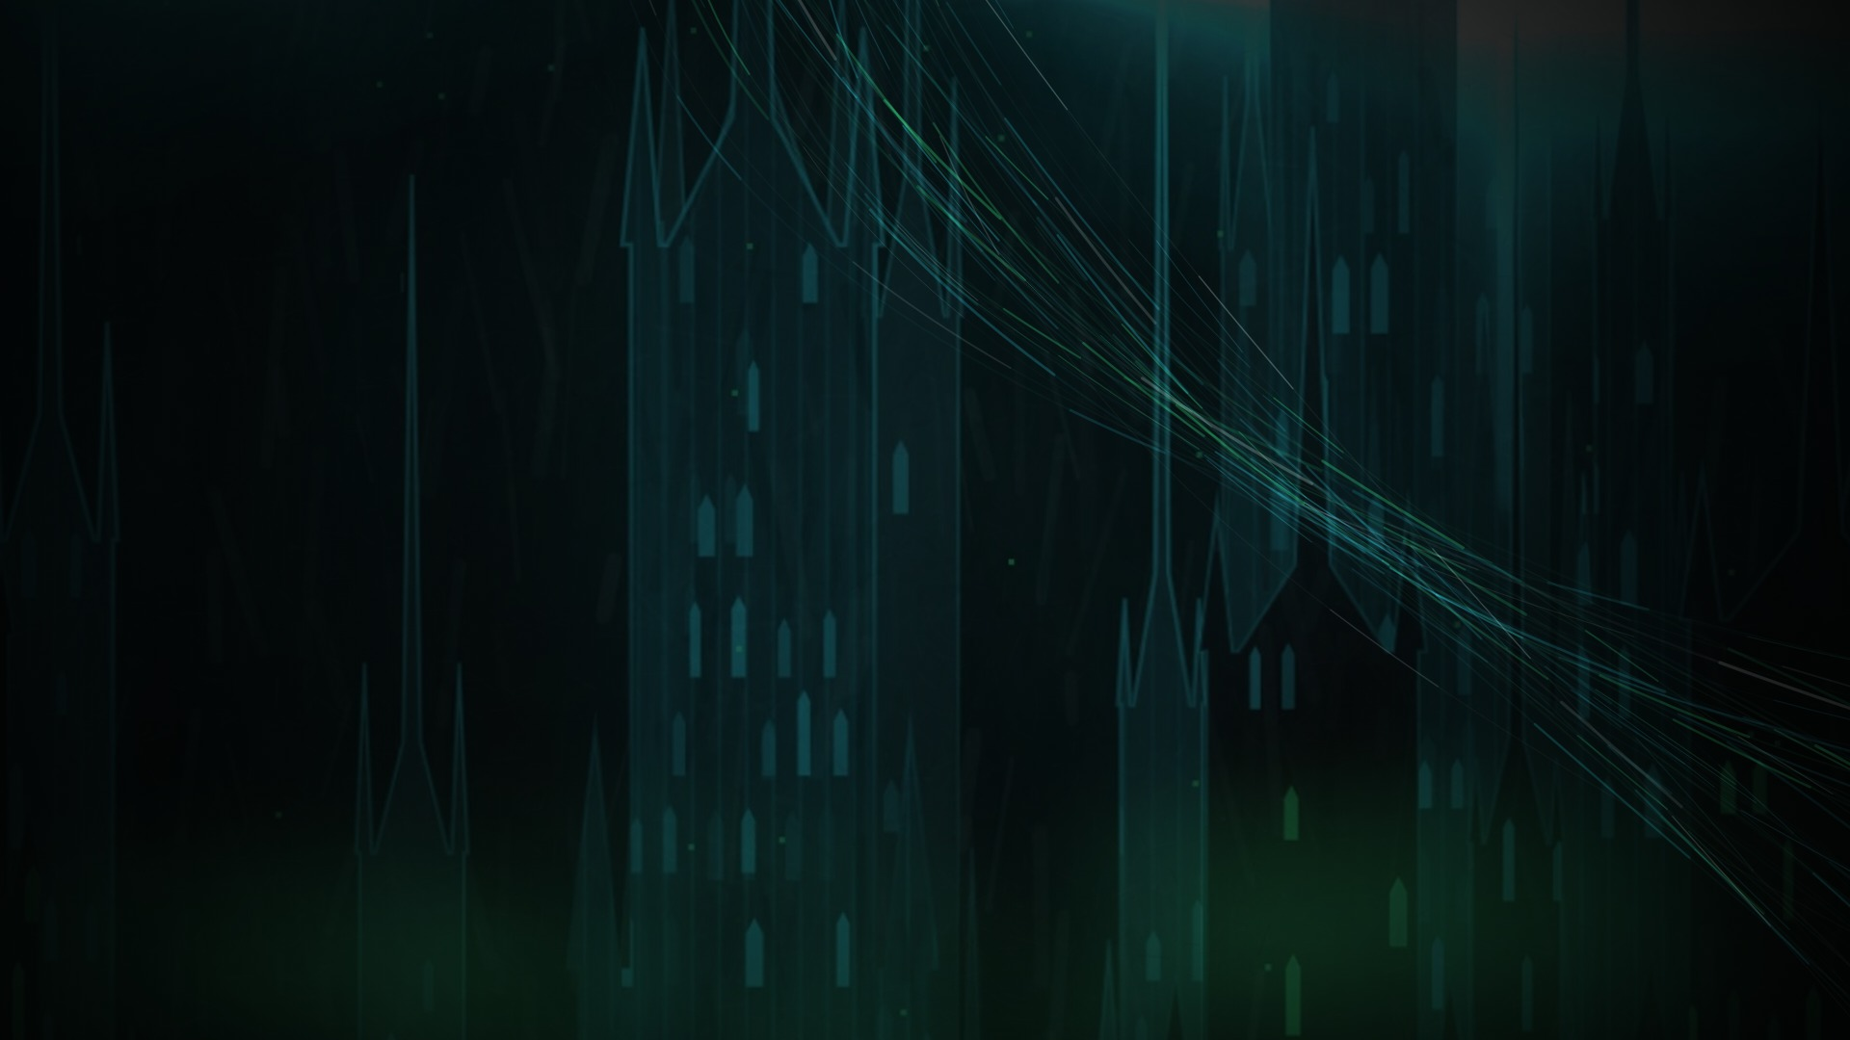
SUBSTRATE
EVERY CITY RUNS ON SOMETHING.
Find the city →
THANK YOU
ZOE SCHULDENFREI · NICHOLAS MOFFATT · MICHAEL BADILLO-SANCHEZ · ARNOLDO GARZA CORTES
Notes:
4:40–4:50. The original said "AMD powers what’s next". We’d rather show it: a whole city of it. Thank you.

