Slide 1
Needs Finding
Muath Bishawi

Slide 2
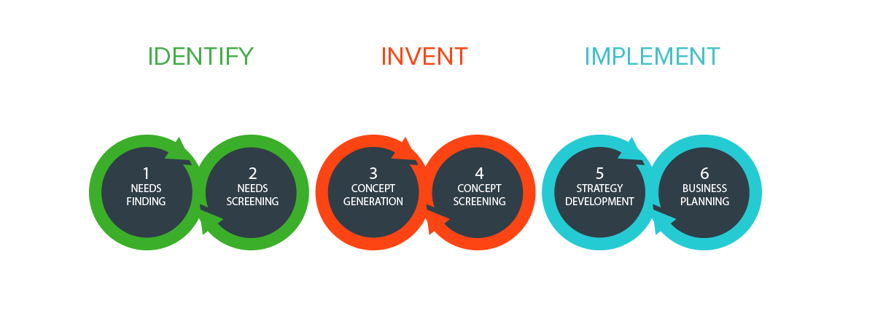

Slide 3
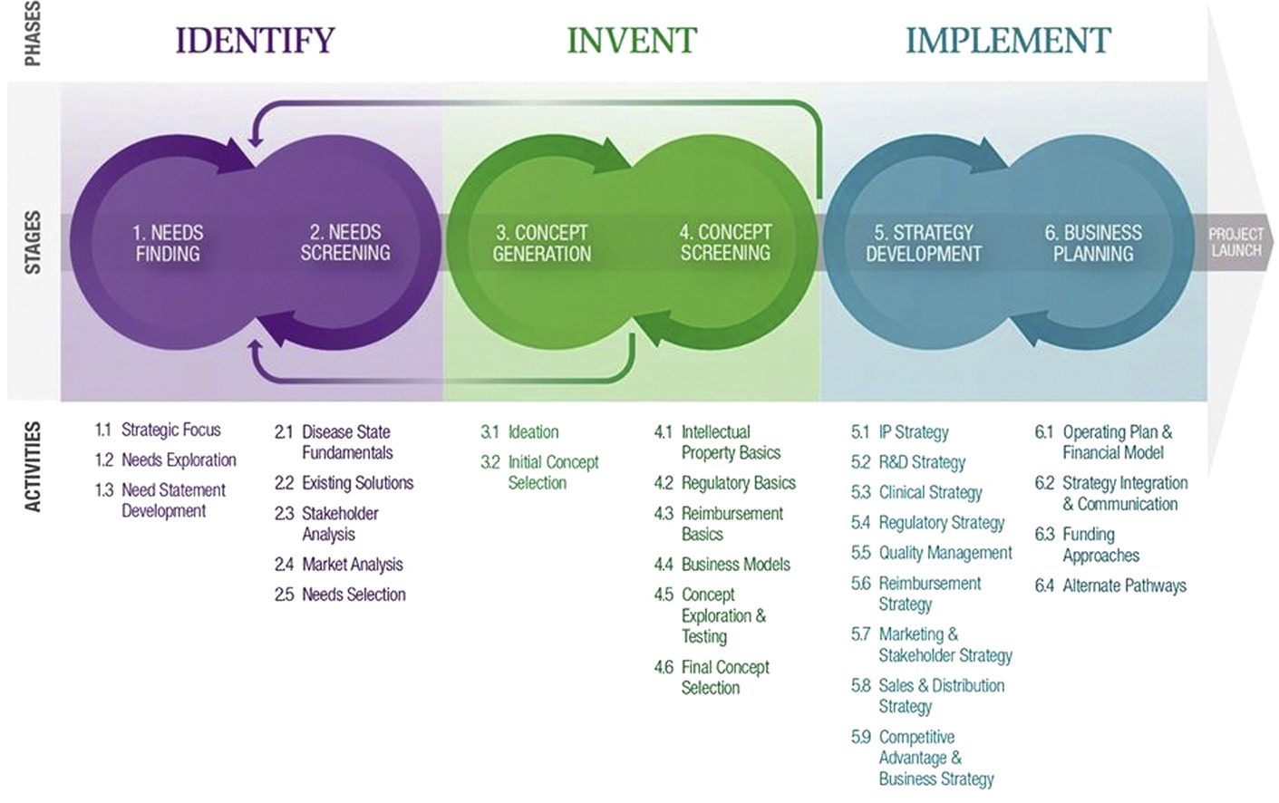

Slide 4
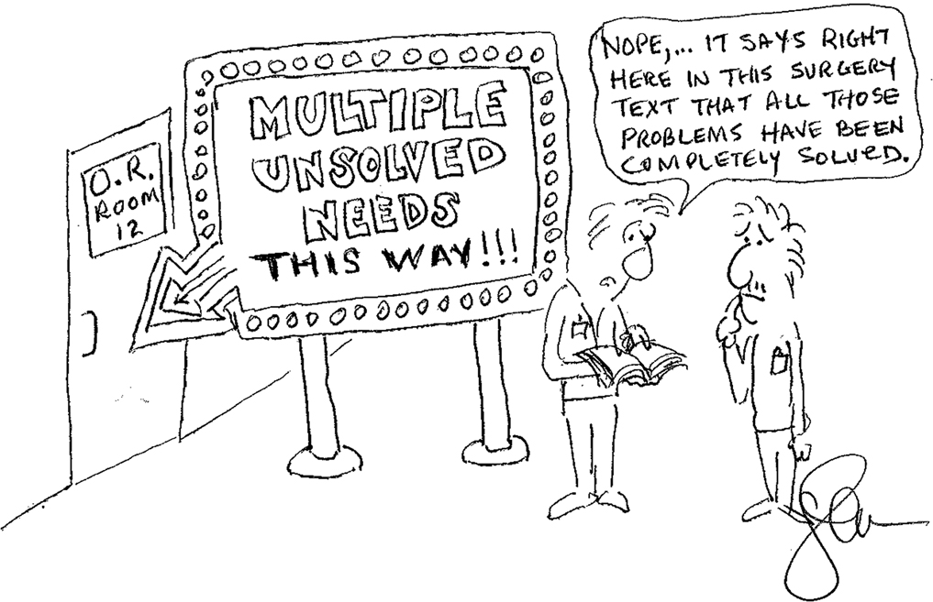
The Importance of Direct Observations
Cartoon by Josh Makower.

Slide 5
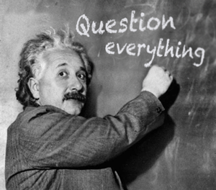
If I had an hour to solve a problem and my life depended on the solution, I would spend the first 55 minutes determining the proper question to ask, for once I know the proper question, I could solve the problem in less than five minutes.
Albert Einstein (1879 - 1955)

Slide 6
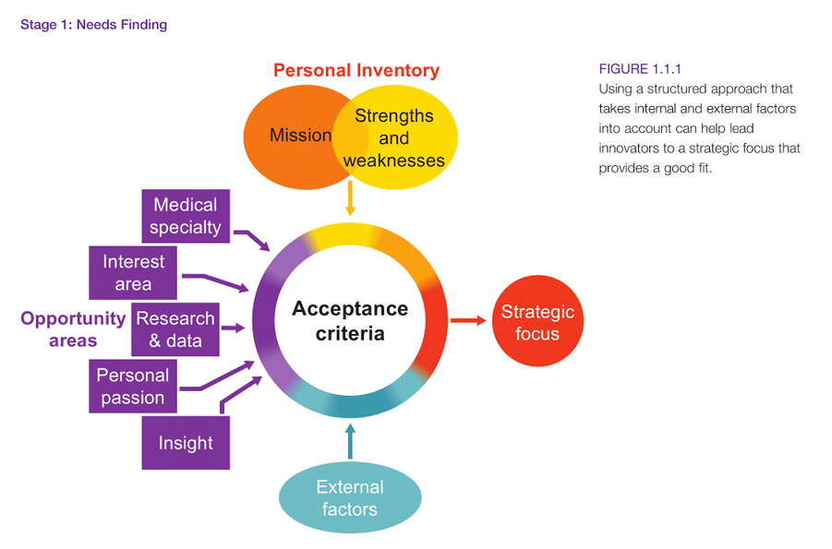

Slide 7
How to “needs find”
Observe first hand
  Need Primary Source
Directed interview questions
Speaking with stakeholders
  Doctors, nurses, patients
Generate a needs statement (problem, population and outcome)
Try to see the world without corrections

Slide 8
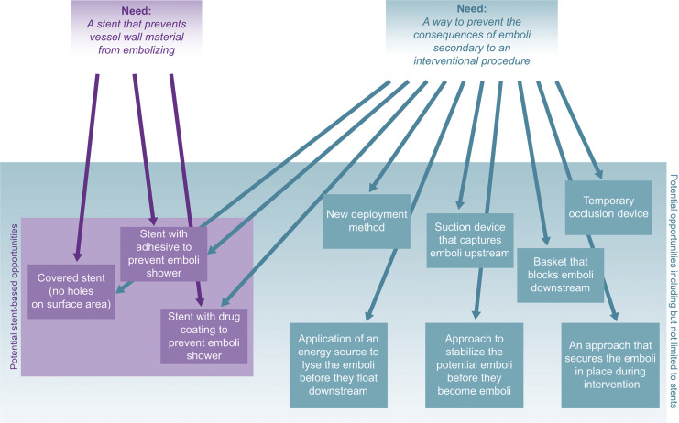

Slide 9
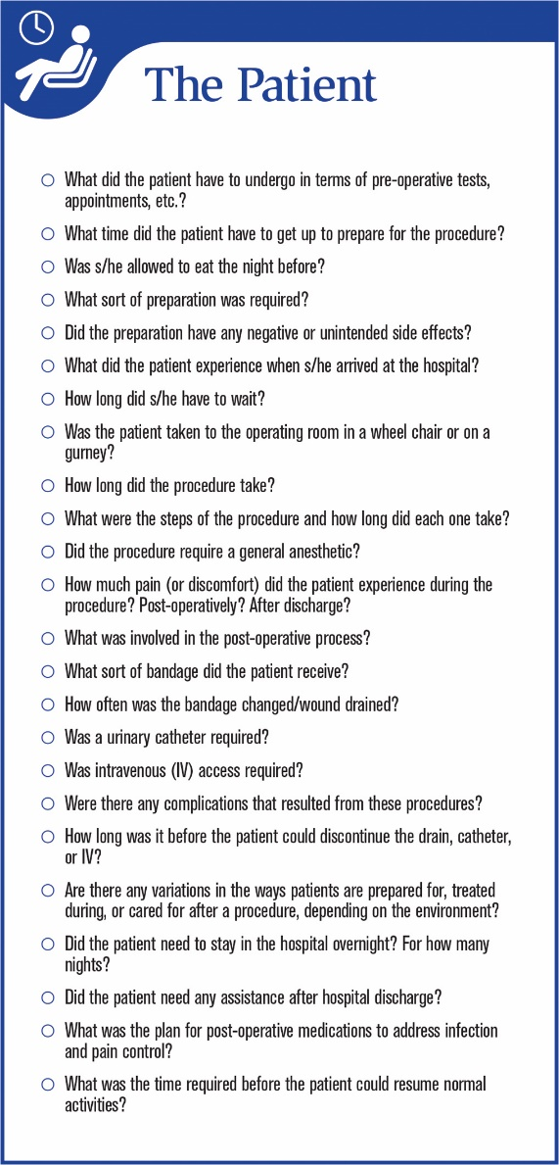
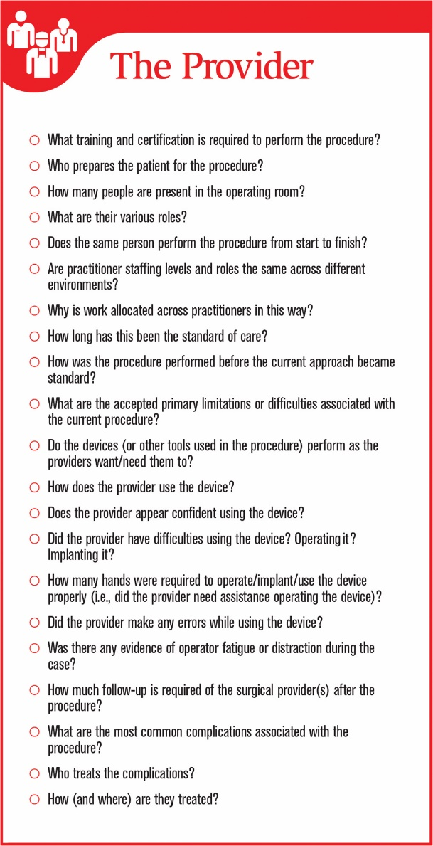
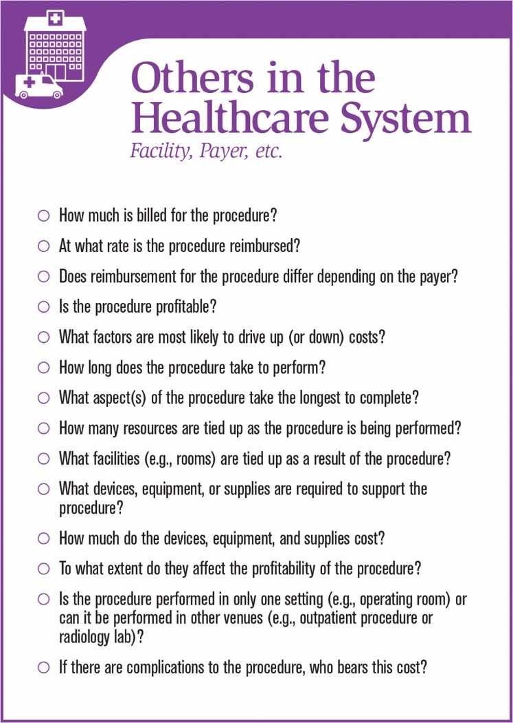
Stakeholders

Slide 10
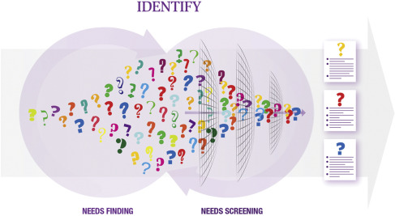

Slide 11
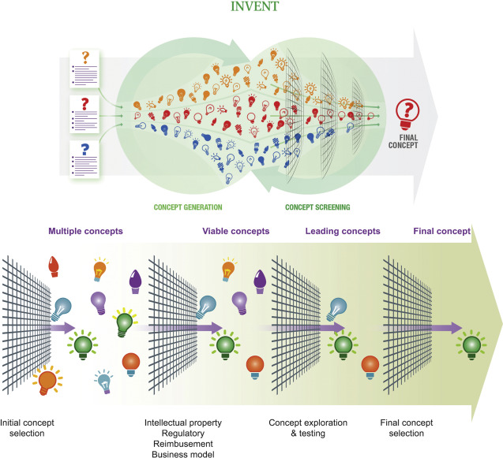

Slide 12
Clinical observation
Do your homework
Take notes
Ask questions
Be thankful, respectful and polite
Follow up

Slide 13
People First Language
Never define someone by their disability
  Use people with disabilities vs. disabled people
  Interact with user (person with disability)
Recognize cues
Be thankful, respectful and polite
Ask client their perspective

