Slide 1
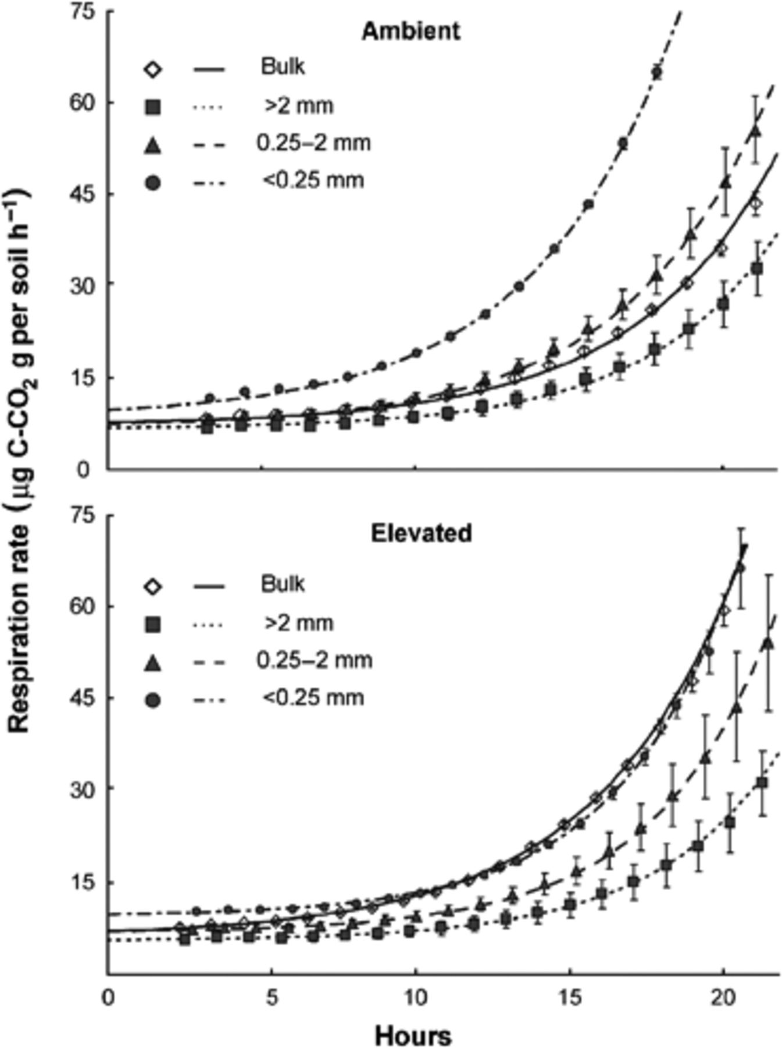

3 Measured respiration rates (symbols) and values fitted according to Eq.5 (lines) after glucose and nutrients ...
Notes:
3 Measured respiration rates (symbols) and values fitted according to Eq.5 (lines) after glucose and nutrients amendment of the bulk soil and three aggregate size classes under ambient (top) and elevated (bottom) CO 2 . Values are averages (± SE) of four replicates.
Unless provided in the caption above, the following copyright applies to the content of this slide: © 2009 Federation of European Microbiological Societies. Published by Blackwell Publishing Ltd. All rights reserved

