Slide 1
Blue Ocean Gear Exploratory Data Analysis
University of Chicago - Data Science Clinic
Zoey Jiao
Brinda Sapra
18th Oct, 2022

Slide 2
Goals of EDA
We had five objectives for this analysis:
Identify and drop “bad” data prior to the subsequent analysis.
Describe the distribution of buoys and messages across time and by fishery.
Segment buoy messages into deployments according to their system status flags, and describe deployments across time and by fishery.
Compare buoys’ swing range across fisheries and identify outliers.
Examine water temperature by fishery.

Slide 3
Drop Bad Data
Bad Data - occur outside of expected geographical zone
Any buoy messages that were identified outside this range were dropped: 31.885447 <= latitudes <= 49.237 and -77.60128 <= longitude <= -58.327663
This is the range for coastal areas near Maine, Massachusetts and New Brunswick
Began with 31398 records
Dropped 1589 records
Remaining analysis done on 29809 records

Slide 4
Missing Values
3 fields had all empty values:
fast_update
last_updated
long_life
High correlations emerged among the below fields:
Cloud_battery_soc and battery_soc = 0.94
Position_delta and system_status = 0.57
Water_temperature_q3 and fishery_id = -0.59
Water_temperature_q3 and water_temperature_mean = 0.7
Fishery_id and longitude = 0.81
Fishery_id and latitude = 0.79

Slide 5
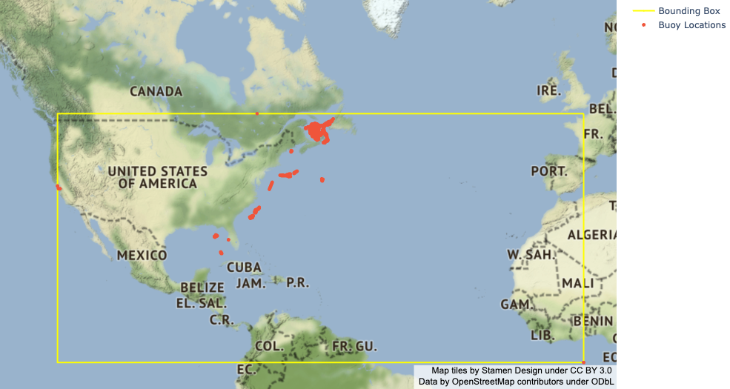
Known Geography/Current Patterns - before dropping bad data

Slide 6
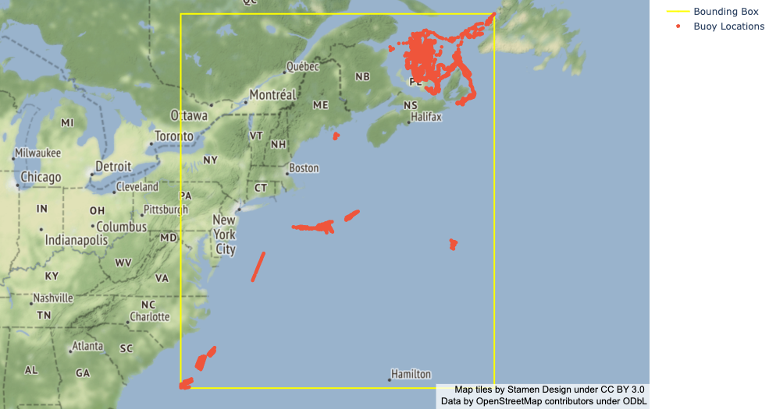
Known Geography/Current Patterns - after dropping bad data

Slide 7
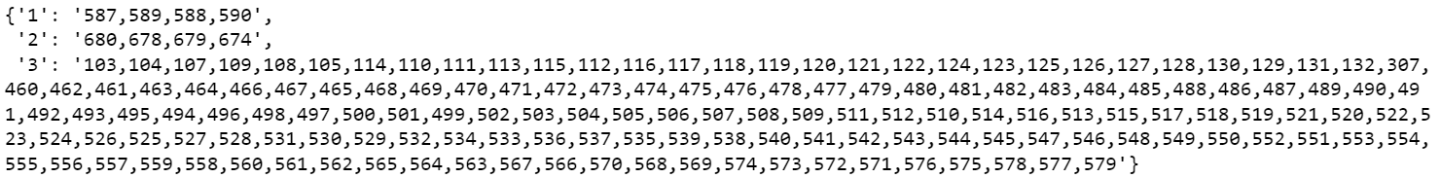
Buoy Counts
29809 buoy messages
158 unique buoys
Buoys by Fishery Id

Slide 8
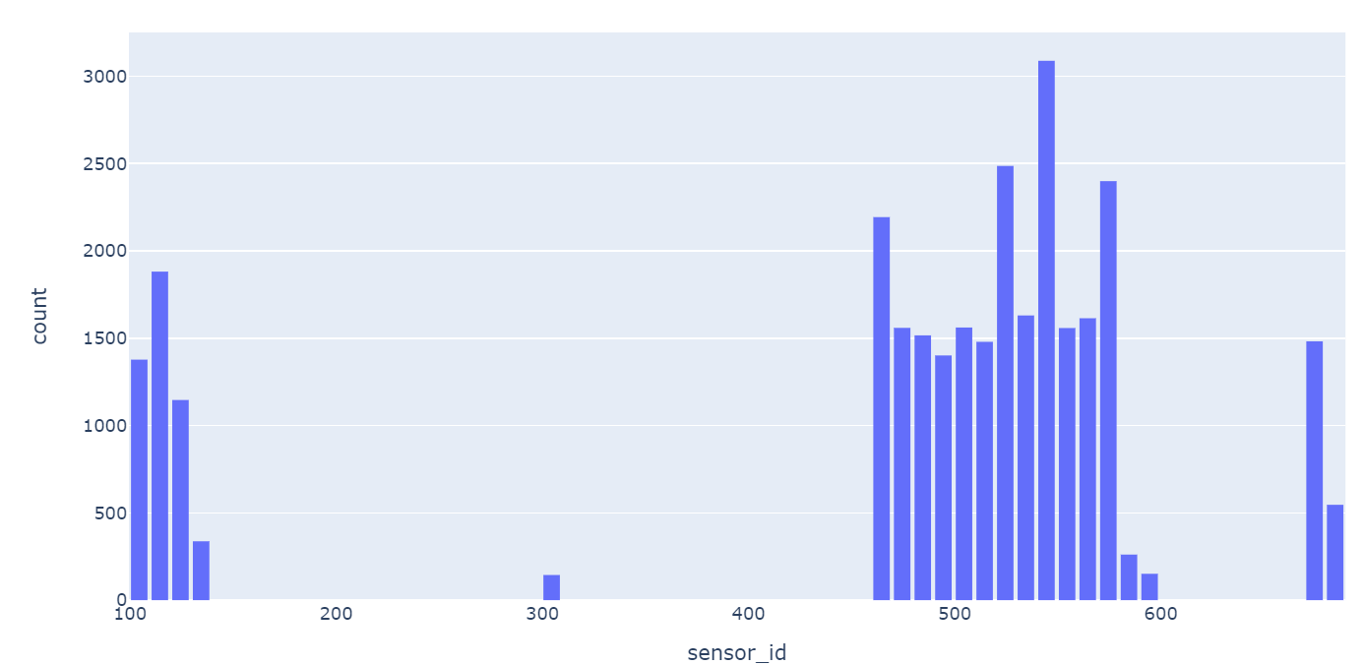
Message Counts
Messages counts by Buoy

Slide 9
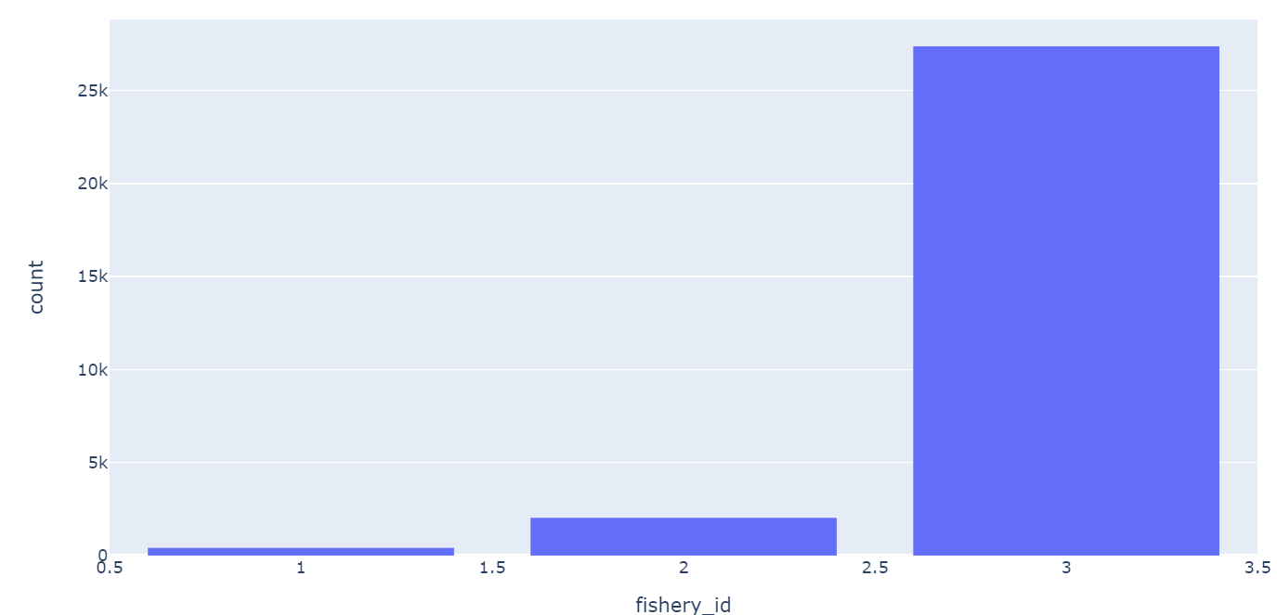
Message Counts
Messages counts by Fishery

Slide 10
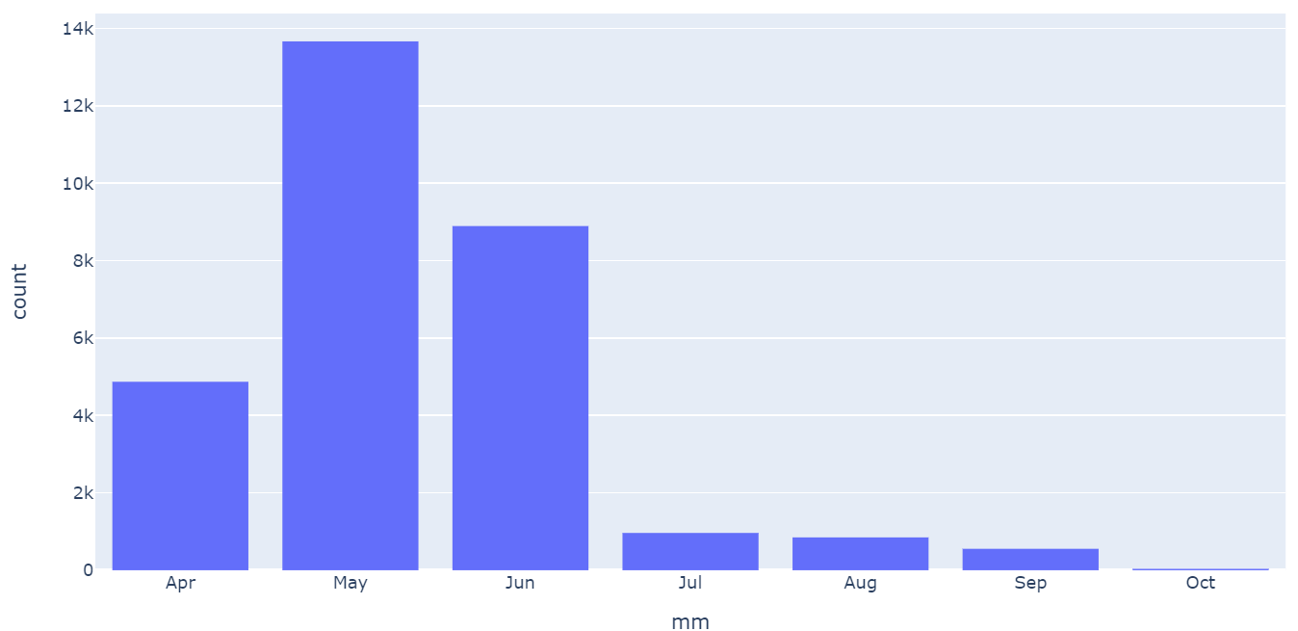
Message Counts
Buoy messages across time
(12th April to 4th Oct 2022)

Slide 11
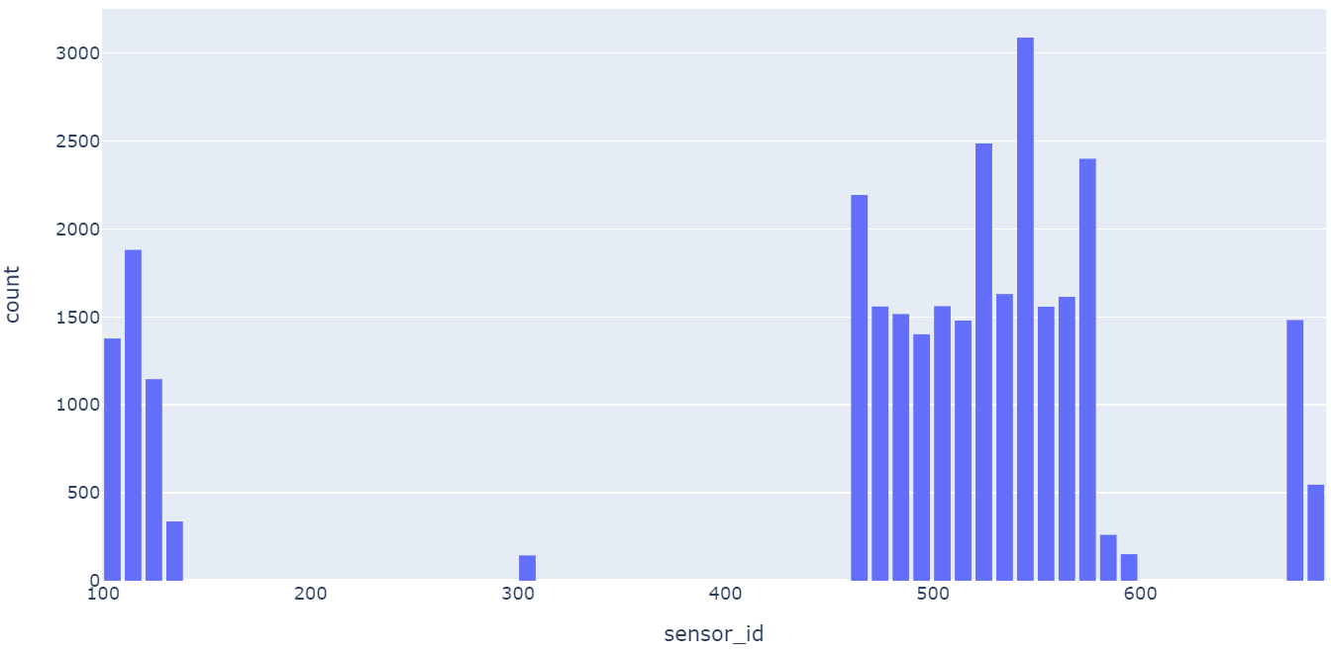
Message Counts
Messages across Buoy IDs

Slide 12
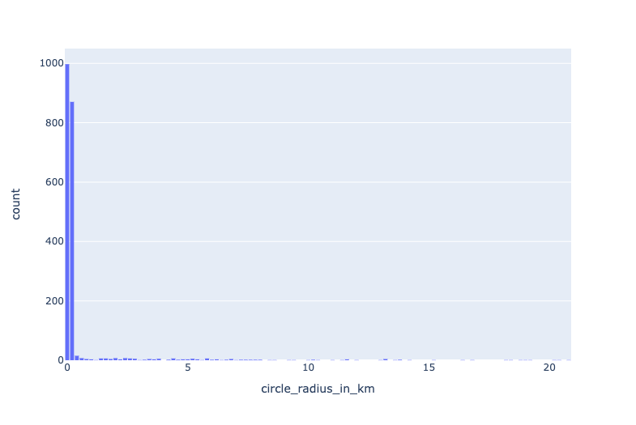
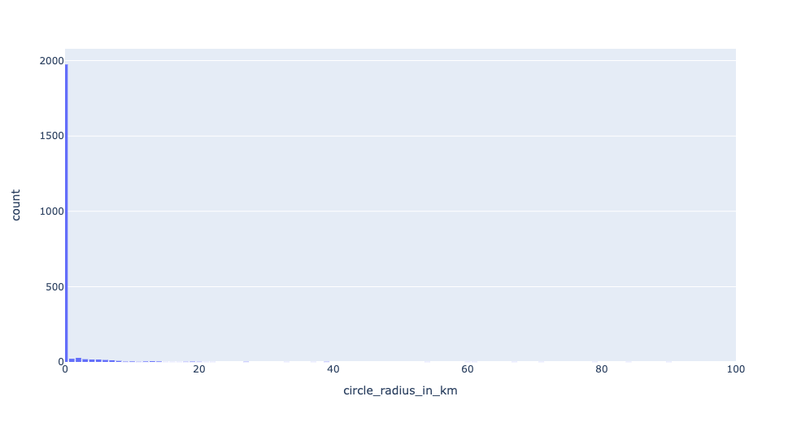
Buoy Swing Range
Swing Range Across Deployments after removing outliers 2 standard deviations away from mean
Swing Range Across Deployments before filtering outliers
Notes:
Plot distribution by fishery_id before removing
Breakaway points - buoy motion path?

Slide 13
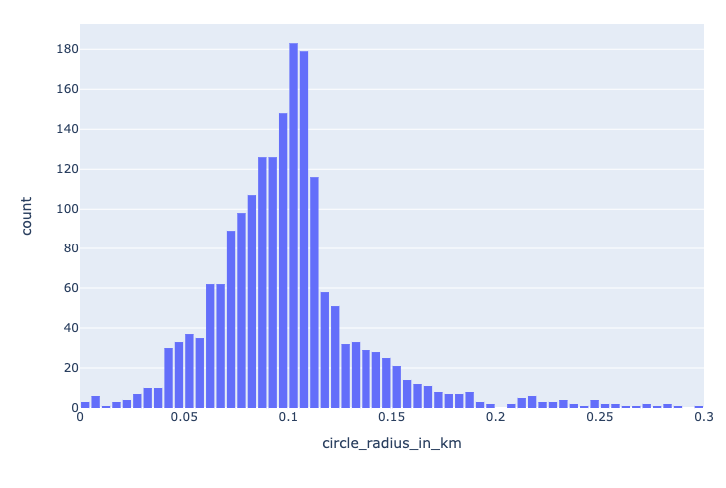
Potential outliers
Average radius size after removing outliers: 0.0996 km
Swing Range Across Deployments after removing outliers
2 standard deviations away from mean
Swing Range Across Deployments after removing outliers
Whose circle_radius_in_km > 0.3km

Slide 14
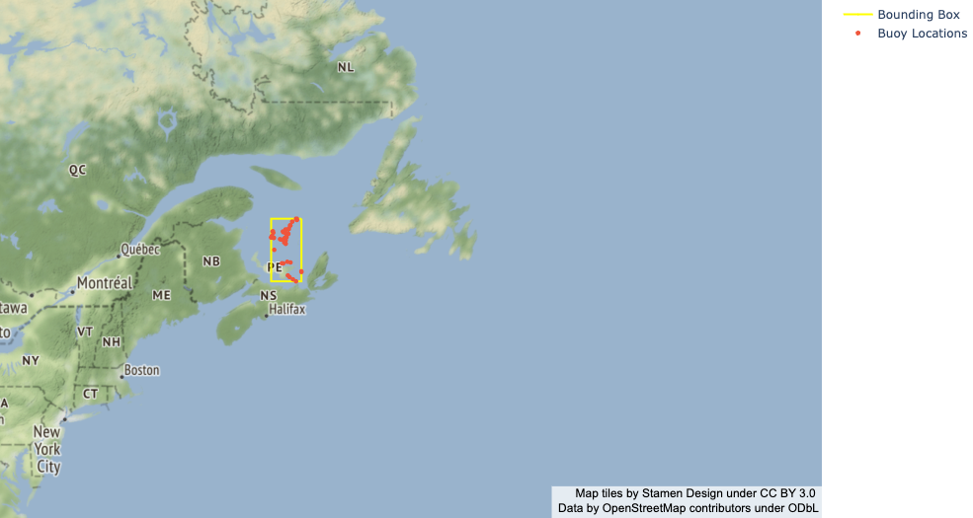
Potential Outliers in Map
196 outliers in total

Slide 15
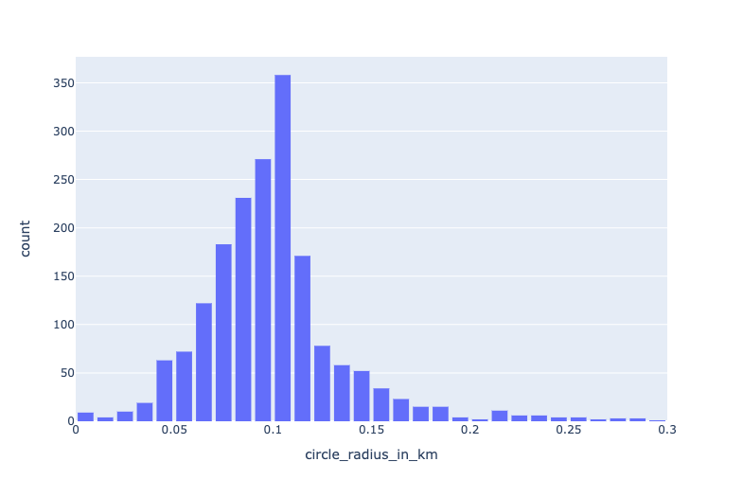
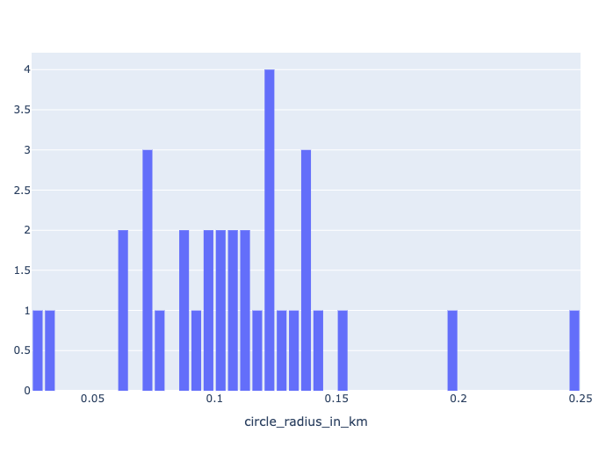
Buoy Swing Range by Fishery
Final Swing Range Across Deployments -
New Brunswick/Gulf of St. Lawrence
Final Swing Range Across Deployments - Maine

Slide 16
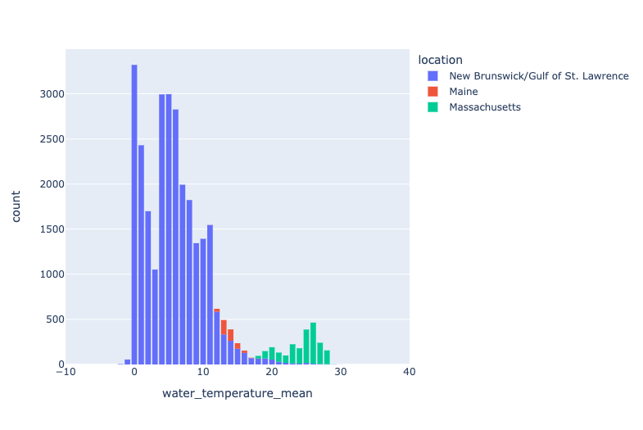
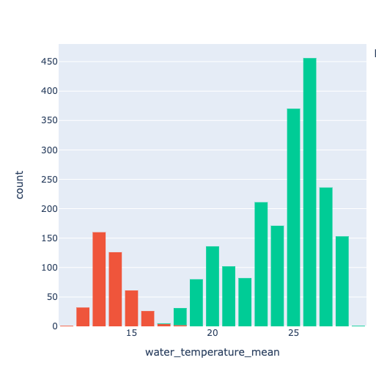
Temperature by Fishery
Water temperature mean across three fishery locations
Water temperature mean in Maine v.s. Massachusetts

Slide 17
Next Steps
Start with the smallest enclosing circles developed during EDA as a baseline
Run hundreds of thousands of simulations of secured buoys in the North Atlantic using OceanParcels
Use simulation data to train random forests (RF), long short-term memory neural networks (LSTM), and/or transformers and then fine-tune models on actual BOG buoy trajectories
Evaluate and compare model results

