Slide 1
MRXplorer
MARKET ANALYSIS REPORT
Cookie Preference Insights & Menu Strategy
Data source: cookie_survey_synthetic_n1000_realistic_binary.xlsx
Prepared by Z. Johnson
zjohnson@mrxplorer.com
Explore. Learn. Lead.

Slide 2

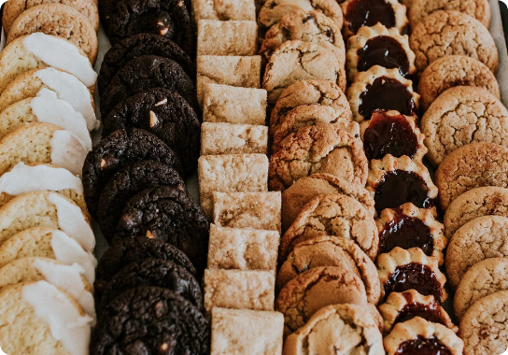


Executive Summary
MRXplorer
Data Source: 1,000 diverse respondents surveyed.
Core Finding: Classic flavors dominate overall market.
Demographic Shift: Distinct preferences by age bracket.
mrxplorer.com
Cookie Preference Report

Slide 3
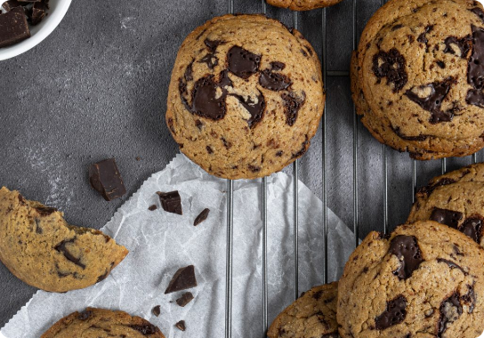
Overall Market Leader
MRXplorer
Chocolate Chip Dominates
42%
Overall respondent preference rate.
mrxplorer.com
Cookie Preference Report

Slide 4
Favorites by Age Bracket
MRXplorer
Under 18
18 – 34
35 – 54
55+
Frosted Sugar
Peanut Butter
Chocolate Chip
Oatmeal Raisin
38% category share.
32% category share.
45% category share.
41% category share.
mrxplorer.com
Cookie Preference Report

Slide 5



Opening Day Menu Strategy
MRXplorer
The Anchor
The Youth Draw
The Niche Play
Lead with Chocolate Chip.
Include colorful Frosted Sugar.
Offer classic Oatmeal Raisin.
mrxplorer.com
Cookie Preference Report

Slide 6
What you'll leave with
MRX
plorer
Explore.
Learn.
Lead.
zjohnson@mrxplorer.com
https://www.mrxplorer.com

Slide 7


Image Sources
https://www.cookietakeabite.com/wp-content/uploads/2021/01/CTAB-5.webp
Source: www.cookietakeabite.com
https://www.cakesperiments.com/wp-content/uploads/2023/12/Chocolate-Chip-Cookies-4-1026x1536.jpg
Source: www.cakesperiments.com

