Slide 1


Consumer Cookie Survey Findings & Bakery Menu Strategy
Data-Driven Bakery Menu Recommendations

Slide 2
1,000-Person Survey Reveals Clear Preferences
Classic Flavors and Textures Lead Baseline Bakery Preferences
Total Survey Sample: N=1,000 consumers surveyed to determine baseline bakery preferences.
Top Favorite Across All Ages: Chocolate Chip emerged as the undisputed leader across every demographic.
Secondary Overall Favorites: Double Chocolate and Snickerdoodle demonstrated strong mass appeal.
Core Drivers of Choice: Consumer selections are heavily influenced by nostalgic familiarity, a balanced sweetness level, and broad texture appeal—specifically favoring soft and chewy centers with crisp edges.

Slide 3
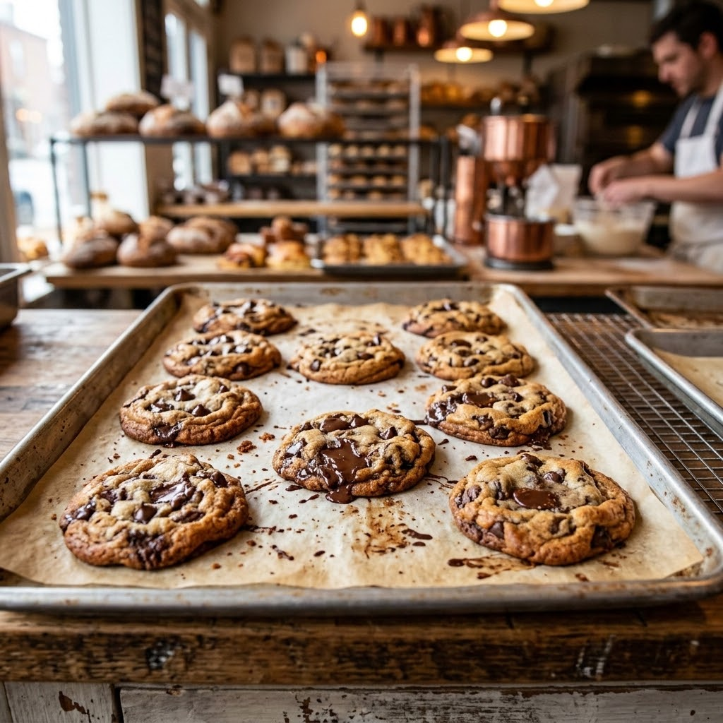
Chocolate Chip Dominates as the Top Cookie Choice Across All Demographics
The Undisputed Champion
Chocolate Chip is the top favorite cookie across all age brackets in the N=1,000 sample.
Key Drivers for Chocolate Chip
Nostalgic Familiarity: Consumers strongly associate this flavor with positive memories and classic simplicity.
Balanced Sweetness Level: It provides the ideal middle ground for broad consumer palates.
Broad Texture Appeal: The ideal chocolate chip cookie satisfies the universal preference for a soft/chewy center paired with crisp edges.
Supporting Favorites
Double Chocolate and Snickerdoodle follow as the secondary overall favorites.
Access more resources: https://www.mrxplorer.com | zjohnson@mrxplorer.com

Slide 4
Cookie Preferences Shift from Indulgent Chocolate to Wholesome Classics with Age
Age 18–24
Age 25–34
Primary favorites are Chocolate Chip and Double Chocolate
Secondary interest in White Chocolate Macadamia and Shortbread
Chocolate Chip leads
Followed by Snickerdoodle and Peanut Butter
Age 35–44
Age 45+
Chocolate Chip remains first
Oatmeal Raisin and Snickerdoodle or Ginger Molasses as strong secondary choices
Classic Chocolate Chip and Oatmeal Raisin tie for primary favorites
Supported by Shortbread and Crisp Sugar Cookies

Slide 5
Indulgence, Nostalgia, and Texture Profiles Dictate Consumer Purchasing Decisions
Younger Demographics
Ages 18–24: Driven by high indulgence, rich chocolate flavors, and a predominantly soft/chewy texture.
Ages 25–34: Motivated by flavor variety, nostalgic appeal, and how well the cookie pairs with coffee or milk.
Mature Demographics
Ages 35–44: Seek out spiced flavors, warmth, and wholesome ingredients.
Ages 45+: Prioritize classic simplicity, a buttery crisp texture, and a moderate sweetness level.
Universal Standard
Universal Texture Standard:
Across most demographics, a soft and chewy center with crisp edges is the winning preparation strategy.
Access more resources: https://www.mrxplorer.com | zjohnson@mrxplorer.com

Slide 6
A Strategic Menu: Balancing Staples with Specialties
Core Anchors
Everyday Staples
Classic Chocolate Chip: Appeals across all age brackets
Double Chocolate Fudge: Drives strong interest among ages 18–34
Cinnamon Sugar Snickerdoodle: Broad cross-generational appeal
Demographic Specialties
Targeted Additions
Oatmeal Raisin: Captures 35+ demographics preferring wholesome options
Buttery Shortbread: Appeals strongly to mature customers and hot beverage drinkers
White Chocolate Macadamia or Peanut Butter: Rotating daily specials
Preparation Strategy
Baking Standard
All core cookies will be baked to achieve a soft and chewy center with crisp edges.

