Slide 2
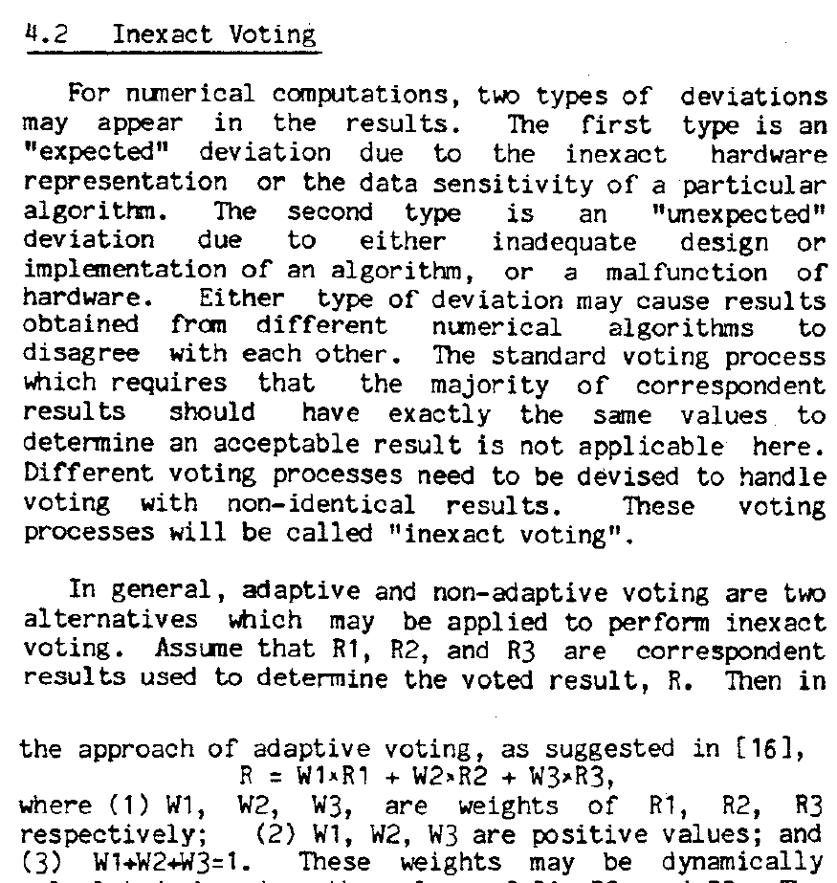
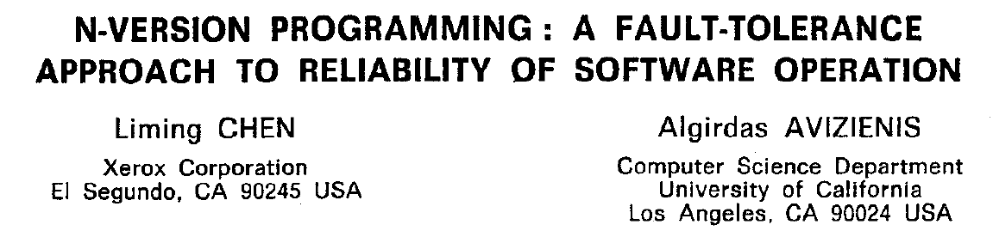
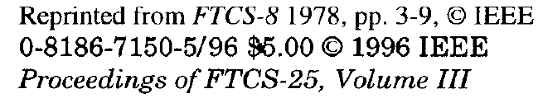
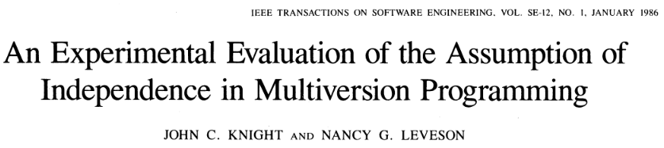
研究动机
Review comments of "Boosting Multimode Ruling in DHR Architecture with Metamorphic Relations"
Despite different names, the reviewer cannot see any fundamental difference between DHR and N-version programming (Knight, J. C. and Leveson, N. G. 1986), which is a traditional software engineering approach and has been investigated in numerous studies. The authors should give clear comparison between these two approaches…

Slide 3
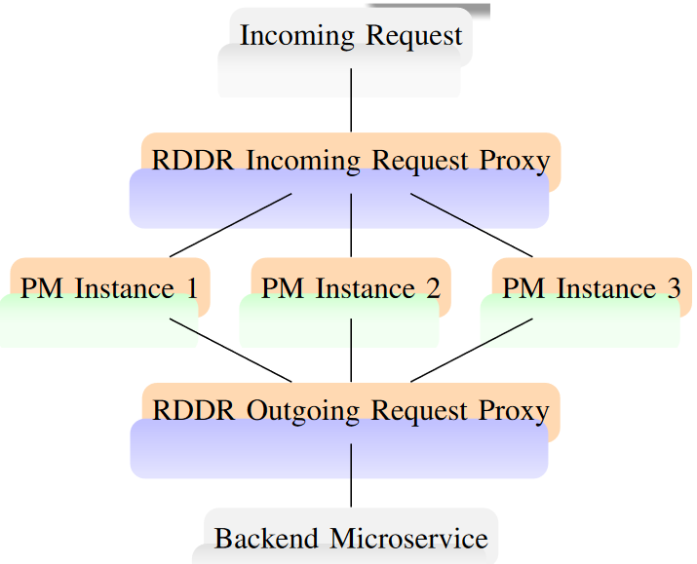
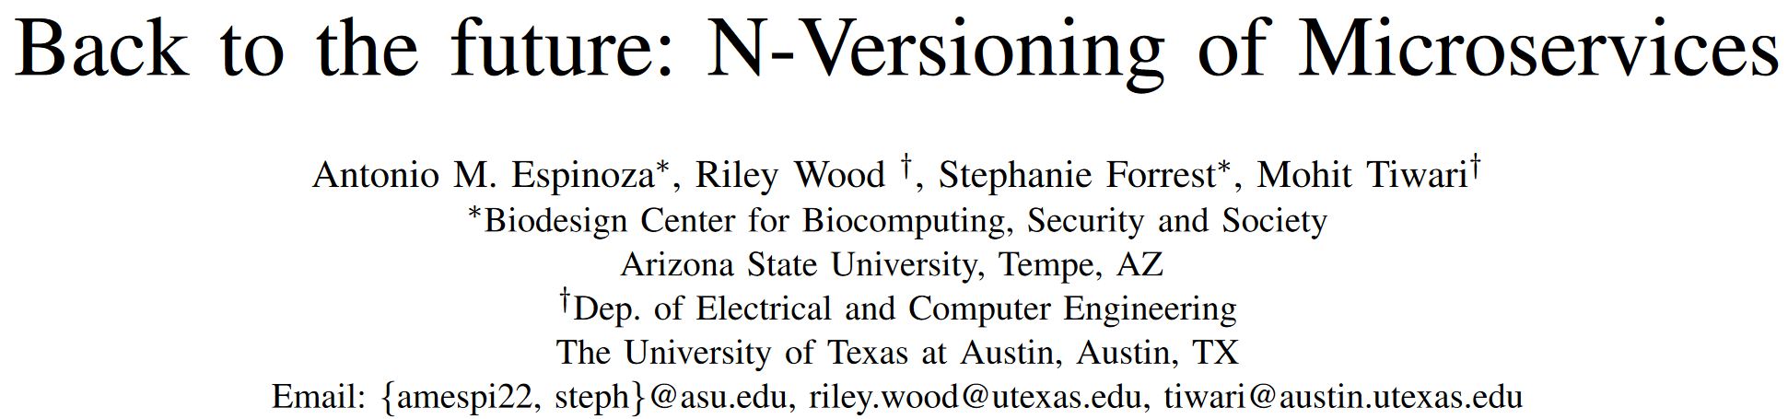
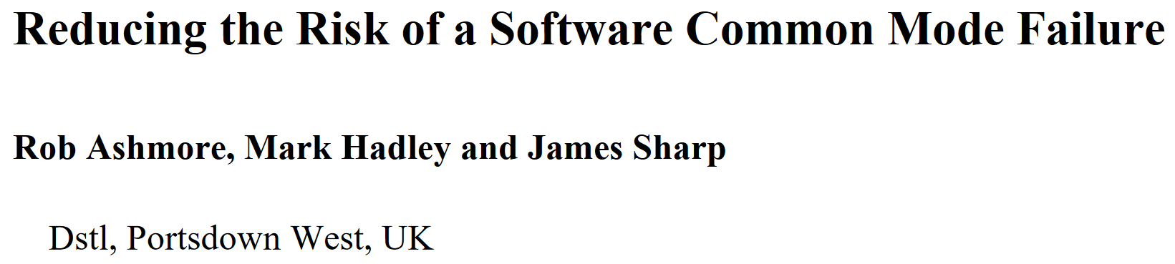
研究动机
异构执行体的来源
Independent implementations
Different versions of the same implementation
System/process level diversity
2023-08-28
Dstl: 英国国防科学与技术实验室

Slide 4
研究动机
Common Mode Failure (CMF)的危害
Ariane 5 (1996) 阿丽亚娜5型火箭
两路惯性制导系统SRIs (Inertial Reference Systems) 在点火后36.7秒遇到异常，从64位浮点数转换到16位带符号整数时发生溢出，导致助推剂和主机分离，火箭自毁
Subsonic / Supersonic Boundary (2010) 亚音速边界
机载武器需要调用遥感系统，调用发生异常导致机载电脑重启，飞机靠滑行挺过去了，飞行员未感知
NATS System Failure (2014) 英国空中管制局系统错误
NATS的两路System Flight Server (SFS)同时失效，影响1900航班
Airbus A330-302 (2020) 上海飞台北航班，制动系统失灵
3路机载控制系统Flight Control Primary Computers (FCPCs)同时失灵，飞行员手动降落。该系统已服务了超过870万次航班。

Slide 5
防御：动态异构冗余架构DHR
策略裁决
提供等价服务功能的异构执行体或场景
提供等价服务功能的异构执行体或场景
算法控制
输入代理
纠错输出
可重构运行场景 1
服务请求
可重构运行场景 2
【O】
【I】
（P）
服务响应
可重构运行场景 k
反馈控制
允许存在未知漏洞后门/病毒木马或传统功能安全问题
允许存在未知漏洞后门/病毒木马或传统功能安全问题
控制指令
裁决参数

Slide 6
软件漏洞的主动防御
Fault Avoidance
Careful design
Verification
Testing
Fault Tolerance
Data diversity
Design diversity
Recovery Blocks
N-Version Programming
N-Self Checking
Different Functionality
Watchdog Timers
动态、异构、冗余思想

Slide 7
软件漏洞的主动防御
Fault Tolerance
Data diversity
Providing identical software with different inputs
Failure is only triggered for small parts of the input space
Design diversity
Creating versions of software that fail in non-identical ways
Design diversity typically provides greater protection than data diversity

Slide 8
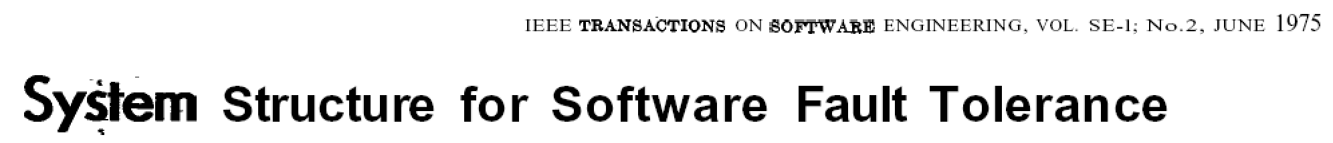
软件漏洞的主动防御
Design Diversity — Recovery Blocks
Randell introduced the concept of recovery blocks in 1975. These were motivated by the observation that it is standard practice to structure a program of any significant complexity into a series of blocks (e.g. modules, procedures, subroutines, methods)
Before a "significant" block is executed, a recovery point is stored. The first alternate block is run and its output is subjected to an acceptance test. If the output is not acceptable then the program is rewound to the recovery point, the second alternate block is executed and its output is tested for acceptance.
The process is repeated until either an acceptable output is found or all alternates have been exercised

Slide 9
软件漏洞的主动防御
Design Diversity — N-Version Programming
Chen introduced this approach in 1978. Several alternate versions are run in parallel and their output is passed to an adjudicator. The adjudicator provides a consolidated output for use by the rest of the system. For example, this consolidation could check that outputs are within pre-defined bounds and then return an average; another alternative would be the use of a simple majority voter
In the evaluation study, 27 different students each wrote a program to satisfy the same set of requirements. Each program had to pass a series of acceptance tests. Once each program was "acceptable", the collection of programs was subjected to a large barrage of tests. Several common faults were detected between the programs and, more significantly, the number of common faults was higher than would be predicted if the programs exhibited independent faults.

Slide 10
软件漏洞的主动防御
Design Diversity — N-Self Checking
The n-self checking approach can be considered as a hybrid of the other two approaches. It involves the use of at least two self-checking software components. A component could be made by combining a version of the software and an acceptance test. Alternatively, it could be made by combining several versions of the software with an adjudicator
The approach of n-self checking software has been studied less extensively in academia than either recovery blocks or n-version programming

Slide 11
软件漏洞的主动防御
Design Diversity — Different Functionality
In some applications it may be possible to achieve design diversity by implementing software that achieves the same system-level outcome but using different functionality.
The use of a different control law in an aircraft flight control system
Implementing software deliberately intended to manage degraded modes of operation
In some cases, an easy way of achieving some design diversity may be to use an older version of software alongside the most recent one. This might be appropriate if the change between the two software versions was solely related to performance issues.
It is not appropriate if the new version fixed a safety-related issue.

Slide 12
软件漏洞的主动防御
Watchdog Timers
In general, the system is designed so that it signals the watchdog once during each prescheduled interval. If the timer is not reset (and, in some cases, if it is reset more than once) during an interval then the watchdog raises an error. This error can be trapped and used, for example, to restart a processor
Hence, watchdog timers, which are often implemented in hardware, can be used to provide protection against particular types of software error, including those that cause applications to crash and those that result in infinite loops.

Slide 13
总结
There is no reliable way of entirely removing the possibility of software CMF
When multiple copies of software are used, it will always represent a risk
Whilst the value of diversity is noted, there is no preferred way of mitigating this risk
There does not appear to be a standard way of assessing the level of protection (or risk mitigation) provided by a particular approach, or combination of approaches

