Slide 1
Predicting Start-up Outcomes in Pakistan: An Integrated Econometric and Multidimensional Statistical Approach
By:
Zoha Ehsan (3001-BS-STAT-22)
Department of Statistics
Government College University, Lahore
Supervised by:
Dr. Hina Khan
Associate Professor

Slide 2
Introduction
01
02
03
04
Global Context
Pakistan Context
90% of startups fail worldwide
50% fail within first 5 years
88% funding decline (2022→2024)
90% fail within first 3 years
Startup Ecosystem
High-Profile Failure
55+ funded startups closed in 2021-24
2022 = "exodus year"
Airlift: $109M → shut down in 1 year
Careem: suspended after 10 years

Slide 3
Objectives
Describe characteristics of Pakistani startups
Identify factors that predict startup survival
Identify factors that predict startup revenue
To develop a statistical model for predicting startup closure.
Research Gap
No integrated statistical framework for Pakistani startups at department of Statistics in GCU Lahore.
Survival and revenue are rarely studied together.

Slide 4
Data
Cities:
Lahore Karachi Islamabad
Sample:
150 Startups
Time Period: Founded between 20210-2022
Type: Secondary data
Source:
Open Data Pakistan, Crunchbase, Ministry of planning & Development

Slide 5
Variables
Size
Revenue
Startup Status
Industry
Total Funding
Annual Growth
Employee Count
Funding Rounds
City
Dependent Variables

Slide 6
Literature Review
Bruckner et al. (2022) | Schulte-Althoff et al. (2021)
Method: Qualitative narrative analysis of overfunded failed startups Finding: Abundant resources can paradoxically accelerate failure Aligns with my "funding paradox" i.e. more funding = higher closure risk | Method: Quantitative analysis of AI, platform, and service startups Finding: Revenue scales sublinearly with employee count Aligns with my linear regression i.e. each employee adds 0.4% revenue.

Slide 7
Methodology
Integrated Econometric Methods
ANOVA
Independent T-Test
Multidimensional Statistical Methods
MANOVA
Linear Regression
Cox Regression
Kaplan-Meier
K-Means Cluster
Easy Fit

Slide 8
Descriptive Statistics of Continuous Variables
Variable | Min | Max | Average | Std. Deviation | Skewness | Kurtosis
Annual Growth (%) | -96.00 | 243.00 | Mean = 15.02 | 44.65 | 2.234 | 7.812
Revenue ($1000) | 35.00 | 120,000.00 | Mean = 4,593.42 | 10,733.71 | 8.692 | 90.859
Employee Count | 1 | 666 | Mode = 5 | 91.13 | 3.766 | 17.548
Total Funding ($1000) | 0 | 282,000 | Mean = 7,387.50 | 27,507.95 | 7.649 | 69.491
Funding Rounds | 0 | 6 | Mean = 0.78 | 1.15 | 1.909 | 4.210

Slide 9
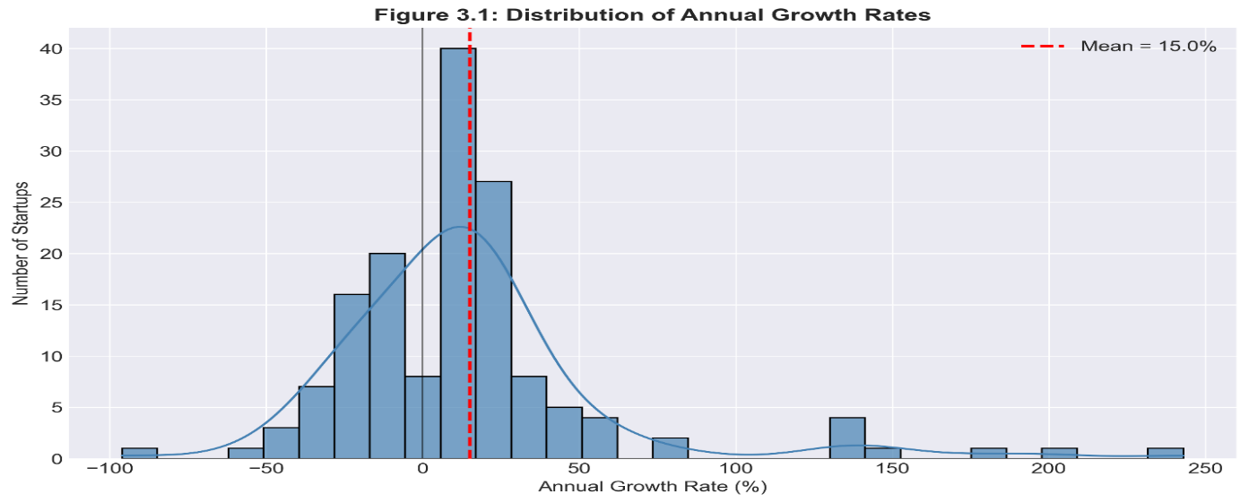
Distribution of Annual Growth Rates

Slide 10
Average Annual Growth by Startup size

Slide 11
Distribution Fitting using EasyFit H₀: The data follow the specified theoretical distribution. H₁: The data do not follow the specified theoretical distribution.
Revenue
(Critical value=0.13309)
Total Funding
(Critical value=0.16615)
Distribution | Test Statistic
Weibull | 0.07711
Pareto | 0.07895
Gamma | 0.11582
Lognormal | 0.08694
Distribution | Test Statistic
Weibull | 0.05428
Pareto | 0.06942
Gamma | 0.14846
Lognormal | 0.08930

Slide 12
ANOVA by Startup Size
Larger startups have significantly more revenue, funding, and growth
Size is a meaningful factor in distinguishing startup performance
Variable | F-value | P-value | Decision
Revenue | 18.819 | < 0.001 | Significant
Total Funding | 7.817 | 0.001 | Significant
Annual Growth | 5.371 | 0.006 | Significant

Slide 13
ANOVA by Industry
Revenue and funding rounds vary significantly by industry
Total funding shows weak industry influence
Variable | F-value | P-value | Decision
Revenue | 4.907 | < 0.001 | Significant
Total Funding | 1.769 | 0.065 | Significant
Funding Rounds | 3.142 | 0.001 | Significant

Slide 14
INDEPENDENT T-Test
Active startups grow significantly faster regardless of funding.
The growth gap is wider for funded startups than zero-funded ones with very
large effect sizes (d = 1.50).
 | Zero-Funded Startups | Funded Startups
Mean Active Growth | 27.78% (n = 67) | 45.61% (n = 27)
Mean Closed Growth | -16.54% (n = 16) | -14.38% (n = 40)
t-value | 4.388 | 6.033
p-value | < 0.001 | < 0.001
Cohen's d | 1.22 (Large) | 1.50 (Very Large)

Slide 15
MANOVA: Multivariate Results
Startup status significantly affects the combined dependent variables (growth
and revenue)
Startup size also significantly affects the combined dependent variables
Effect | Wilks' Lambda | F | Sig. | Partial η²
Intercept | 0.065 | 1016.621 | < 0.001 | 0.935
Status | 0.856 | 11.923 | < 0.001 | 0.144
Size | 0.776 | 9.604 | < 0.001 | 0.119

Slide 16
MANOVA: Between-Subjects Effects
A startup can make decent revenue and still fail. Growth separates survivors
from failures.
Larger startups grow faster and earn more.
Source | Dependent Variable | F | Significance level | Significant
Status | Annual Growth | 23.926 | < 0.001 | Yes
Status | Revenue | 0.003 | 0.953 | No
Size | Annual Growth | 7.129 | 0.001 | Yes
Size | Revenue | 14.697 | < 0.001 | Yes

Slide 17
LINEAR REGRESSION
The model explains 26.1% of the variance in revenue (R² = 0.261) and is
statistically significant, F(3, 146) = 17.200, p < 0.001. The Durbin-Watson
statistic is 1.892, indicating no autocorrelation in the residuals.
Revenue = 5.503 + 0.004(Employees) + 0.720(Size) + 0.096(Time)
Predictor | B | Std. Error | β | t | Effect
(Constant) | 5.503 | 0.417 | — | 13.209 | —
Employee Count | 0.004 | 0.001 | 0.232 | 2.595 | +0.4% per employee
Startup Size | 0.720 | 0.216 | 0.299 | 3.341 | +72% per category
Time | 0.096 | 0.045 | 0.152 | 2.118 | +9.6% per year

Slide 18
COX REGRESSION
The Cox regression model is statistically significant, χ²(3) = 80.926, p < 0.001.
The Cox regression equation shows that negative growth increases closure risk by 15.17
times (strongest effect), revenue reduces risk by 25% (protective), and funding slightly
increases risk (funding paradox).
h(t) = h₀(t) × exp[2.719(Negative_Growth) - 0.288(Revenue) + 0.003(Total Funding)]
Predictor | B | SE | Wald | df | Sig. | Exp(B) | Interpretation
Negative Growth | 2.719 | 0.393 | 47.986 | 1 | < 0.001 | 15.165 | 15x higher hazard
Revenue | -0.288 | 0.125 | 5.314 | 1 | 0.021 | 0.750 | 25% lower hazard
Total Funding ($1000) | 0.003 | 0.0001 | 4.763 | 1 | 0.029 | 1.000 | Small increase

Slide 19
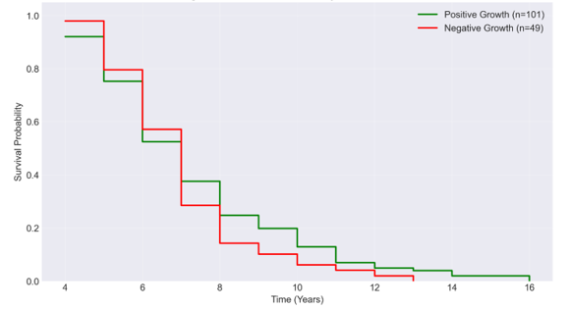
kaplan-Meier Survival Analysis
Negative growth startups: 48 closures
Positive growth startups: 8 closures
Median survival (negative growth): 7.0 years
Median survival (positive growth): Not reached
Only 30.6% survive past 7 years (negative growth)
None survive beyond 13 years (negative growth)
Log-rank test: χ² = 90.162, p < 0.001
Highest hazard risk: Years 5 to 8
Kaplan-Meier Survival Curves by Growth Status

Slide 20
K-Means Cluster Analysis
Cluster 1 contains only one startup (outlier). Statistically insufficient for meaningful segmentation.
Variable | Cluster 1 n=1 (Outlier) | Cluster 2 n=136 | Cluster 3 n=13
Revenue | 10.75 | -0.14 | 0.65
Funding Efficiency | 11.24 | -0.07 | -0.12
Employee Count | -0.08 | -0.25 | 2.63
Annual Growth | -0.07 | -0.13 | 1.34

Slide 21
K-Means Cluster Analysis (Refined Sample)
High Growth cluster (8.7% of startups) has 75% annual growth, 293 employees,
and 69.2% survival rate.
Mainstream cluster (91.3% of startups) has 9% annual growth, 30 employees,
and 61.8% survival rate.
Variable | Cluster 1 n=13 (High Growth) | Cluster 2 n=136 (Mainstream)
Revenue | 0.65 | -0.14
Annual Growth | 1.34 | -0.13
Employee Count | 2.63 | -0.25
Funding Efficiency | -0.12 | -0.07

Slide 22
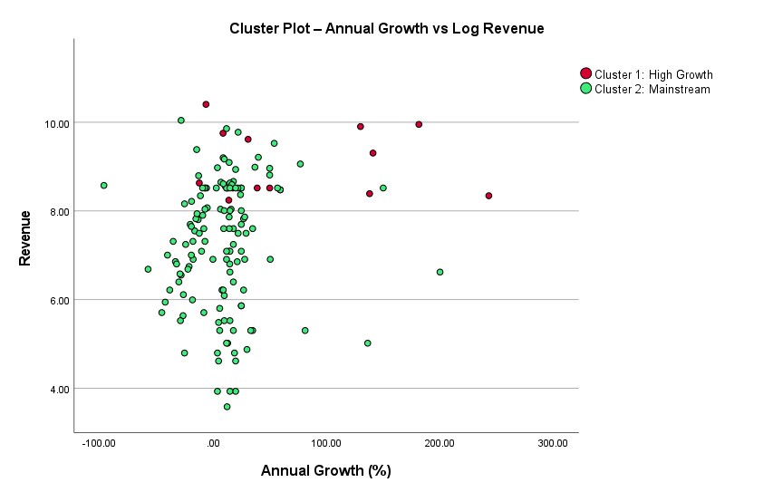
High-growth startups (red) are on the right side with higher annual growth.
Mainstream startups (green) are on the left with lower growth, reflecting the real challenges startups face.

Slide 23
Summary of Key Findings
Finding | Method
Negative growth = 15x higher closure hazard | Cox Regression
1% revenue increase = 25% lower closure hazard | Cox Regression
Higher funding = small increase in closure risk (Funding Paradox) | Cox Regression
Each size category = 72% higher revenue | Linear Regression
Each employee = 0.4% higher revenue | Linear Regression
Status affects growth, not revenue | MANOVA
Active vs Closed growth gap: d = 1.22 and 1.50 | T-Test
High-growth startups: 8.7% of sample, 69.2% survival | Cluster Analysis
Negative growth: only 30.6% survive past 7 years | Kaplan-Meier

Slide 24
Research Questions Answered
Question | Answer
What are main characteristics of Pakistani startups? | Wide variation in revenue, funding, growth; most have 5 employees
What predicts survival? | Growth (15x higher hazard if negative)
What predicts revenue? | Size (72% increase per category)
Can models predict outcomes? | Yes (Cox: χ²=80.9, Linear: R²=0.261)
Are multidimensional methods effective? | Yes (Cluster, MANOVA)

Slide 25
Thank You!

