Slide 1
Storify: A Story Management Application
Advanced Programming: End Semester Project

Slide 2
Group Members & Division
Aamna Sarosh : The Designer
Ali Ather: Back end
Ahmad Bilal: Login Management
Ali Chishti: Front end and File Management
Zohaa Ali: Front end and FIle Management

Slide 3
Problem Statement
“Implementing a story/status management application being used in different modern social media apps.
Basic features should include user management, 24 hour story management, view management, and database management”

Slide 4
Motivation
“Story management functionality in applications is in high demand. Moreover, this solution will provide an extensive understanding of front end development in React Native as well as use of novel databases i.e Firebase. ”

Slide 5
Design & Implementation
Tools and Technologies:
React Native (Front End)
Expo (Running Engine)
Firebase for (Back End)

Slide 6
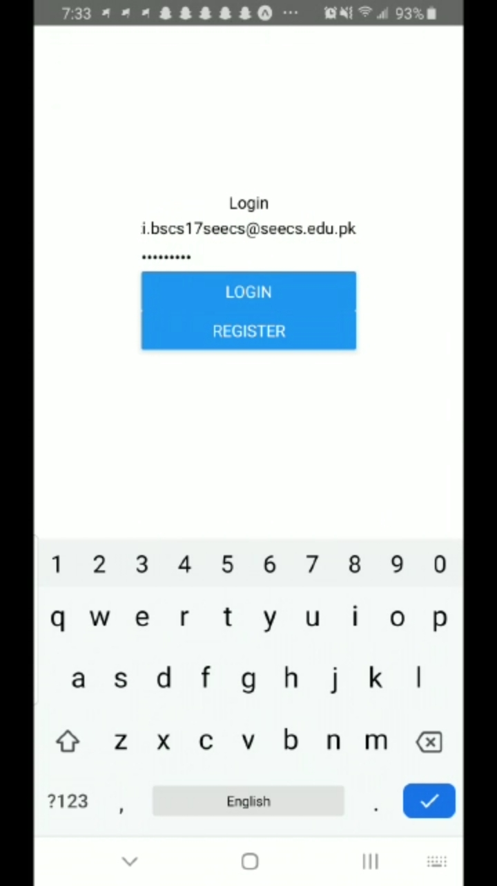
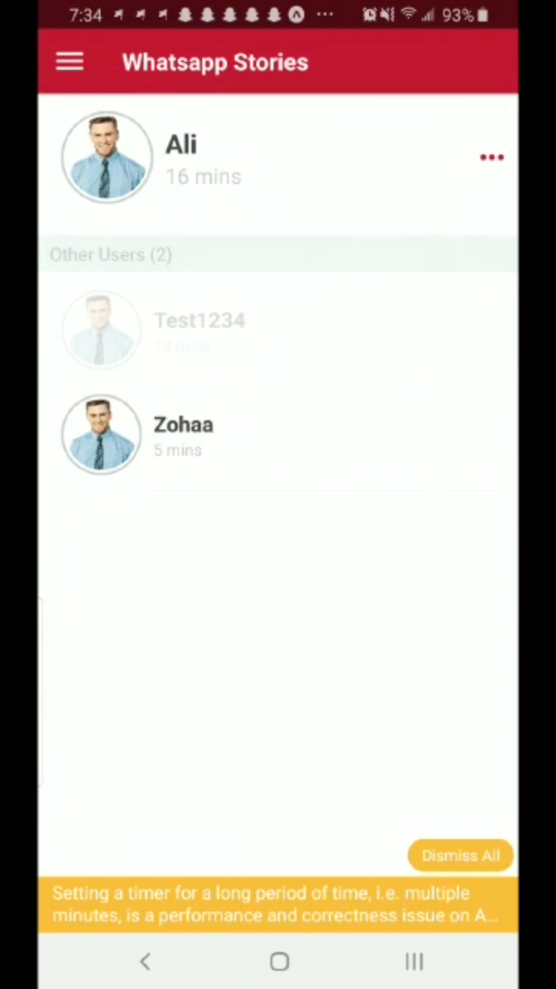
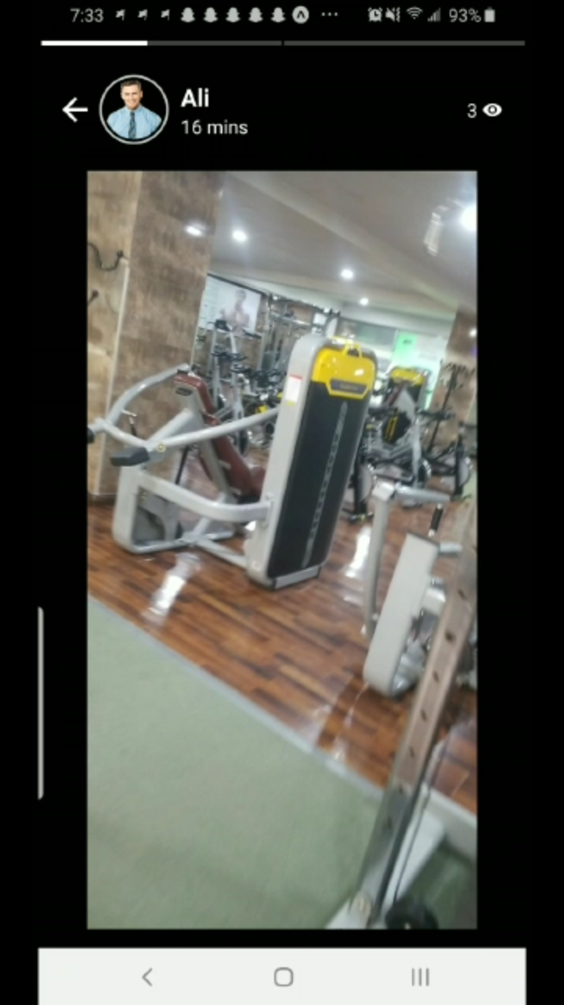
Front End (React Native)

Slide 7
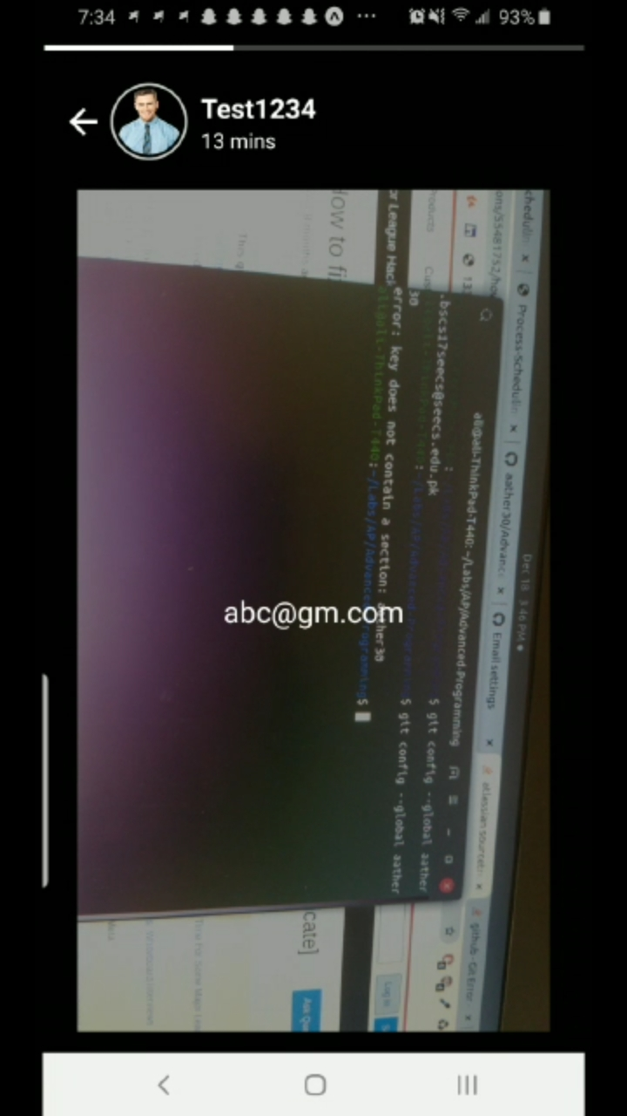
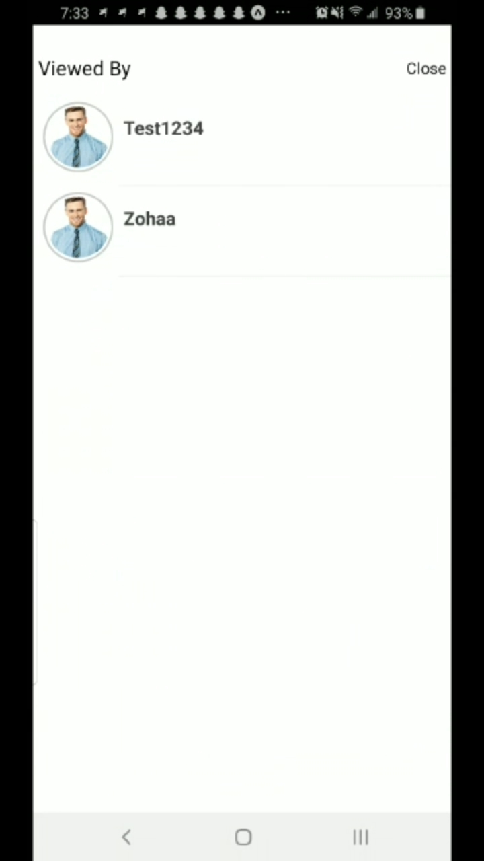

Slide 8

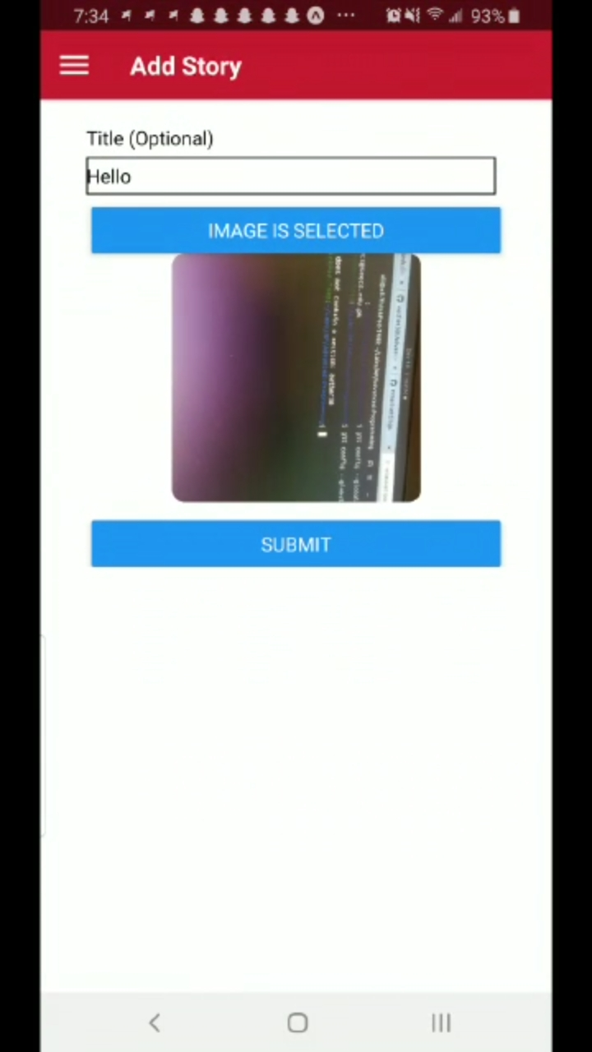

Slide 9
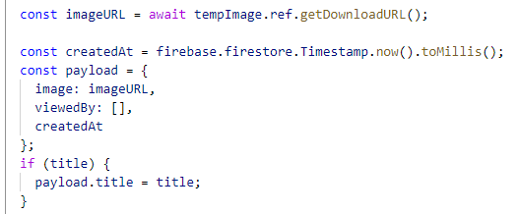
Back End (Firebase)

Slide 10
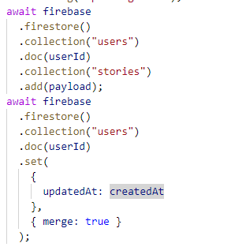
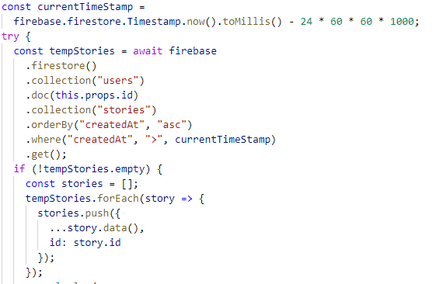

Slide 11
Limitations
&
Problems Faced

Slide 12
Limitations
The application only covers the status management part of a social media app.
No chatting/timeline features included.
Interface for deleting stories is not provided.
The application is not currently hosted, and hence, is tested on single device only using expo.

Slide 13
Problems Faced
Building and installing dependencies for libraries used.
Synchronising compatibility of modules with the platform version.
Understanding and implementing the storage management with Firebase.
Finding appropriate interface functions to add a more sleek look and feel to the application.

Slide 14
Conclusion
“ Storify provides a comprehensive solution to a status management application and covers modern features being implemented in various modern social media applications.”

Slide 15
Thank you!
Any Questions?

