Slide 1
Mars Weight Problem
By: Muhammad Zohad Ijaz

Slide 2
Problem Statement
An Earthling weighs only 37.8% of their Earth weight on Mars. Write a Python program that asks the user for their weight on Earth, calculates their corresponding weight on Mars, and displays the result rounded to two decimal places.

Slide 3


Understanding Problem:

Slide 4
Understanding Problem:
Weight on Earth: 100kg

Slide 5
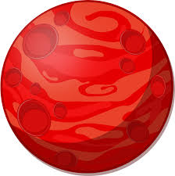
Understanding Problem:

Slide 6
Understanding Problem:
37.8% of Earth
Weight on Mars: 37.8kg

Slide 7
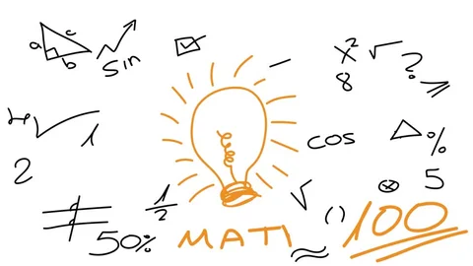
Convert the percentage to decimals = 37.8%= 37.8/100 = 0.378
Mars Weight = Earth Weight * 0.378

Slide 8

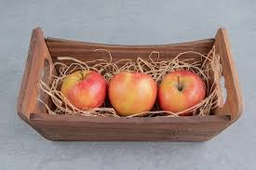
Variables & Type Casting
Mangos
Apples

Slide 9


