Slide 1
COMPREHENSION AND QUIZ GENERATION SYSTEM
Rehan Ali Tajik (23I-0730)
Zohaib Umer (23I-0528)

Slide 2
DATASET
DATASET UTILIZED: RACE DATASET (KAGGLE)
LARGE SCALE READING COMPREHENSION DATASET COLLECTED FROM ENGLISH EXAMS FOR MIDDLE AND HIGH SCHOOL STUDENTS
PROVIDES PERFECT CONTEXT-QUESTION-ANSWER TRIPLETS NEEDED TO TRAIN/EVALUATE MODELS FOR GENERATING HINTS AND DISTRACTORS.

Slide 3
EXPLORATORY DATA ANALYSIS
Checked dataset structure, column names, and sample records
Performed missing value and duplicate data analysis
Created text-based analytical features (article/question word counts)
Analyzed article/question length distribution
Examined answer class distribution (A, B, C, D)
Identified common question types
Generated summary statistics for numerical features
Extracted and analyzed most frequent words in the dataset
Studied correlations between text-length features
Visualized class distributions using charts and plots
Saved cleaned and processed datasets for further modeling

Slide 4
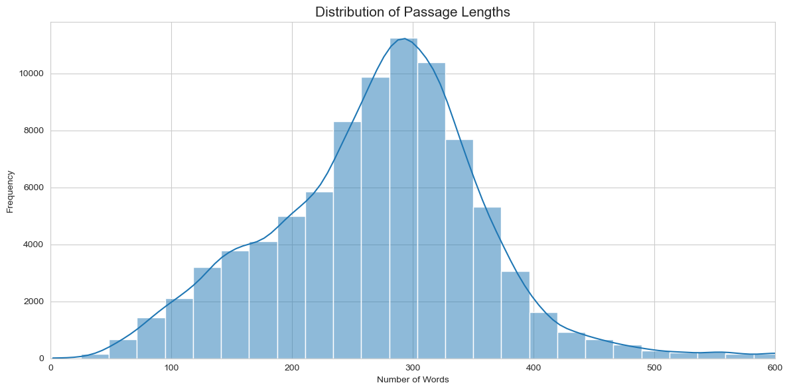
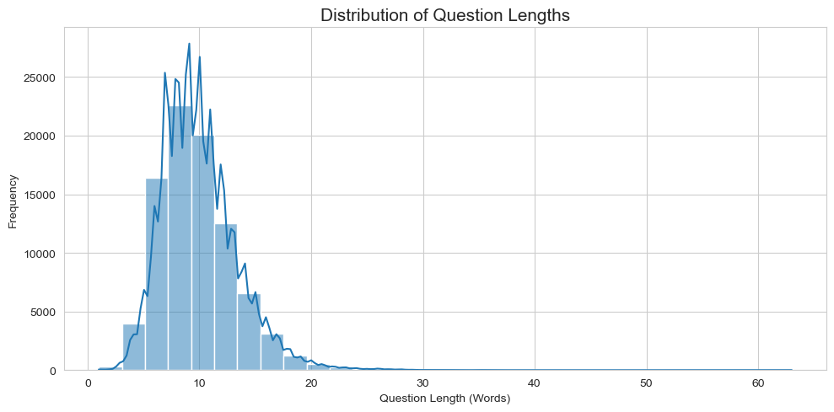
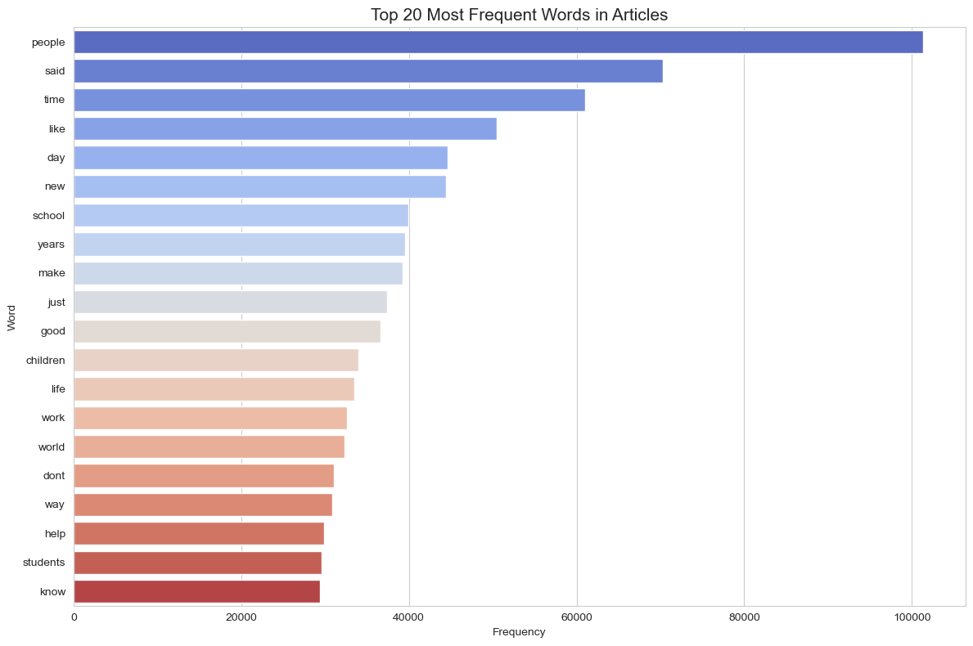
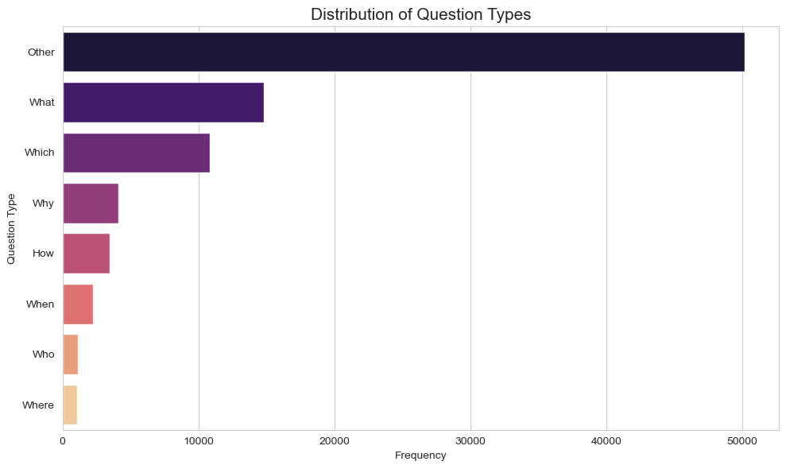
EXPLORATORY DATA ANALYSIS

Slide 5
Statistical Methods
TF-IDF (Term Frequency-Inverse Document Frequency): Used to statistically evaluate how important a word is to a specific document within the overall dataset corpus.
SVD (Singular Value Decomposition): Applied for dimensionality reduction and latent semantic analysis to find hidden relationships between words and passages.
K-Means Clustering: An unsupervised statistical method used to group similar texts or questions based on their feature vectors.

Slide 6
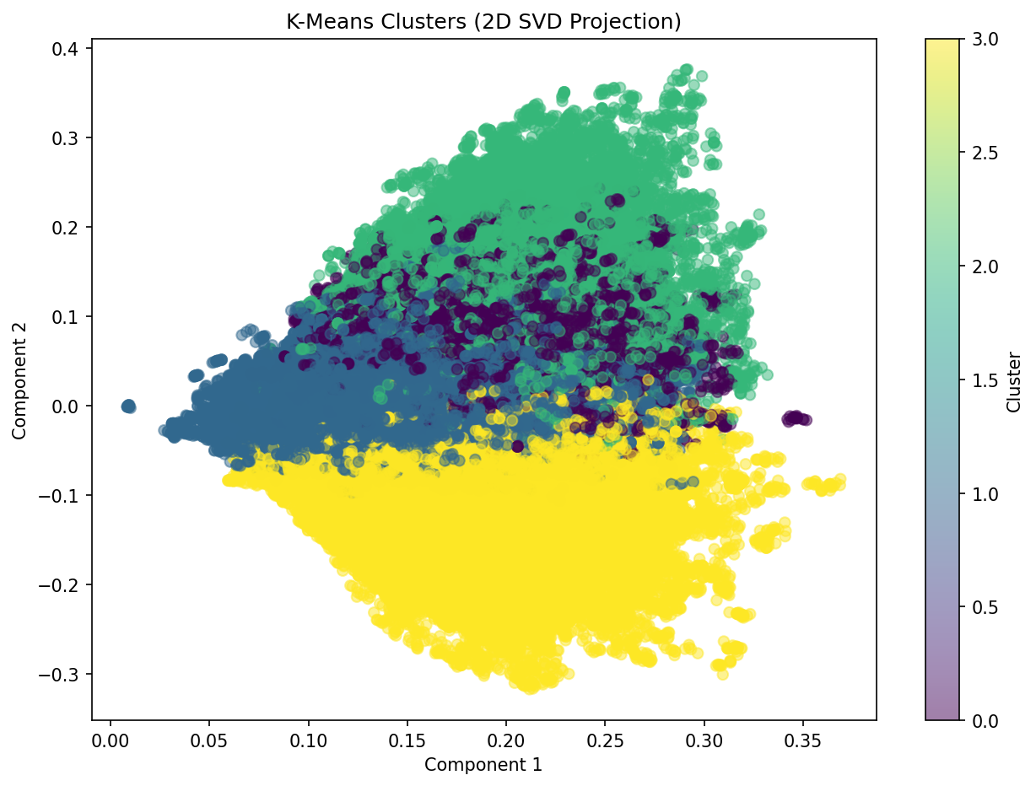
INTERPRETATION OF RESULTS
TF-IDF Insights: Highlighted the most distinguishing keywords for different topics, effectively filtering out common "noise" words.
SVD Dimensionality: Showed that the complex text data could be reduced to a smaller number of core concepts without losing significant meaning, improving computational efficiency.
Cluster Meanings (K-Means): The algorithm created 4 distinct clusters that indicate different vocabulary,contextual structure and subject.

Slide 7
PREPROCESSING
Loaded raw train and test datasets using pandas
Cleaned textual data by:
  Converting text to lowercase
  Removing punctuation marks
Applied preprocessing to key text columns:
  Article
  Question
  Options A, B, C, and D
Created cleaned versions of text features (clean_article, clean_question, etc.)
Saved cleaned datasets into processed data files
Combined article and question text for feature extraction
Built a Bag-of-Words representation using CountVectorizer
Limited vocabulary size to the top 5000 features
Converted textual data into sparse numerical feature matrices
Transformed both training and testing datasets using the same vectorizer
Saved the trained vectorizer model using Joblib
Stored processed sparse matrices (X_train, X_test) for machine learning tasks
Prepared structured numerical input suitable for NLP classification models

Slide 8
MODEL SELECTION
The Goal: We needed models that handle text classification well without being overly complex or resource-heavy.
Traditional Baseline Models: Selected Naive Bayes (excellent for baseline text classification based on probability) and Logistic Regression (strong linear classifier for establishing feature weights).
The Final Choice (Ensemble): We opted for a Soft Voting Ensemble.
Instead of relying on a single algorithm, the ensemble averages the predicted probabilities of the underlying models (Naive Bayes, Logistic Regression, etc.), resulting in a more robust and accurate final prediction than any individual model could achieve alone.

Slide 9
MODEL TRAINING
Data Splitting: Divided the preprocessed RACE dataset into training (e.g., 80%) and testing (20%) sets.
Individual Training: Fit the Naive Bayes and Logistic Regression models on the training data using the TF-IDF features.
Ensemble Integration: Combined the trained traditional models into the soft voting classifier, tuning it to balance the weight of each base model's input.
Unsupervised Training: Separately fit the K-Means and SVD models on the dataset to establish the clustering definitions.

Slide 10
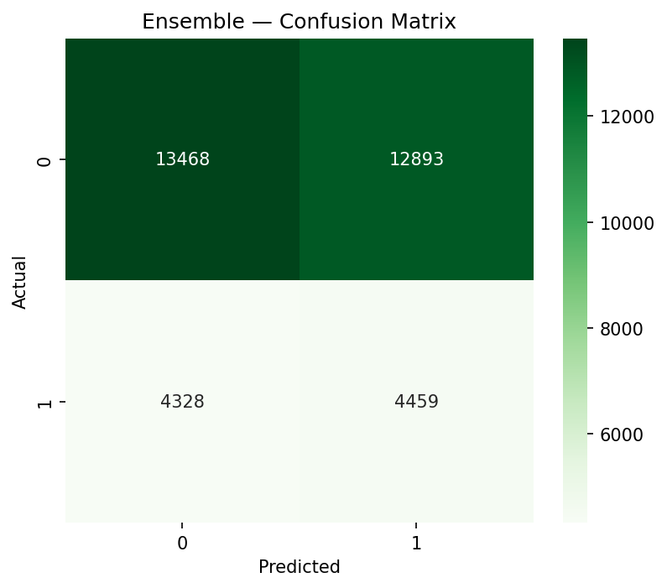
MODEL TESTING/RESULTS
Testing Methodology: Ran the unseen 20% test data through the trained ensemble model.
Pipeline Verification: Ensured the test data went through the exact same NLTK preprocessing and vectorization steps before inference.
This confusion matrix visualizes the performance of our Soft Voting Ensemble.
The relatively even split between correct predictions (on the diagonal) and incorrect predictions (the off-diagonal) shows that the model performs at roughly 51% accuracy across both classes.

Slide 11
PERFORMANCE
ACCURACY: 51%
PRECISION: 26%
RECALL: 51%
F1 SCORE: 34.5%

