Slide 1
Functional Dependency
Formal Definition: Attribute B is functionally dependant upon attribute A (or a collection of attributes) if a value of A determines a single value of attribute B at any one time.
Formal Notation: A → B This should be read as ‘A determines B’ or ‘B is functionally dependant on A’. A is called the determinant and B is called the object of the determinant.
Example:
Functional Dependencies
staffNo job dept dname
SL10 Salesman 10 Sales
SA51 Manager 20 Accounts
DS40 Clerk 20 Accounts
OS45 Clerk 30 Operations
staffNo → job
staffNo → dept
staffNo → dname
dept → dname

Slide 2
Partial Functional Dependency
Partial Functional Dependency: This is the situation that exists if it is necessary to only use a subset of the attributes of the composite determinant to identify its object uniquely.
Example:
Full Functional Dependencies
Student# Crs# CrsName grade
(Student#, Crs#) → grade
Partial Functional Dependencies
Crs# → CrsName

Slide 3
Full Functional Dependency
Full Functional Dependency: Only of relevance with composite determinants. This is the situation when it is necessary to use all the attributes of the composite determinant to identify its object uniquely.
Example:
Full Functional Dependencies
order# Pd# qty price
A001 001 10 200
A002 001 20 400
A002 002 20 800
A004 001 15 300
(Order#, Pd#) → qty
(Order#, Pd#) → price

Slide 4
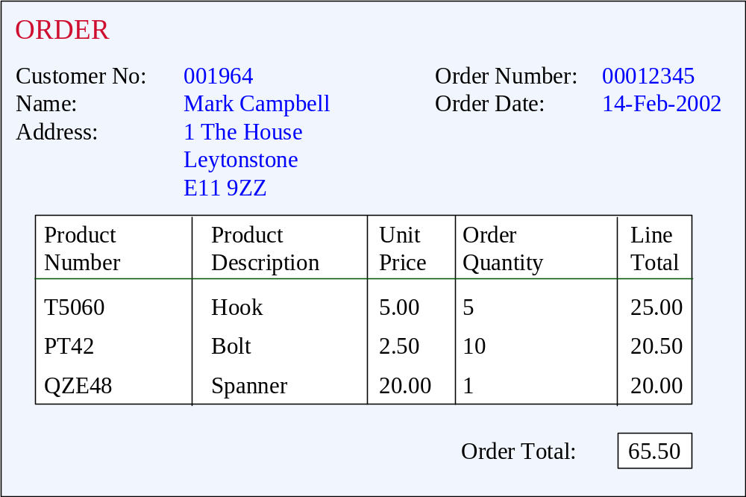
Unnormalised Normal Form (UNF)
ORDER (order-no, order-date, cust-no, cust-name, cust-add,
(prod-no, prod-desc, unit-price, ord-qty, line-total)*, order-total

Slide 5
First Normal Form (1NF)
Definition: A relation is in 1NF if, and only if, all its underlying attributes contain atomic values only.
Remove repeating groups into a new relation
A repeating group is shown by a pair of brackets within the relational schema.
ORDER (order-no, order-date, cust-no, cust-name, cust-add,
(prod-no, prod-desc, unit-price, ord-qty, line-total)*, order-total

Slide 6
Steps from UNF to 1NF:
Remove the outermost repeating group (and any nested repeated groups it may contain) and create a new relation to contain it.
Add to this relation a copy of the PK of the relation immediately enclosing it.
Name the new entity (appending the number 1 to indicate 1NF)
Determine the PK of the new entity
Repeat steps until no more repeating groups.

Slide 7
Example - UNF to 1NF
ORDER (order-no, order-date, cust-no, cust-name, cust-add,
(prod-no, prod-desc, unit-price, ord-qty, line-total)*, order-total
1. Remove the outermost repeating group (and any nested repeated groups it may contain) and create a new relation to contain it. (rename original to indicate 1NF)
ORDER-1 (order-no, order-date, cust-no, cust-name, cust-add, order-total
(prod-no, prod-desc, unit-price, ord-qty, line-total)
2. Add to this relation a copy of the PK of the relation immediately enclosing it.
ORDER-1 (order-no, order-date, cust-no, cust-name, cust-add, order-total
(order-no, prod-no, prod-desc, unit-price, ord-qty, line-total)
3. Name the new entity (appending the number 1 to indicate 1NF)
ORDER-LINE-1 (order-no, prod-no, prod-desc, unit-price, ord-qty, line-total)
4. Determine the PK of the new entity
ORDER-LINE-1 (order-no, prod-no, prod-desc, unit-price, ord-qty, line-total)

Slide 8
Second Normal Form (2NF)
Definition: A relation is in 2NF if, and only if, it is in 1NF and every non-key attribute is fully dependent on the primary key.
Remove partial functional dependencies into a new relation

Slide 9
Steps from 1NF to 2NF:
Remove the offending attributes that are only partially functionally dependent on the composite key, and place them in a new relation.
Add to this relation a copy of the attribute(s) which are the determinants of these offending attributes. These will automatically become the primary key of this new relation.
Name the new entity (appending the number 2 to indicate 2NF)
Rename the original entity (ending with a 2 to indicate 2NF)

Slide 10
Example - 1NF to 2NF
ORDER-LINE-1 (order-no, prod-no, prod-desc, unit-price, ord-qty, line-total)
1. Remove the offending attributes that are only partially functionally dependent on the composite key, and place them in a new relation.
ORDER-LINE-1 (order-no, prod-no, ord-qty, line-total)
(prod-desc, unit-price)
2. Add to this relation a copy of the attribute(s) which determines these offending attributes. These will automatically become the primary key of this new relation..
ORDER-LINE-1 (order-no, prod-no, ord-qty, line-total)
(prod-no, prod-desc, unit-price)
3. Name the new entity (appending the number 2 to indicate 2NF)
PRODUCT-2 (prod-no, prod-desc, unit-price)
4. Rename the original entity (ending with a 2 to indicate 2NF)
ORDER-LINE-2 (order-no, prod-no, ord-qty, line-total)

Slide 11
Third Normal Form (3NF)
Definition: A relation is in 3NF if, and only if, it is in 2NF and every non-key attribute is non-transitively dependent on the primary key.
Remove transitive dependencies into a new relation

Slide 12
Steps from 2NF to 3NF:
Remove the offending attributes that are transitively dependent on non-key attribute(s), and place them in a new relation.
Add to this relation a copy of the attribute(s) which are the determinants of these offending attributes. These will automatically become the primary key of this new relation.
Name the new entity (appending the number 3 to indicate 3NF)
Rename the original entity (ending with a 3 to indicate 3NF)

Slide 13
Example - 2NF to 3NF
ORDER-2 (order-no, order-date, cust-no, cust-name, cust-add, order-total
1. Remove the offending attributes that are transitively dependent on non-key attributes, and place them in a new relation.
ORDER-2 (order-no, order-date, cust-no, order-total
(cust-name, cust-add )
2. Add to this relation a copy of the attribute(s) which determines these offending attributes. These will automatically become the primary key of this new relation..
ORDER-2 (order-no, order-date, cust-no, order-total
(cust-no, cust-name, cust-add )
3. Name the new entity (appending the number 3 to indicate 3NF)
CUSTOMER-3 (cust-no, cust-name, cust-add )
4. Rename the original entity (ending with a 3 to indicate 3NF)
ORDER-3 (order-no, order-date, cust-no, order-total

Slide 14
Example - Relations in 3NF
ORDER-3 (order-no, order-date, cust-no, order-total
CUSTOMER-3 (cust-no, cust-name, cust-add )
PRODUCT-2 (prod-no, prod-desc, unit-price)
ORDER-LINE-2 (order-no, prod-no, ord-qty, line-total)
prod-no
order-no
PRODUCT
ORDER
places
contains
shows
placed by
belongs to
cust-no
order-no, prod-no
CUSTOMER
part of
ORDER-LINE

Slide 15
Stages of Normalisation
Unnormalised
(UDF)
Remove repeating groups
First normal form
(1NF)
Remove partial dependencies
Second normal form
(2NF)
Remove transitive dependencies
Third normal form
(3NF)

