Slide 1
Course Project
Typing Master Application

Slide 2


PRIME MINISTER’S KAMYAB NOJAWAN PROGRAM
Group Members:
Zohaib ul Hassan
Daniyal Shehzad Dar

Slide 3
What is
Typing Master App
Typing Speed Calculating app which is made on the idea of improving vocabulary mistakes which we done in our daily lives .This app has a vast library where all important words are listed in bunch .We also include time and score feature in this app which gives user a target to complete more problem

Slide 4

What makes it Different ?
We Use Famous language python programming language to give it extra strength moreover for make it user friendly we use tkinter library to setup optimal screen feature which makes user compatible with any type of screen such as mobile ,laptop , Pc and other. We also use exception handling feature to avoid crash in runtime

Slide 5
Advantages:
It can be used to improve vocabulary and typing speed
The user can track his progress overtime as he improves he's typing speed and vocabulary

Slide 6
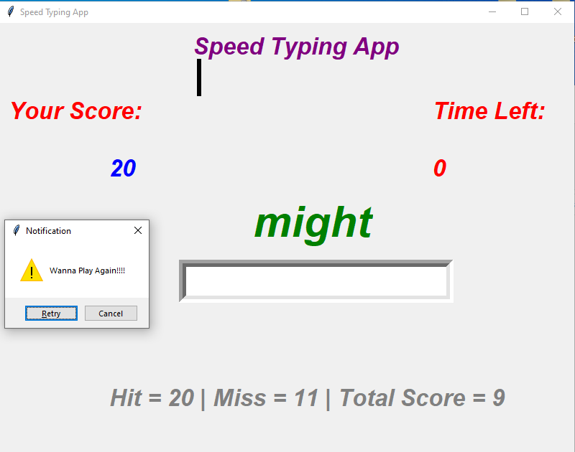
APP Template

Slide 7
Thankyou

