Slide 1




PRIME FITNESS
A Gym Management System
by VeloTech
Zohaib Hassan
Fahad Faisal

Slide 2


Slide 3
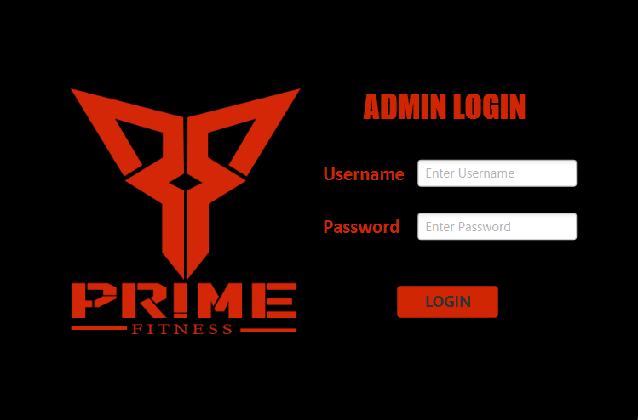

Slide 4
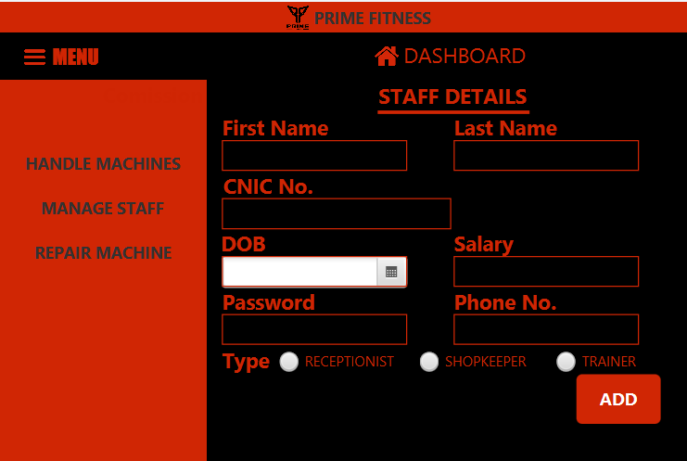

Slide 5
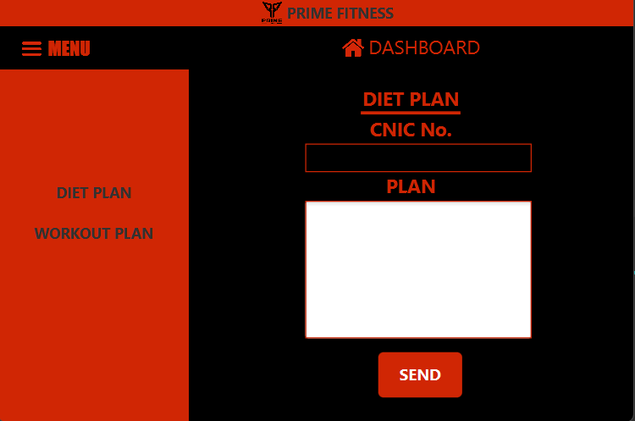

Slide 6
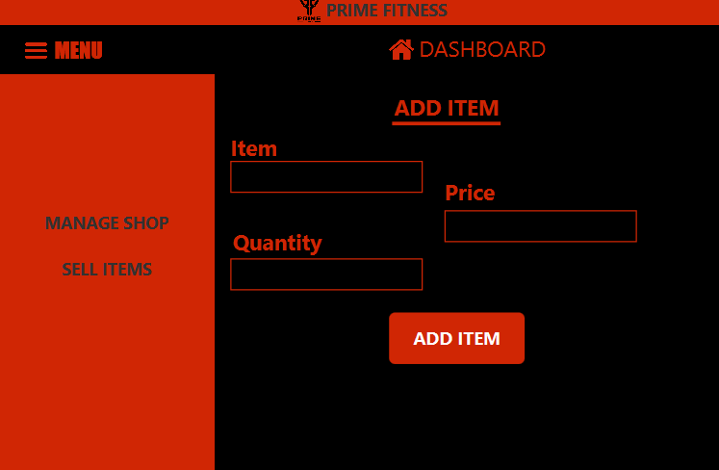

Slide 7
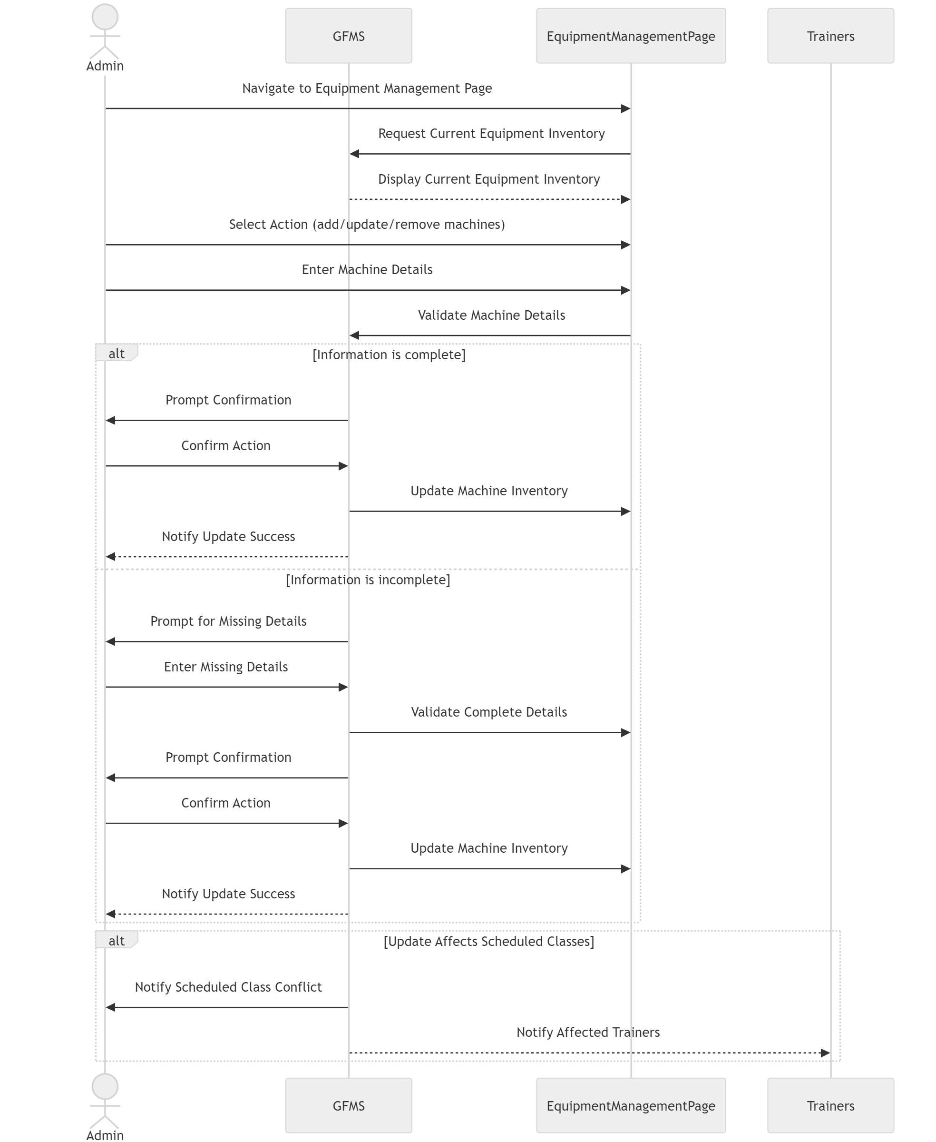

Slide 8
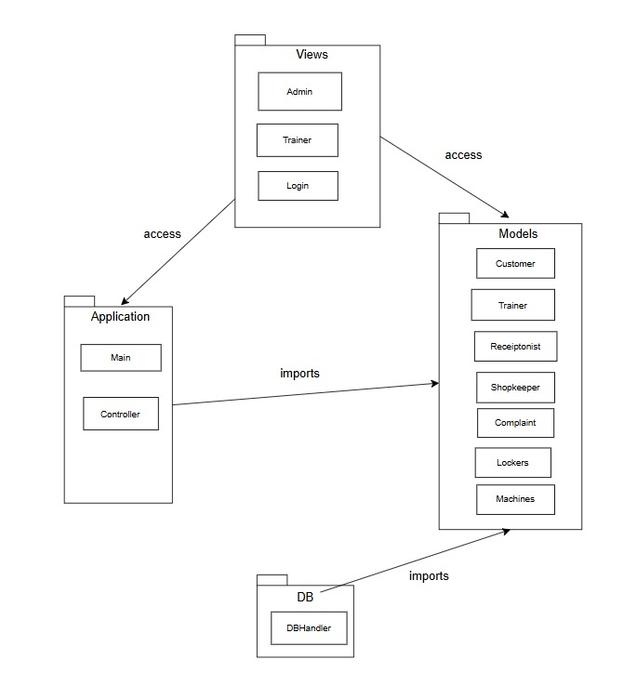
Package Diagram

Slide 9
THANK YOU!

