Slide 1
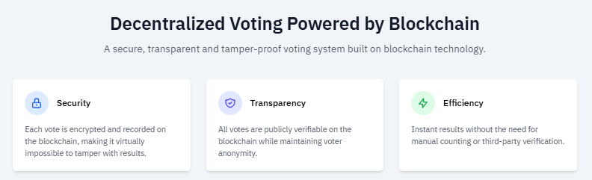
INTRODUCTION Blockchain Voting System: Revolutionizing Elections
Exploring a secure, transparent, and accessible future for elections through blockchain technology.

Slide 2
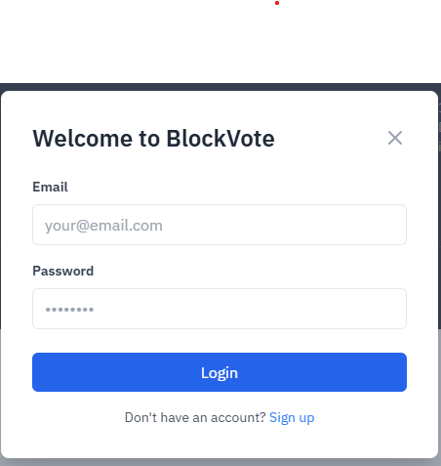
Problem 1: User Access & Security
How do we ensure only eligible individuals can participate in
voting?
Unauthorized access and
multiple votes from a
single entity pose significant
risks.
A robust authentication
mechanism is crucial for
system integrity.

Slide 3
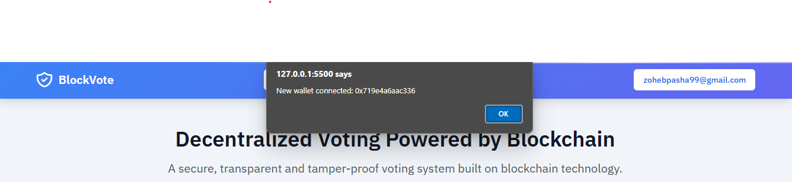
Solution 1: Authenticated Access
Implemented a secure login and signup system.
Users must authenticate before accessing voting features.
This prevents unauthorized participation and maintains voter integrity.

Slide 4
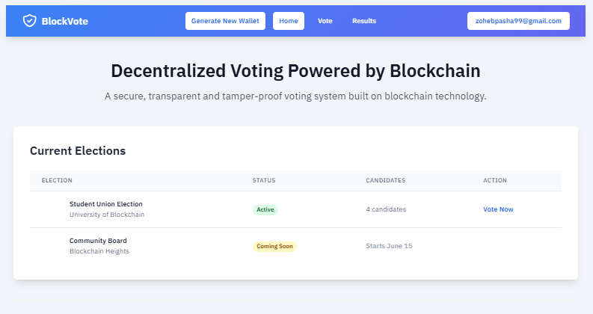
Problem 2: Vote Integrity & Trust
Traditional voting systems
often face skepticism
regarding vote manipulation.
Voters need assurance that
their vote is accurately
recorded and unalterable.
Ensuring transparency and
preventing fraud are
paramount for public trust

Slide 5
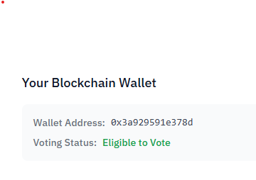
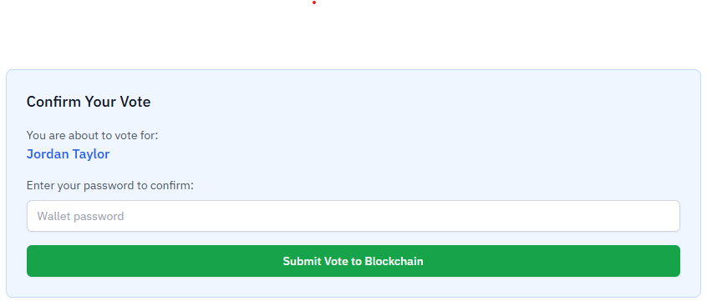
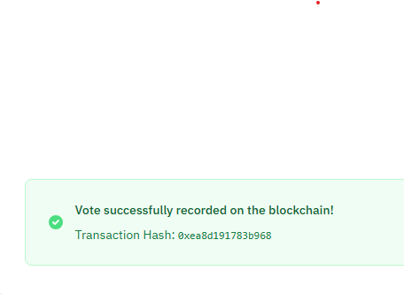
Solution 2: Blockchain Immutability
Votes are recorded as
transactions on a blockchain.
This makes each vote
immutable and tamper-proof.
Blockchain technology
inherently provides
transparency and security.

Slide 6
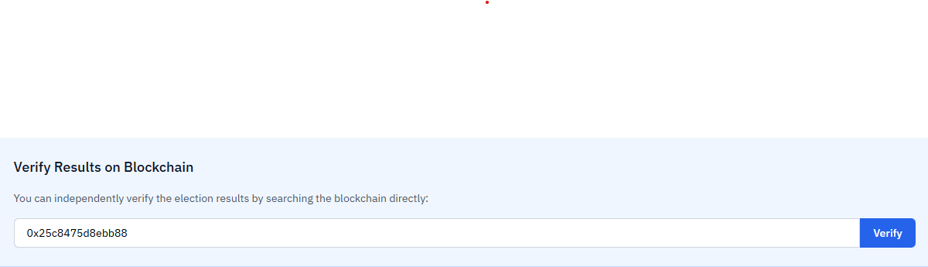
Problem 3: Result Verification & Transparency
Voters often lack a direct way to confirm their vote was counted correctly.
The process of auditing election results can be
complex and non-transparent.
Independent verification is essential for building
confidence in the outcome

Slide 7
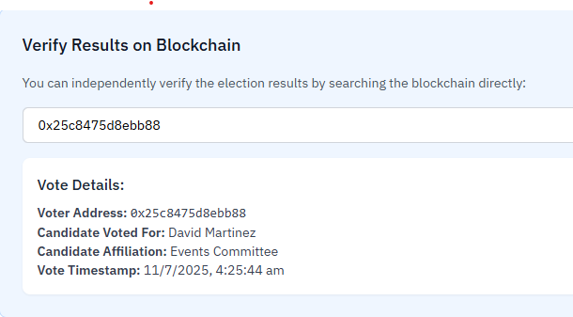
Solution 3: On-Chain Verification
Users can verify their specific vote directly on the blockchain.
Inputting a wallet address reveals vote details and timestamp.
This provides an auditable and transparent record for every voter

Slide 8
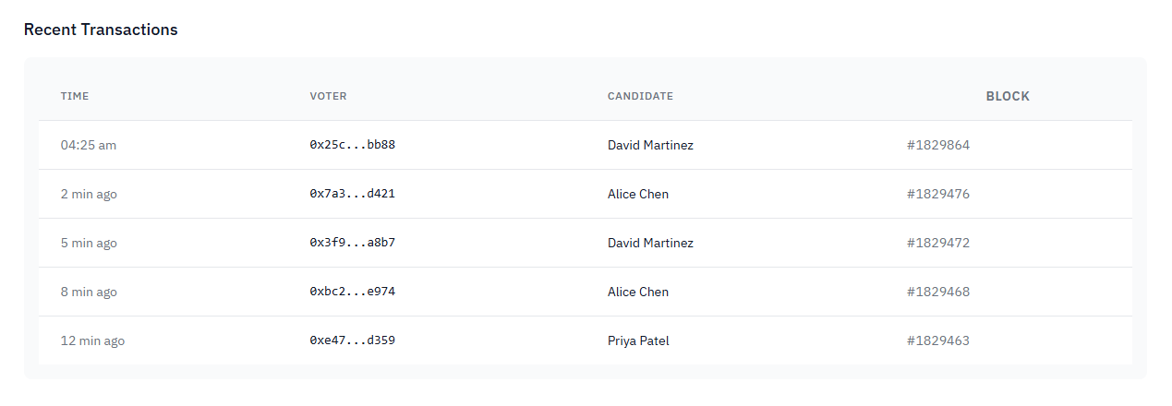
Problem 4: Real-time Result Accessibility
Access to election results is
often delayed or presented
opaquely.
Stakeholders require
immediate and clear
insights into voting
progress.
A dynamic display of vote
distribution enhances
engagement and trust.

Slide 9
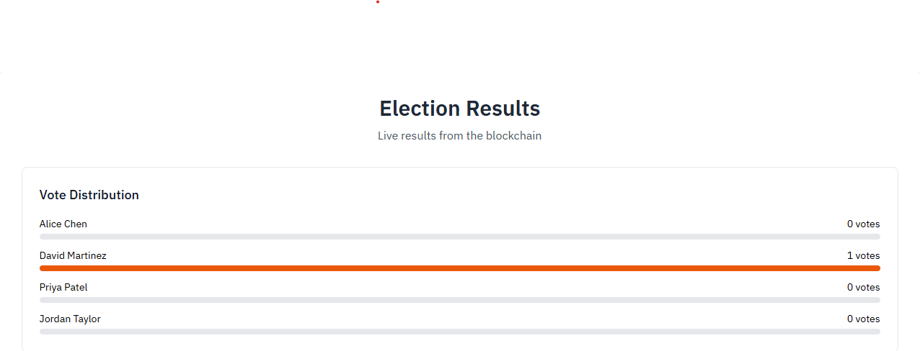
Solution 4: Dynamic Result Display
Provides a live "Results Page" with real-time vote distribution.
Displays recent transactions, showing who voted for whom.
Offers immediate, transparent insights into election progress.

Slide 10
THANKYOU

