Slide 1
UNIQUE FACE OBJECT
Presented by : Private Label (UFO Team) Team Member : Vilas Zade, Abhilash Acharya, Rohit Singh, Sandeep Gulati & Kishan Bhalotiya

Slide 2
UFO : UNIQUE FACE OBJECT
Introduction
Why ?
Where ?
How it works ?
Enhancement ?

Slide 3
Introduction
A Unique Face Object system is a computer based web application capable of identifying or verifying a person from a digital image.
One of the ways to do this is by comparing selected facial features from the image and a facial database.
Some of the popular techniques
Traditional
3-D
Skin texture analysis
Notes:
It is typically used in security systems and can be compared to other biometrics such as fingerprint or eye iris recognition systems. Generally access codes for buildings, banks accounts and computer systems often use PIN's for identification and security clearances. Using the proper PIN gains access, but the user of the PIN is not verified. Unique Face Object may solve this problem since a face is undeniably connected to its owner expect
in the case of identical twins.

Slide 4
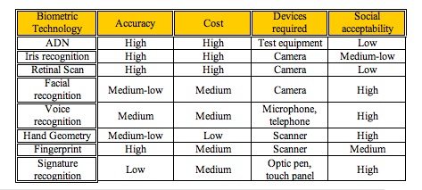
Why UFO ?
Why ?
Non intrusive
Cheap technology
Notes:
The following table compares some of the biometric systems used lately,
from the point of view of accuracy, cost, devices required and social
acceptability.

Slide 5
Where ?
To catch traffic rule violations
Access Control
Security (i.e. IT ,Passport , police verification etc…..)
Notes:
Surveillance and police verification

Slide 6
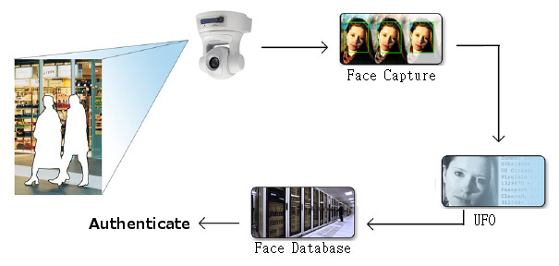
How it Works ?

Slide 7
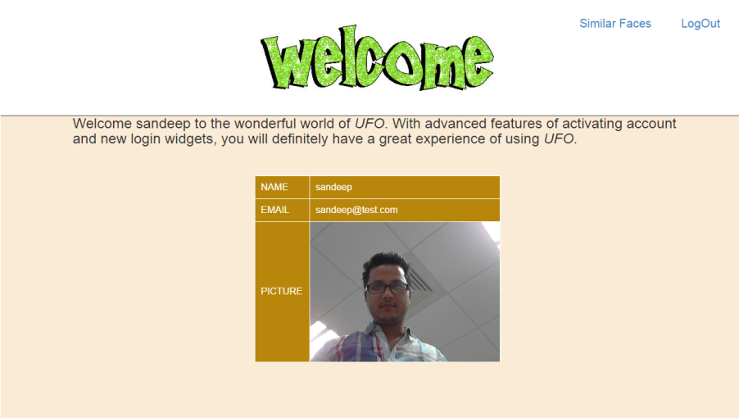

Similar Faces
Notes:
Similar faces will show all the similar faces from database

Slide 8
Enhancement
Pixel Auto Detect
Retina Scan
Finger Print Scan
Shadow verification

Slide 9

Questions ?

Slide 10
Thank You!

