Slide 1
Illumination

Slide 2
Contents
Today we will start to look at illumination models in computer graphics
  Why do we need illumination models?
  Different kinds of lights
  Different kinds of reflections
  Basic lighting model

Slide 3

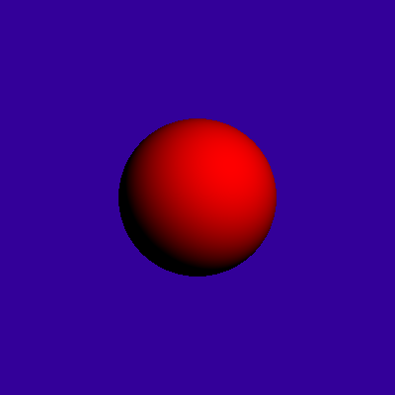
Why Lighting?
If we don’t have lighting effects nothing looks three dimensional!

Slide 4
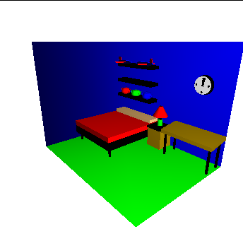
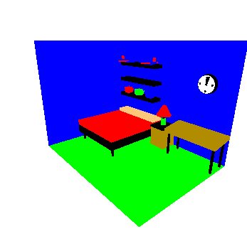
Why Lighting? (cont…)

Slide 5
Point Light Sources
A point source is the simplest
model we can use for a light
source
We simply define:
  The position of the light
  The RGB values for the colour of the light
Light is emitted in all directions
Useful for small light sources

Slide 6
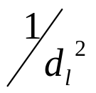
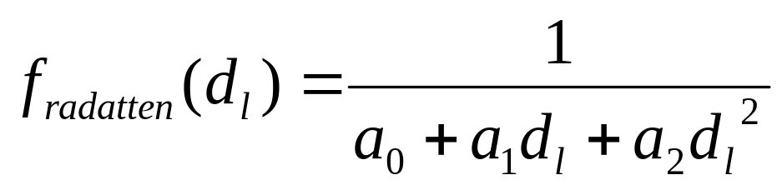
Radial Intensity Attenuation
As light moves from a light source its intensity diminished
At any distance d_{l} away from the light source the intensity diminishes by a factor of
However, using the factor does not produce very good results so we use something different
We use instead in inverse quadratic function of the form:
where the coefficients a₀, a₁, and a₂ can be varied to produce optimal results

Slide 7
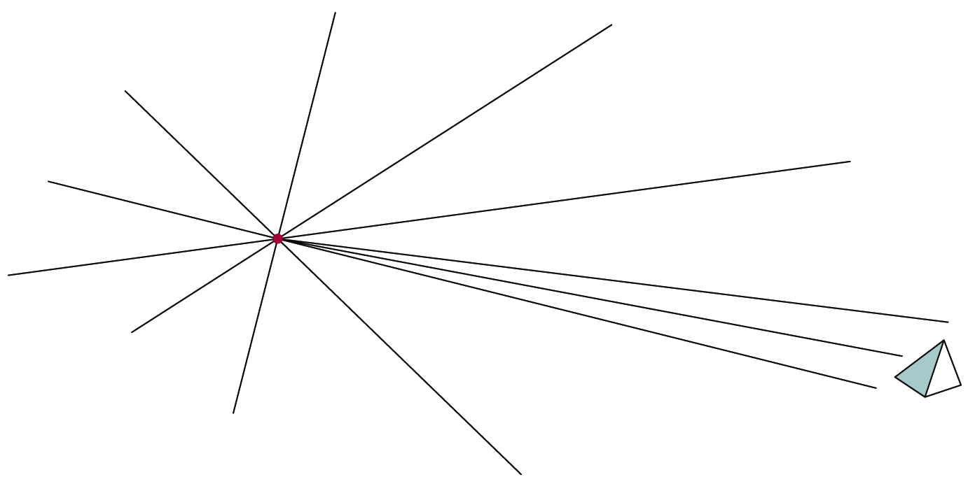
Infinitely Distant Light Sources
A large light source, like the sun, can be modelled as a point light source
However, it will have very little directional effect
Radial intensity attenuation is not used

Slide 8
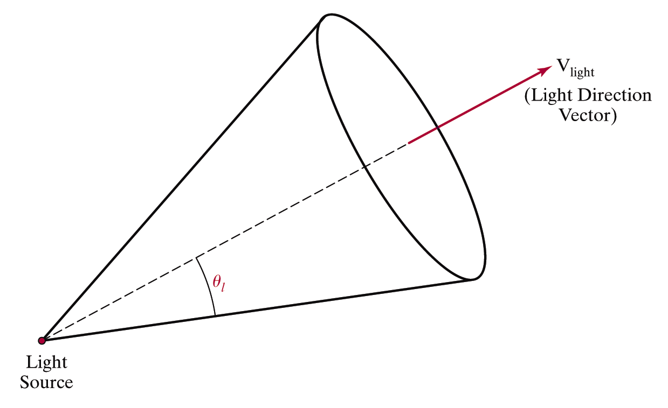
Directional Light Sources & Spotlights
To turn a point light source into a spotlight we simply add a vector direction and an angular limit θ_{l}

Slide 9
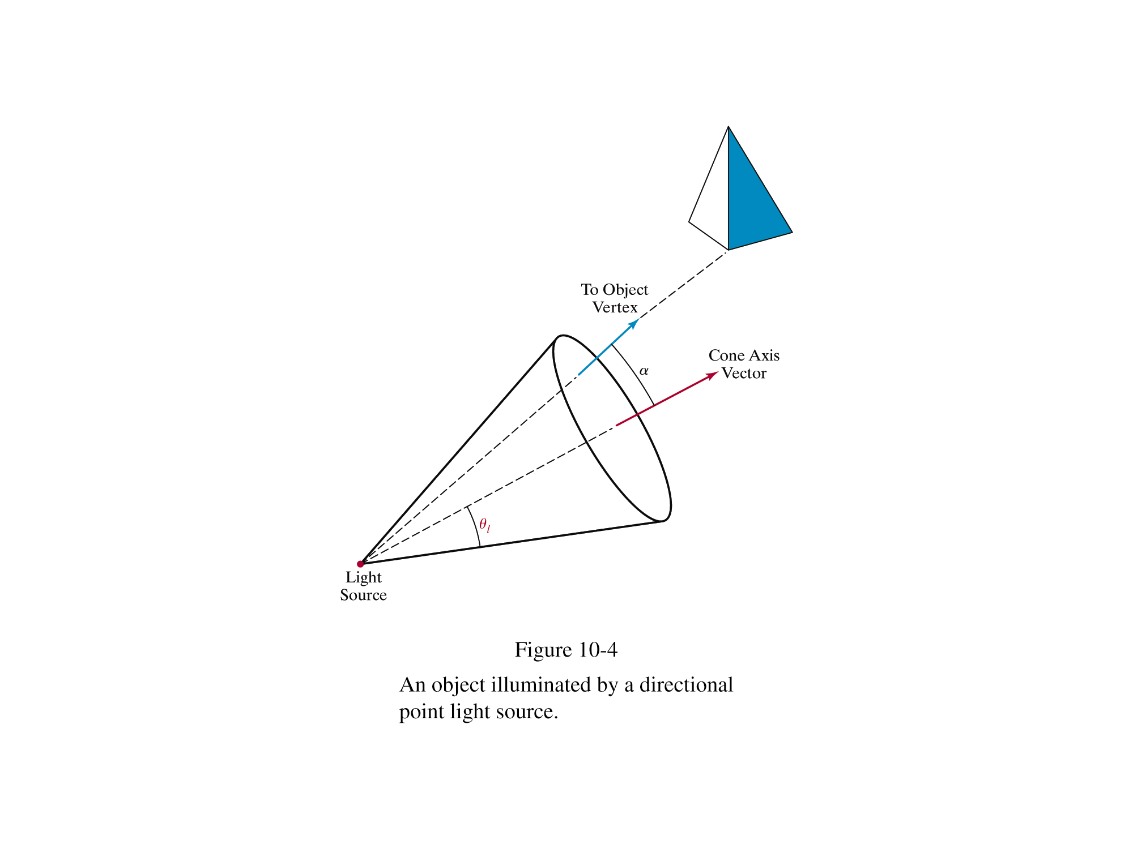
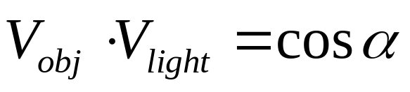
Directional Light Sources & Spotlights
We can denote V_{light} as the unit vector
in the direction of the light and V_{obj}
as the unit vector from the light
source to an object
The dot-product of these
two vectors gives us the
angle between them
If this angle is inside the light’s angular limit then the object is within the spotlight

Slide 10
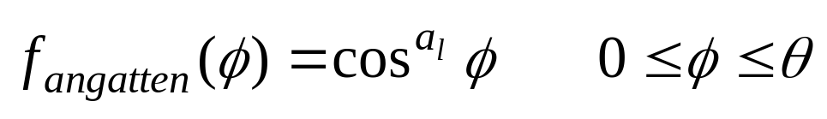

Angular Intensity Attenuation
As well as light intensity decreasing as we move away from a light source, it also decreases angularly
A commonly used function for calculating angular attenuation is:
where the attenuation exponent a_{l} is assigned some positive value and angle is measured from the cone axis

Slide 11

Reflected Light
The colours that we perceive are determined by the nature of the light reflected from an object
For example, if white
light is shone onto a
green object most
wavelengths are
absorbed, while green
light is reflected from
the object
White Light
Colours Absorbed
Green Light

Slide 12
Surface Lighting Effects
The amount of incident light reflected by a surface depends on the type of material
Shiny materials reflect more of the incident light and dull surfaces absorb more of the incident light
For transparent surfaces some of the light is also transmitted through the material

Slide 13
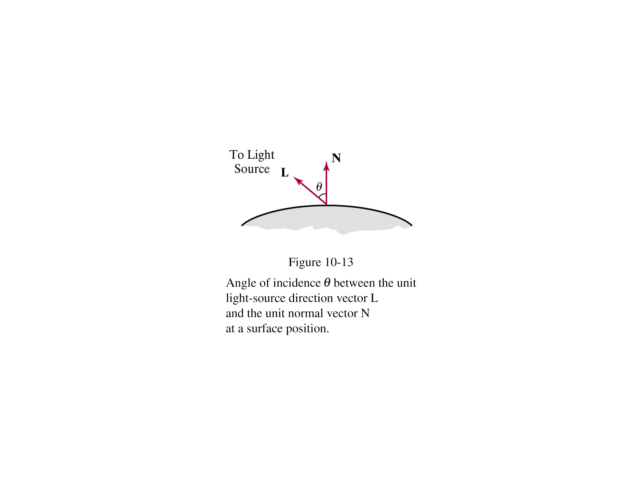
Diffuse Reflection
Surfaces that are rough or grainy tend to reflect light in all directions
This scattered light is called diffuse reflection

Slide 14
Specular Reflection
Additionally to diffuse reflection some of the reflected light is concentrated into a highlight or bright spot
This is called specular reflection

Slide 15

Ambient Light
A surface that is not exposed to direct light may still be lit up by reflections from other nearby objects – ambient light
The total reflected light from a surface is the sum of the contributions from light
sources and reflected
light

Slide 16
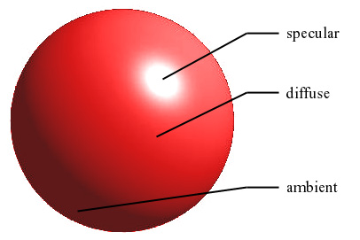
Example

Slide 17
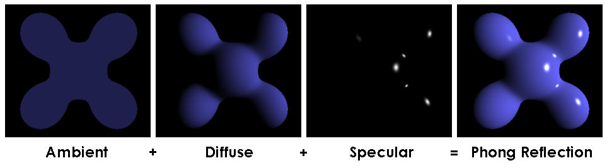
Example
Ambient
Diffuse
Final
Image
Specular

Slide 18
Basic Illumination Model
We will consider a basic illumination model which gives reasonably good results and is used in most graphics systems
The important components are:
  Ambient light
  Diffuse reflection
  Specular reflection
  Emissive light
For the most part we will consider only monochromatic light

Slide 19
Ambient Light
To incorporate background light we simply set a general brightness level for a scene
This approximates the global diffuse reflections from various surfaces within the scene
We will denote this value as I_{a}

Slide 20
Diffuse Reflection
First we assume that surfaces reflect incident light with equal intensity in all directions
Such surfaces are referred to as ideal diffuse reflectors or Lambertian reflectors

Slide 21
Diffuse Reflection (cont…)
A parameter k_{d} is set for each surface that determines the fraction of incident light that is to be scattered as diffuse reflections from that surface
This parameter is known as the diffuse-reflection coefficient or the diffuse reflectivity
k_{d} is assigned a value between 0.0 and 1.0
  0.0: dull surface that absorbs almost all light
  1.0: shiny surface that reflects almost all light

Slide 22
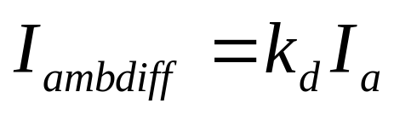
Diffuse Reflection – Ambient Light
For background lighting effects we can assume that every surface is fully illuminated by the scene’s ambient light I_{a}
Therefore the ambient contribution to the diffuse reflection is given as:
Ambient light alone is very uninteresting so we need some other lights in a scene as well

Slide 23
Diffuse Reflection (cont…)
When a surface is illuminated by a light source, the amount of incident light depends on the orientation of the surface relative to the light source direction
N
N
L
L

Slide 24
Diffuse Reflection
The angle between the incoming light direction and a surface normal is referred to as the angle of incidence given as θ

Slide 25
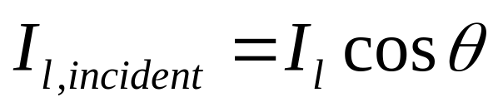
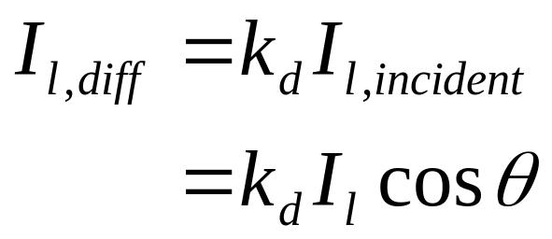
Diffuse Reflection (cont…)
So the amount of incident light on a surface is given as:
So we can model the diffuse reflections as:

Slide 26
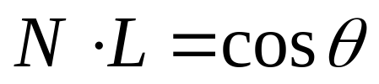
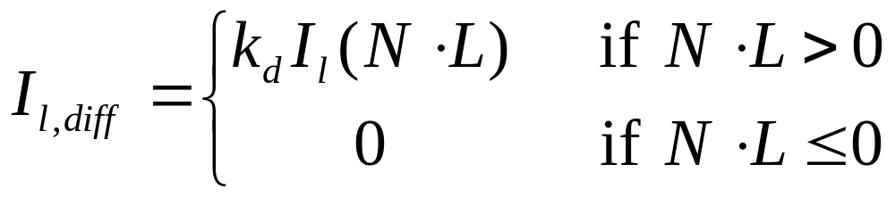
Diffuse Reflection (cont…)
Assuming we denote the
normal for a surface as N
and the unit direction
vector to the light source
as L then:
So:

Slide 27
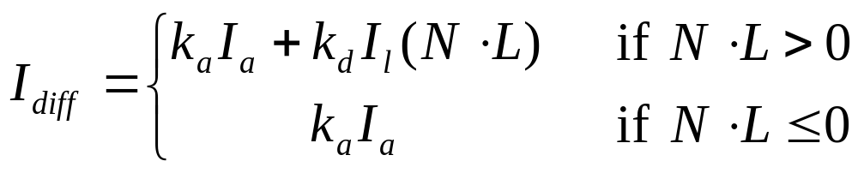
Combining Ambient And Incident Diffuse Reflections
To combine the diffuse reflections arising from ambient and incident light most graphics packages use two separate diffuse-reflection coefficients:
  k_{a} for ambient light
  k_{d} for incident light
The total diffuse reflection equation for a single point source can then be given as:

Slide 28
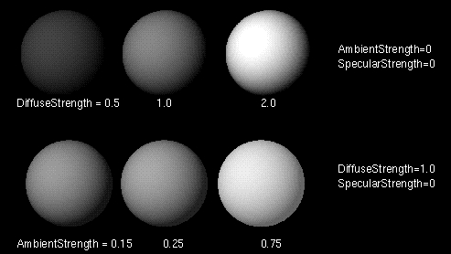
Examples

Slide 29
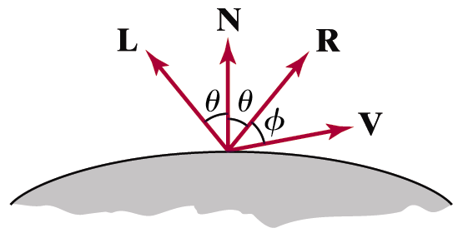
Specular Reflection
The bright spot that we see on a shiny surface is the result of near total of the incident light in a concentrated region around the specular reflection angle
The specular reflection angle equals the angle of the incident light

Slide 30
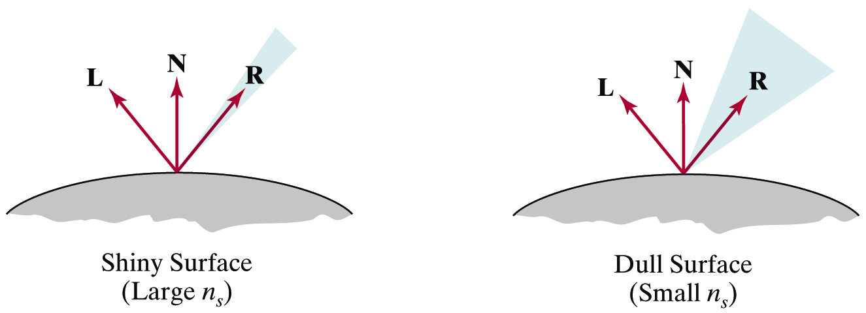
Specular Reflection (cont…)
A perfect mirror reflects light only in the specular-reflection direction
Other objects exhibit specular reflections over a finite range of viewing positions around vector R

Slide 31
The Phong Specular Reflection Model
The Phong specular reflection model or Phong model is an empirical model for calculating specular reflection range developed in 1973 by Phong Bui Tuong
The Phong model sets the intensity of specular reflection as
proportional to the angle
between the viewing
vector and the specular
reflection vector

Slide 32
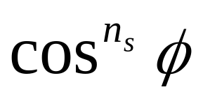
The Phong Specular Reflection Model
So, the specular reflection intensity is proportional to
The angle Φ can be varied between 0° and 90° so that cosΦ varies from 1.0 to 0.0
The specular-reflection exponent, n_{s} is determined by the type of surface we want to display
  Shiny surfaces have a very large value (>100)
  Rough surfaces would have a value near 1

Slide 33
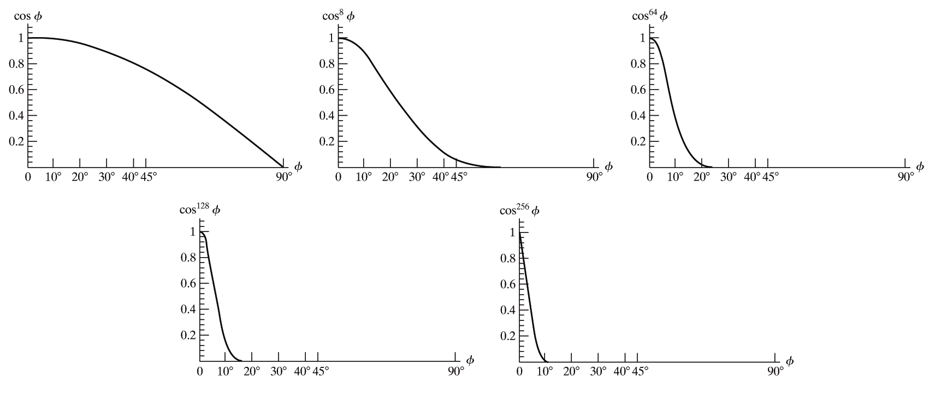
The Phong Specular Reflection Model
The graphs below show the effect of n_{s} on the angular range in which we can expect to see specular reflections

Slide 34
The Phong Specular Reflection Model
For some materials the amount of specular reflection depends heavily on the angle of the incident light
Fresnel’s Laws of Reflection describe in great detail how specular reflections behave
However, we don’t need to worry about this and instead approximate the specular effects with a constant specular reflection coefficient k_{s}

Slide 35
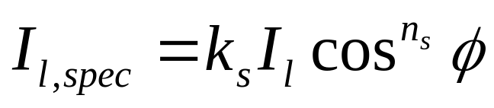
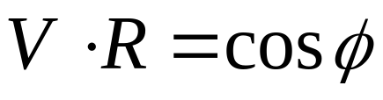
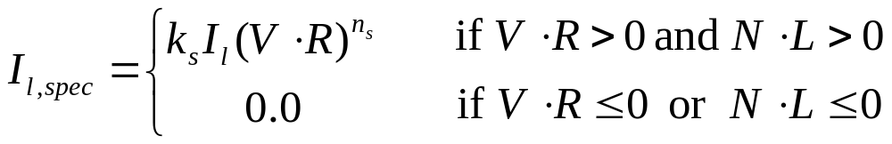
The Phong Specular Reflection Model
So the specular reflection intensity is given as:
Remembering that
We can say:

Slide 36
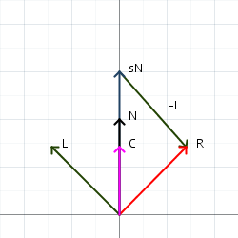



Calculating Reflection Vector

Slide 37
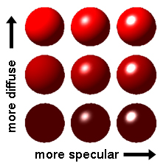
Example

Slide 38
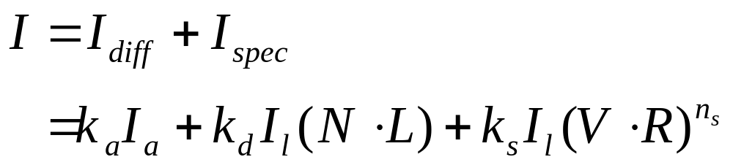
Combining Diffuse & Specular Reflections
For a single light source we can combine the effects of diffuse and specular reflections simply as follows:

Slide 39
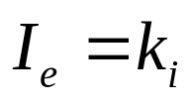
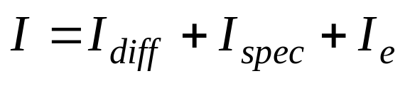
Emission
Some objects are self-luminous
Light intensity due to emission is measured as –
Therefore,

Slide 40
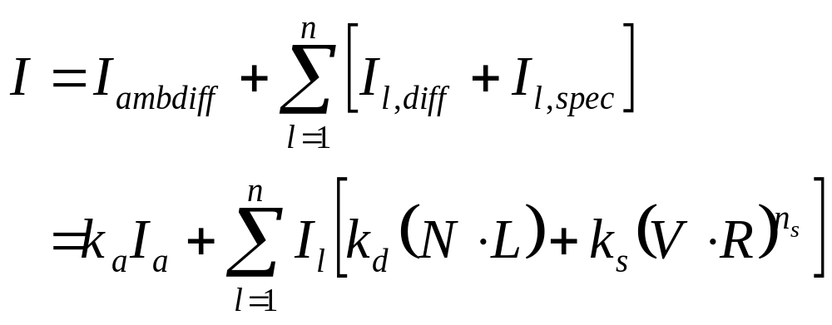
Diffuse & Specular Reflections From Multiple Light Sources
We can place any number of light sources in a scene
We compute the diffuse and specular reflections as sums of the contributions from the various sources

Slide 41
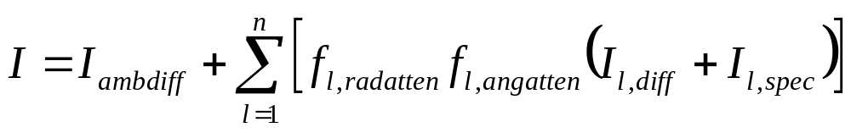
Adding Intensity Attenuation
To incorporate radial and angular intensity attenuation into our model we simply adjust our equation to take these into account
So, light intensity is now given as:
where f_{radatten} and f_{angatten} are as discussed previously

Slide 42
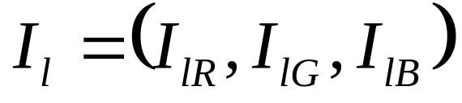
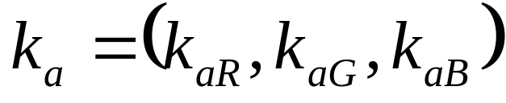
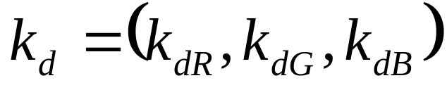

RGB Colour Considerations
For an RGB colour description each intensity specification is a three element vector
So, for each light source:
Similarly all parameters are given as vectors:

Slide 43
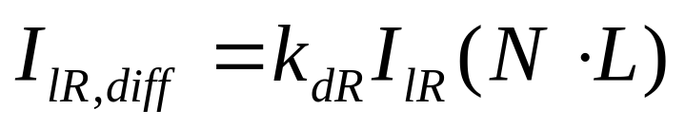
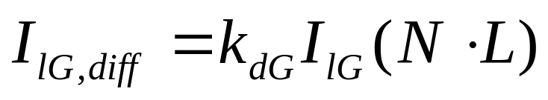

RGB Colour Considerations (cont…)
Each component of the surface colour is then calculated with a separate expression
For example:

Slide 44
Summary
To create realistic (or even semi-realistic) looking scenes we must model light correctly
To successfully model lighting effects we need to consider:
  Ambient light
  Diffuse reflections
  Specular reflections

