Slide 1
Mockups

Slide 2
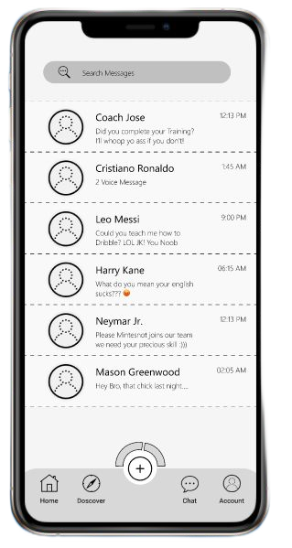
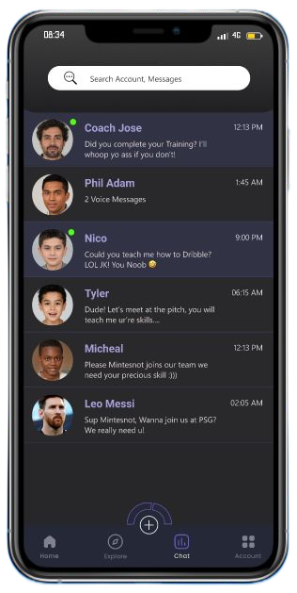
Before usability study
After usability study
Based on the insights from usability studies, I applied a feature changes such as an indication of online users, a dark screen for people who have hard time using app with high brightness

Slide 3
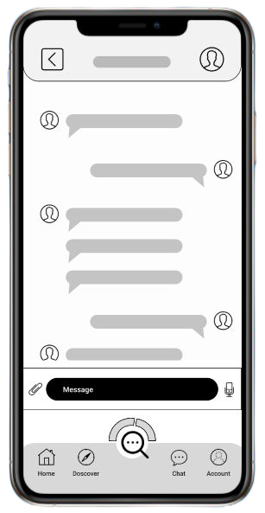
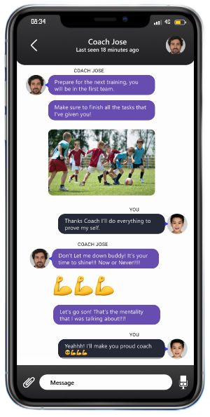
Before usability study
After usability study
A minor change has been added based on research insights, Now the chatting screen has more space and freedom to chat with coaches and scouts. Navigation menu removed from chatting

Slide 4
