Slide 1

Fruit Type Classification Using Deep Learning
Optimizing Agricultural Automation for Indian Markets
Authors: Kishalay Majumder (22052123), Aditya Sharma (22052001)
Guide: Dr. Partha Pratim Sarangi

Slide 2
Index
NO. | TOPIC | PAGE
1 | Introduction | 3
2 | Objectives | 4
3 | Literature Review | 5
4 | Methodology | 6
5 | System Architecture | 7
6 | Implementation Details | 8
7 | Deployment Feasibility | 9
8 | Results and Analysis | 10
9 | Dataset Composition | 11
10 | Conclusion | 12
11 | Future Scope | 13

Slide 3
Introduction
3
• India leads in fruit production but faces post-harvest inefficiencies.
• Manual classification is error-prone and unscalable.
• Solution: Deep learning-based automated fruit classification optimized for Indian mandis.

Slide 4
Objectives
4
• Develop high-accuracy fruit classification model(>90%).
• Ensure real-time inference on edge devices.
• Address lighting, occlusion, and intra-class similarity challenges.

Slide 5
Literature Review
5
Traditional Approaches:
Feature extraction + SVM/k-NN
Poor in real-world variability
Deep Learning Advances:
CNNs for feature extraction
Transfer learning (VGG16, ResNet50)
Hybrid CNN-RNN-LSTM architecture

Slide 6
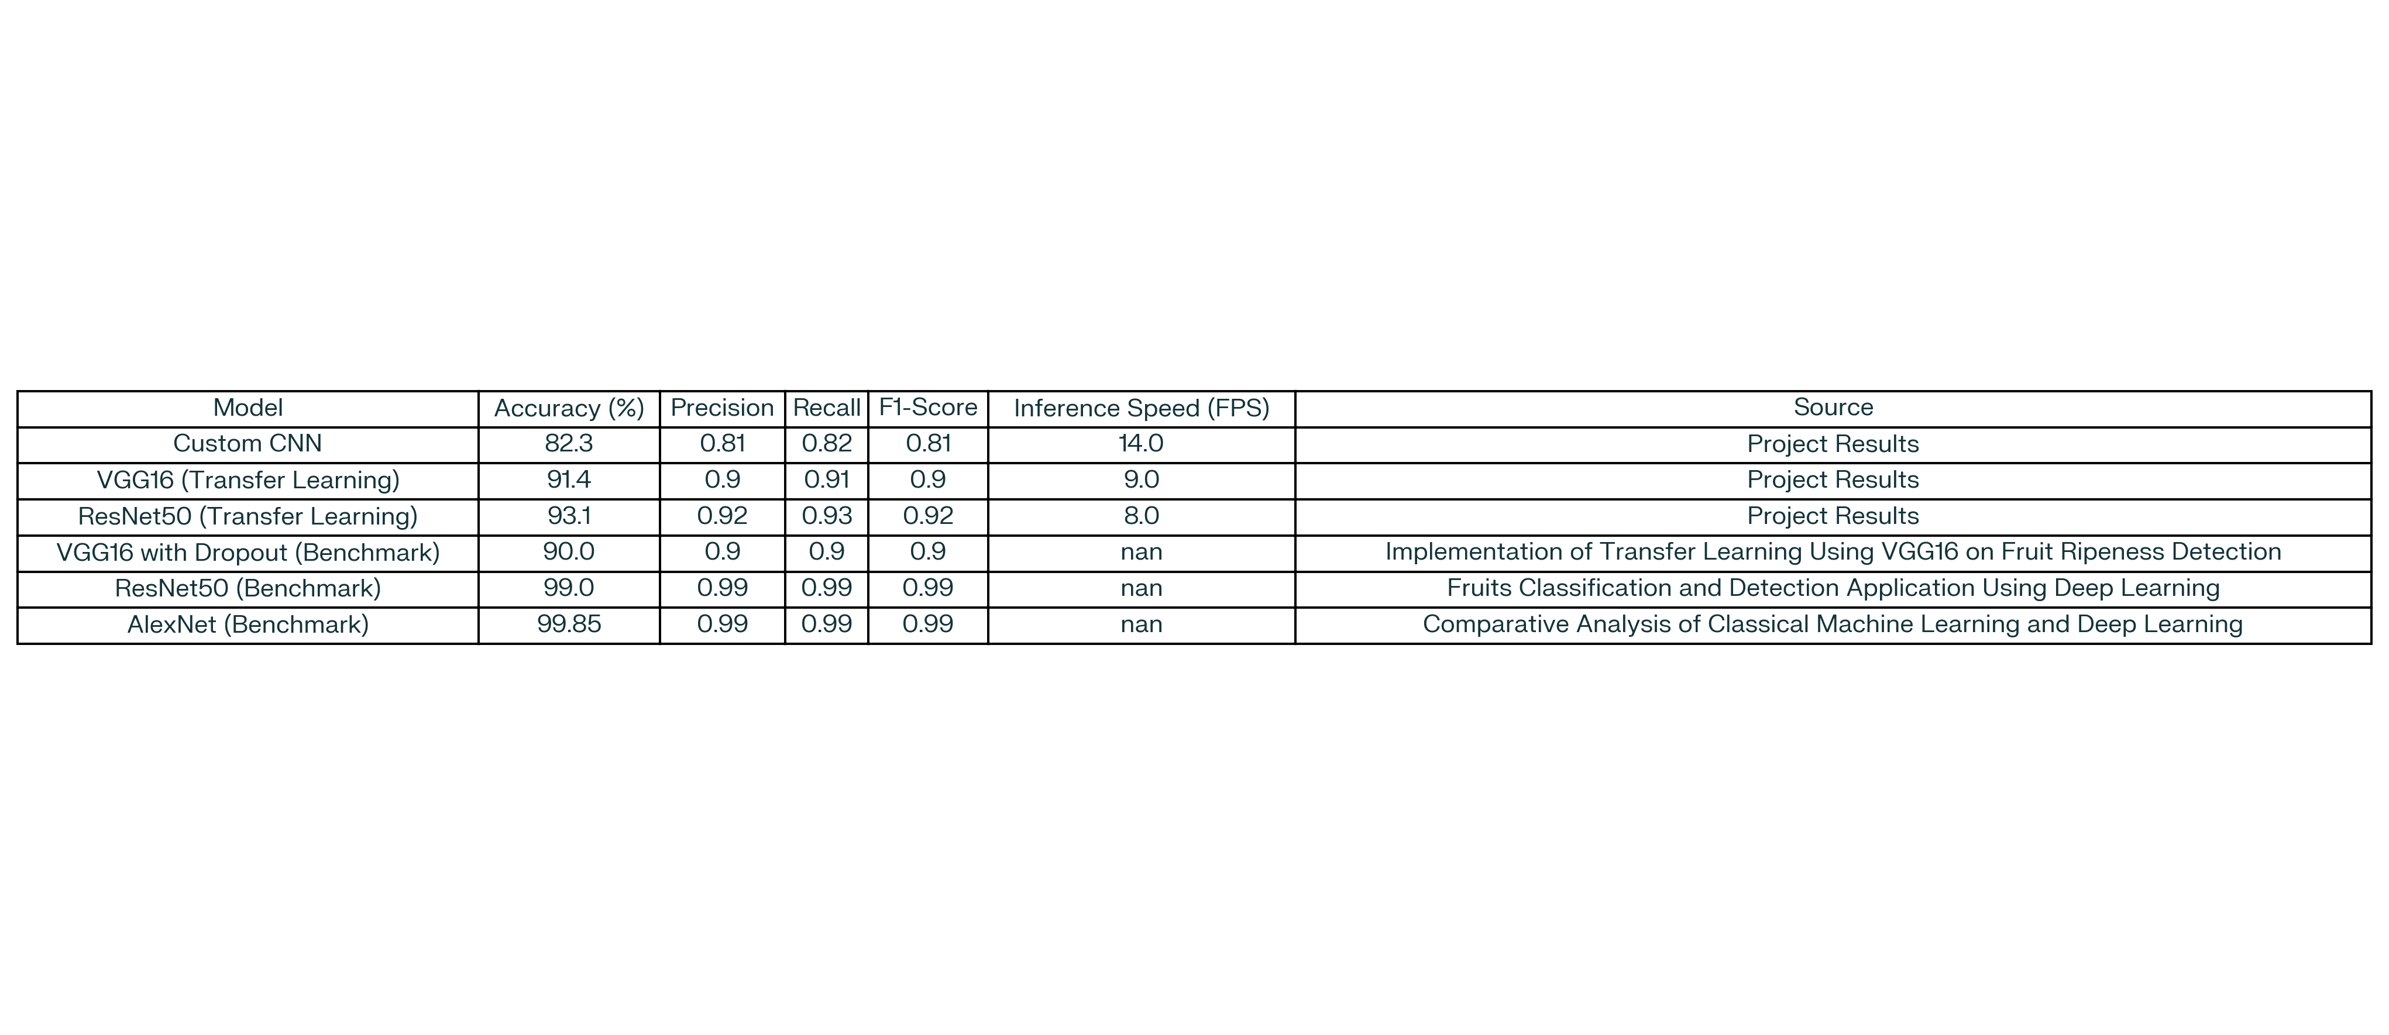
Methodology
6
• 15 Indian fruit classes, 5,000+ images
• Lighting, background, occlusion variations
• Models: CNN (82.3%), VGG16 (91.4%), ResNet50 (93.1%)
• Hybrid Architecture: CNN + RNN + LSTM

Slide 7
System Architecture
7
Image Input
CNN
Feature Extraction
RNN
Label Sequence
Preprocessing
(Resize, Normalize, Augment)
LSTM
Temporal Context
Prediction Output

Slide 8
Implementation Details
8
• Tools: Python, Keras, TensorFlow, OpenCV
• Dataset split: 70% train, 20% val, 10% test
• Metrics: Accuracy, F1, Precision, Recall
• Optimization: Dropout, Data Augmentation

Slide 9
Deployment Feasibility
9
• Model size < 50MB
• Inference speed < 120ms/image
• Suitable for mobile and embedded deployment
• Tested with TensorFlow

Slide 10
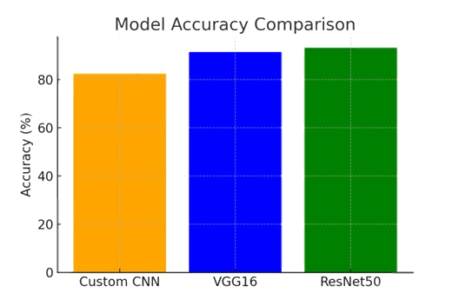
Results and Analysis
10

Slide 11
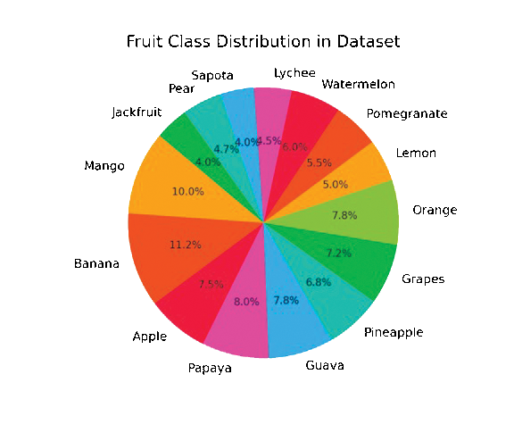
Dataset Composition
11

Slide 12
Conclusion
12
• Hybrid deep learning models effectively solve classification problems in agriculture.
• Scalable, real-time solution for Indian rural markets.
• Contributes to precision agriculture and farmer welfare.

Slide 13
Future Scope
13
• Add ripeness and defect segmentation
• Use hyperspectral imaging
• IoT + sensor integration
• Blockchain for agri-traceability

Slide 14
Thank You!

