Slide 1

Short Term SPY ETF Prediction
Erdos Institute Bootcamp Spring 2023
Team: Sailun Zhan, Xinwu Yang, Aolong Li, Amin Idelhaj, Zongze Liu

Slide 2
The objective and goals
Facts: as zero-commission investing becomes increasingly popular, many retail traders enter the market. Some of them are day traders.
Objective: to predict the short-term high and low prices of the SPY ETF, leveraging historical price data and technical indicators.
Goal: to create a model capable of providing high/low prices forecasts in 1 hour to aid investment decision-making, using prices/volumes/technical indicators in the past two hours.

Slide 3
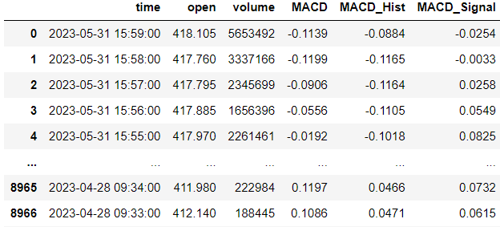
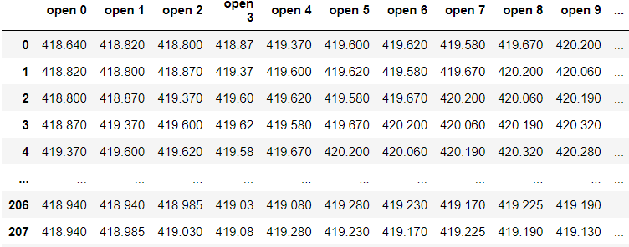
Data and Metrics
Training Data: historical (4/28-5/17) 1-min interval information on SPY ETF are collected from AlphaVantage. This includes Open, Volume, MACD, MACD_Hist, and MACD_Signal from 9:30 am to 4 pm.
Metrics: we are predicting the high/low prices in an hour for a day and calculating the Mean Average Error.
Example: at 2 pm, the input contains Open, Volume, MACD, MACD_Hist, and MACD_Signal in a 2-hour window from 12:00 pm to 1:59 pm, and the output is the highest/lowest price from 2 pm to 2:59 pm.

Slide 4
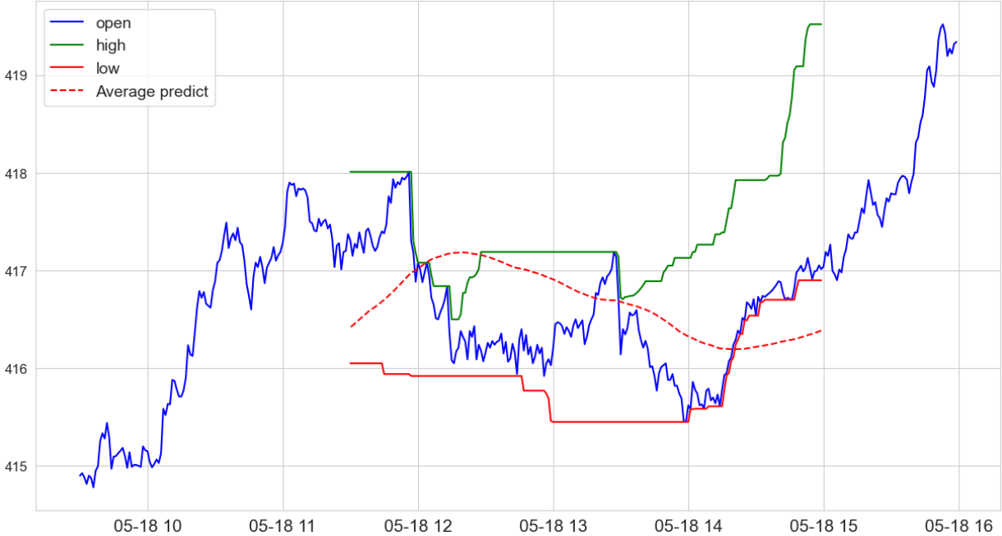
Baseline Model: average model
MAE_HIGH: 0.8755099920634972 MAE_LOW: 0.9240777698412639

Slide 5
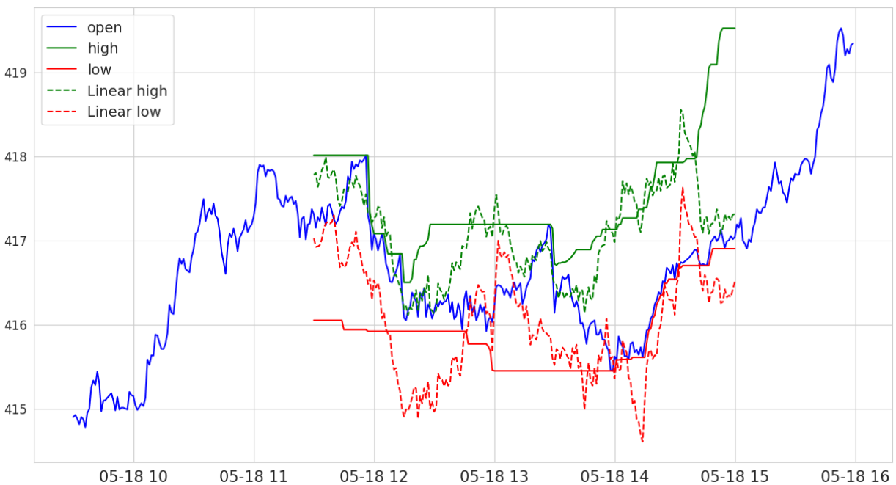
Linear Regression (Linear/Ridge/Lasso)
MAE_HIGH: 0.6714075232109371 MAE_LOW: 0.47605331180088833

Slide 6
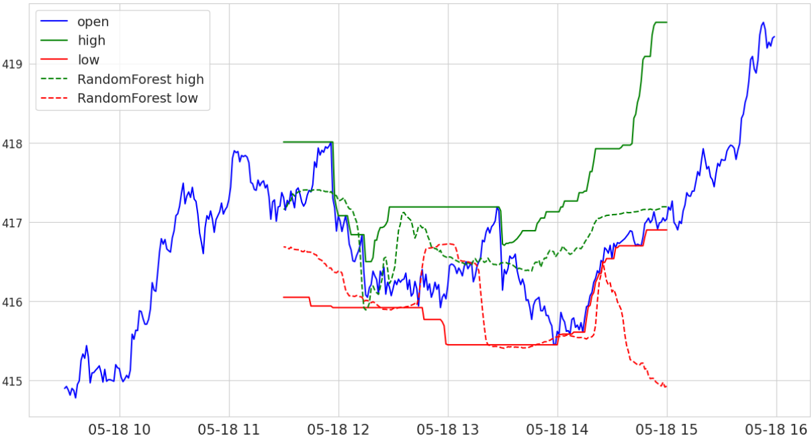
RandomForest
MAE_HIGH: 0.6864251421799351 MAE_LOW: 0.49716685308068687

Slide 7
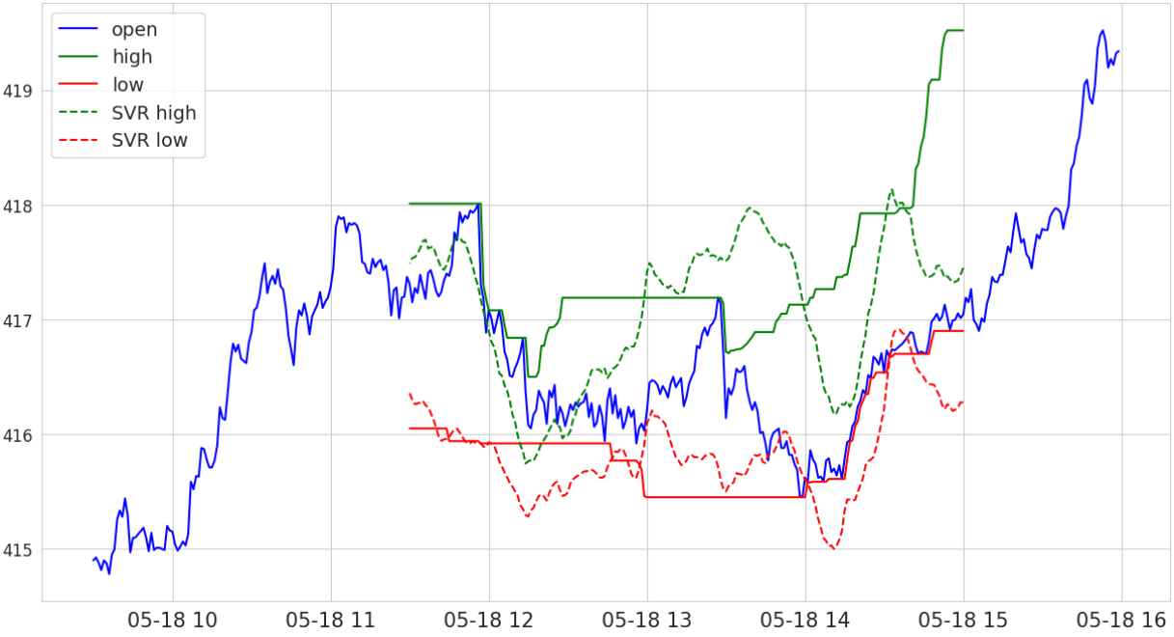
SVR
MAE_HIGH: 0.6517660619477909 MAE_LOW: 0.41521838054688726

Slide 8
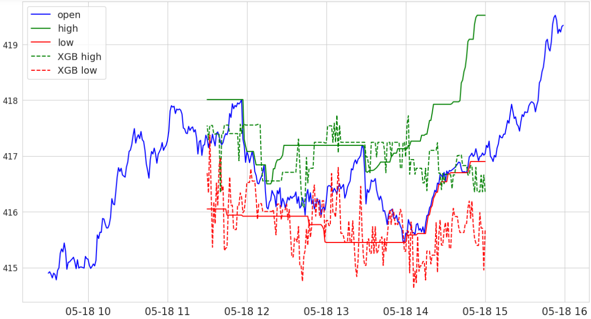
XGBoost
MAE_HIGH: 0.5858999102117873 MAE_LOW: 0.42129327676059264

Slide 9
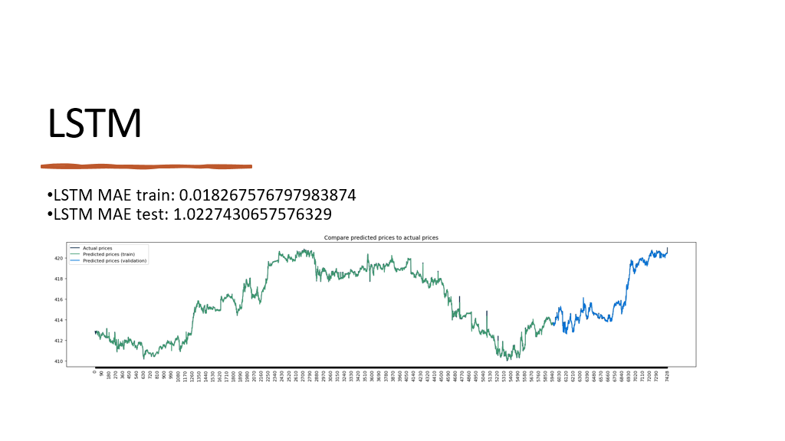

Slide 10
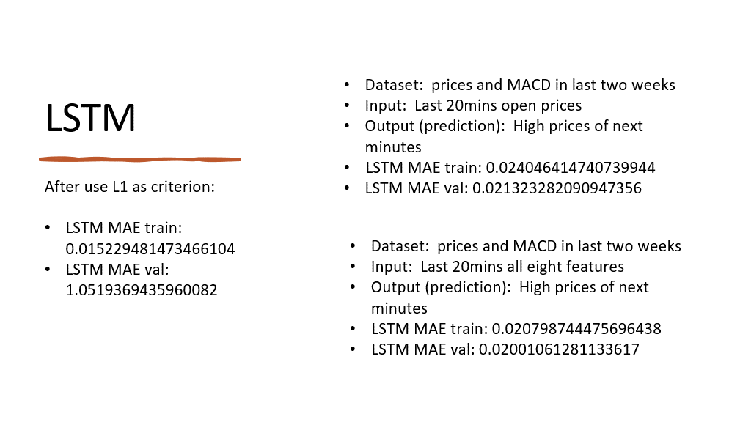

Slide 11
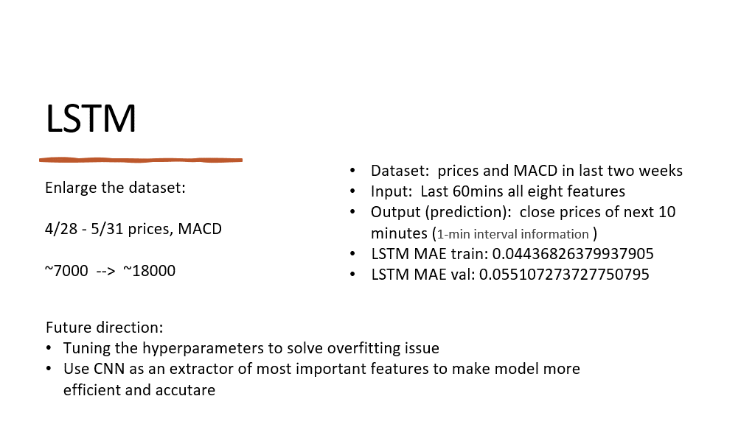

Slide 12
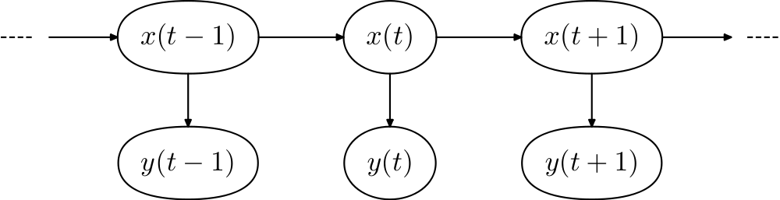
Hidden Markov Model (HMM)
What is HHM?
x(t): Hidden states. x(t) is determined by x(t-1) only
y(t): Observables. y(t) is determined by y(t) only
In our analysis, y(t) = (open(t), high(t), low(t))

Slide 13
Hidden Markov Model (HMM)
How to make prediction on t+1?
We search a state y(t*) in the past two hours that is “similar” to y(t)
Predict the change y(t+1) - y(t) = y(t*+1) - y(t*)
Therefore, y(t+1) = (y(t*+1) - y(t*)) + y(t)

Slide 14
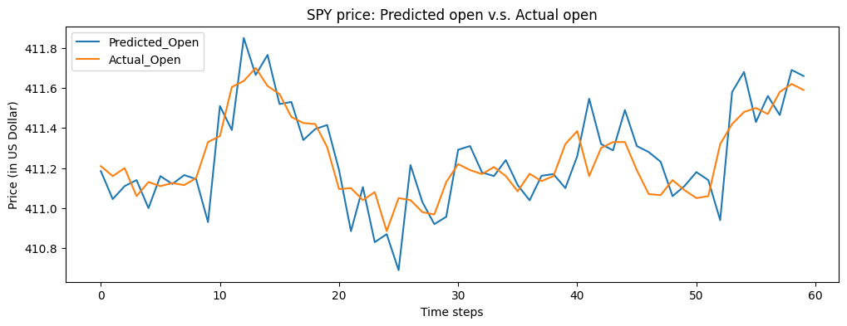
Hidden Markov Model (HMM)
MAE_open = 0.11159666666666794

Slide 15
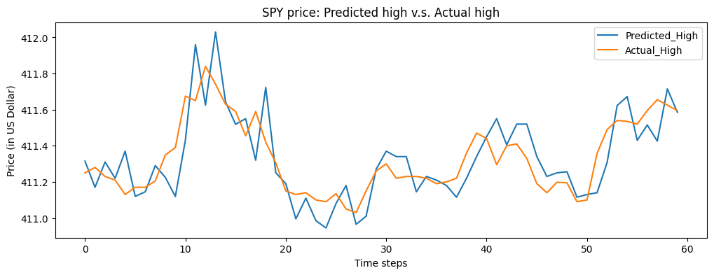
Hidden Markov Model (HMM)
MAE_high = 0.11585666666665588

Slide 16
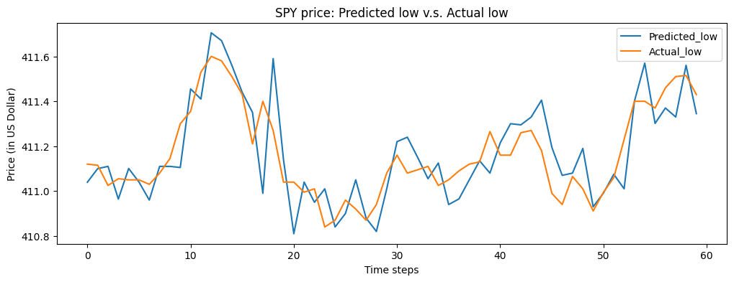
Hidden Markov Model (HMM)
MAE_low = 0.0983016666666695

Slide 17
Thank you very much!!!

