Slide 1

Home Credit
Default Risk
AUC
Metric (ROC-AUC)
Modular Machine Learning Pipeline (Python)
CLI
From raw CSV → clean features → validated model → plots → submission-ready predictions
End-to-end execution
Created by:
Bokó Zoltán
Team members:
Molnár Sándor
Nagy Ádám
Szabó Zoltán Géza
Plots
Diagnostics + explainability
Home Credit Default Risk • ML Pipeline (Python)
1/10
Notes:
Enhanced visual theme with Unsplash hero image. [Sources] - https://unsplash.com/photos/trading-charts-displayed-on-multiple-screens-and-tablet-vKNRKjSNbTo (hero background)

Slide 2
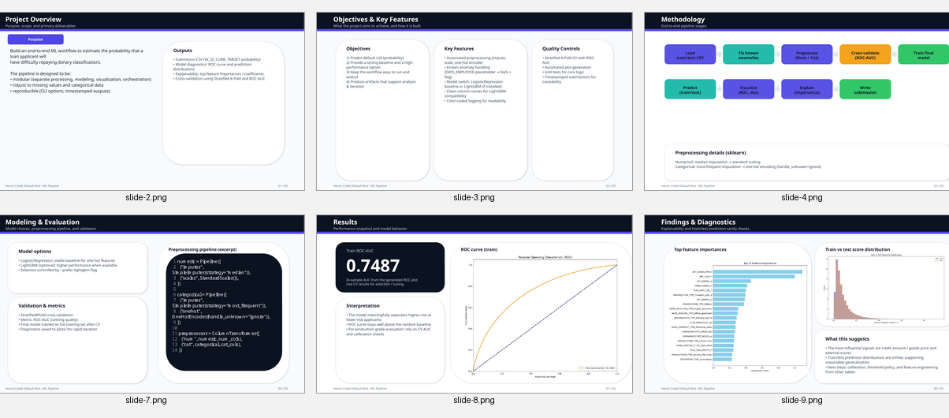
Project Overview
Purpose
Inputs
Build a clean, modular ML workflow to estimate the probability that an applicant will have difficulty repaying a loan (TARGET = 1).
Designed for reproducibility and extension (baseline → boosted model), with rich evaluation artifacts.
• application_train.csv
• application_test.csv
• Configurable CV folds
• Optional LightGBM acceleration
Outputs
• Submission-ready CSV
• ROC curve + AUC
• Feature importance
• Train vs test score distributions
Quality Controls
• Stratified K-Fold CV (ROC-AUC)
• Robust encoding for unseen categories
• Timestamped artifacts
• Unit tests for key logic
Key idea: make the pipeline easy to run, audit, and improve.
Home Credit Default Risk • ML Pipeline (Python)
2/10

Slide 3
Architecture & Modules
Modular design
Codebase footprint (non-empty LOC)
main.py
Thin CLI entry point (options, data path, folds, model selection)
orchestrator.py
Coordinates end-to-end workflow and artifact generation
data_processing.py
Load data + fix known anomalies (DAYS_EMPLOYED placeholder)
modeling.py
Preprocessing pipeline + cross-validated training (LR / LightGBM)
visualization.py
Why this matters
ROC curve, feature importance, distribution diagnostics
The pipeline is intentionally split into single-purpose modules so you can:
• unit test transformations
• swap models without refactoring
• generate consistent artifacts across runs
Home Credit Default Risk • ML Pipeline (Python)
3/10

Slide 4

Methodology
End-to-end workflow
Load CSV
Fix anomalies
Preprocess
Cross-validate
Train final
Predict &
export
Core techniques
• Categorical: most-frequent imputation + one-hot encoding (handle_unknown=ignore)
• Numerical: median imputation + standard scaling
• Validation: Stratified K-Fold cross-validation with ROC-AUC
• Artifacts: ROC curve, feature importance, score distribution checks, submission CSV
Home Credit Default Risk • ML Pipeline (Python)
4/10
Notes:
Unsplash hero background used for visual emphasis. [Sources] - https://unsplash.com/photos/trader-analyzing-stock-market-charts-on-multiple-screens-j_hho1mE47s (hero background)

Slide 5
Data Processing
Preprocessing & anomaly handling
Robust preprocessing
data_processing.py (excerpt)
• Automatic separation of categorical vs numerical features
• Missing values handled via imputers
• Scaling for numeric stability
• Safe one-hot encoding for unseen categories
1 def fix_known_anomalies(df: pd.DataFrame) -> pd.DataFrame: 2 """Convert DAYS_EMPLOYED placeholder to NaN + add flag.""" 3 if "DAYS_EMPLOYED" in df.columns: 4 anom_val = 365243 5 df = df.copy() 6 df["DAYS_EMPLOYED_ANOM"] = (df["DAYS_EMPLOYED"] == anom_val).astype(np.int8) 7 df.loc[df["DAYS_EMPLOYED"] == anom_val, "DAYS_EMPLOYED"] = np.nan 8 return df
Known anomaly fix
The Home Credit dataset contains a placeholder value in DAYS_EMPLOYED (365243).
The pipeline converts it to NaN and adds an explicit flag feature to preserve information.
Home Credit Default Risk • ML Pipeline (Python)
5/10

Slide 6
Modeling & Validation
Modeling approach
Model options
modeling.py (model selection + CV)
• Logistic Regression: stable baseline for sparse one-hot features
• LightGBM (optional): higher performance; enable with --prefer-lightgbm
Fallback: if LightGBM is missing/unusable, a warning is logged and Logistic Regression is used.
1 def try_build_model(prefer_lightgbm: bool):
2 if prefer_lightgbm:
3 try:
4 from lightgbm import LGBMClassifier
5 return LGBMClassifier(**CONFIG.lgbm_params)
6 except Exception as e:
7 logger.warning('LightGBM not usable; falling back to LR')
8 return LogisticRegression(**CONFIG.logreg_params)
Validation
• Stratified K-Fold cross-validation
• ROC-AUC per fold + mean AUC
• Designed to detect leakage / instability early
Home Credit Default Risk • ML Pipeline (Python)
6/10

Slide 7
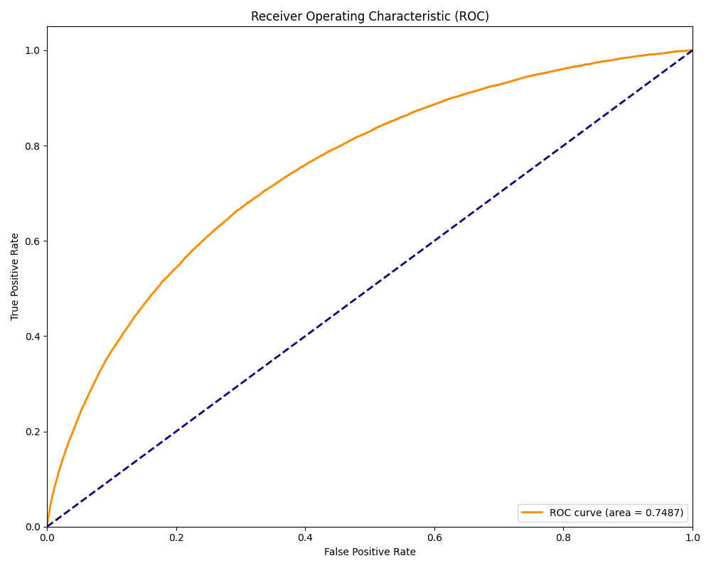
Results
Performance snapshot
0.7487
Train ROC-AUC (from generated ROC plot)
Interpretation
• Curve is well above the random baseline
• Suitable as a baseline for iteration
• Optimize via LightGBM parameters, feature engineering, and calibration
Home Credit Default Risk • ML Pipeline (Python)
7/10

Slide 8
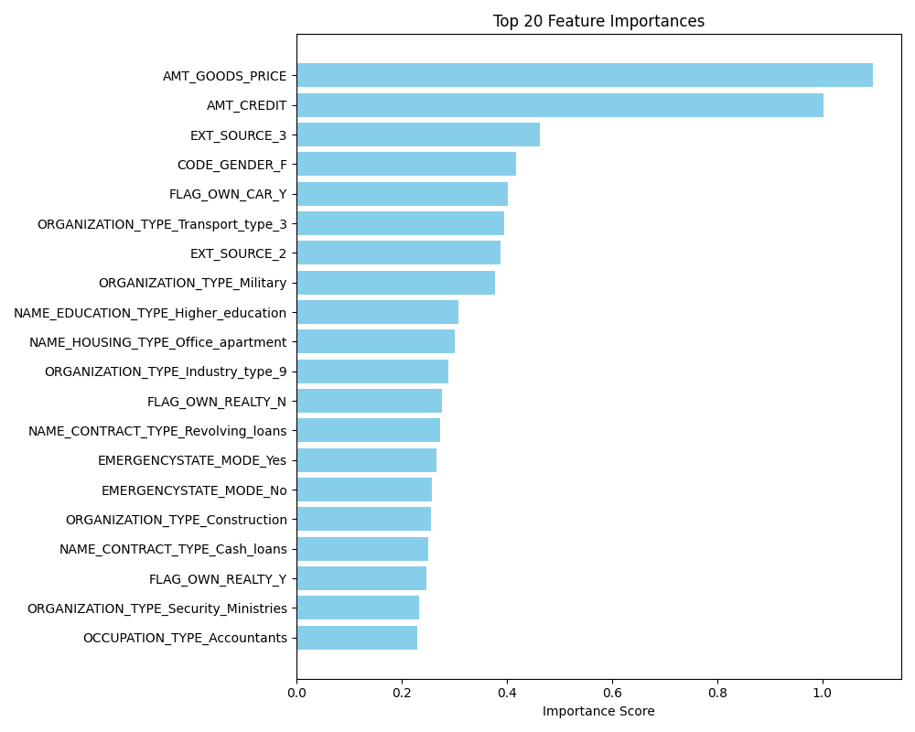
Explainability
Top feature importances
What shows up as important
From the generated plot, high-impact signals include:
• AMT_GOODS_PRICE
• AMT_CREDIT
• EXT_SOURCE_3
These typically capture affordability + bureau-derived scores.
How to use this
• Sanity-check: does the model rely on plausible signals?
• Identify data quality needs (missingness, scaling)
• Inform next features (ratios, interactions, domain rules)
Home Credit Default Risk • ML Pipeline (Python)
8/10

Slide 9
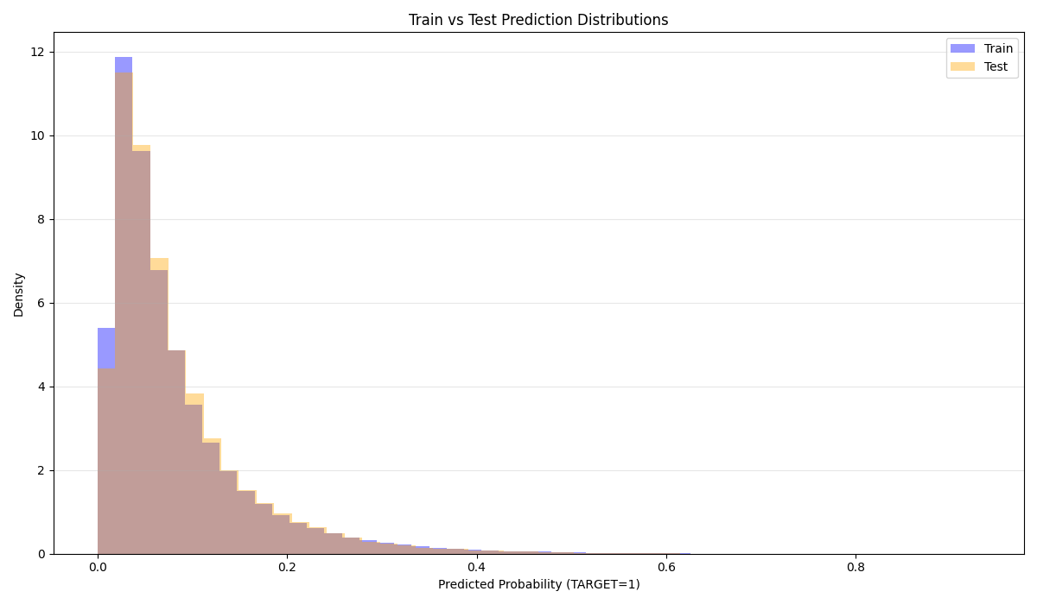
Diagnostics
Prediction distribution checks
Why this plot exists
A quick distribution comparison helps spot:
• train/test shift
• extreme overconfidence
• probability calibration issues
Operational guardrails
• Consistent preprocessing across splits
• Timestamped submissions
• Unit tests for preprocessing + modeling components
Home Credit Default Risk • ML Pipeline (Python)
9/10

Slide 10
Conclusions & Next Steps
What the project delivers
Achievements
• Modular, testable ML pipeline
• Robust preprocessing (impute / scale / OHE)
• Dataset-specific anomaly handling
• Automated plots + submission export
• Baseline performance snapshot (ROC-AUC)
Recommended upgrades
1) Add calibration (Platt / isotonic)
2) Tune LightGBM with early stopping
3) Add engineered ratios (credit-to-income, annuity-to-income)
4) Improve explainability (SHAP)
5) Add data validation checks (schema + drift)
Next step: productionize the pipeline
with monitoring + retraining hooks.
Home Credit Default Risk • ML Pipeline (Python)
10/10
Notes:
Includes Unsplash image in the right-side panel. [Sources] - https://unsplash.com/photos/trader-analyzing-stock-market-charts-on-multiple-screens-j_hho1mE47s (image panel)

