Slide 1
Home Credit Default Risk
End-to-end Python ML pipeline (preprocessing → model training → evaluation → Kaggle submission)
Python_DS project showcase
Dataset: 307,511 train rows • 48,744 test rows
Notes:
[Sources] - https://www.kaggle.com/c/home-credit-default-risk (competition overview) [/Sources]

Slide 2
Project overview
Python_DS
Objectives
Quick facts (included dataset)
Predict probability of loan default (TARGET=1) for Home Credit applicants.
Provide a reproducible baseline with strong preprocessing, CV evaluation, and submission export.
Generate diagnostics (ROC curve, feature importance, train/test score distribution) for interpretability.
Train rows
Test rows
307,511
48,744
122 columns
121 columns
Default rate
Categoricals
8.1%
16
Key deliverables
24,825 / 307,511
106 numeric
Timestamped Kaggle submission CSV (SK_ID_CURR, TARGET).
Automated plots saved to /plots (ROC, feature importance, distribution comparison).
Command-line interface for quick experimentation (folds, model preference, output path).
Known anomaly handled
55,374
DAYS_EMPLOYED=365243 (18.0%)
Pipeline implemented in main.py using pandas + scikit-learn, with optional LightGBM.
Notes:
[Sources] - https://www.kaggle.com/c/home-credit-default-risk (problem context) [/Sources]

Slide 3
Dataset & evaluation
Python_DS
Metric
Validation strategy
Artifacts
ROC AUC
Stratified K-Fold
Plots + CSV
Primary leaderboard metric
Default: 3 folds (configurable)
Saved to /plots and /submissions
Class balance (train)
Why AUC + stratified folds?
AUC evaluates ranking quality across thresholds, which is robust for imbalanced defaults.
Stratified splitting preserves the ~8% default rate in each fold.
Cross-validation provides a more stable estimate than a single holdout.
Observed training ROC AUC
0.7487
From plots/train_roc_curve.png (model trained on full training set).
Note: final model is trained on the full training set after CV; CV AUC is printed to console.
Notes:
[Sources] - https://scikit-learn.org/stable/modules/generated/sklearn.model_selection.StratifiedKFold.html - https://scikit-learn.org/stable/modules/generated/sklearn.metrics.roc_auc_score.html [/Sources]

Slide 4
End-to-end pipeline
Python_DS
Load data
Fix anomalies
Preprocess
train/test CSV
DAYS_EMPLOYED
impute/encode/scale
Train model
Evaluate
Export
LightGBM / LogReg
CV + plots
submission CSV
Implementation highlights
Single entry point: main.py (argparse CLI).
Preprocessing is defined once and reused in CV + final training via sklearn.Pipeline.
Artifacts are deterministic (random_state=42) and saved into structured folders.
Outputs
plots/feature_importance.png • plots/train_roc_curve.png • plots/train_test_distribution_comparison.png • submissions/submission_<timestamp>.csv
This layout matches the project README and supports fast iteration for Kaggle-style workflows.
Notes:
[Sources] - https://scikit-learn.org/stable/modules/compose.html (ColumnTransformer/Pipeline concepts) [/Sources]

Slide 5
Methodology
Preprocessing + modeling choices tuned for tabular, mixed-type data

Slide 6
Preprocessing methodology
Python_DS
Core steps
Missingness (top columns)
Anomaly fix: converts DAYS_EMPLOYED=365243 to NaN and adds DAYS_EMPLOYED_ANOM flag (18.0% of rows).
Numerical: median imputation + StandardScaler (stabilizes optimization and model behavior).
Categorical: most-frequent imputation + OneHotEncoder(handle_unknown="ignore").
ColumnTransformer to apply transformations in parallel; outputs a pandas feature table.
1 def fix_known_anomalies(df): 2 if "DAYS_EMPLOYED" in df.columns: 3 anom = 365243 4 df = df.copy() 5 df["DAYS_EMPLOYED_ANOM"] = (df["DAYS_EMPLOYED"] == anom).astype(np.int8) 6 df.loc[df["DAYS_EMPLOYED"] == anom, "DAYS_EMPLOYED"] = np.nan 7 return df 8 9 # numeric: median + scaler | categorical: most_frequent + one-hot 10 preprocessor = ColumnTransformer([...])
The pipeline uses SimpleImputer to ensure models can train with high-missingness housing attributes.
Preprocessing is built lazily to infer categorical vs numerical columns from the input dataframe.
Notes:
[Sources] - https://scikit-learn.org/stable/modules/generated/sklearn.compose.ColumnTransformer.html - https://scikit-learn.org/stable/modules/generated/sklearn.preprocessing.OneHotEncoder.html - https://scikit-learn.org/stable/modules/generated/sklearn.impute.SimpleImputer.html [/Sources]

Slide 7
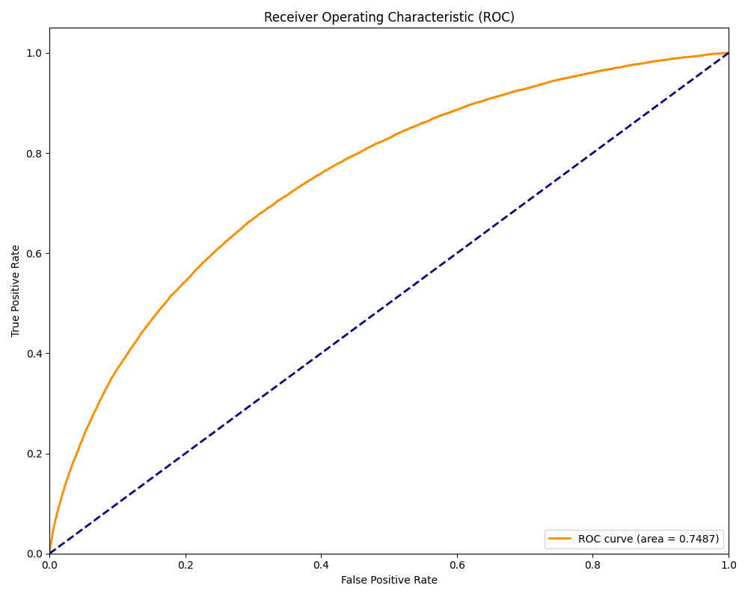
Modeling & validation
Python_DS
Model options
ROC curve (training)
Baseline: LogisticRegression (lbfgs, max_iter=1000) for a stable, interpretable reference.
Preferred: LightGBM (n_estimators=800, learning_rate=0.05, subsample=0.8) for non-linear interactions.
Both are wrapped in the same sklearn.Pipeline to avoid train/test skew.
Validation: Stratified K-Fold CV prints fold AUC and mean/std to console.
1 def try_build_model(prefer_lightgbm: bool): 2 if prefer_lightgbm: 3 return LGBMClassifier( 4 n_estimators=800, learning_rate=0.05, 5 num_leaves=31, subsample=0.8, 6 colsample_bytree=0.8, random_state=42 7 ) 8 return LogisticRegression( 9 solver="lbfgs", max_iter=1000, random_state=42 10 ) 11 12 # CV uses StratifiedKFold and roc_auc_score
AUC ≈ 0.7487
Computed on the training set as a diagnostic; CV provides the more reliable estimate.
LightGBM is used when available; the CLI can force a simpler Logistic Regression baseline.
Notes:
[Sources] - https://lightgbm.readthedocs.io/en/latest/pythonapi/lightgbm.LGBMClassifier.html - https://scikit-learn.org/stable/modules/generated/sklearn.linear_model.LogisticRegression.html [/Sources]

Slide 8
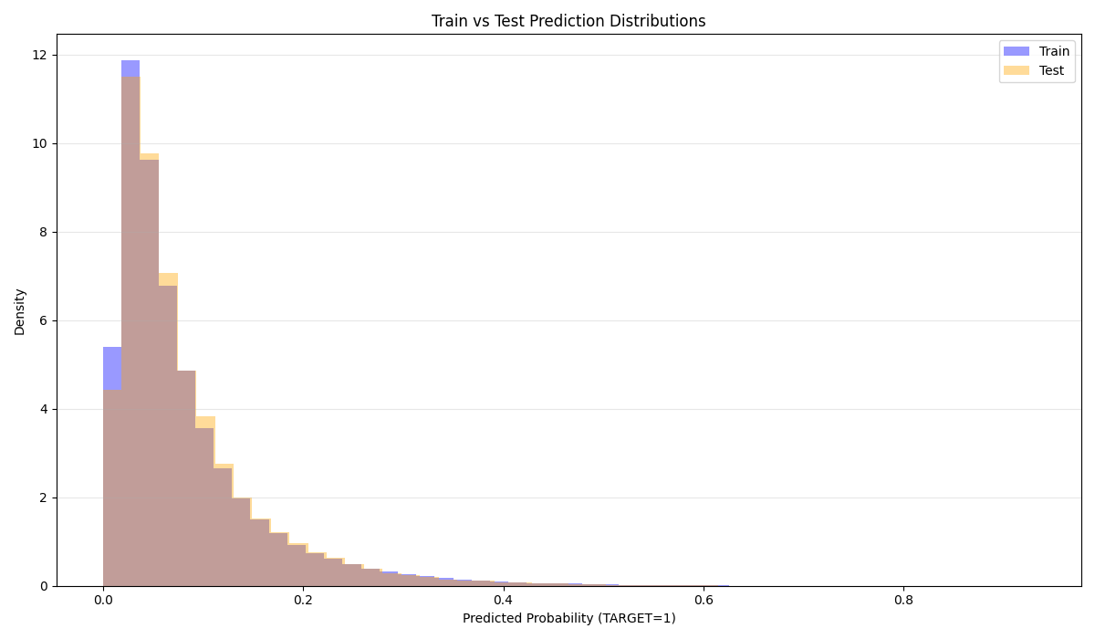
Results & diagnostics
Python_DS
Prediction distributions (train vs test)
The project plots predicted probability densities for both splits.
Close alignment suggests the model is not producing extreme distribution shift on the provided test set.
This is a useful sanity check before submitting to Kaggle.
Diagnostics are saved under plots/ so results are reviewable and versionable.
Notes:
[Sources] - https://www.kaggle.com/c/home-credit-default-risk (submission workflow context) [/Sources]

Slide 9
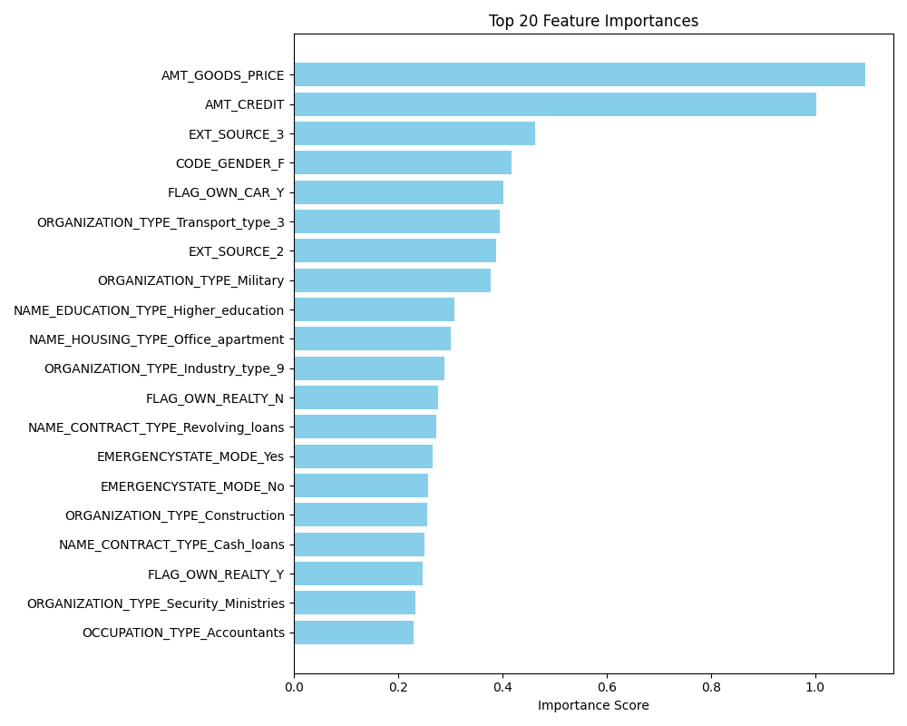
Interpretability & insights
Python_DS
Top drivers (model importance)
Observed patterns
Amounts matter: AMT_GOODS_PRICE and AMT_CREDIT dominate importance.
External scores: EXT_SOURCE_2/3 are consistently strong predictors in this competition.
Socio-demographic proxies: e.g., education type and organization type categories appear in the top 20.
These are directional insights only; use SHAP or permutation importance for deeper explainability.
Takeaway
The pipeline produces interpretable artifacts automatically, enabling rapid iteration and review.
Feature importance plot is generated from LightGBM gain or Logistic Regression coefficients.
Notes:
[Sources] - https://lightgbm.readthedocs.io/en/latest/Features.html (feature importance concepts) [/Sources]

Slide 10
Implementation & usage
Python_DS
Command-line interface
Code structure
1 # Basic run (defaults to Logistic Regression) 2 poetry run python main.py 3 4 # Prefer LightGBM, increase folds 5 poetry run python main.py --prefer-lightgbm --folds 5 6 7 # Custom data folder + explicit output 8 poetry run python main.py --data-dir data --out submissions/my_submission.csv
1 Python_DS/ 2 ├─ data/ 3 │ ├─ application_train.csv 4 │ └─ application_test.csv 5 ├─ plots/ 6 ├─ submissions/ 7 ├─ main.py 8 └─ README.md
main.py is deliberately self-contained: easy to run, audit, and extend.
Uses sklearn Pipelines for leak-safe preprocessing and consistent feature handling.
Reproducible defaults (random_state=42) enable meaningful comparisons across runs.
Outputs created automatically:
submissions/submission_<timestamp>.csv
plots/feature_importance.png
plots/train_test_distribution_comparison.png
plots/train_roc_curve.png
The project is ready for Kaggle submissions and can be expanded to include additional tables/features.
Notes:
[Sources] - https://scikit-learn.org/stable/modules/compose.html [/Sources]

Slide 11
Conclusions & next steps
Python_DS
What this project demonstrates
A complete and reproducible tabular ML workflow for credit-default prediction.
Robust preprocessing for mixed types (missingness, categoricals, scaling).
Validation discipline via stratified CV and clear diagnostic artifacts.
Extensible design: swap models, add features, or incorporate additional Kaggle tables.
Recommended enhancements
Use CV out-of-fold predictions for a more faithful ROC curve (vs. training diagnostic).
Add probability calibration (Platt/Isotonic) if decision thresholds matter.
Feature engineering: ratios, interaction terms, and aggregation across auxiliary tables.
Explainability: SHAP values for LightGBM to quantify per-customer drivers.
Operationalization: save the fitted pipeline (joblib) and add input validation.
Thank you.
Notes:
[Sources] - https://scikit-learn.org/stable/modules/calibration.html (calibration options) - https://shap.readthedocs.io/en/latest/ (SHAP explainability) [/Sources]

