Slide 1

Home Credit
Default Risk
AUC
Metric (ROC-AUC)
Modular Machine Learning Pipeline (Python)
CLI
From raw CSV → clean features → validated model → plots → submission-ready predictions
End-to-end execution
Created by:
Bokó Zoltán
Team members:
Molnár Sándor
Nagy Ádám
Szabó Zoltán Géza
Plots
Diagnostics + explainability
Home Credit Default Risk • ML Pipeline (Python)
1/15
Notes:
Enhanced visual theme with Unsplash hero image. [Sources] - https://unsplash.com/photos/trading-charts-displayed-on-multiple-screens-and-tablet-vKNRKjSNbTo (hero background)

Slide 2
5
Target Variable Identification
Project Context
Key Metrics
The primary objective is to predict whether an applicant will encounter difficulties repaying a loan, helping Home Credit broaden financial inclusion for the unbanked population by leveraging alternative data.
Quantitative: AMT_INCOME_TOTAL, AMT_CREDIT, DAYS_EMPLOYED, and EXT_SOURCE scores.
Qualitative: NAME_EDUCATION_TYPE, OCCUPATION_TYPE, and family status.
Selection Process
Examples
The target variable is TARGET. It is a binary indicator (1 for payment difficulties, 0 otherwise). This is the most important variable as it directly measures the financial risk and success of the loan approval process.
Similar to the LendingClub Loan Analysis or Fannie Mae Mortgage Default Prediction, where a binary status allows for identifying high-risk patterns to improve portfolio health.
Home Credit Default Risk • ML Pipeline (Python)
2/15

Slide 3

Project Overview
Purpose
Inputs
Build a clean, modular ML workflow to estimate the probability that an applicant will have difficulty repaying a loan (TARGET = 1).
Designed for reproducibility and extension (baseline → boosted model), with rich evaluation artifacts.
• application_train.csv
• application_test.csv
• Configurable CV folds
• Optional LightGBM acceleration
Outputs
• Submission-ready CSV
• ROC curve + AUC
• Feature importance
• Train vs test score distributions
Quality Controls
• Stratified K-Fold CV (ROC-AUC)
• Robust encoding for unseen categories
• Timestamped artifacts
• Unit tests for key logic
Home Credit Default Risk • ML Pipeline (Python)
3/15

Slide 4
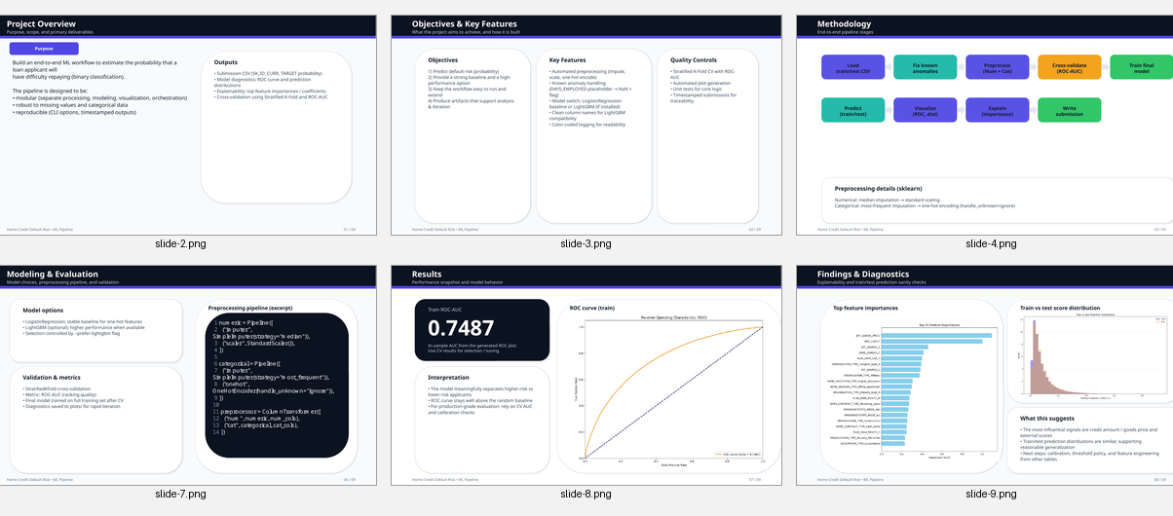
Project Overview
Key idea: make the pipeline easy to run, audit, and improve.
Home Credit Default Risk • ML Pipeline (Python)
4/15

Slide 5
Architecture & Modules
Modular design
Codebase footprint (non-empty LOC)
main.py
Thin CLI entry point (options, data path, folds, model selection)
orchestrator.py
Coordinates end-to-end workflow and artifact generation
data_processing.py
Load data + fix known anomalies (DAYS_EMPLOYED placeholder)
modeling.py
Preprocessing pipeline + cross-validated training (LR / LightGBM)
visualization.py
Why this matters
ROC curve, feature importance, distribution diagnostics
The pipeline is intentionally split into single-purpose modules so you can:
• unit test transformations
• swap models without refactoring
• generate consistent artifacts across runs
Home Credit Default Risk • ML Pipeline (Python)
5/15

Slide 6
Module/Component Descriptions
main.py
src/config.py
The primary entry point for the application. It handles Command Line Interface (CLI) arguments and triggers the orchestration logic.
Key Functions:
main(): Uses argparse to handle user inputs such as data directories, number of CV folds, model preference, and output paths.
Interactions: Acts as the user interface, passing configuration to src/orchestrator.py.
This module centralizes all project-wide settings to ensure consistency across different execution environments.
Key Functions/Classes:
ColorFormatter: A custom logging formatter that colors INFO messages green for better readability in the terminal.
ModelConfig: A frozen dataclass that stores hyperparameters for both Logistic Regression and LightGBM models.
setup_directories(): Ensures that plots/ and submissions/ folders exist before the pipeline attempts to write to them.
Interactions: Imported by almost every other module to access the global logger and the CONFIG object.
src/data_processing.py
Responsible for the "Extract and Transform" part of the ETL process.
Key Functions:
load_data(data_dir): Reads the training and testing datasets from CSV files.
fix_known_anomalies(df): Implements domain-specific cleaning logic, such as handling the "1000-year" employment anomaly.
Interactions: Called early in the orchestrator.py workflow to prepare data for modeling.
Home Credit Default Risk • ML Pipeline (Python)
6/15

Slide 7
Module/Component Descriptions
src/modeling.py
src/visualization.py
Contains the structural definitions of the machine learning models and the cross-validation logic.
Key Functions:
build_pipeline(cat_cols, num_cols): Creates a ColumnTransformer that imputes and scales data based on whether a column is categorical or numerical.
try_build_model(prefer_lightgbm): A factory function that attempts to instantiate LGBMClassifier but falls back to LogisticRegression if LightGBM is unavailable.
cross_validate_auc(x, y, folds): Performs Stratified K-Fold cross-validation and logs the Mean AUC score.
Interactions: Receives cleaned data from the orchestrator and provides trained pipelines back to it.
Provides visual evidence of model performance and data health.
Key Functions:
plot_feature_importance(clf): Extracts coefficients or importance scores from the trained model and creates a bar chart.
plot_roc_curve(y_true, y_probes): Generates the ROC curve and calculates the AUC for the training set.
plot_train_test_distribution(train_proba, test_proba): Overlays histograms of predictions to check for model stability.
Interactions: Called by the orchestrator after the final model training is complete.
Home Credit Default Risk • ML Pipeline (Python)
7/15

Slide 8
Module/Component Descriptions
test_data_processing.py & test_modeling.py
src/orchestrator.py
Unit tests designed to ensure the stability of the core logic.
Key Tests:
test_fix_known_anomalies: Verifies that the employment anomaly flag is correctly created.
test_build_pipeline: Confirms that the ColumnTransformer correctly processes different data types.
Interactions: Standalone scripts that import src modules to validate their behavior via pytest.
The central workflow coordinator that connects all components into a single pipeline.
Key Functions:
run_pipeline(...): Orchestrates the sequence of events: directory setup, data loading, anomaly fixing, cross-validation, final training, visualization, and submission generation.
Interactions: Imports and invokes functionality from all other src/ modules.
Home Credit Default Risk • ML Pipeline (Python)
8/15

Slide 9
Methodology
End-to-end workflow
Load CSV
Fix anomalies
Preprocess
Cross-validate
Train final
Predict &
export
Core techniques
• Categorical: most-frequent imputation + one-hot encoding (handle_unknown=ignore)
• Numerical: median imputation + standard scaling
• Validation: Stratified K-Fold cross-validation with ROC-AUC
• Artifacts: ROC curve, feature importance, score distribution checks, submission CSV
Home Credit Default Risk • ML Pipeline (Python)
9/15
Notes:
Unsplash hero background used for visual emphasis. [Sources] - https://unsplash.com/photos/trader-analyzing-stock-market-charts-on-multiple-screens-j_hho1mE47s (hero background)

Slide 10
Data Processing
Preprocessing & anomaly handling
Robust preprocessing
data_processing.py (excerpt)
• Automatic separation of categorical vs numerical features
• Missing values handled via imputers
• Scaling for numeric stability
• Safe one-hot encoding for unseen categories
1 def fix_known_anomalies(df: pd.DataFrame) -> pd.DataFrame: 2 """Convert DAYS_EMPLOYED placeholder to NaN + add flag.""" 3 if "DAYS_EMPLOYED" in df.columns: 4 anom_val = 365243 5 df = df.copy() 6 df["DAYS_EMPLOYED_ANOM"] = (df["DAYS_EMPLOYED"] == anom_val).astype(np.int8) 7 df.loc[df["DAYS_EMPLOYED"] == anom_val, "DAYS_EMPLOYED"] = np.nan 8 return df
Known anomaly fix
The Home Credit dataset contains a placeholder value in DAYS_EMPLOYED (365243).
The pipeline converts it to NaN and adds an explicit flag feature to preserve information.
Home Credit Default Risk • ML Pipeline (Python)
10/15

Slide 11
Modeling & Validation
Modeling approach
Model options
modeling.py (model selection + CV)
• Logistic Regression: stable baseline for sparse one-hot features
• LightGBM (optional): higher performance; enable with --prefer-lightgbm
Fallback: if LightGBM is missing/unusable, a warning is logged and Logistic Regression is used.
1 def try_build_model(prefer_lightgbm: bool):
2 if prefer_lightgbm:
3 try:
4 from lightgbm import LGBMClassifier
5 return LGBMClassifier(**CONFIG.lgbm_params)
6 except Exception as e:
7 logger.warning('LightGBM not usable; falling back to LR')
8 return LogisticRegression(**CONFIG.logreg_params)
Validation
• Stratified K-Fold cross-validation
• ROC-AUC per fold + mean AUC
• Designed to detect leakage / instability early
Home Credit Default Risk • ML Pipeline (Python)
11/15

Slide 12
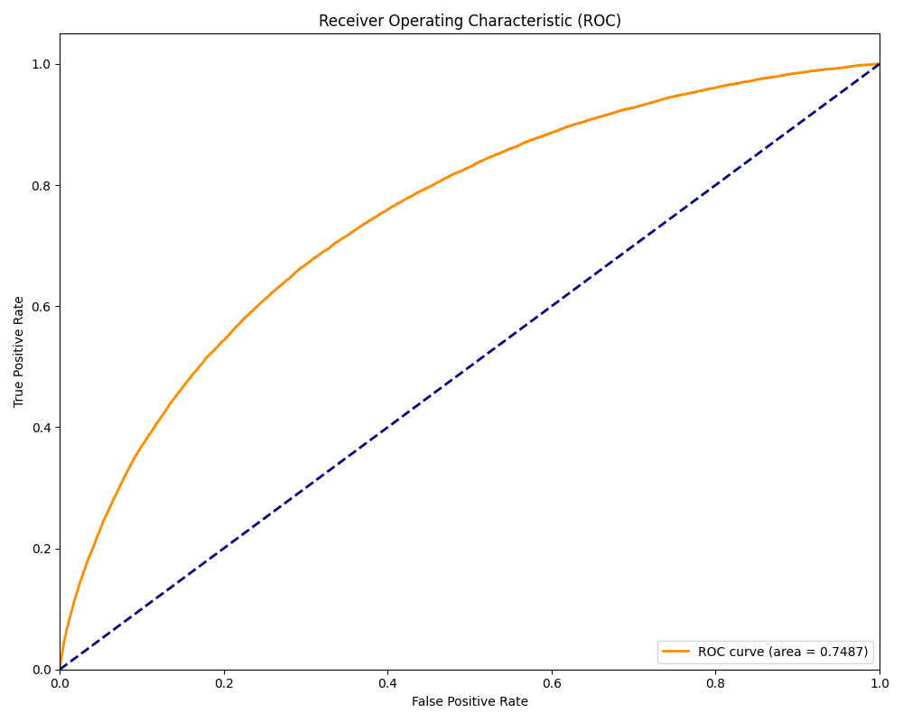
Results
Performance snapshot
0.7487
Train ROC-AUC (from generated ROC plot)
Interpretation
• Curve is well above the random baseline
• Suitable as a baseline for iteration
• Optimize via LightGBM parameters, feature engineering, and calibration
Home Credit Default Risk • ML Pipeline (Python)
12/15

Slide 13
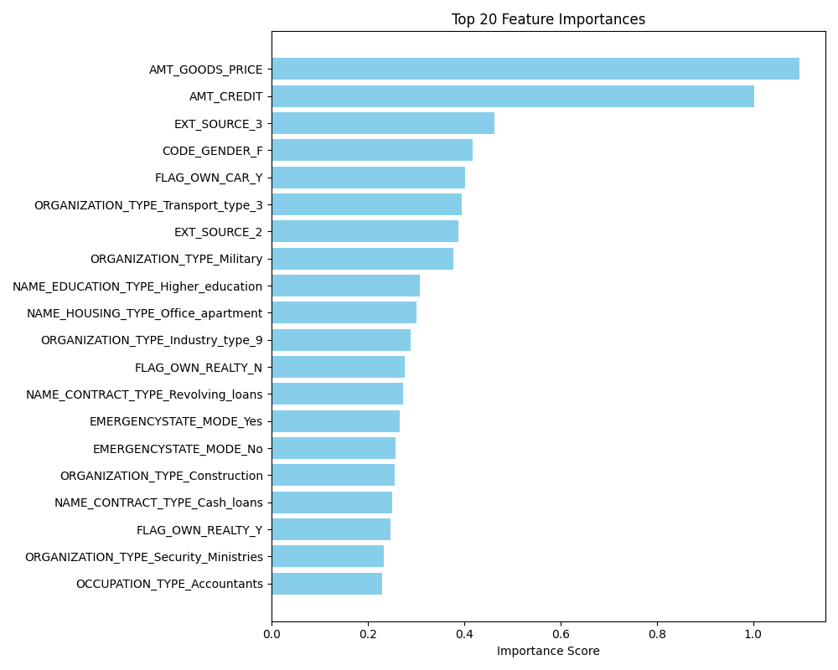
Explainability
Top feature importances
What shows up as important
From the generated plot, high-impact signals include:
• AMT_GOODS_PRICE
• AMT_CREDIT
• EXT_SOURCE_3
These typically capture affordability + bureau-derived scores.
How to use this
• Sanity-check: does the model rely on plausible signals?
• Identify data quality needs (missingness, scaling)
• Inform next features (ratios, interactions, domain rules)
Home Credit Default Risk • ML Pipeline (Python)
13/15

Slide 14
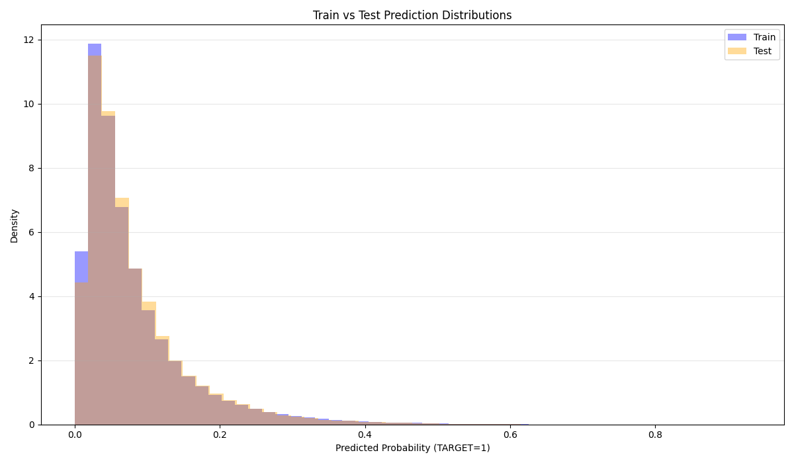
Diagnostics
Prediction distribution checks
Why this plot exists
A quick distribution comparison helps spot:
• train/test shift
• extreme overconfidence
• probability calibration issues
Operational guardrails
• Consistent preprocessing across splits
• Timestamped submissions
• Unit tests for preprocessing + modeling components
Home Credit Default Risk • ML Pipeline (Python)
14/15

Slide 15
Conclusions & Next Steps
What the project delivers
Achievements
• Modular, testable ML pipeline
• Robust preprocessing (impute / scale / OHE)
• Dataset-specific anomaly handling
• Automated plots + submission export
• Baseline performance snapshot (ROC-AUC)
Recommended upgrades
1) Add calibration (Platt / isotonic)
2) Tune LightGBM with early stopping
3) Add engineered ratios (credit-to-income, annuity-to-income)
4) Improve explainability (SHAP)
5) Add data validation checks (schema + drift)
Next step: productionize the pipeline
with monitoring + retraining hooks.
Home Credit Default Risk • ML Pipeline (Python)
15/15
Notes:
Includes Unsplash image in the right-side panel. [Sources] - https://unsplash.com/photos/trader-analyzing-stock-market-charts-on-multiple-screens-j_hho1mE47s (image panel)

