Slide 1
Python_DS
Home Credit Default Risk — modular machine‑learning pipeline
Reproducible
Drift‑aware
Explainable
End‑to‑end lifecycle
Kaggle‑ready
End‑to‑end lifecycle
Ingest
Prep
Engineer
Train
Calibrate
Explain
Export
github.com/zolcsika71/Python_DS

Slide 2
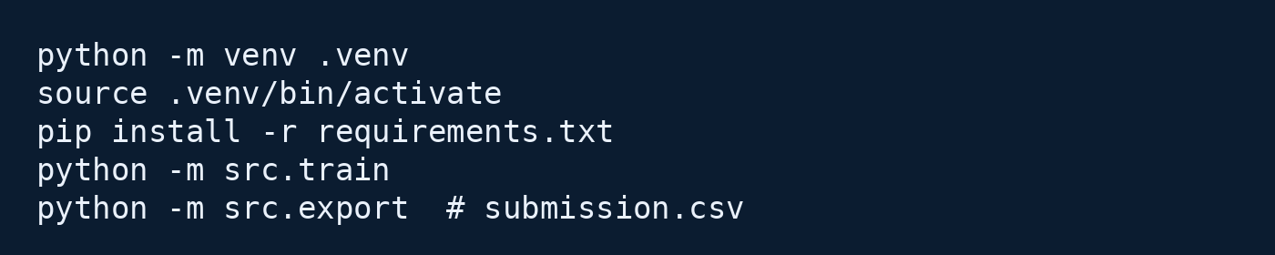
Python_DS • Home Credit Default Risk
Overview
Project overview
A reproducible ML pipeline for probability-of-default prediction using tabular credit-risk data.
Purpose & significance
Quick start (CLI)
A complete pipeline built to solve the Home Credit Default Risk challenge: ingest, preprocess, feature engineering, model training, evaluation, explainability, and export of submission-ready predictions.
What it delivers
• End-to-end automation from raw CSVs to Kaggle submission
• Reusable experiments (Poetry + structured configs)
• Explainability hooks and drift checks for production-readiness
• Clear separation of data prep, features, training, and export
Core capabilities
Preprocessing
Feature engineering
Drift mitigation
Explainability
Top‑10 risk list
Reproducible runs
github.com/zolcsika71/Python_DS

Slide 3
Python_DS • Home Credit Default Risk
Problem & data
Problem framing & inputs
Predict default probability per applicant by joining multiple relational tables into a unified feature store.
Challenge framing
Relational inputs → feature store
Goal: estimate repayment difficulty for each applicant using both application metadata and behavioral history (bureau, prior applications, POS/cash, installments, card balance).
bureau
bureau_balance
Data requirements (minimal)
• application_train / application_test (primary index)
• bureau + bureau_balance (credit history)
• previous_application (prior decisions & offers)
• installments_payments, POS_CASH_balance, credit_card_balance
• optional: engineered ratios + missingness signals
application
(train/test)
previous_application
POS_CASH_balance
installments_payments
credit_card_balance
Note: joins are aggregated by SK_ID_CURR with time-windowed statistics and missingness signals.
github.com/zolcsika71/Python_DS

Slide 4
Python_DS • Home Credit Default Risk
Methodology
End‑to‑end methodology
A modular pipeline with quality gates, reproducibility, and clear artifacts at each stage.
Pipeline (numbered stages)
1
Ingest
2
Clean
3
Features
4
Validate
5
Train
6
Calibrate
7
Export
Process controls & quality gates
Reproducible execution
• Automated missingness checks and type-aware preprocessing
• Leakage prevention via time-consistent aggregations
• Cross-validation with out-of-fold probability calibration
• Artifact logging: metrics, plots, configs, and outputs
Run tests
pytest -q
Train models
python -m src.train --config configs/baseline.yaml
Export
python -m src.export --out submission.csv
github.com/zolcsika71/Python_DS

Slide 5
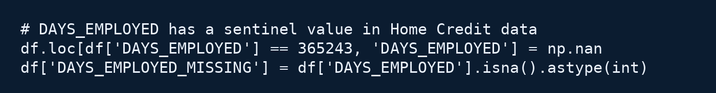
Python_DS • Home Credit Default Risk
Implementation I
Feature engineering that matters
Focus on interpretable ratios and robust preprocessing rather than large blocks of code.
Key techniques
Example engineered ratios
• Type-aware imputation and scaling (numeric vs categorical)
• Missingness indicators for systematically absent fields
• Stable aggregations across relational tables (time-windowed stats)
• Ratio features to capture affordability and credit burden
credit_to_income
annuity_to_income
AMT_CREDIT / AMT_INCOME_TOTAL
AMT_ANNUITY / AMT_INCOME_TOTAL
goods_to_credit
income_per_person
AMT_GOODS_PRICE / AMT_CREDIT
AMT_INCOME_TOTAL / CNT_FAM_MEMBERS
Robustness example: known anomaly fix
github.com/zolcsika71/Python_DS

Slide 6
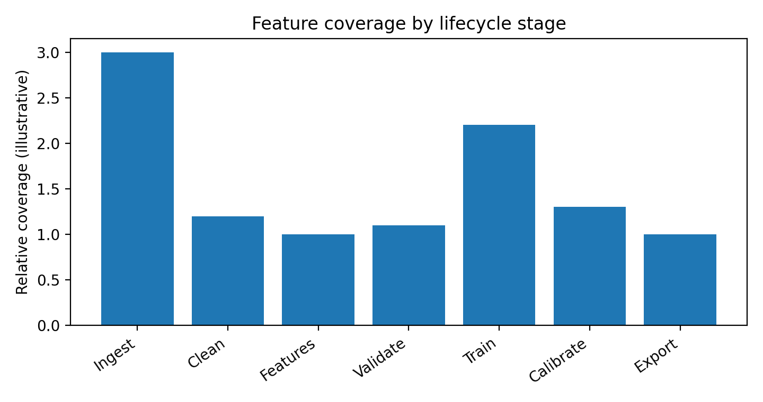
Python_DS • Home Credit Default Risk
Implementation II
Modeling, drift mitigation & calibration
A pragmatic dual-model strategy with evaluation artifacts and calibrated probabilities.
Dual-model strategy
Coverage & diagnostics
Baseline: Logistic Regression
Fast iteration, interpretable coefficients, strong reference point for feature validation and stability checks.
Optimized: Gradient Boosting (e.g., LightGBM)
Captures non-linear interactions; used with early stopping and feature pruning. Outputs are calibrated to produce reliable probabilities.
Risk controls
• Probability calibration (Platt / isotonic)
• Drift checks (PSI) between train and test
• Explainability snapshots for stakeholder review
v1.2+ insight: combine drift monitoring with explainability snapshots to support deployment decisions.
github.com/zolcsika71/Python_DS

Slide 7
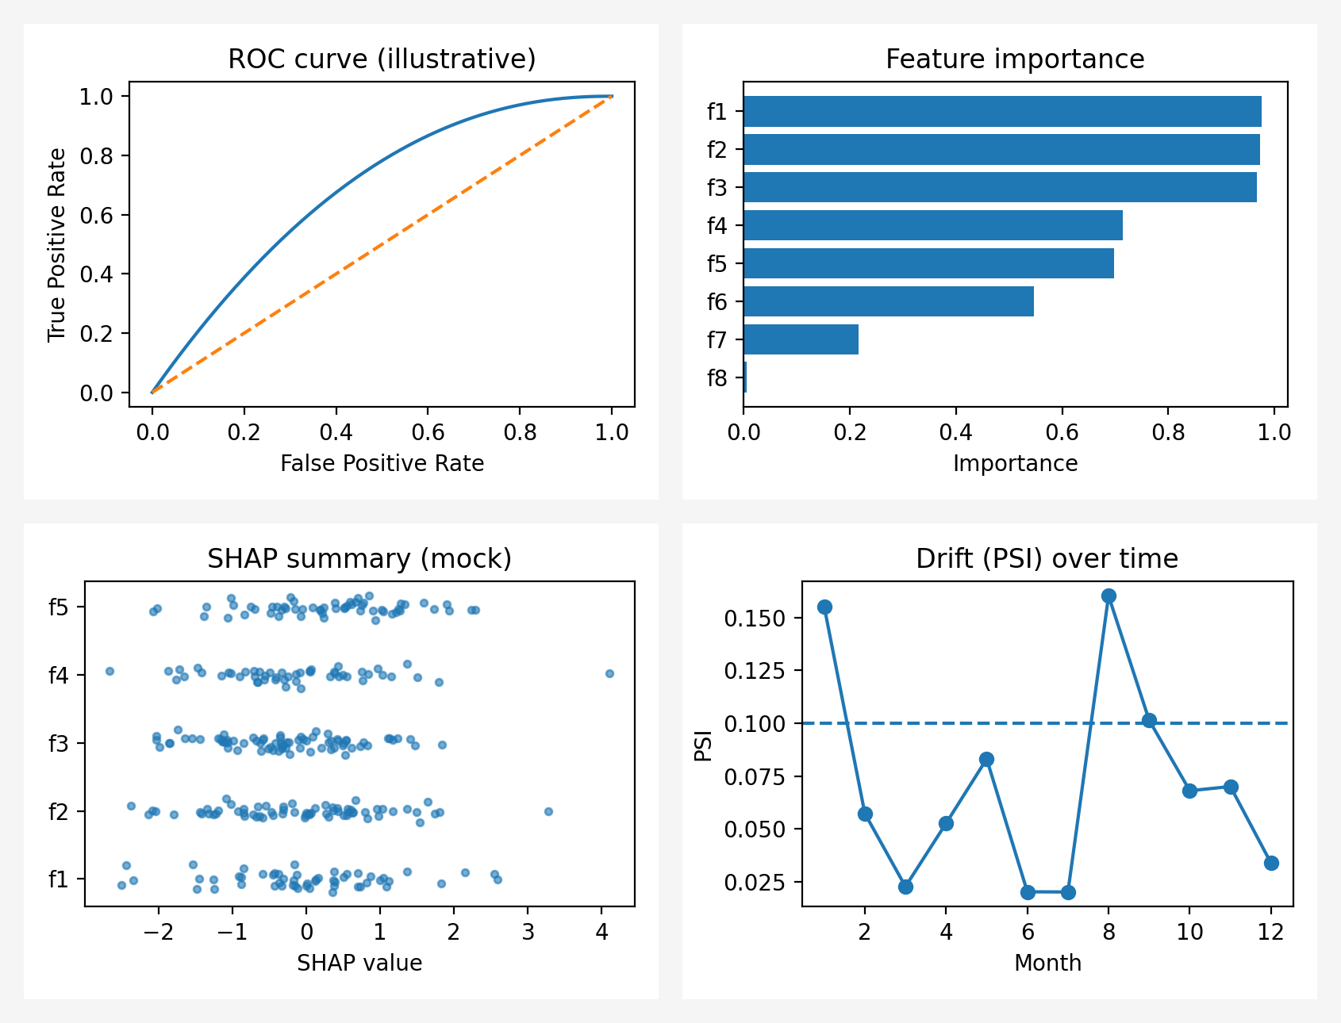
Python_DS • Home Credit Default Risk
Outcomes
Significant outcomes & artifacts
The pipeline produces actionable outputs for both competition submission and production hardening.
What you get after a run
Artifact montage (illustrative)
• Submission-ready predictions (submission.csv)
• Validation metrics (CV AUC, calibration curves)
• Feature importance and explainability snapshots
• Drift comparison summary between train/test
• Config + run metadata for reproducibility
ROC • Feature importance • SHAP summary • Drift (PSI)
github.com/zolcsika71/Python_DS

Slide 8
Python_DS • Home Credit Default Risk
Conclusion
Key insights & next steps
A production-minded DS pipeline: stable features, calibrated probabilities, and auditable artifacts.
Key insights
Next-step roadmap
• Modularity reduces experimentation risk and makes workflows easier to test and tune.
• Stable ratio features + missingness signals provide strong baselines for credit risk.
• Calibrated probabilities are essential for decision-making, not just leaderboard metrics.
• Drift + explainability artifacts help validate whether a model remains trustworthy over time.
1
Add relational feature aggregation (time windows)
2
Expand drift tests + alerts for production monitoring
3
Integrate SHAP reports and calibration plots as artifacts
4
Package as CLI/project template (cookiecutter/uv)
5
Add unit tests and data contracts for ingestion
Takeaway: a reproducible, production-ready DS pipeline that balances performance, robustness, and explainability.
github.com/zolcsika71/Python_DS

