Slide 1
Phishing Awareness
Cyber Rangers Training – ICT302 Project

Slide 2
What is Phishing?
Cybercrime tricking you into revealing sensitive info
Usually comes through:
Emails (fake invoices, overdue notices)
SMS messages (fake bank/OTP requests)
QR codes (leading to malicious websites)
Goal: steal passwords, money, or personal data

Slide 3
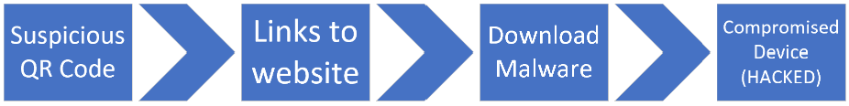
Quishing (example)
https://www.straitstimes.com/singapore/woman-who-scanned-qr-code-with-malware-lost-20k-to-bubble-tea-survey-scam-while-she-was-sleeping
What happened?
Woman scanned a QR code RIGHT OUTSIDE a bubble tea shop promising a free drink
Unknowingly installed malware on her phone
Scammers remotely access her bank app and transferred $20k while she was asleep

Slide 4
Real Examples in Our Game
SMS Phishing – 'Click this link to verify your account'
QR Code Phishing – scan leads to fake login page
Email Phishing – fake Murdoch University payment notice
(These are the Easter eggs in your Library storyline)
Find ‘em all! Interact with objects on the map to find them!

Slide 5
How to Spot Phishing
✅ Check sender address and spelling
✅ Hover over links before clicking
✅ Don’t trust urgent 'Pay Now!' messages
✅ Avoid scanning random QR codes
✅ Verify with the real source (bank, university, etc.)
See the next couple of slides for examples.

Slide 6
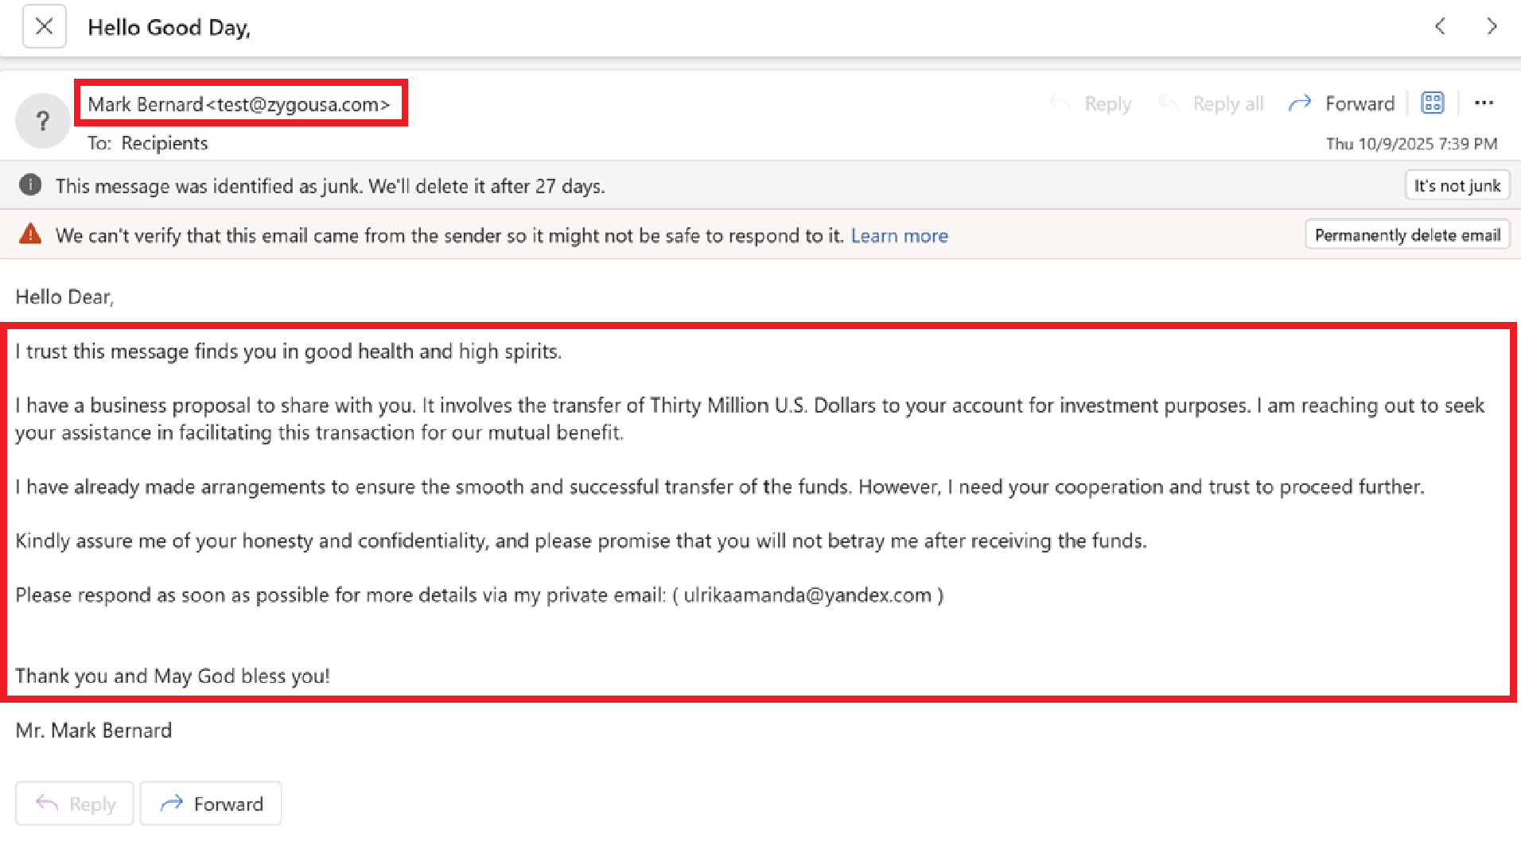
This email uses promise of wealth and requests for trust to gain cooperation from victims.
Always look out for suspicious sender address (test@zygousa.com)
Unrealistic money offers
Requests to reply to a different email

Slide 7
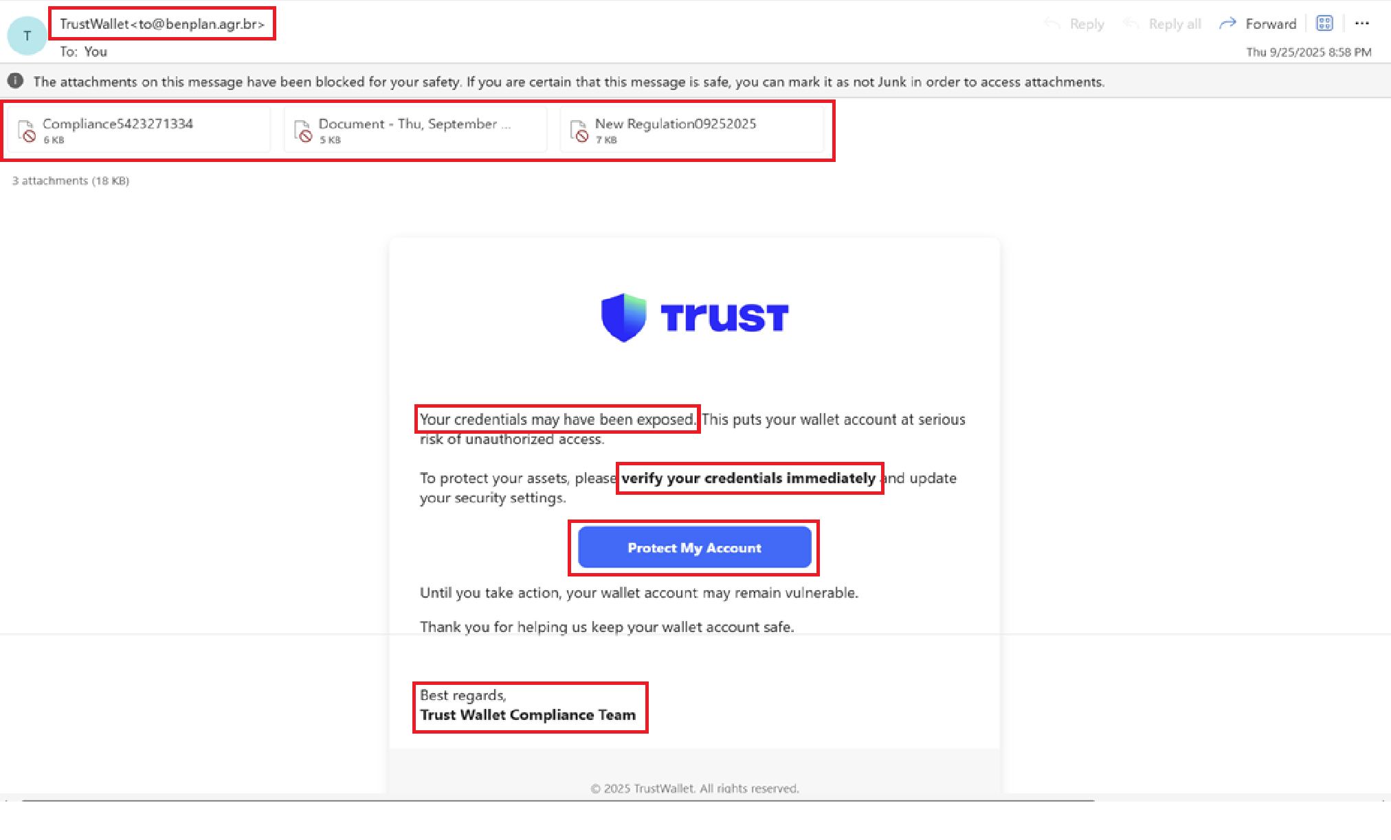
This email uses fear and urgency to trick victims, pretends to be from a trusted company and warning about “exposed credentials”.
Never open attachments in email
Never click through emails links, always check the official website directly!

Slide 8
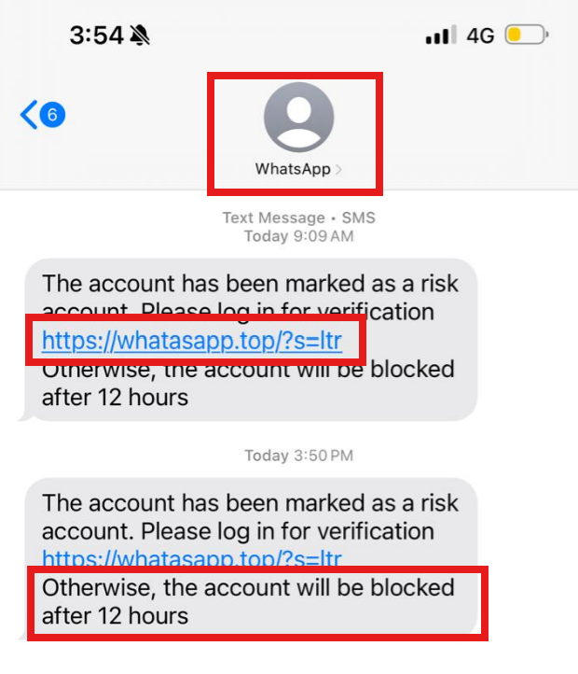
This fake WhatsApp message uses urgency and fear to trick users into clicking a spoofed link (whatasapp.top). The sender’s name is fake and real WhatsApp never asks for verification via links.
Always verify only in the official app

Slide 9
Stay Safe Online
Be skeptical, pause before clicking
Report suspicious messages to IT/security team
Always check the official website directly
Remember: Think Before You Click!

