Slide 1
Food Delivery Platform Architecture
A modular monolith with vertical slices: designed for launch, evolved for growth, hardened for failure, and extended for an acquisition
Notes:
Introduce the exercise: one platform, four stages. The point is not the final picture but how each decision is justified by the problem in front of us at that stage.

Slide 2
The brief: three users, one business, very tight constraints
What the system needs to do
Customers: create an account, browse restaurants, view menus, basket, place and pay for orders, track, view history
Restaurants: manage menu, receive orders, accept or reject, update status, see previous orders
Drivers: become available, receive delivery requests, accept, update status, see deliveries
Business: orders and revenue, completed deliveries, basic reporting
Starting constraints
1 restaurant, few drivers, small customer base
3 developers, no DevOps team
Very limited infrastructure budget
Prove the business model first
Rule we design by: "Don't solve problems we haven't been given. If you introduce complexity, explain what problem it solves."
Notes:
The brief says: do not solve problems we have not been given, and be ready to explain any complexity we introduce. Every decision in this deck is tested against that rule.

Slide 3
One architecture, evolved four times
Stage | Context | What we add | Deliberately not
Q1 Design | 1 restaurant, 3 devs, no DevOps | Modular monolith, 8 modules, vertical slices, schema per module, adapters for external systems | Microservices, message broker, GPS tracking
Q2 Growth | 15 to 50 restaurants, 5 devs, 1 city | Redis cache, outbox + PostgreSQL job queue, worker process, read replica, rolling deploys | Microservices, RabbitMQ, Kubernetes, search engine
Q3 Failure | 50 restaurants, 3 cities, 12 devs in 2 teams | Order-first, payment ledger with UNKNOWN, idempotency keys, circuit breaker, reconciliation | Extracting Payments, second provider, 2PC
Challenge | Acquired company with its own systems | Anti-Corruption Layer module, ID mapping, synced catalogue, contract tests | Shared database, rewrite, payment merge
Constant through every stage: one deployable, one PostgreSQL database, hard module boundaries, one folder per use case.
Notes:
This is the whole talk on one slide. The topology never changes: one modular monolith with vertical slices. Each stage adds only what its problems require. Q1 boundaries make Q2 changes local; the Q2 outbox is what makes Q3 safe; Q3 patterns are reused for the acquisition.

Slide 4
Question 1: Design the architecture
1 restaurant | 3 developers | no DevOps | very limited budget | prove the business model
Notes:
Three developers, no DevOps, one restaurant, so we build one deployable: a modular monolith. Eight modules each own their own schema in one PostgreSQL database and talk only through a public API or events. Inside each module, code is organised by use case as vertical slices, so each requirement in the brief is a folder.

Slide 5
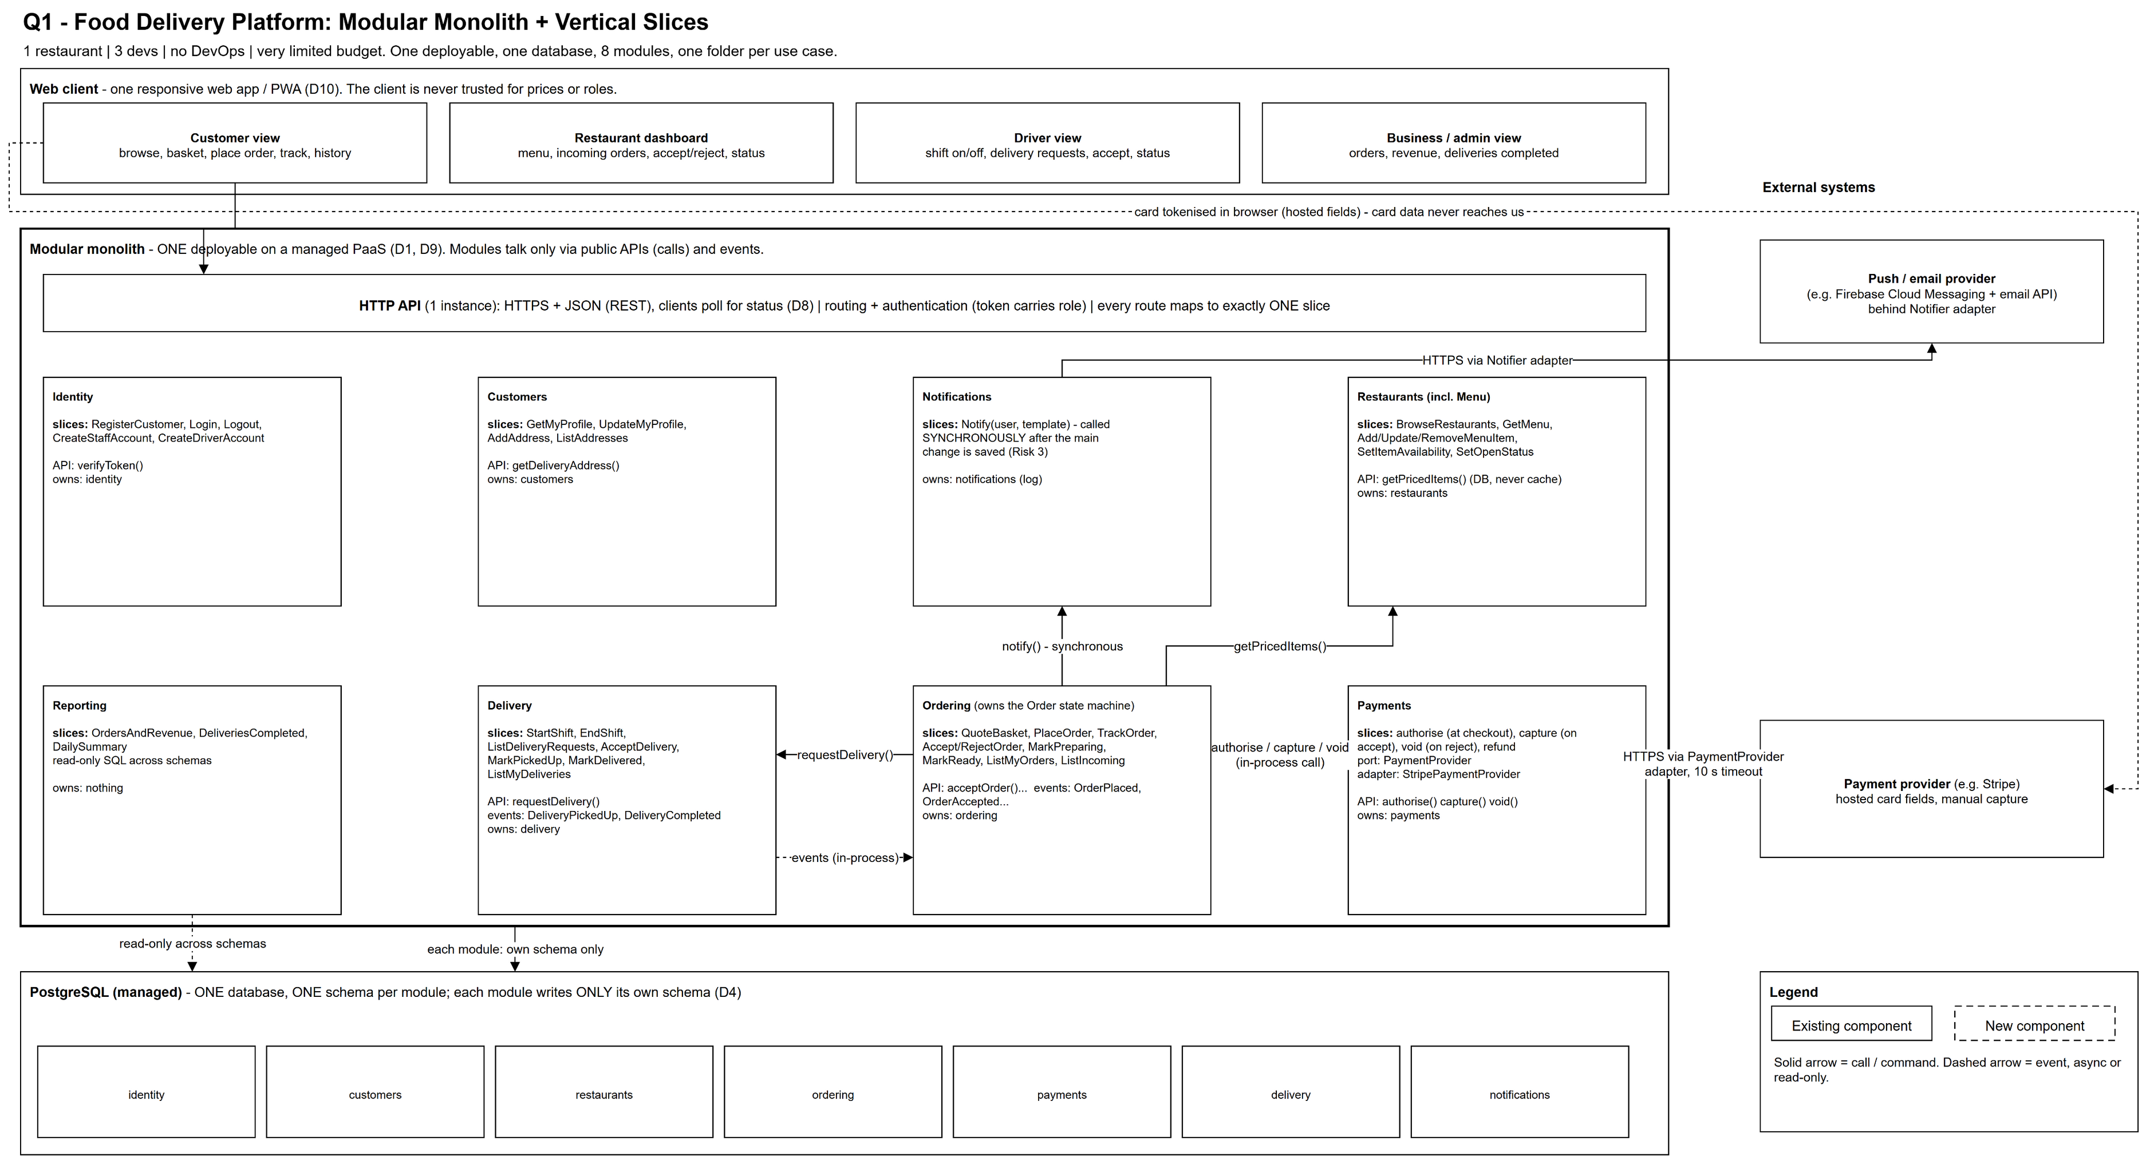
Q1 architecture: one app, eight modules, one database
Full-size diagram: FinalAnswers/Question1/diagrams/Q1-Architecture.drawio (page 1)
Notes:
Walk the diagram top to bottom: one responsive web app; one application with eight modules; one PostgreSQL database with one schema per module; two external systems behind adapters. Point out that the card is tokenised in the browser so card data never reaches us. Ordering is the heart; arrows show calls (solid) and events (dashed).

Slide 6
Each module owns its use cases and its data
Identity
RegisterCustomer, Login
Create staff / driver accounts
owns: identity
Customers
Profile, addresses
owns: customers
Restaurants (incl. menu)
Browse, GetMenu
Manage menu, open/close
owns: restaurants
Ordering
PlaceOrder, Accept/Reject
Status, Track, History
owns: ordering
Payments
Authorise, Capture, Void
Provider behind adapter
owns: payments
Delivery
Shifts, delivery requests
Accept, pick up, deliver
owns: delivery
Notifications
Push / email to users
owns: notification log
Reporting
Orders, revenue, deliveries
owns: nothing (read-only)
Notes:
With vertical slices, a responsibility is a slice is a folder. Every requirement in the brief maps to exactly one slice in exactly one module. Menu is part of Restaurants because it has the same owner and the same read path. Reporting owns no data and reads read-only across schemas.

Slide 7
Data, communication and boundaries
Where data is stored
One managed PostgreSQL, one schema per module
Only the owning module writes its schema
IDs only across modules; no cross-schema foreign keys
Order lines keep a price snapshot
Card numbers never touch our servers
How components communicate
Client to API: HTTPS + JSON, polling for status
Commands: direct call to a module's public API
Facts: in-process events (e.g. DeliveryCompleted)
External systems: through adapters with timeouts
Architecture test fails the build on illegal imports
Major boundaries
Deployment: one deployable app
Modules: code + schema + public API
Slices: one folder per use case
External: our model vs the provider's
Trust: client never decides prices or roles
Notes:
Data: one database, a schema per module, only the owner writes, IDs only across modules, snapshots of prices on order lines. Communication: commands are direct calls to a public API; facts are in-process events, which breaks the Ordering-Delivery cycle. Boundaries: deployment, module, slice, external, trust.

Slide 8
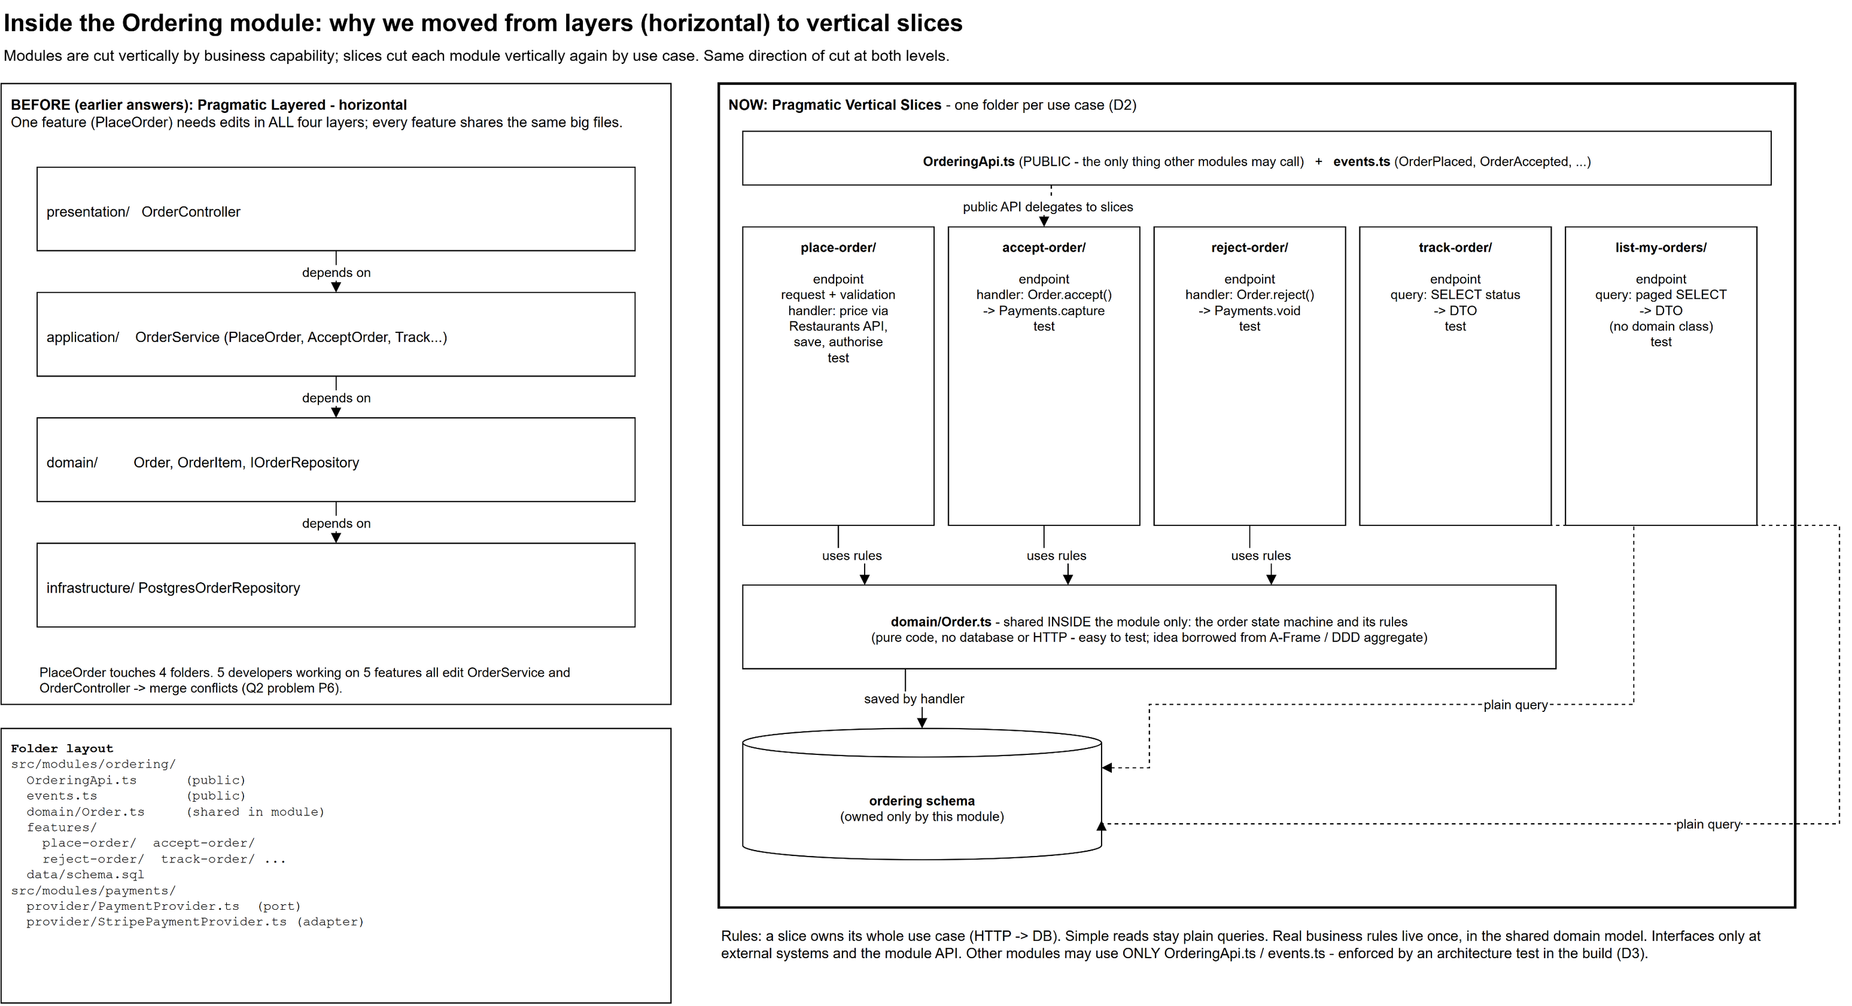
Inside a module: vertical slices instead of layers
Modules cut the system by business capability; slices cut each module by use case
Notes:
Left: the earlier layered design. One feature touches four folders and every developer edits the same OrderService. Right: vertical slices. One feature is one folder. Simple reads stay plain queries; real rules like the order state machine live once in a small shared domain model. That is the pragmatic part.

Slide 9
Three important architectural decisions
1 Modular monolith
One deployable, one database, schema per module
Why: 3 devs, no DevOps, tiny budget
Rejected: microservices, unstructured monolith
2 Vertical slices inside modules
One folder per use case + small shared domain
Why: features change in one place, low ceremony
Rejected: layered / Clean everywhere
3 Authorise, then capture
Hold at checkout, capture on accept, void on reject
Why: no refunds for rejected orders
Provider behind an adapter; hosted card fields
Also recorded: drivers belong to restaurants, polling over WebSockets, managed PaaS hosting, in-process events.
Notes:
Decision 1 is about cost of operation. Decision 2 is about cost of change. Decision 3 is about money correctness: hold at checkout, take on accept, release on reject, so a rejection is never a refund.

Slide 10
Three risks, and two things we chose not to do
Risks we accept
Boundary erosion: a shared database makes "just one JOIN" easy. Mitigated by schemas, public APIs, architecture tests
Payment provider on the order path: a timeout may hide a successful hold. Fixed by hand at this scale (becomes Q3)
One process, one database: one heavy query or slow call slows everything (becomes Q2)
Not done 1: microservices or a broker
They solve big-team and scaling problems we do not have
Modules can be extracted later if needed
Not done 2: real-time GPS tracking
Status-based tracking meets "track the order"
Revisit if support load or customers demand it
Notes:
The risks are honest and they set up the next two questions: shared resources is exactly what Q2 reports, and the payment provider on the order path is exactly what Q3 breaks.

Slide 11
Which internal style? We combined what pays off
Option | Used? | How
Vertical Slice Architecture | Yes, primary | Code organised by use case inside each module
Hexagonal / Ports and Adapters | At the edges | Payment provider and notification provider sit behind our own interfaces
Domain-Driven Design | Selectively | Modules are bounded contexts; Order is an aggregate guarding its state machine
A-Frame | The idea | Order rules are pure code with no database or HTTP, so they are easy to test
Clean Architecture | No | Concentric layers and interfaces everywhere: too much ceremony for 3 developers
Notes:
The question lists five styles. We do not pick one dogmatically: vertical slices are the primary structure; ports and adapters only at external systems; DDD strategically for module boundaries and tactically only for Order; the A-Frame idea of keeping decision logic pure.

Slide 12
Question 2: Six months later
15 restaurants, 50 expected | 5 developers | still one city | more budget, still no DevOps
Notes:
We keep the architecture, because none of the symptoms is caused by being a monolith. Each symptom gets a targeted fix, and we deliberately do not add microservices, a message broker or Kubernetes.

Slide 13
Every symptom traced to a Q1 cause, and one fix
Symptom | Cause in Q1 | Fix in Q2
Browsing gets most traffic | Every menu view hits the database | Redis cache-aside for browse and menu, CDN
Expensive DB operations | 15x data, missing indexes | Measure (pg_stat_statements), index, paginate
Notifications slow requests | Sent synchronously in the request | Outbox + PostgreSQL job queue + worker
Reporting hurts performance | Heavy queries on the live database | Read replica + daily summary table
Disruptive deployments | One instance, breaking migrations | 2+ instances, rolling deploys, expand/contract
Developers collide | No ownership; DB not protected | DB role per module, CODEOWNERS, CI tests
Add restaurants fast | Manual onboarding | Self-service onboarding slices
Notes:
Go row by row. The pattern is always the same: symptom, the Q1 decision that causes it, the cheapest fix that removes the cause.

Slide 14
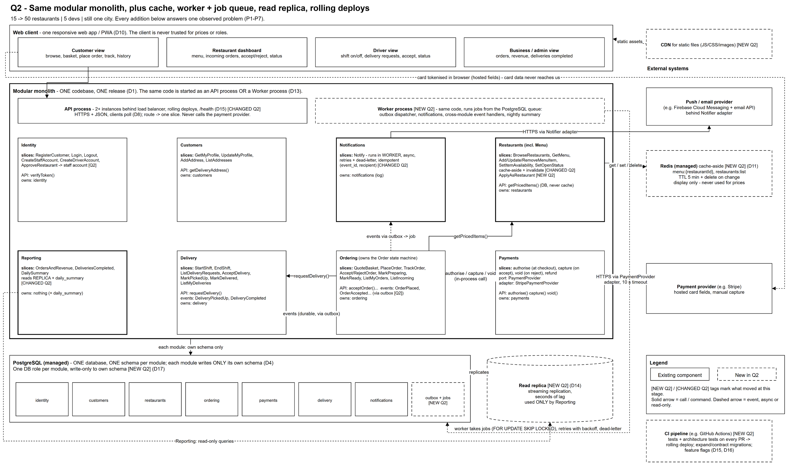
Q2 architecture: same monolith, targeted additions
Dashed = new in Q2, thick border = changed in Q2
Notes:
Same layout as Q1 on purpose. Dashed boxes are new: CDN, Redis, worker process, outbox and job tables, read replica, CI pipeline. Thick borders are modules that changed. The worker is the same codebase started with a different command, not a new service.

Slide 15
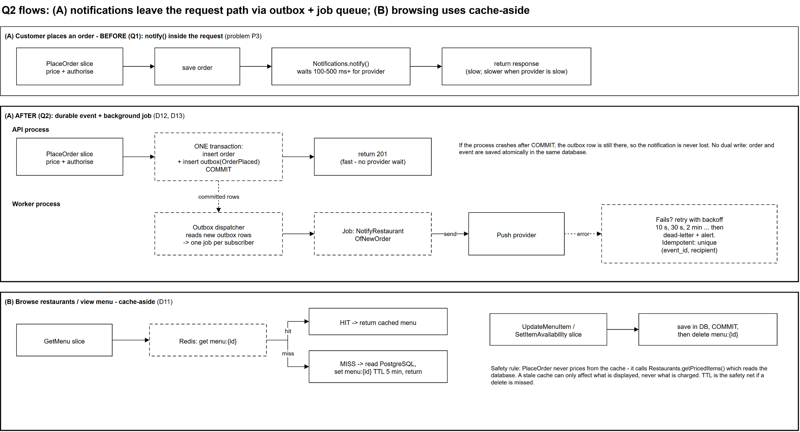
Notifications leave the request path
Why not RabbitMQ?
Save order, then publish: a crash in between loses the message (dual write)
So we need an outbox anyway
A PostgreSQL queue is transactional with our data
No new server for a team without DevOps
Notes:
The order and its event are saved in one transaction, so a crash after commit cannot lose the notification. RabbitMQ would still need an outbox to avoid the dual-write problem, so we keep the queue in PostgreSQL: no new server, no lost messages.

Slide 16
Kept, changed, and deliberately kept simple
Still works (kept)
Modular monolith
Vertical slices: now paying off
Module boundaries and schemas
Ports and adapters
Authorise / capture payments
Polling for status
Reconsidered (changed)
Sync notifications to async worker
In-memory events to durable outbox
Reports on live DB to read replica
No cache to Redis cache-aside
Single instance to rolling deploys
Code checks to + DB roles, CODEOWNERS
Deliberately simple
One deployable
One primary database
No message broker
No Kubernetes
No search engine
No multi-city work
Notes:
This answers the question's three lists directly. We are not allowed to redesign because we can, and we do not.

Slide 17
Should we introduce...? Each answer names its problem
Option | Answer | Problem it solves, or why not
Caching | Yes | Read-heavy, rarely-changing browse and menu data
Background processing | Yes | Slow notification work leaves the request path
Messaging | Durable events, no broker | Crash-safe events without a new server
Queues | Yes, in PostgreSQL | Retries, backoff, dead-letter, transactional
Separate reporting storage | Read replica | Removes contention; a warehouse is not needed
Independent deployment | No | Rolling deploys fix the disruption more cheaply
Additional services | No | A worker process from the same codebase is enough
Stronger module boundaries | Yes | DB roles, CODEOWNERS, tests on every PR
Notes:
Every yes is tied to a symptom. Every no has a cheaper alternative that already solves the problem.

Slide 18
Question 3: Friday night, the payment provider fails
50 restaurants | 3 cities | 12 developers in 2 teams | 10 more cities planned
Notes:
The root mistake was treating a payment as success or failure. Over a network it can also be unknown. Everything in this section follows from taking unknown seriously.

Slide 19
The root mistake: treating payment as success or failure
SUCCEEDED
The provider said yes
FAILED
The provider said no
UNKNOWN
We asked and never heard back
What happened on Friday | Why the Q2 design produced it
Charged but cannot see the order | Timeout recorded as failed although the provider succeeded
Customers clicked Place Order again | Each click created a new order and a new payment
Some restaurants never got orders | Requests died mid-way; nothing finished the work
Data still wrong after recovery | Nothing reconciled our records with the provider
Notes:
Over a network, no reply does not mean failed. The request may never have arrived, may have succeeded with the reply lost, or may still be running. Our Q2 code turned every timeout into "failed", which is why customers were charged without seeing an order and clicked again.

Slide 20
Eight changes, all inside existing modules
Ordering and Payments
Create the order first, then request payment by event
Payment attempt ledger with an explicit UNKNOWN state
Idempotency keys: client, job handlers, provider
Provider calls only in the worker, behind a circuit breaker
Recovery and visibility
Reconciliation: webhooks, sweeper, daily settlement
Compensation: void a late hold, refund if captured
"Confirming your payment" screen; one pending order per customer
Support timeline and alerts on circuit state and UNKNOWN count
Notes:
No new topology. Every change lives in Payments or Ordering, plus support tooling. Read them as prevent, contain, survive, converge, compensate, explain.

Slide 21
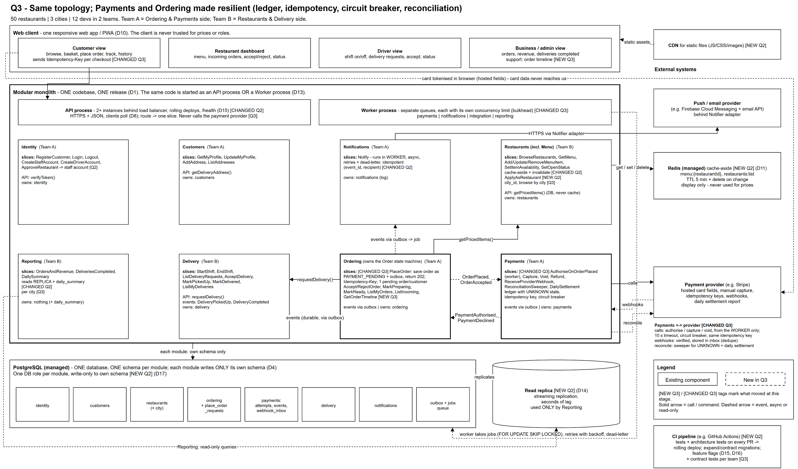
Q3 architecture: same topology, resilient payments
Thick border = changed in Q3 (Ordering, Payments)
Notes:
Payments now runs provider calls only from the worker, on its own queue with its own concurrency limit. Provider webhooks come back into an inbox. A sweeper and a daily settlement check reconcile anything uncertain. Modules are grouped by team: Team A owns ordering and payments, Team B owns restaurants and delivery.

Slide 22
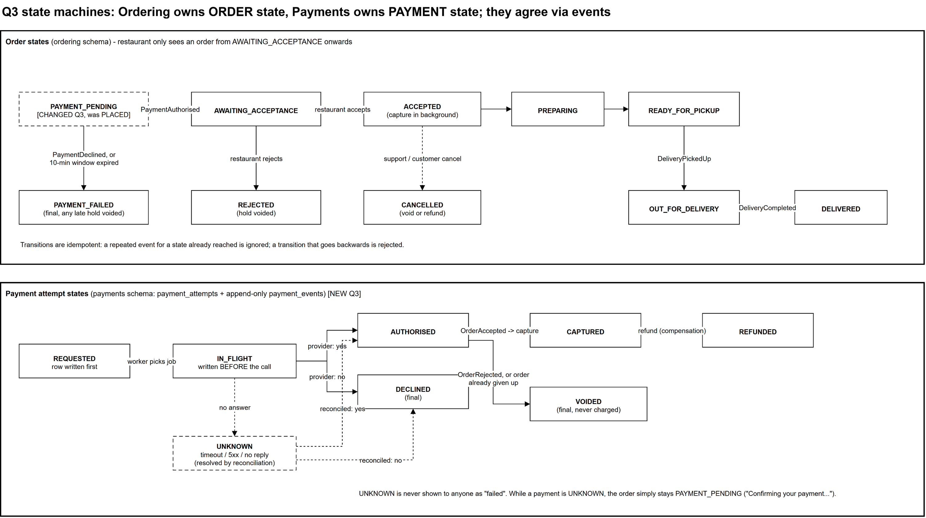
Order state and payment state live in different modules
Restaurants only see orders from AWAITING_ACCEPTANCE onwards
Notes:
Ordering owns order state, Payments owns payment state, and they agree through events. While a payment is UNKNOWN, the order just stays PAYMENT_PENDING; Ordering never needs to know why. The restaurant only sees an order once payment is authorised.

Slide 23
Walkthrough: exactly what happens when...
Scenario | What happens
Payment request times out | Attempt marked UNKNOWN, not failed. Order stays PAYMENT_PENDING; reconciliation scheduled
It actually succeeded | Webhook, sweeper (same key replay) or settlement finds it; order proceeds, or the hold is voided if we gave up
Customer retries | Same idempotency key returns the same order; a new key hits the one-pending-order rule
Same request received twice | Unique constraints, state checks and the provider key make every repeat a no-op
Crash after payment succeeds | Job re-runs with the same key; result and event saved in one transaction (outbox)
Provider comes back online | Circuit half-opens, backlog drains at a capped rate, sweeper resolves every UNKNOWN
Failed operations retried | Only transient errors, same key, backoff with jitter, then dead-letter. Declines are never auto-retried
Notes:
This is the core of the answer; practise it without notes. Each scenario has a mechanism, and every mechanism is safe to run more than once.

Slide 24
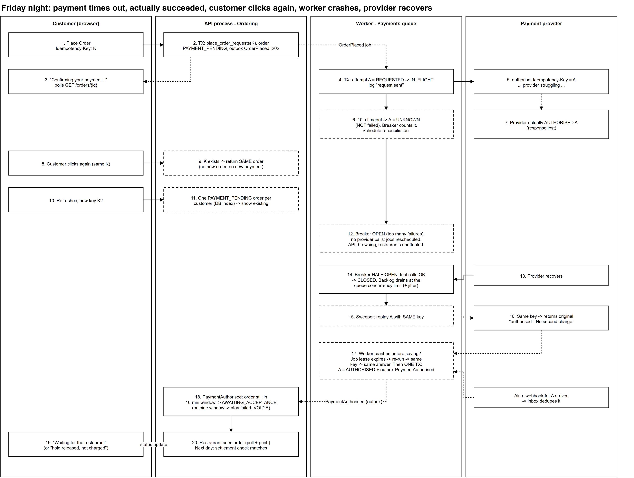
From timeout to recovery, step by step
The safety mechanisms
Timeout becomes UNKNOWN, never failed
Same key returns the same order
One pending order per customer
Circuit breaker stops calls while the provider is down
Same-key replay cannot charge twice
One transaction saves result and event
Notes:
Read the lanes left to right: customer, API, worker, provider. Steps 6, 9, 11, 12, 15 and 17 are the safety mechanisms. Step 18 is the decision: inside the 10-minute window the order proceeds, outside it the hold is voided.

Slide 25
How the architecture recovers
Layer | Mechanism | Protects against
Prevent | Order first, idempotency keys, one pending order per customer | Duplicates; charged with no order
Contain | Worker-only provider calls, own queue, timeouts, circuit breaker | A slow provider dragging everything down
Survive crashes | Ledger written before calling, outbox in the same transaction | Lost results and lost events
Converge | Webhooks, sweeper, daily settlement check | Outcomes we never heard
Compensate | Void or refund rules | Money held for orders that will not happen
Explain | Payment events log, order history, support timeline, alerts | Support questions and post-incident review
Notes:
Six layers, each answering one of the question's prompts. If asked how we know what happened after the fact: the append-only payment events table, order status history, and the order id as a correlation id in every log.

Slide 26
Synchronous or asynchronous, and where failures stop
Synchronous
Browse and basket quote
Recording the order (returns 202)
Restaurant accept / reject
Status updates and history
Asynchronous
Authorise, capture, void, refund
Notifications
Reconciliation
Reporting summaries
Deliberately not done
Extracting Payments: adds another network hop that can also time out
Second payment provider
Two-phase commit
Event sourcing everywhere
Notes:
Rule of thumb: synchronous when the user waits and only our own database is touched; asynchronous when a third party or slow work is involved. Failures are isolated at the Payments adapter, inside the payments worker queue, behind the circuit breaker.

Slide 27
Final challenge: integrating an acquired company
Their own customer, restaurant, order and payment systems | integrate without rewriting either platform
Notes:
We add one module, an anti-corruption layer. It is the only code that knows the acquired platform exists. Each platform keeps owning its own data and its own payments.

Slide 28
First decide what "integrate" means, and who owns what
Phase 1 scope
In: our customers can order from their restaurants
In: combined orders and revenue reporting
Unchanged: their customers keep using their app
Later: merging customer accounts (with consent)
Out: rewriting either platform, merging payments
Data ownership
Their restaurants and menus: they own; we hold a read-only copy
Orders on our platform: we own the customer-facing order
Fulfilment of those orders: their system and drivers
Payment: each platform charges for its own orders
ID mapping: owned by the integration module
Notes:
Scope is the first architectural decision. Phase 1 delivers the commercial value: their restaurants on our platform and combined reporting. Each fact has exactly one owner; copies are labelled as copies; no dual writes, no shared database.

Slide 29
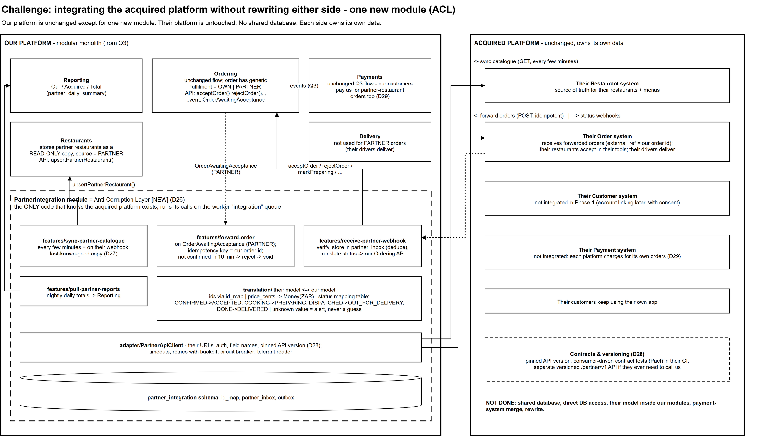
One new module: the Anti-Corruption Layer
Our modules never see their model; their platform is untouched
Notes:
The PartnerIntegration module is the only code that knows them. Catalogue is synced in as a read-only copy, orders are forwarded with our order id as the idempotency key, and their status webhooks are translated into our own Ordering commands. It is just another module: own schema, slices, adapter.

Slide 30
Their failures stay on their side
Failure | What happens
Their API down during sync | Serve last synced copy; after 30 min mark their restaurants unavailable
Their API down when forwarding | Retry with the same key; no confirmation in 10 min means reject and void
Webhook missed or duplicated | Polling reconciles; inbox drops duplicates
Their payload changes shape | Translation fails loudly to dead-letter; our data is never corrupted
Versioning and coupling
Pin their API version in the adapter
Consumer-driven contract tests
Tolerant reader for additive changes
Separate versioned partner API if they call us
No shared code, data or database
Notes:
Their platform is treated exactly like the payment provider in Q3: an external dependency we do not control. We reuse the same tools: worker queue, circuit breaker, idempotency, reconciliation. Versioning is pinned and protected by contract tests.

Slide 31
The thread through all four answers
Q1 boundaries make every Q2 change local. The Q2 outbox is what makes Q3 safe. Q3 resilience patterns are reused for the acquisition.
Questions?
Notes:
Close by restating the method: design for the constraints you have, keep boundaries strong, and add complexity only when a named problem demands it.

