Slide 1
Special Course on Modelling Supermarket Refrigeration Systems
Zoltan Mark Pinter, s172040
Supervisor for special course: Dimitrios Papageorgiou <dimpa@elektro.dtu.dk>

Slide 2
Schedule
Description of model
Description of architecture
Results
Quick description of Modelica and TIL
Comparison of the two implementation

Slide 3
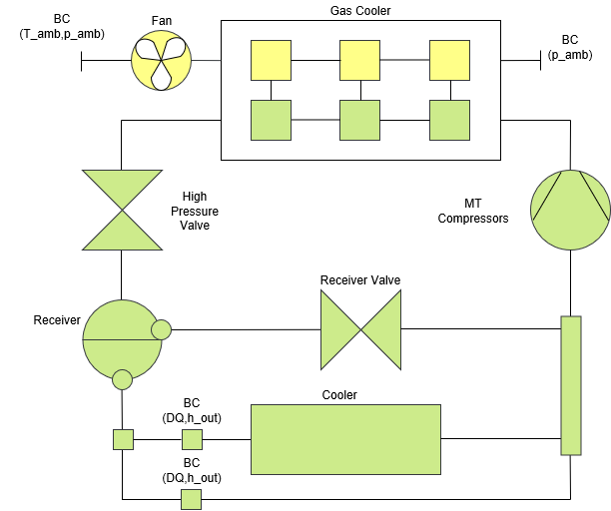
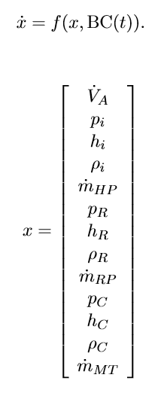
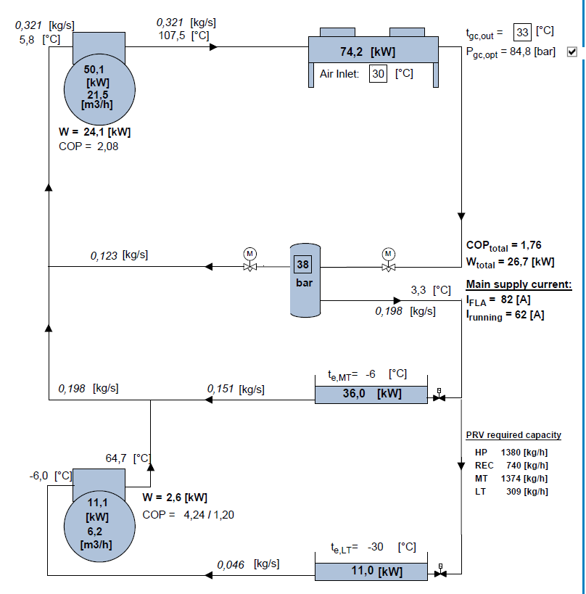




Description of model
Gas Cooler as main perspective
Cooler
Boundary conditions
Supercritical design point
Basic equations:
Energy balance
Mass Balance
Partial differential rule
Low pass filter

Slide 4
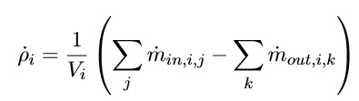
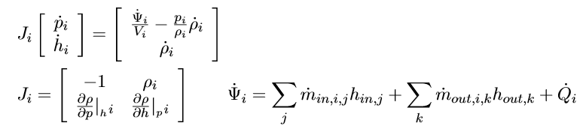
Description of model: Volumes
Tank
Inheritance: receiver and evaporator
Heat Exchanger
Joint matrix, excitation
Receiver: noheat transfer, and outlet states separately calculated
Evaporator: BC with given heat and enthalpy outlet, THEN volume

Slide 5
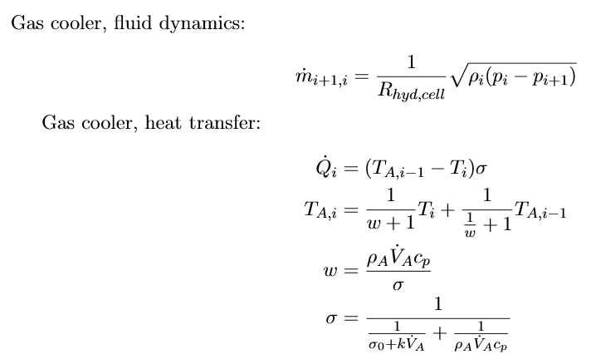
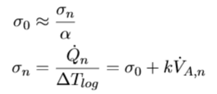
Description of model: Gas cooler
Constant volume cell structure to model heat transfer correctly
Low pass filters for interactions
States: pressure, enthalpy, density
Tube resistance: mass flow rate states
Thermal resistance: air temperature states

Slide 6

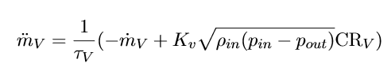

Description of model: concentrated elements with states
Fan:
Valves:
Compressor (MT):

Slide 7
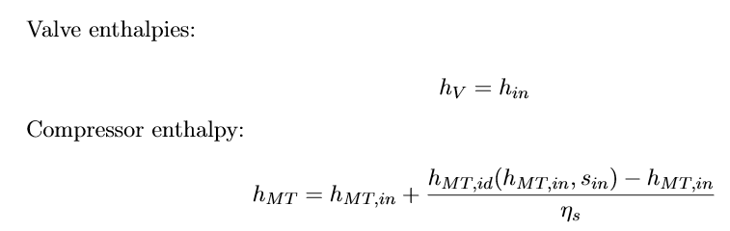
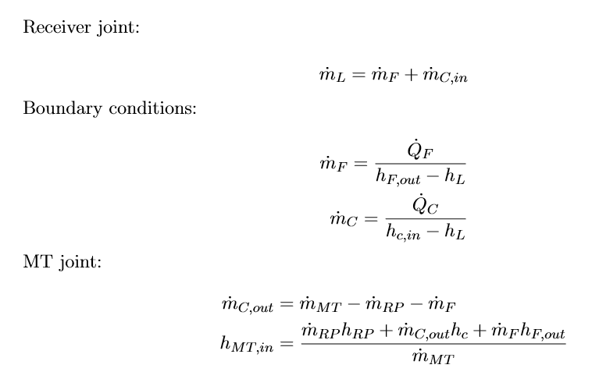
Description of model: constraints
Order of assignments is important

Slide 8
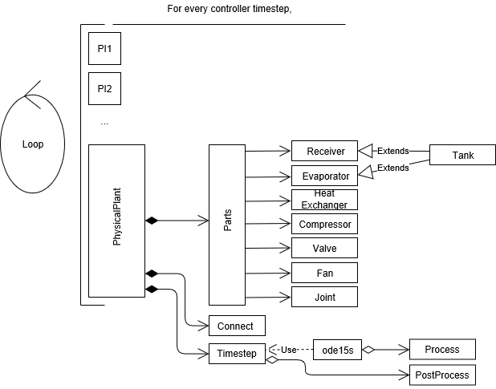
Description of acrhitecture
Solver: ode15s
Explicit solver
For stiff equations
Modularity
Connect function for outer constaints

Slide 9
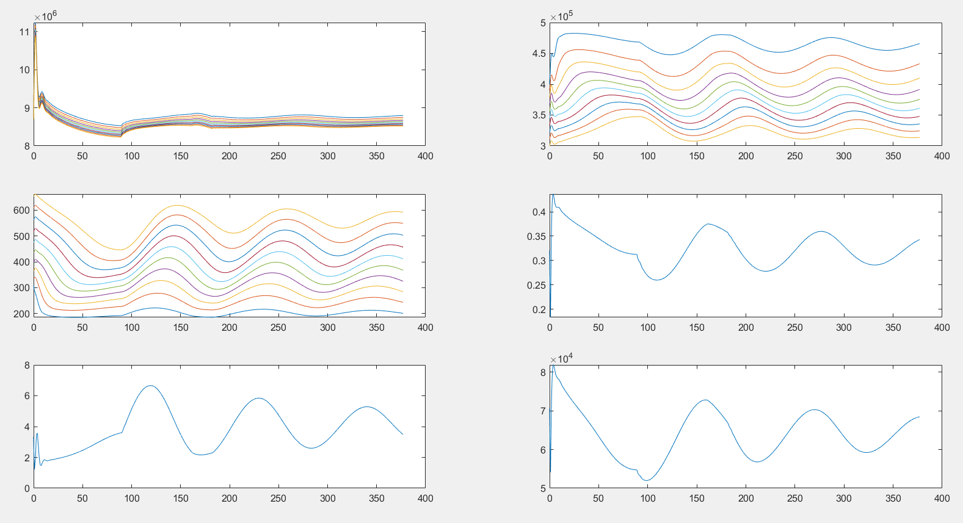
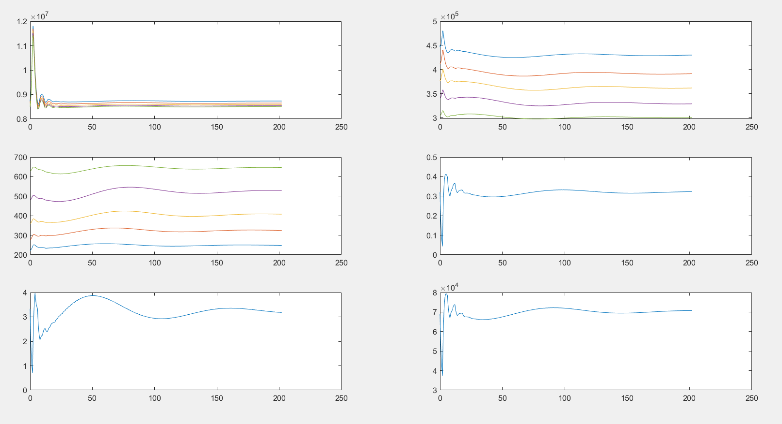
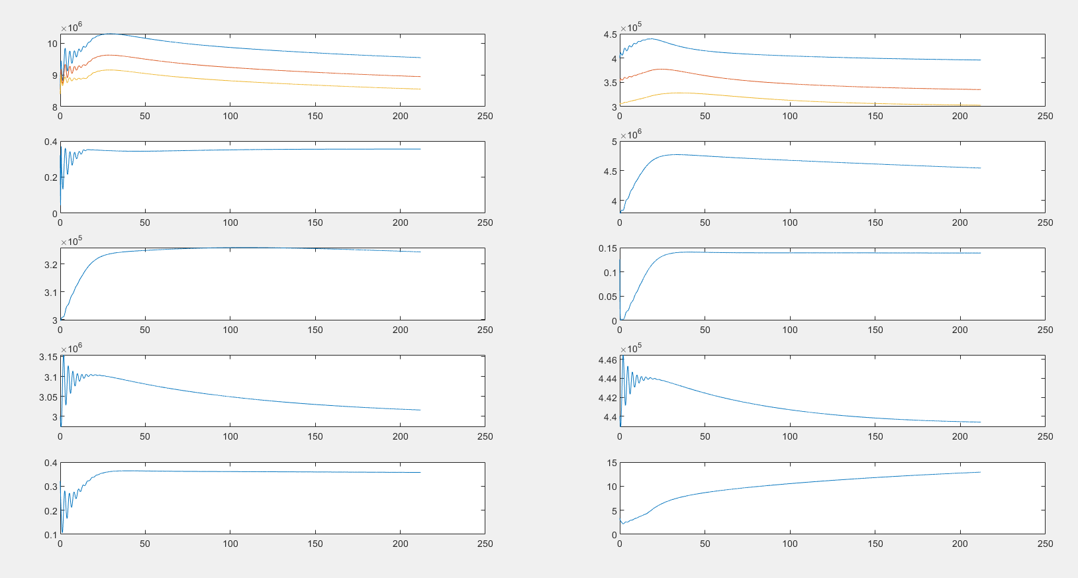
Results
Volume flow value is wrong (does not satisfy energy balance for air)

Slide 10
Results
Volume flow value is wrong (does not satisfy energy balance for air)

Slide 11
Results
Volume flow value found with sigma*10

Slide 12
Results
Entire system with no LPFs for flow resistance and heat flow

Slide 13
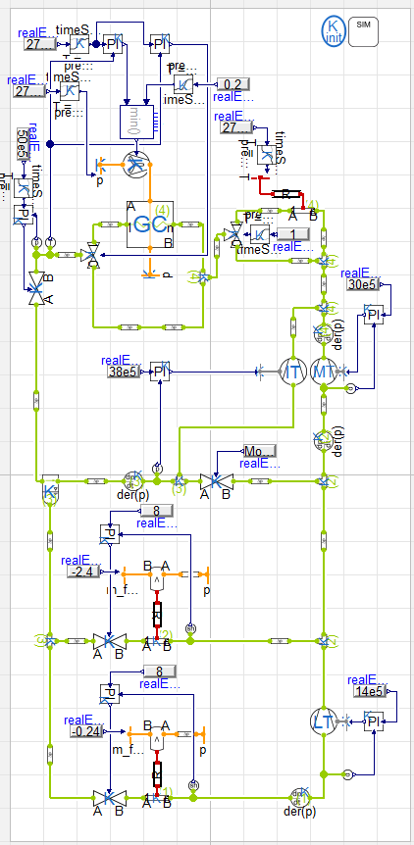
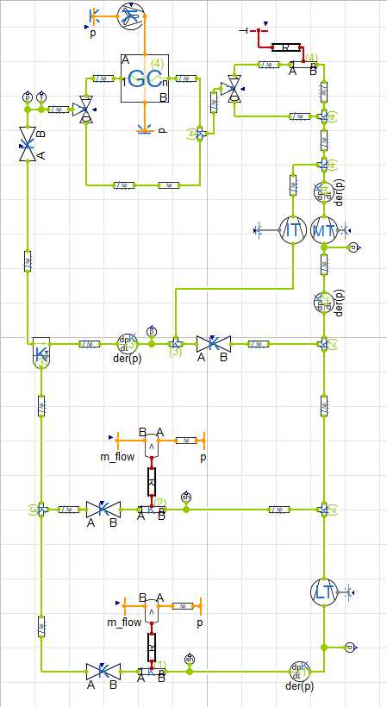
Modelica and TIL (KoolLibrary)
Object oriented programming
More systemized
Dymola IDE gives the opportunity for ‘visual coding’
Two level solver architecture
explicit inner, implicit outer, DAE solvers (DASSL)
PI controllers

Slide 14
Comparison of KoolLibrary and matlab model
TIL has extreme value handling and some smoothing functions, e.g. for square root
TIL
does not state equations for mass flow rate in gas cooler (optimizes for it)
neglects –p/d*dp term at volumes
has more states describingheat flow dynamics in gas cooler (gas and wall cells)
There is no natural convection
TIL uses low level coded CoolProp, matlab model uses high level (slower)
Modelica uses DASSL solver:
More stuck initially and provides wrong transients, then speeds up close to steady state
Matlab model is
about 100 slower (partially due to handling sampled control actions)
provides more reliable initial transients,
Conclusion:
matlab model is better used for initial model check for model based controller design
but experiments shall be done on the Modelica model

Slide 15
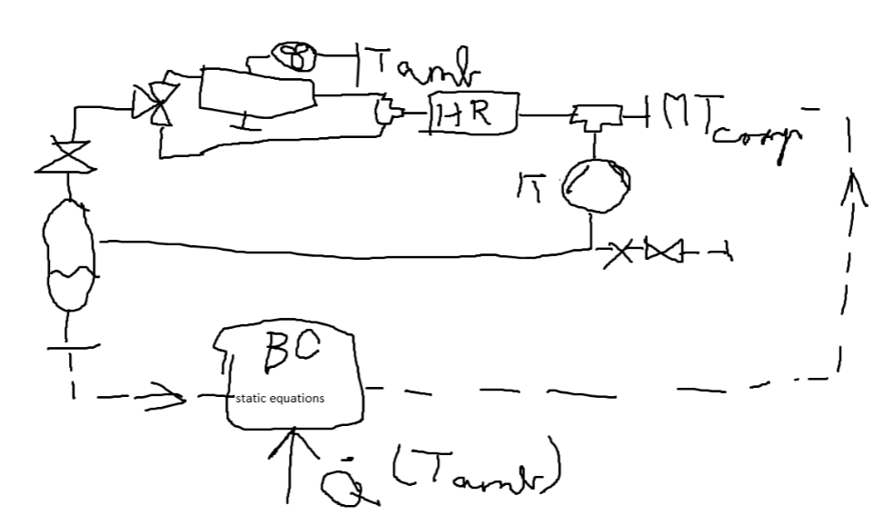
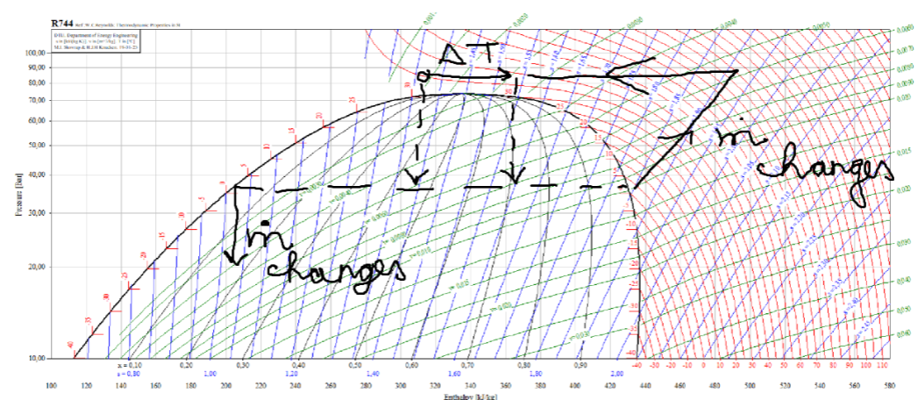
Master Thesis
Gas Loop
Deviation or hysteresis in temperature measurement
-> Fluid heats up and loses heat gaining capacity
-> Hot gas is circulated, while cabinets warm up
Model for thesis: heat recovery and bypass valve added, cooler volume excluded
-> reducing model uncertainty
Only for control purposes
Current solution: increasing pressure temporarily
Possible tasks:
Identification of highly nonlinear parameters
Estimation for control
Control in a feasible way (with early detection, or robust control?)

Slide 16
Thank you for the attention!

