Slide 1
2UV-Project
MES software for automation of different sectors

Slide 2
Layout
Introduction
Modules
DatabaseEditor
Logging
Server
Commands + simulators
Methods and ObjectMethods

Slide 3
Introduction
This project is a method to automate production processes. Should be fast adaptable, highly accessible from different platforms and represent the data in different way’s. It is open for connections to hardware and software from external partners. Internal we have cycle builders to build the logic with different routines of the different processes.

Slide 4
Modules
Object viewer
Object Locator
Schedule planner
Cycle builder
Measure values representation

Slide 5
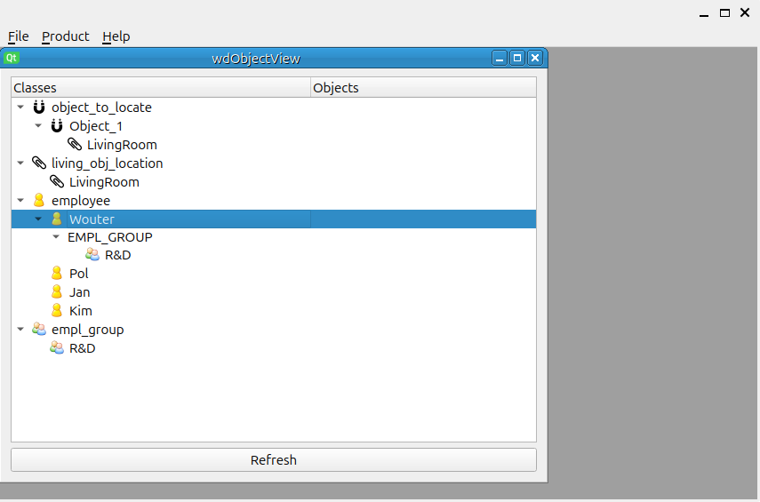
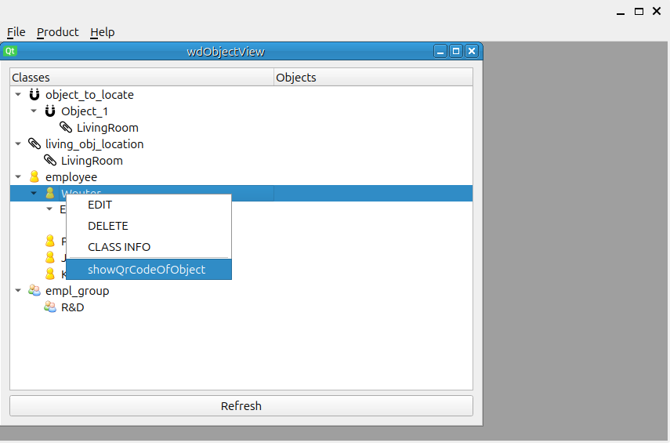
Object viewer
All configured objects displayed, only classes who are configured.
Only methods who are configured displayed

Slide 6
Object Viewer
Logic
Server
DB
Object Viewer

Slide 7
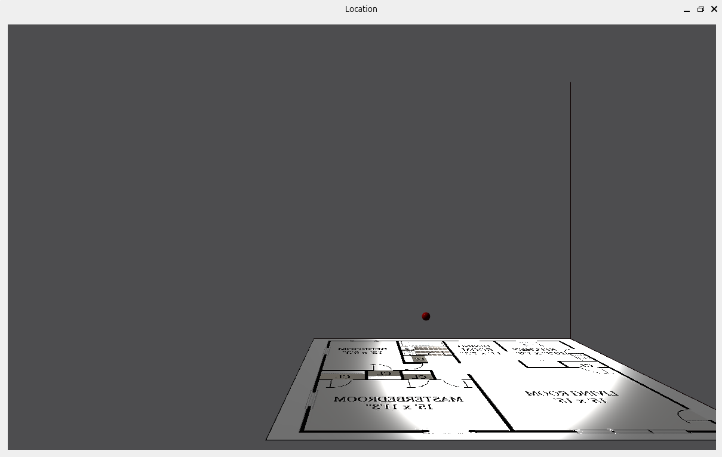
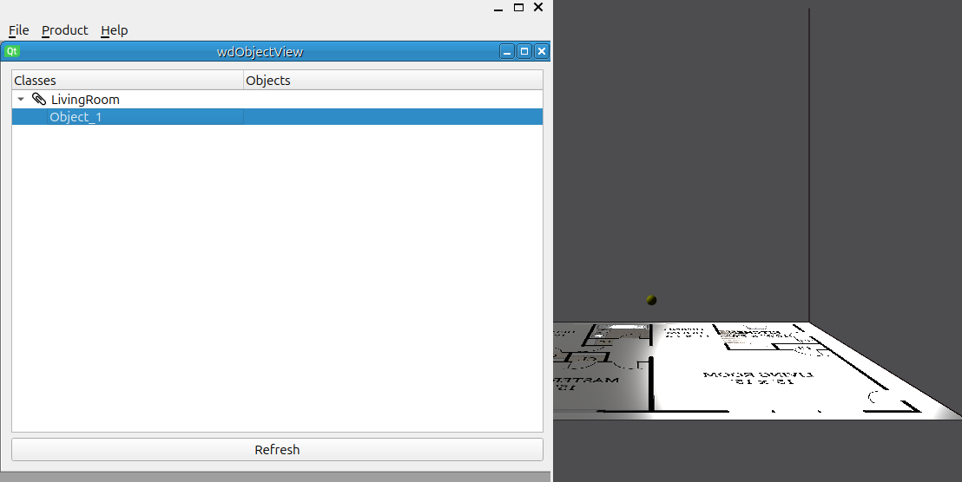
Object Locator
In the Livingroom object_1 is located with certain coord. When selected it is yellow on the floor plan. You van have several living rooms and maps diplayed.

Slide 8
Object Locator
Logic
Server
ServerTest
Living_obj_location
SocketBox
DB
Object Locator
Measure HW

Slide 9
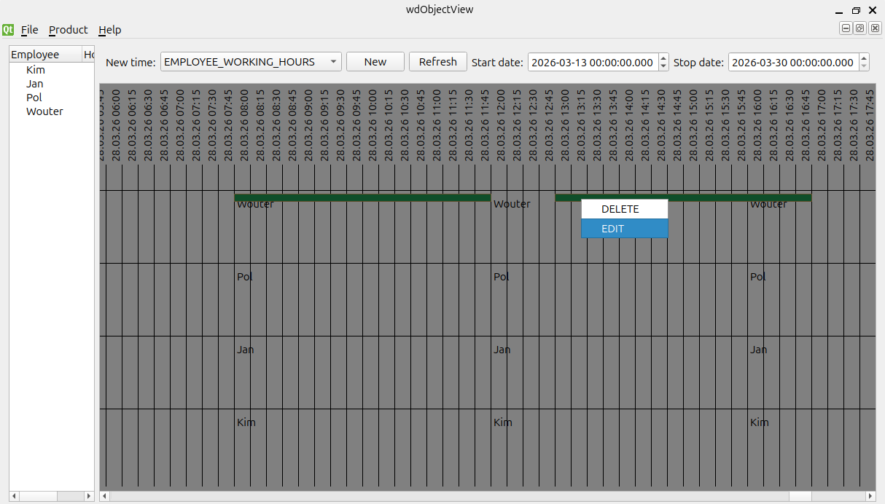
Schedule planner
Schedule planner we can display working hours calculated and modify them. According the worksteps pro product we can calulate how many load there is for that time. Then with a planning method we can plan the times over the users. Modifying manually is also possible.
Classes for working hours are configured in the XML file of the database structure.
There you can add attributes to the planning object.

Slide 10
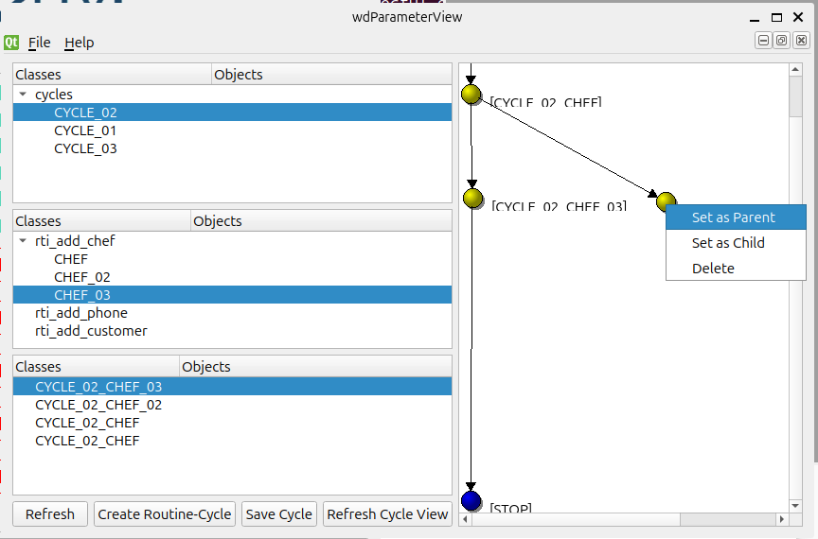
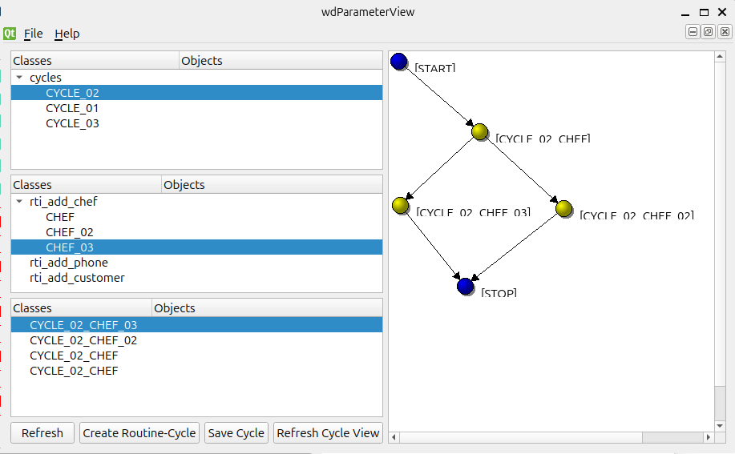
Cycle Builder
Here we can configure the tree structure of the cycle builder. The return argument of the routine decides where it will go, left or right when cycling. You can pass objects to a routine.
In a routine we can set methods to communicate with the side HW or machines connected.

Slide 11
Cycle Builder
Logic setup cycling
Server
DB
Cycle Builder

Slide 12
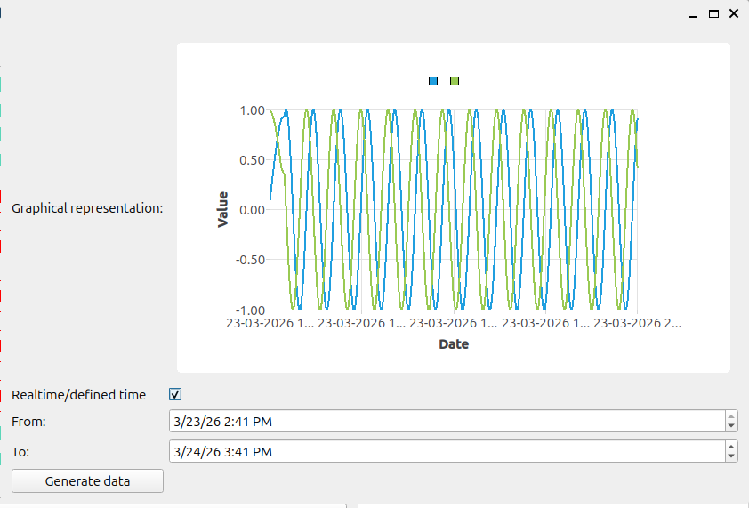
Measure Data
We can check the measure data over a defined time/ real time and export the data to a certain format. All data is in the database in operations.
We can configure in an xml file the:
- Measure equipment for HW
- Kind of measure value
- Multiple or not multiple values

Slide 13
Measure Data
Logic
Server
ServerTest
Living_obj_meas
SocketBox
DB
Measure Data
Measure HW

Slide 14
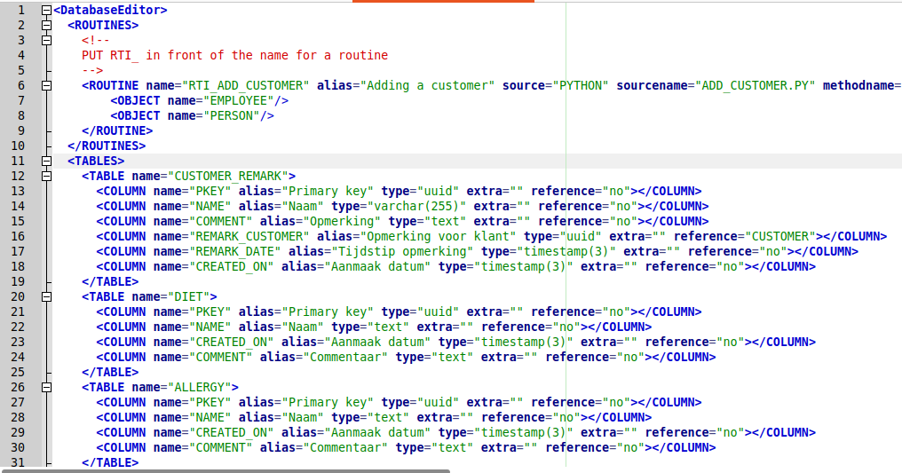
Database Editor
The database structure is defined in an xml. We have routines and tables with different columns.
Following data types:
Int, int[], int4, int4[], int8, int8[]
Timestamp,timestamp[]
Timestamp(3),timestamp(3)[]
Float4,float4[]
Float8,float8[]
Text,text[]
Varchar(255),varchar(255)[]
Varchar(64),varchar(64)[]
Uuid,uuid[]
Format[ ][ ] will be added.

Slide 15
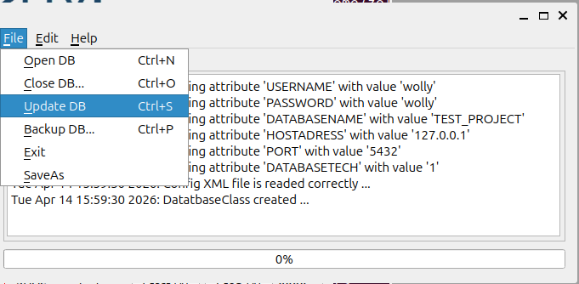
Database Editor
After modif of the xml you can open the db and update the db, database will be updated without data loss if you don’t drop tables of collumns.
DB
DBEditor

Slide 16
Logging
Logging goes over separate ice functions.
In every application we implement the logging.
Server
Transferred params are:
- lognr
- pc name
- log application
- time
LoggingServer
ServerTest
Object Viewer
...

Slide 17
Server
Server is mainly for connection to the DB
Can implement methods in the server
Communciates to every application over ZerocIce so all applications can run remote on other computers
We can connect apache to the server wich makes webbrowsing in DB possible
Apache
Postgres
Server
ICE
Remote
Applic
Oracle
MariaDB

Slide 18
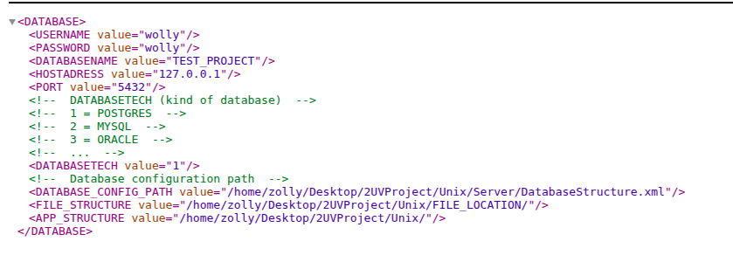
Server

Slide 19
Commands
ServerTest
Living OBJ Mach
SocketBox
Or Simulator
Protocol DLL
HW
Living OBJ Loc
Neutral commands
Living OBJ Meas
Sockets

Slide 20
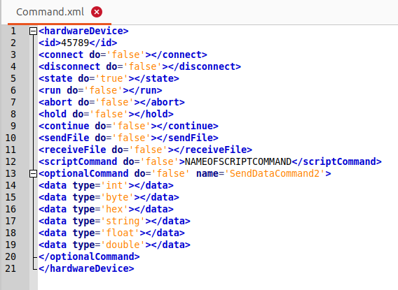
Commands
Neutral commands
SocketBox
With translation
Plugin to protocol

Slide 21
Commands
For example return on state request
<returnHardwareDevice>
<id>123456</id>
<state>W0R0D0P0C0T5648779879</state>
<datas>
</datas>
<error></error>
</returnHardwareDevice>
SocketBox
With translation
Plugin to protocol

Slide 22
Simulators
We can replace the socketbox with python scripts.
This scripts act with a socket as a simulator.
Here we can program the behaviour of the machine.

Slide 23
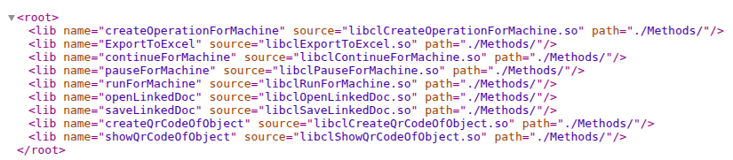
Methods
We can define a fix loadable dll with logging and database access to call a method. So the methods are not programmed inside the application but just loaded.
These are always called with the same arguments, CLASS and UUID of the object.

Slide 24
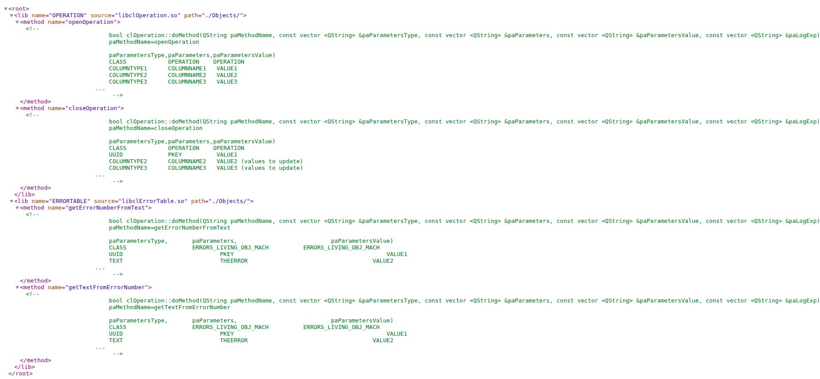
Objects

Slide 25
Objects
Objects have multiple methods so one argument is the name of the method. Other methods are commented into the libMap.xml
These are loaded into the system.
In the software a object class exists which loads this DLL inside

