Slide 1
GREYIN
E C O S Y S T E M
The Verified Professional Network — Salary Intelligence, Peer-Verified Reputation & Career Opportunity, in One Login. Seed Investor Deck · 2026

Slide 2
THE PROBLEM
Professionals can't verify what they're worth — salary data is opaque, scattered across self-reported surveys
Credentials and reputation are unverifiable — anyone can claim years of experience with nothing to back it up
Career tools are fragmented — a job board, a gig marketplace, a community and a benchmarking tool are all separate logins with no shared trust signal
Incumbents optimize for volume, not verification — LinkedIn, Glassdoor and Indeed each solve one slice, none combine them

Slide 3
OUR SOLUTION: SIX INTEGRATED PILLARS
DeepEdge — enterprise hiring & peer-verified salary benchmarking
FlexPro — freelance gig marketplace & paid mentorship
StackWorks — collaborative projects with a verified track record
Salt & Pepper — senior peer community & industry insights
GreyMatters — reputation-building technical blog, AI-scored
Longlist — quiet, future-dated recruiting pipeline
One login, one verified identity, six connected products — every pillar feeds real signal into a single Greyin Score.

Slide 4
THE MARKET OPPORTUNITY
$2.5B
$15M
$180M
100K
TAM
SAM
SOM (Yr 3)
Target Users

Slide 5
GO-TO-MARKET: FOUR ACQUISITION CHANNELS
DIRECT SALES — 20%
REFERRAL — 40%
PARTNERS — 15%
CONTENT — 25%
Enterprise & HR outreach for company licensing and DeepEdge seats
Peer-to-peer invites; viral coefficient ~1.2x per active user
Job boards, professional networks and community integrations
Salary reports & benchmarking data drive organic search and shares

Slide 6
WHY NOW
AI-grade credibility scoring meets a cultural demand for salary transparency — and we already ship both.

Slide 7
UNIT ECONOMICS: A CLEAR PATH TO EFFICIENCY
Metric | Year 1 | Year 2 | Year 3
ARPU (annual, USD) | $12 | $18 | $24
CAC (USD) | $8 | $6 | $4
LTV : CAC | 4.5x | 9x | 18x
Annual Retention | 58% | 72% | 82%
Net Revenue Retention | 92% | 105% | 115%

Slide 8
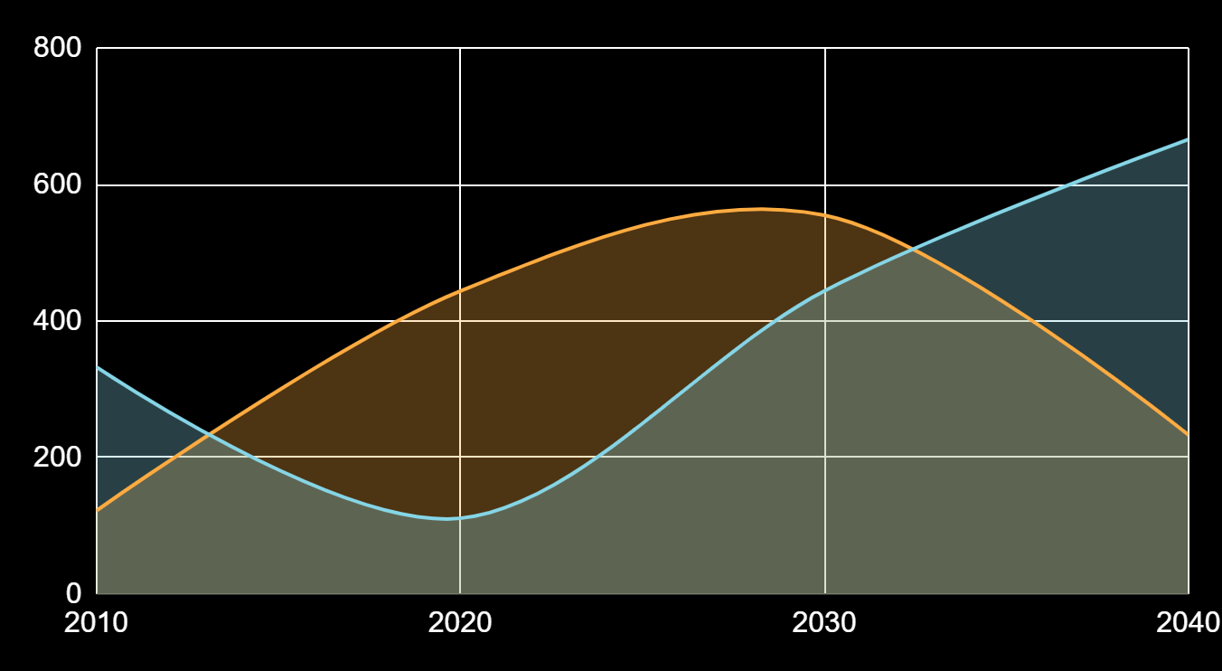
REVENUE GROWTH: $600/MO TO $1.8M/MO
Monthly recurring revenue at each growth milestone, per the 3-year budget model

Slide 9
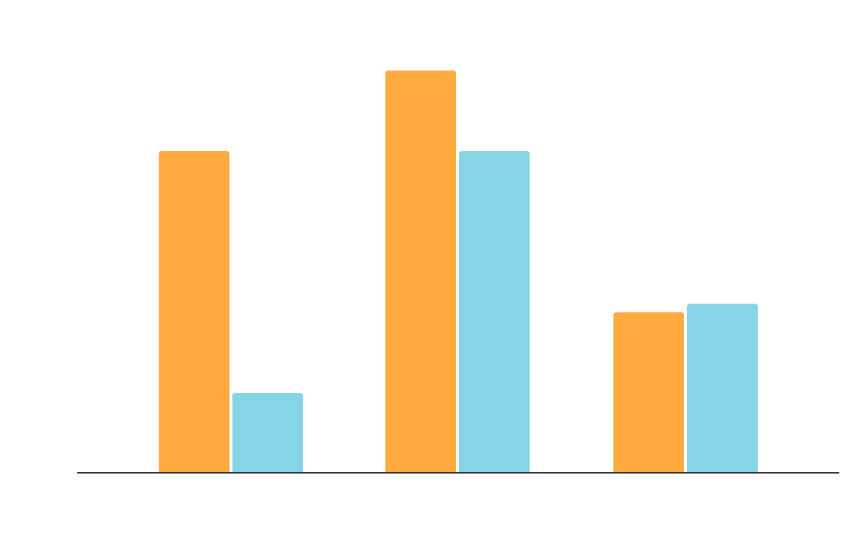
PATH TO PROFITABILITY: BREAK-EVEN AT MONTH 12
Monthly operating cost vs. monthly revenue, on-site scenario (USD) — crossover at ~5,000 users

Slide 10
$1.28M
Projected annual recurring revenue at 100,000 users by Month 36 — blended across all six pillars

Slide 11
$70K
$450K
$1.8M
Monthly revenue run-rate at Month 12 — break-even
Monthly revenue run-rate at Month 24
Monthly revenue run-rate at Month 36

Slide 12
ENTERPRISE SERVICES: ILLUSTRATIVE UPSIDE
B2B LICENSING
OUTPLACEMENT
FRACTIONAL LEADERSHIP
$100K-800K/yr — company directory access
~$300K/yr — 20 deals x 75 staff x $200/head
~$125K/yr — 25 placements x $5K fee

Slide 13
WHY EXISTING PLATFORMS DON'T SOLVE THIS
LEGACY POINT SOLUTIONS
GREYIN
LinkedIn: networking, no verified salary data
Glassdoor: anonymous reviews, no peer verification
Indeed: job volume, no gig work or mentorship layer
Peer-verified salary intelligence with k-anonymity
AI-scored, Bayesian-shrunk reputation across 6 pillars
Hiring, gig work, mentorship and community — one login

Slide 14
3-YEAR ROADMAP
MONTH 1 — SEED
MONTH 24 — SCALE
MONTH 12 — BREAK-EVEN
MONTH 36 — MATURE
5,000 users; contribution turns positive
100,000 users; $1.8M/mo revenue
100 users onboarded; PMF validation begins
25,000 users; $450K/mo revenue

Slide 15
THE ASK
WHAT WE'RE RAISING
HOW IT'S USED
Seed round to fund operations through Month-12 break-even and beyond
10-person India team, self-hosted infra, and referral-led growth

Slide 16
WHY INVESTORS ARE BACKING GREYIN
DIVERSIFIED REVENUE
PRODUCTION-READY
AI MOAT
PATH TO PROFITABILITY
CAPITAL-EFFICIENT INFRA
INDIA COST ADVANTAGE
Subscriptions + marketplace + B2B
110+ features shipped, live today
Bayesian scoring — hard to copy
Break-even at 5K users (M12)
Self-hosted, under $50/mo today
~2-3x lower engineering cost

Slide 17
THANK YOU
Questions? Let's talk.
founders@greyin.net
greyin.net
Please keep this slide for attribution.

