Slide 1




Team Name :
Team Size :
Problem Statement :
StackScore
Solo
Hire for how engineers actually work using
an AI-powered Full-Stack assessment framework
Live App
Demo Video

Slide 2
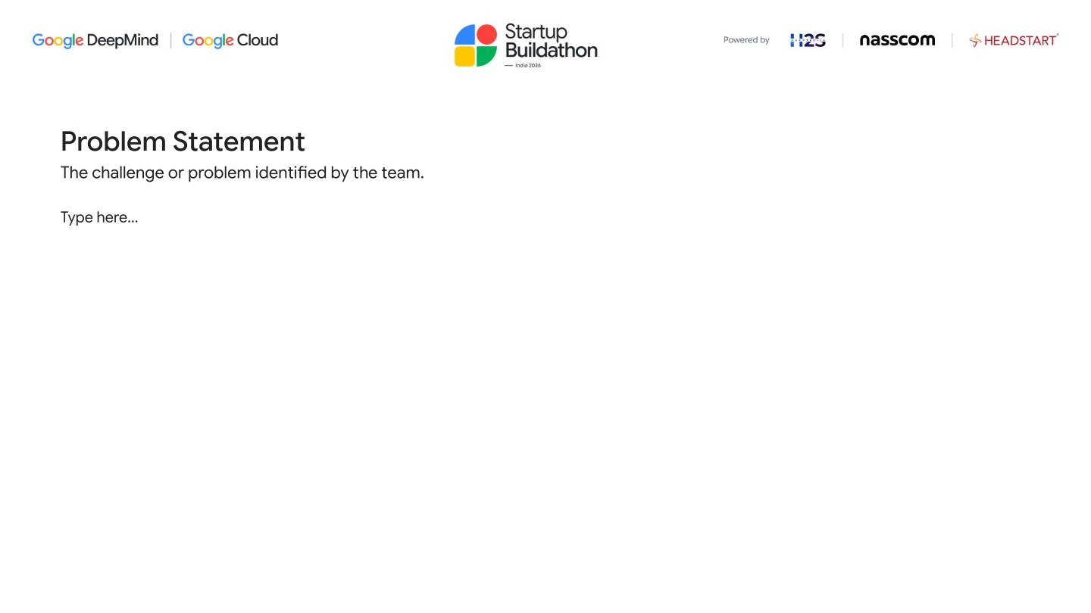
Problem Statement
The challenge or problem identified by the team.
Current technical hiring platforms measure what candidates memorize - not how they engineer to solve a real-time problem.
01
02
03
Wrong Signal
No Standard Rubric
High Cost, Low output
LeetCode/Hackerrank style tests measure algorithmic recall and practice-driven pattern matching. They say nothing about system design judgment, requirements clarity, or adaptability under pressure - the skills that define a strong full-stack engineer.
Every panel interviews differently. Results are undocumented, uncomparable across roles or companies, and irreproducible. The same candidate passes or fails based on who happened to be available - not on structured capability.
A live system-design interview costs 2–3 senior engineering hours per candidate. No feedback is given to candidates. HR can't track or compare scores over time. There's no data layer for improving the process.
A candidate who aces dynamic programming may not design a URL shortener that survives a 10× traffic spike.
Hire decisions reduce to interviewer intuition, not documented engineering capability.
Companies spend hours per candidate and get a binary yes/no with no reusable signal.

Slide 3
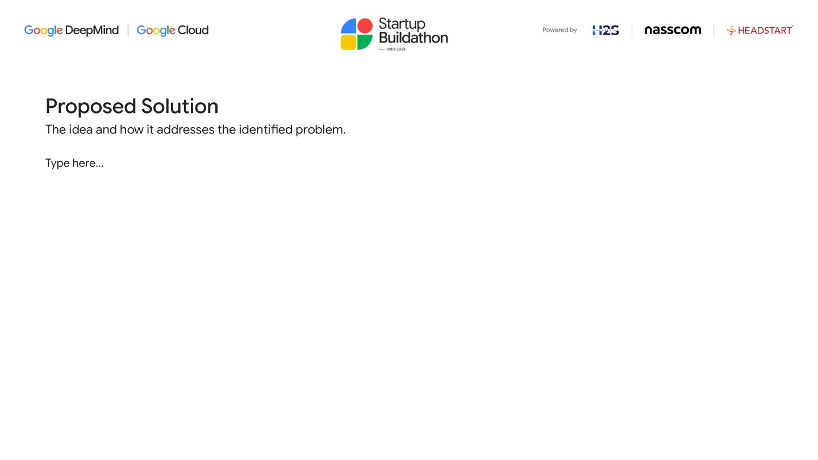
Proposed Solution
The idea and how it addresses the identified problem.
STAGE 1 . 5min
STAGE 2 . 10min
STAGE 3 . 20min
STAGE 4 . 10min
STAGE 5 . 15min
Clarify
Propose
Build
Adapt
Debug
Candidate Q&A with AI stakeholder to scope a deliberately ambiguous brief
Written system design against requirements uncovered in Stage 1
Code the core module; runs in a sandboxed Node.js executor
AI injects a mid-task constraint twist; candidate updates design & code
Candidate finds and fixes a subtle defect AI seeded into their own code
25 scenarios from a 5 × 5 matrix: problem domains × engineering constraint pillars
Gemini 3.8 Flash generates ·
Claude Opus 5.5 judges (adaptive thinking)
Output: StackScore 0–100 ·
role-calibrated · shareable URL

Slide 4
Scoring Rubric
One number. Eleven dimensions. Zero interviewer subjectivity.
55 %
45%
Solution Design / Approach
Code-Level Best Practices
D1 Requirement Framing
Quality of clarifying questions; did they scope the real ambiguity in Stage 1?
D2 Architecture & Component Design
Soundness and clarity of the proposed structure
D3 Tradeoff Reasoning
Explicit justification of choices against the assigned constraint
D4 Constraint Satisfaction
Does the design actually hold up against the assigned pressure - not just mention it?
D5 Adaptability
How well the design absorbs the Stage 4 twist: patched vs re-architected vs collapsed
K1 Design-Code Alignment
Does the implementation match Stage 2 proposal? Flags drift.
K2 Correctness & Edge Cases
Does it work, including boundary and failure conditions?
K3 Code Quality & Maintainability
Naming, modularity, separation of concerns
K4 Security & Defensive Coding
Input validation, secrets handling, auth checks
K5 Testing & Observability
Tests written, error handling, logging and instrumentation present
K6 AI Collaboration Quality
how effectively candidates leverage AI tools - quality of prompting, verification, and knowing when to override.
Each axis independently scored 0–100 · StackScore = Σ(axis × weight)
Role-calibrated: Junior · Mid · Senior · Axis-independent scoring
prevents halo bias

Slide 5
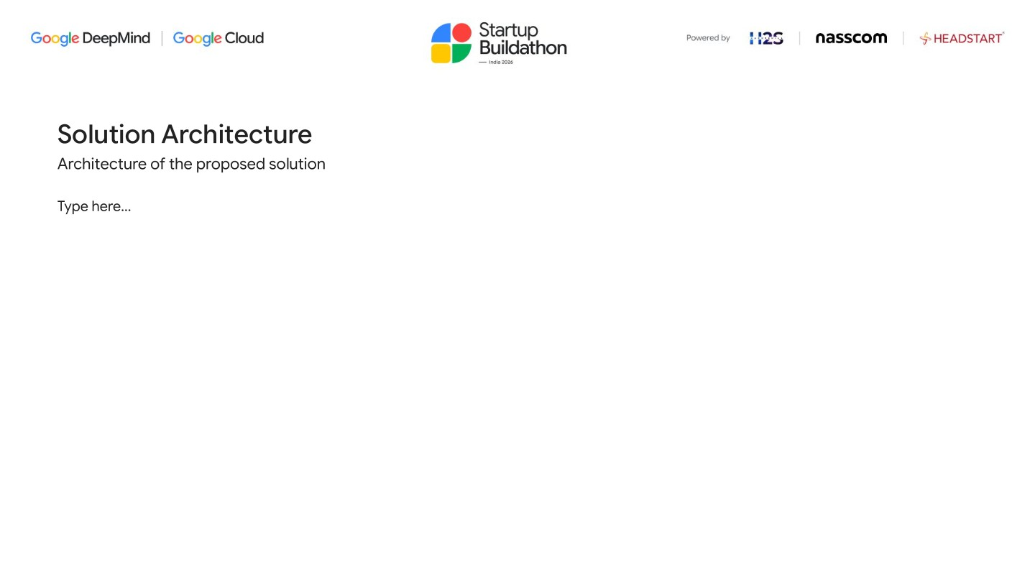
Solution Architecture
Architecture of the Proposed Solution.
GENERATION
Gemini 3.8 Flash
Brief · Stakeholder · Twist · Defect
JUDGING
Candidate
Next.js 14 App
Claude Opus 5.5
Cloud Firestore
/score/[slug]
Browser
Cloud Run · us-central1
11-axis rubric · adaptive thinking
Sessions · Transcripts · Scores
Shareable score card
EXECUTION
Node.js Sandbox
/admin · /review · /dashboard
Code Execution
Admin · Reviewer · HR views

Slide 6
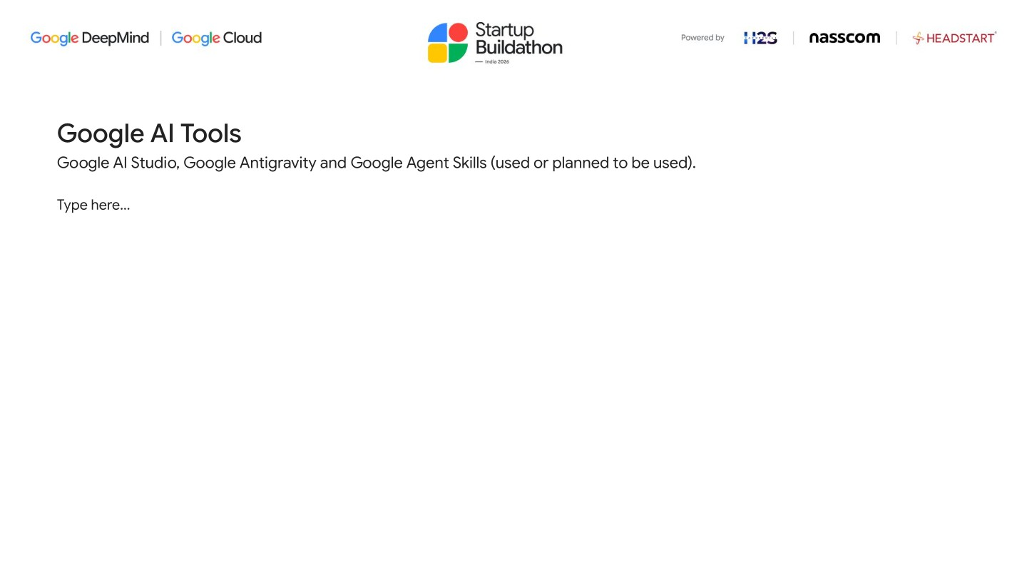
Google AI Tools
Google AI Studio, Google Antigravity and Google Agent Skills (used or planned to be used).
01
02
03
Google AI Studio
@google/genai SDK
Cloud Run
Gemini API key provisioned via AI Studio. Used in production for all generation calls - no Vertex AI billing complexity needed for the MVP.
Official JS SDK for Gemini API. genai.models.generateContent() powers brief generation, stakeholder voice, twist injection, and defect seeding.
Serverless container hosting for the Next.js app. Scales to zero between sessions; 512 MiB RAM, deployed automatically via Cloud Build CI/CD.
aistudio.google.com
model: "gemini-3.8-flash"
us-central1 · auto-scaled · zero-ops
04
05
06
Cloud Firestore
Cloud Build
Secret Manager
Document database storing sessions, stage-by-stage transcripts, and score cards. Queried in the HR dashboard for pass/fail threshold filtering.
CI/CD pipeline via cloudbuild.yaml. Builds Docker image, pushes with COMMIT_SHA tag, and deploys to Cloud Run in one gcloud builds submit command.
Stores GEMINI_API_KEY, ANTHROPIC_API_KEY, FIREBASE_PRIVATE_KEY. Injected into Cloud Run at deploy via --set-secrets. Zero secrets in source code.
sessions · transcripts · scores
cloudbuild.yaml · Docker · Cloud Run
--set-secrets KEY=secret:latest

Slide 7
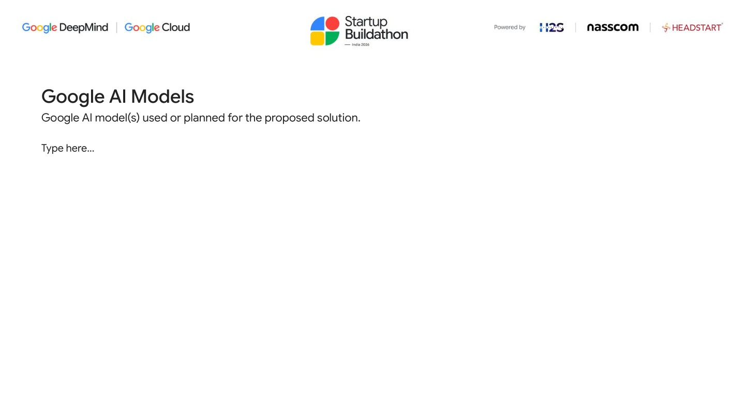
Google AI Models
Google AI model(s) used or planned for the proposed solution.
Gemini 3.8 Flash
GENERATION
Claude Opus 5.5
JUDGING
Fallback Judge
RESILIENCE
via @google/genai · API Key mode
via Anthropic SDK · adaptive thinking
via Anthropic SDK · Judge fallback
Problem brief generation - deliberately underspecified, stakeholder-framed, with hidden constraint woven in implicitly
Stakeholder voice simulation - answers clarifying questions in character without revealing the constraint category
Mid-task constraint twist injection - a natural "scope change from leadership" reframing the session's pressure
Debug defect seeding - plants one non-trivial logic error (off-by-one, missing edge case) in the candidate's own code
Rubric-constrained 11-axis evaluation - each axis scored 0–100 independently to prevent holistic-impression bleed
thinking: { type: "adaptive" } lets the model reason through nuanced design tradeoffs before committing to scores
Role-calibrated prompt - Junior/Mid/Senior expectation bars stated explicitly so the same rubric spans all levels
Returns strict JSON: axis scores + 1–2 sentence feedback per axis, persisted to Firestore and displayed on the score card
Tier 1: Claude Opus 5.5, calibrated — rubric + anchors + adaptive thinking, full fingerprint check
Tier 2: Claude Opus 5.5, uncalibrated — triggered on fingerprint mismatch; session gets "Partially Judged" badge and is enqueued for rejudge drain
Tier 3: uncalibrated also fails → No model — scoring hold active or model unavailable; session goes to pending_review and a human reviewer task is created. human reviewer scores blind (rubric shown, LLM scores hidden to prevent bias)
genai.models.generateContent({ model: "gemini-3.8-flash", contents: prompt })
thinking: { type: "adaptive" }, model: "claude-opus-5-5", max_tokens: 16000

Slide 8
Feature Highlights
What was built for this buildathon beyond the core assessment towards MVP.
01
02
03
Judge Fallback Pipeline
Human Reviewer Role
Scoring Hold & Queue
Three-stage resilience: calibrated judge → uncalibrated retry ('Partially Judged' badge) → auto-created human review task. No assessment is ever silently lost. Rejudge queue with retry limits and automatic escalation to human review when exhausted.
Fourth auth role with its own cookie and registry. Reviewer sees the rubric with anchor bands but NOT the LLM scores — bias-free by design. Admin assigns tasks; reviewer submits structured scores that replace axis scores on the score card.
Admin can pause the scoring pipeline with a toggle — flag in Firestore, not an env var. Submissions during a hold are queued in Firestore and drained automatically when unpaused. Alert-only by default; hold is opt-in per admin decision.
calibrated → partial → pending_review
ss_reviewer cookie · bias boundary at /api/review/submission
Firestore-backed · admin toggle · drain on resume
04
05
06
Calibration Monitor
Gemini Cross-Judge
Full Instrumentation
Daily Cloud Scheduler probe: runs 3 hard-assertion fixtures (~$0.40), checks calibration fingerprint (rubric hash + model + effort), alerts if stale. Prevents silent calibration drift after a rubric edit or model change without re-running the full sweep.
Scripts to send contested fixtures to Gemini 3.8 Flash and compare scores. On K2 (correctness): Gemini confirmed our judge's scoring on 4/5 contested cells. On K5 (testing): both judges agreed near the band floor — authored bands were optimistic.
Every score record stores model, effort, latency, token counts (input/output/cache), and estimated cost per assessment (~$0.14 at Opus 5.5 pricing). Data layer ready for 10x/100x scaling analysis and cost optimization.
daily · fingerprint: sha256(rubric + model + effort)
gemini-triage.json · K2 confirmed · K5 bands revised
judgeUsage · ~$0.14/assessment · cache-aware

Slide 9
Generation Resilience & Scenario Bank
Four-tier fallback ensures zero candidate-facing downtime during Gemini outages.
01
02
03
4-Tier Generation Chain
Pre-Generated Scenario Bank
Atomic Bank Allocation
Gemini 3.8 Flash → Claude Haiku 5.5 → Scenario Bank → Static template. Each tier falls back automatically, transparent to the candidate. Live generation is always tried first; the bank is a last-resort backstop that keeps the interview running.
20 fully-formed assessment packs (brief + twist) pre-generated and stored in Firestore. Cloud Scheduler refills the pool every 2 hours. Packs span all 25 scenario matrix cells (5 domains × 5 constraint pillars).
Firestore runTransaction ensures two concurrent sessions can never claim the same pack. Status flips available → allocated atomically. Race-free under any concurrency level; no double-booking possible.
Gemini Flash → Haiku 5.5 → bank → template · automatic
scenarioBank collection · target pool: 20 · 25-cell coverage
runTransaction · available → allocated · zero races
04
05
06
__pending__ Orphan Reclaim
Twist Pre-Generation
Cloud Scheduler Automation
When session creation fails mid-flow, the allocated pack is marked __pending__. Cloud Scheduler runs reclaim-bank-packs every 30 min to return orphaned packs (10-min TTL) to the available pool. No pack is permanently lost.
Bank packs include a pre-generated twist alongside the brief. inject-twist pulls the stored twist directly — no AI call at Stage 4. Twist injection stays instant even during a complete Gemini + Claude outage.
fill-scenario-bank (every 2h) tops up the pool. reclaim-bank-packs (every 30 min) returns orphaned packs. Admin dashboard at /admin shows live bank stats (available / allocated / total) with one-click manual refill.
__pending__ sentinel · 10-min TTL · 30-min reclaim cycle
bankTwist stored on session · zero-latency Stage 4 · outage-safe
fill every 2h · reclaim every 30min · /admin dashboard

Slide 10
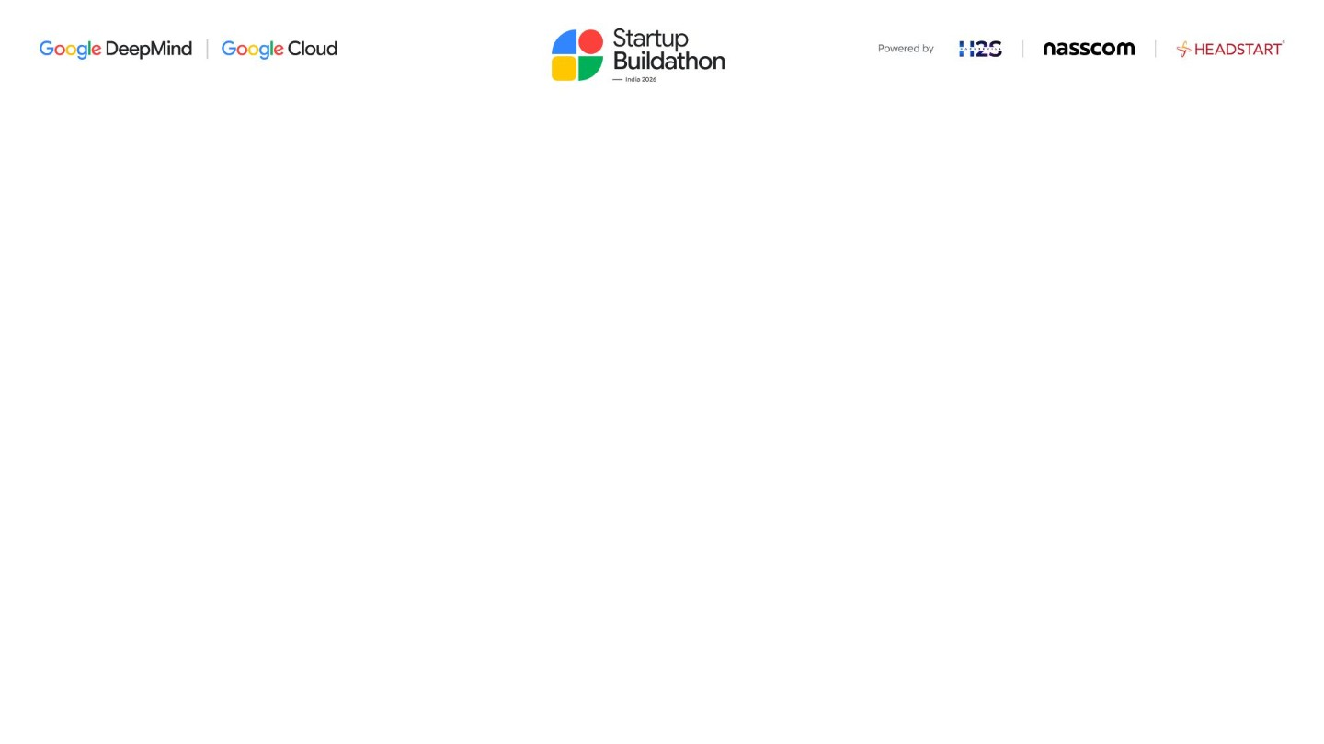
Reliability Evidence
What the judge can prove — without human graders, without authored bands.
01
02
03
Rank Stability
Separation
Rule Compliance
Three independent runs produced the identical ordering of all 10 submissions. Spearman ρ = 1.000 with zero pairwise inversions across all 45 "is A stronger than B?" comparisons. Ranking is the deliverable — this is the number that matters commercially.
Every adjacent pair of submissions is separated by ≥ 2.3 standard deviations (pooled run-to-run sd = 1.18 pts). Gaps range 2.3–14.4 sd. Reliability without separation is useless — a judge scoring everyone 50 is perfectly consistent and completely uninformative.
5/5 hard-assertion fixtures passed: rule-based requirements stated in the system prompt are obeyed including a prompt-injection attempt (scored 12/100 with K4=2). Gemini 3.8 Flash independently scored in-band on 4/5 contested K2 cells, confirming our judge's correctness axis is directionally sound.
ρ = 1.000 · 0 inversions / 45 pairs · 3 runs
2.3–14.4 sd gap · pooled sd 1.18 pts · 10 submissions
5/5 assertions · Gemini cross-validated · panel protocol in repo

Slide 11
Market Positioning & USP
Why StackScore is different from every tool already on the market.
01
02
03
vs LeetCode / HackerRank
vs CodeSignal / Codility
vs Karat / Human Panels
Measures algorithmic recall and speed. Passes engineers who can't design systems; fails engineers who can. Zero signal on requirements framing, tradeoff reasoning, adaptability under pressure, or AI collaboration quality. StackScore: 5-stage scenario, 11 axes, role-calibrated, no memorization advantage.
Pre-employment coding tests with some system-design add-ons. AI judging is "AI-powered" in name — no published calibration, no reliability evidence, no audit trail. Scores are black boxes with no rubric transparency. StackScore: open rubric with anchor bands, published sweep results, human fallback.
Gold standard for signal quality but costs 3–5 engineering hours per candidate. Doesn't scale. No structured rubric → results are undocumented and non-comparable. StackScore: same holistic judgment, structured into 11 axes, delivered in 60 min at ~$0.14 per assessment with a shareable, verifiable score URL.
ρ = 1.000 · 0/45 inversions · ≥ 2.3 sd gap
5 stages · 25 scenarios · 11 axes · role-calibrated
open rubric · sweep in repo · panel protocol committed
04
05
06
Evidence-Based Reliability
Scenario Depth + Adaptability
Calibration Infrastructure
The only publicly demonstrated reliability measures in this space: Spearman ρ = 1.000 (zero rank inversions across 3 independent runs), every adjacent pair ≥ 2.3 sd apart. Cross-validated by a second major model (Gemini). Accuracy claim deliberately withheld — protocol in repo, not in a press release.
5-stage scenario (Clarify → Propose → Build → Adapt → Debug) captures the full engineering workflow, not a single snapshot. The mid-task twist and seeded debug defect are unique stress tests not present in any competitor. The 25-scenario matrix (5 domains × 5 constraint pillars) means every session is a different problem.
Rubric anchors, calibration sweeps, panel protocol, monitor scheduled daily — all committed to the repo. Any user of the platform can inspect the rubric, run the sweep, and validate the judge. No competitor publishes their rubric, their calibration, or their reliability measures. That is structural differentiation.
vs ρ = unknown · black-box AI · no audit trail (competitors)
5 domains × 5 pillars · twist + debug stages unique
data/calibration/ · PANEL.md · daily monitor live

Slide 12


