Slide 1

HMM finds behavioral patterns…
Zoltán Szabó
Eötvös Loránd University

Slide 2


Contributors
Neural Information Processing Group
  György Hévízi (first author)
  Mihály Biczó
  Barnabás Póczos
  Bálint Takács
  András Lőrincz (head)

Slide 3

HCI
Adaptive interface
User’s actual state?
Behavioral model is needed

Slide 4

Possibilities for behavioral models
Examples:
  Markov Chain (MC):
  Hidden Markov Model (HMM):
  Bayes Network ( ) :
more general
X
f(Y|X)
Y

Slide 5
Our long term goal
Adaptation to user by RL: Markov Decision Process
HMM:
  Behavioral components upon practising?
  Similar patterns for users?
  Capable of extracting them?

Slide 6
Tools
Dasher:
  Pointing-gestures driven text entry solution
  Born at Cambridge
  Optional: predictive language model
Our solution: headmouse as input device
  For control experiments: normal desk mouse
HMM: user modelling

Slide 7
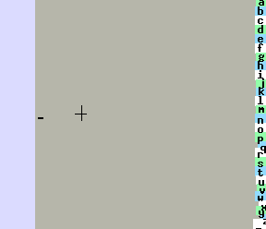
Dasher

Slide 8
Headmouse
Combines: head detection + tracking
  Technical details: Haar wavelets + optic flow
Non-intrusive + cheap
Alternative communication tool
Free for download:
  http://nipg.inf.elte.hu/headmouse/headmouse.html

Slide 9

User modelling
Hidden Markov Model:
  Observation: cursor speed user movement
  Hidden states: Gaussian emission
    Assumption: independence (diagonal covariance)
s

Slide 10
Experiments
Participants:
  5 volunteer PhD students
  unexperienced in Dasher
Task: typing short sentences from lyrics with Dasher
  e.g.: ,,Children need travelling shoes’’
Cursor trajectories were saved

Slide 11
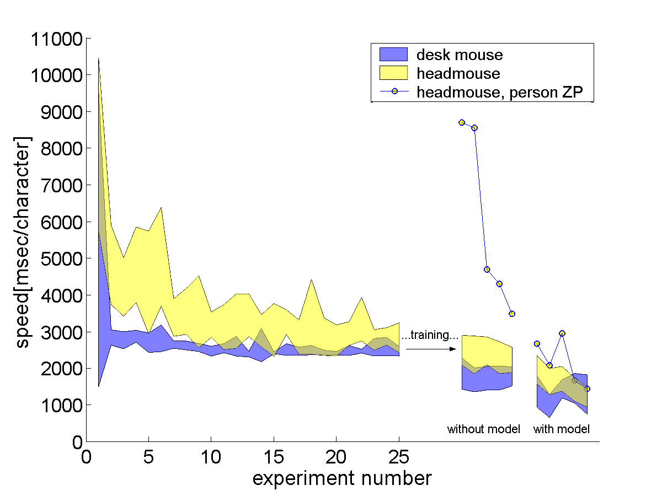
Learning graph
(A)
(B)
Dasher can be learned.
(C)

Slide 12
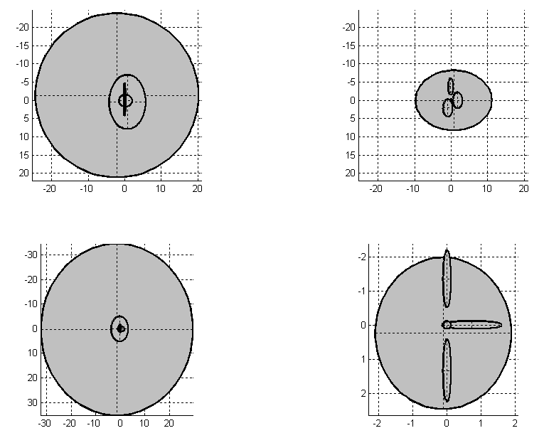
Hidden states found by HMM
Else
Practising
P

Slide 13
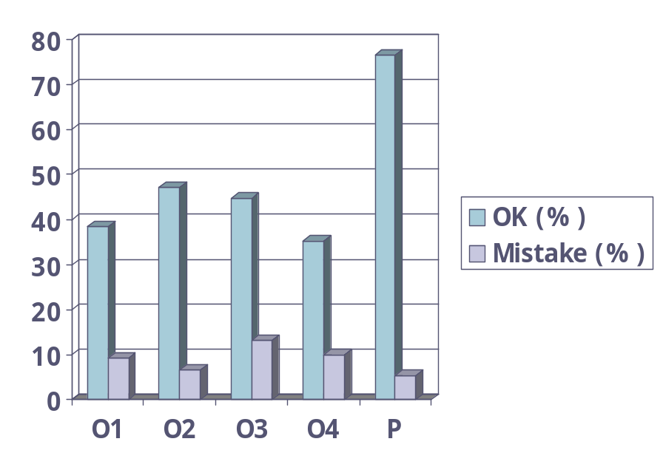
Interpretation of hidden states
Most probable states by Viterbi:
a
z
Mistake
OK
Accelerate
a
z
others

Slide 14
Outlook
Recognition of users’ behavioral patterns:
  On-line adaptive functionality:
    Personalization for individual users
    Alternative help options
  Complex interaction with computer
Relevance:
  tool for handicapped non-speaking people

