Slide 1

The price of intelligence
What actually drove revenue growth at the leading AI companies
Data Research Analyst · final project · August 2026
Notes:
20 sec. "My project looks at the AI industry — specifically, what actually drove the revenue growth of the leading AI companies between early 2025 and early 2026."

Slide 2

RESEARCH QUESTION
What drove the growth?
What are the main factors influencing revenue growth of leading AI companies following the launch of paid AI services, comparing Q1 2025 to Q1 2026?
4 companies
2015 – 2026
OpenAI, Anthropic,
Nvidia, Google
daily market data;
models from 2020
Notes:
60 sec. Say the cleaning note confidently — catching it is a strength. Handoff: "So — what did the revenue actually do?"

Slide 3
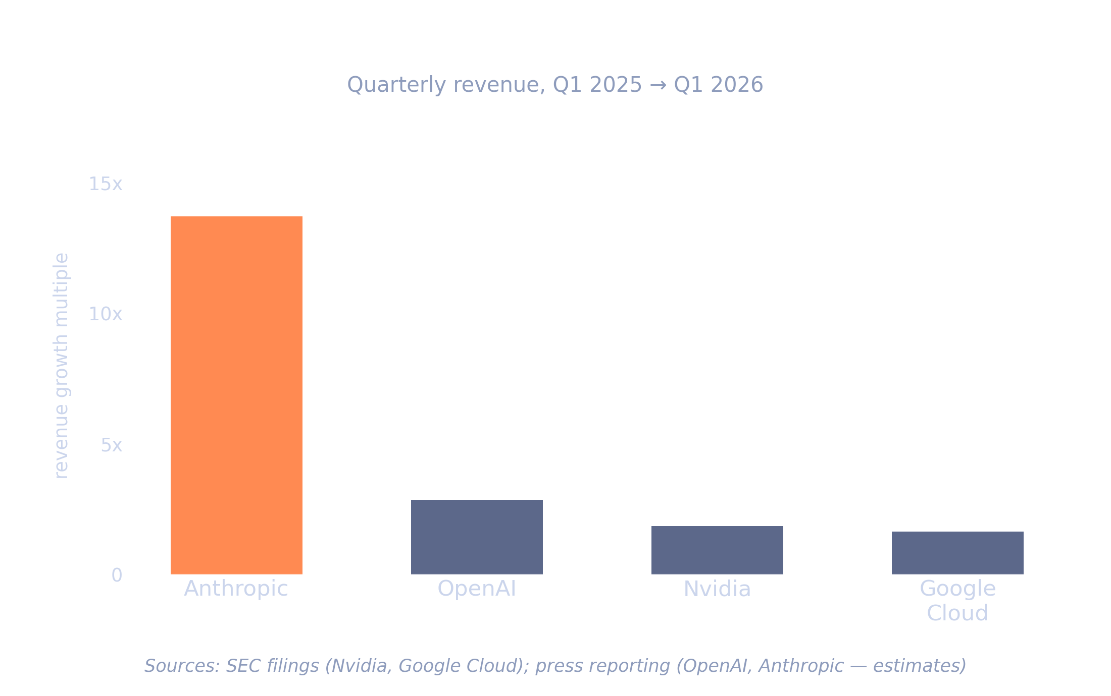
Notes:
90 sec. "All four grew. But not remotely equally. Anthropic grew nearly fourteen times over. OpenAI just under three. Nvidia and Google, both already enormous, grew under two. So the smallest company grew fastest — by a wide margin. That is the puzzle I wanted to explain."
Caveat aloud: neither OpenAI nor Anthropic reports quarterly revenue, so both baselines are press estimates. OpenAI's $2.0B for Q1 2025 is triangulated from $4.3B reported for H1 2025, ~$8B ARR in March 2025, and OpenAI's own statement of $1B per quarter at end-2024. Anthropic's $0.35B is the softest number in the deck — the ordering holds under any estimate, the precise multiple does not.
Handoff: "Before I explain why, here is the dashboard where you can explore all of this."

Slide 4

So — why did revenue grow so unevenly?
Notes:
Pause. 5-10 seconds. Let the question land before you answer it. This is the hinge of the whole talk.

Slide 5
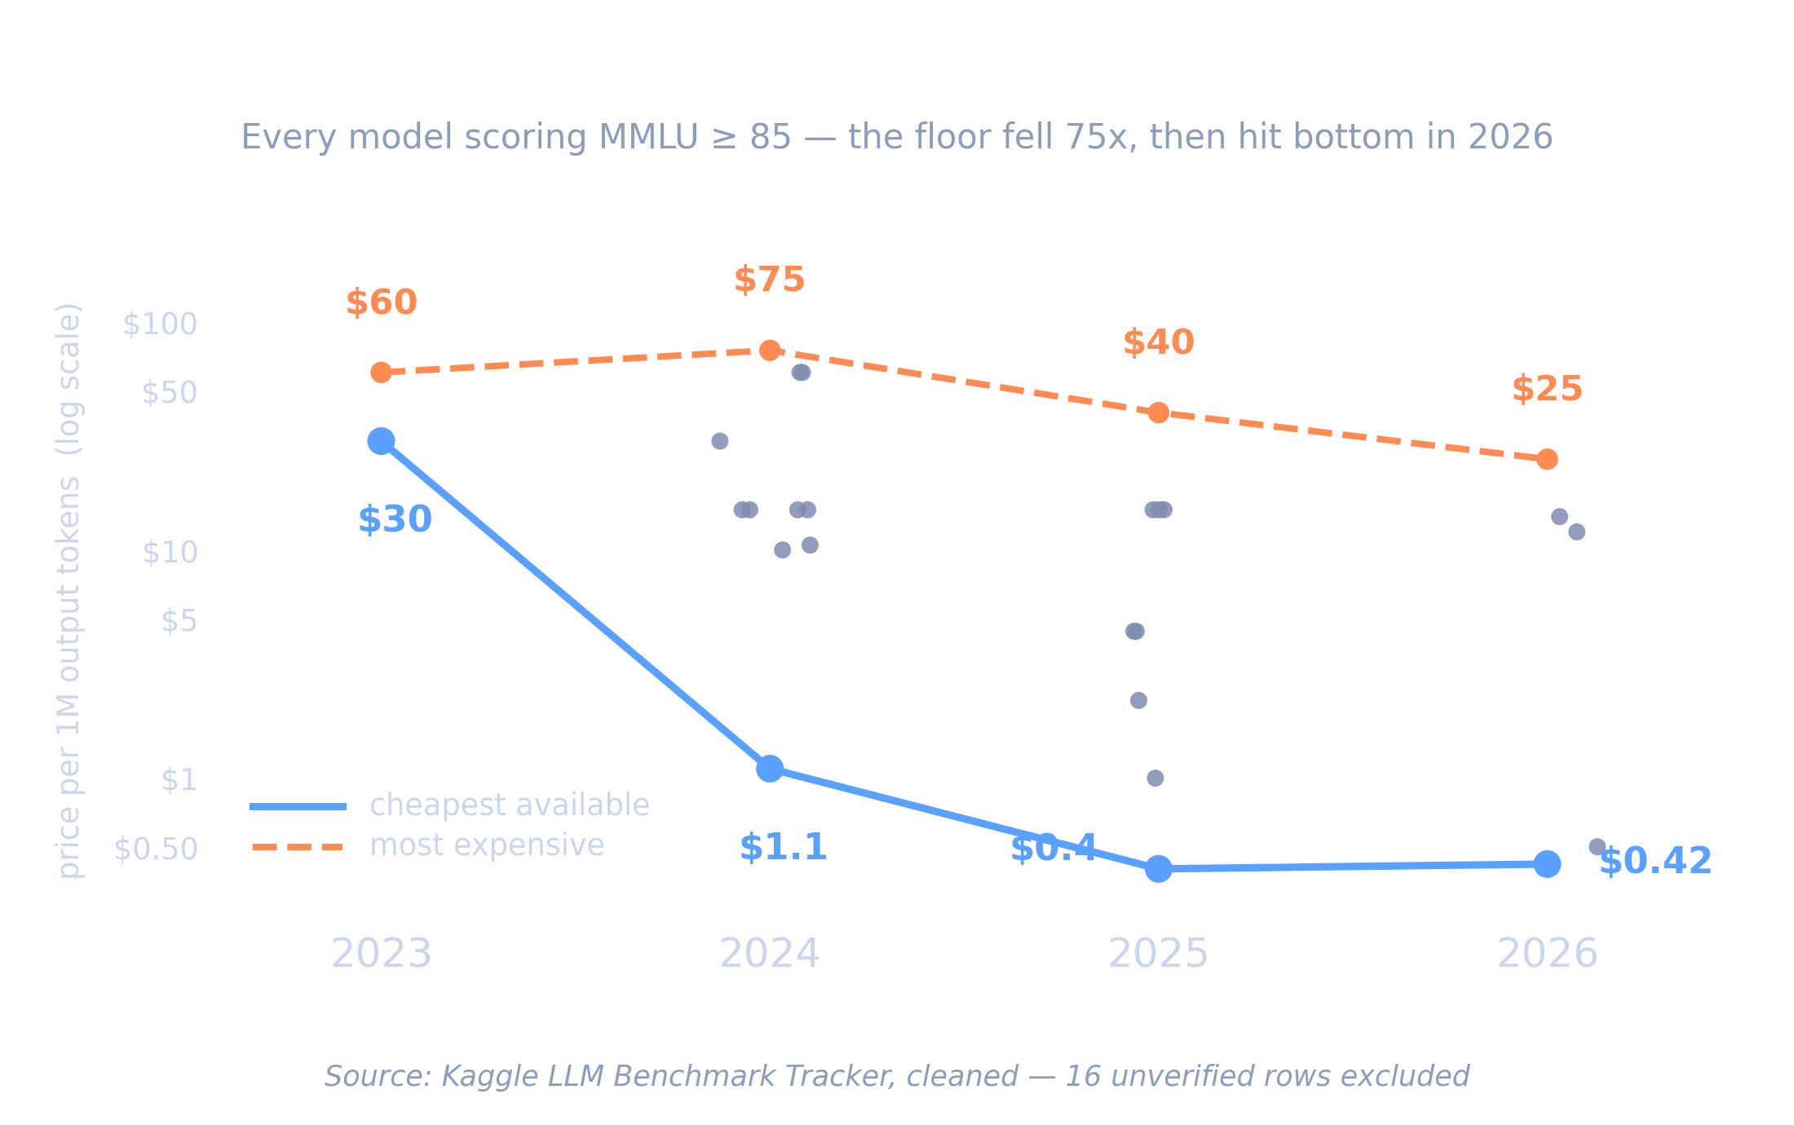
Notes:
2 min — THE CENTRE OF THE PROJECT. Slow down.
"Every model here scores at least 85 on MMLU — a standard benchmark where a human expert scores about 90. So every dot is roughly expert-level. In 2023 the cheapest way to buy that cost $30 per million tokens. By 2025 it cost 40 cents."
"Notice the expensive options did not disappear — the ceiling stayed. What changed is that the floor fell out."
Method line: "A simple year-on-year comparison shows no trend at all. You only see this when you compare models of equal capability. Holding capability constant, price fell roughly 80 to 90 percent per year — and that held under every benchmark I tested."
Handoff: "Which raises an obvious question. If prices collapsed like that, why did revenue go UP?"

Slide 6
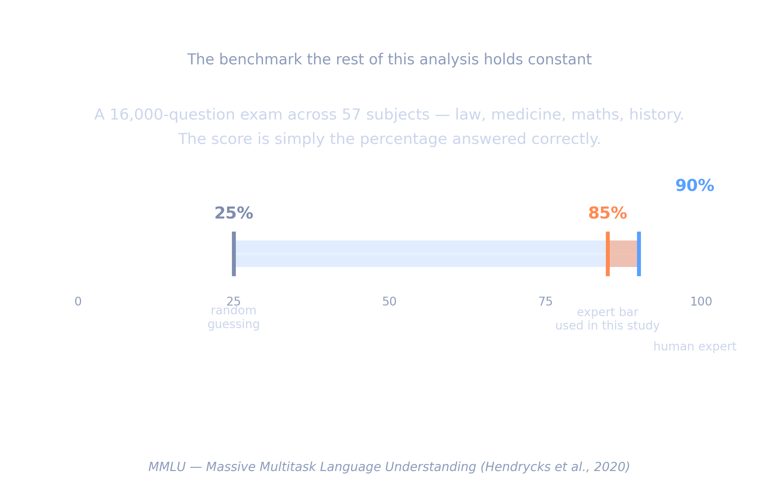

Slide 7
Why did the floor fall?
Notes:
Pause. You have just shown the collapse; now you explain it.

Slide 8
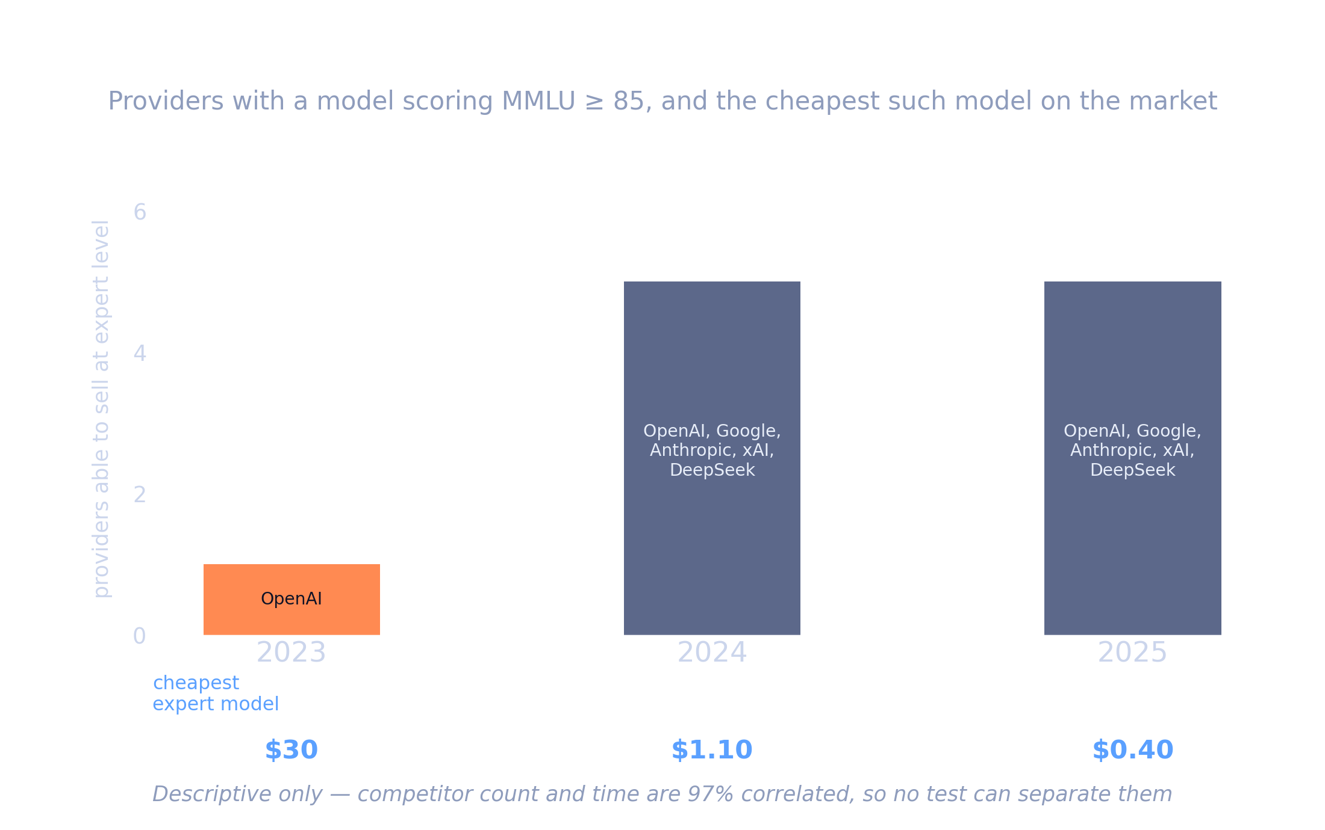
Notes:
75 sec. "Why did the floor fall? In 2023 exactly one company could sell a model at expert level, and it charged thirty dollars. By 2024 five could, and the cheapest was a dollar ten."
Be precise about what this is: "I tested whether competition explains price better than time alone. It fits marginally better — but competitor count and time are 97 percent correlated, so no test can separate them. This is what the market looked like, not a proven cause."
Worth adding: not everyone cut. Anthropic and xAI held at $15 both years and competed on capability instead. Google went $10.50 to $0.40.
Handoff: "So prices collapsed. Why did revenue go UP?"

Slide 9
If prices collapsed, why did revenue rise?
Notes:
Pause. This is the question the audience should already be asking. Naming it out loud shows you saw it too.

Slide 10
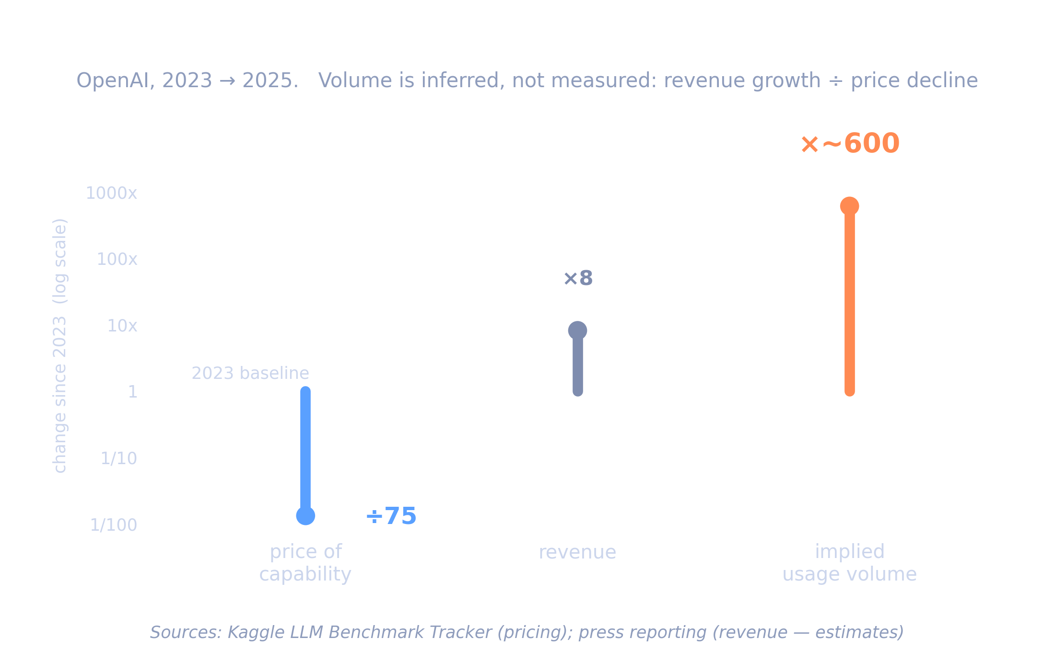
Notes:
2 min. "The answer is volume. For OpenAI, revenue grew about eight times between 2023 and 2025, while the price of capability fell somewhere between 75 and 100 times. For both to be true, usage had to grow by two to three orders of magnitude — roughly a hundred to a thousand times over."
"Customers did not buy a little more when it got cheaper. They built things that were not affordable before. That is elastic demand — the price cut more than paid for itself."
Handoff: "So where does all that extra usage actually go?"

Slide 11
Where does all that extra usage actually go?
Notes:
Pause. Bridges from an abstract number to something physical.

Slide 12
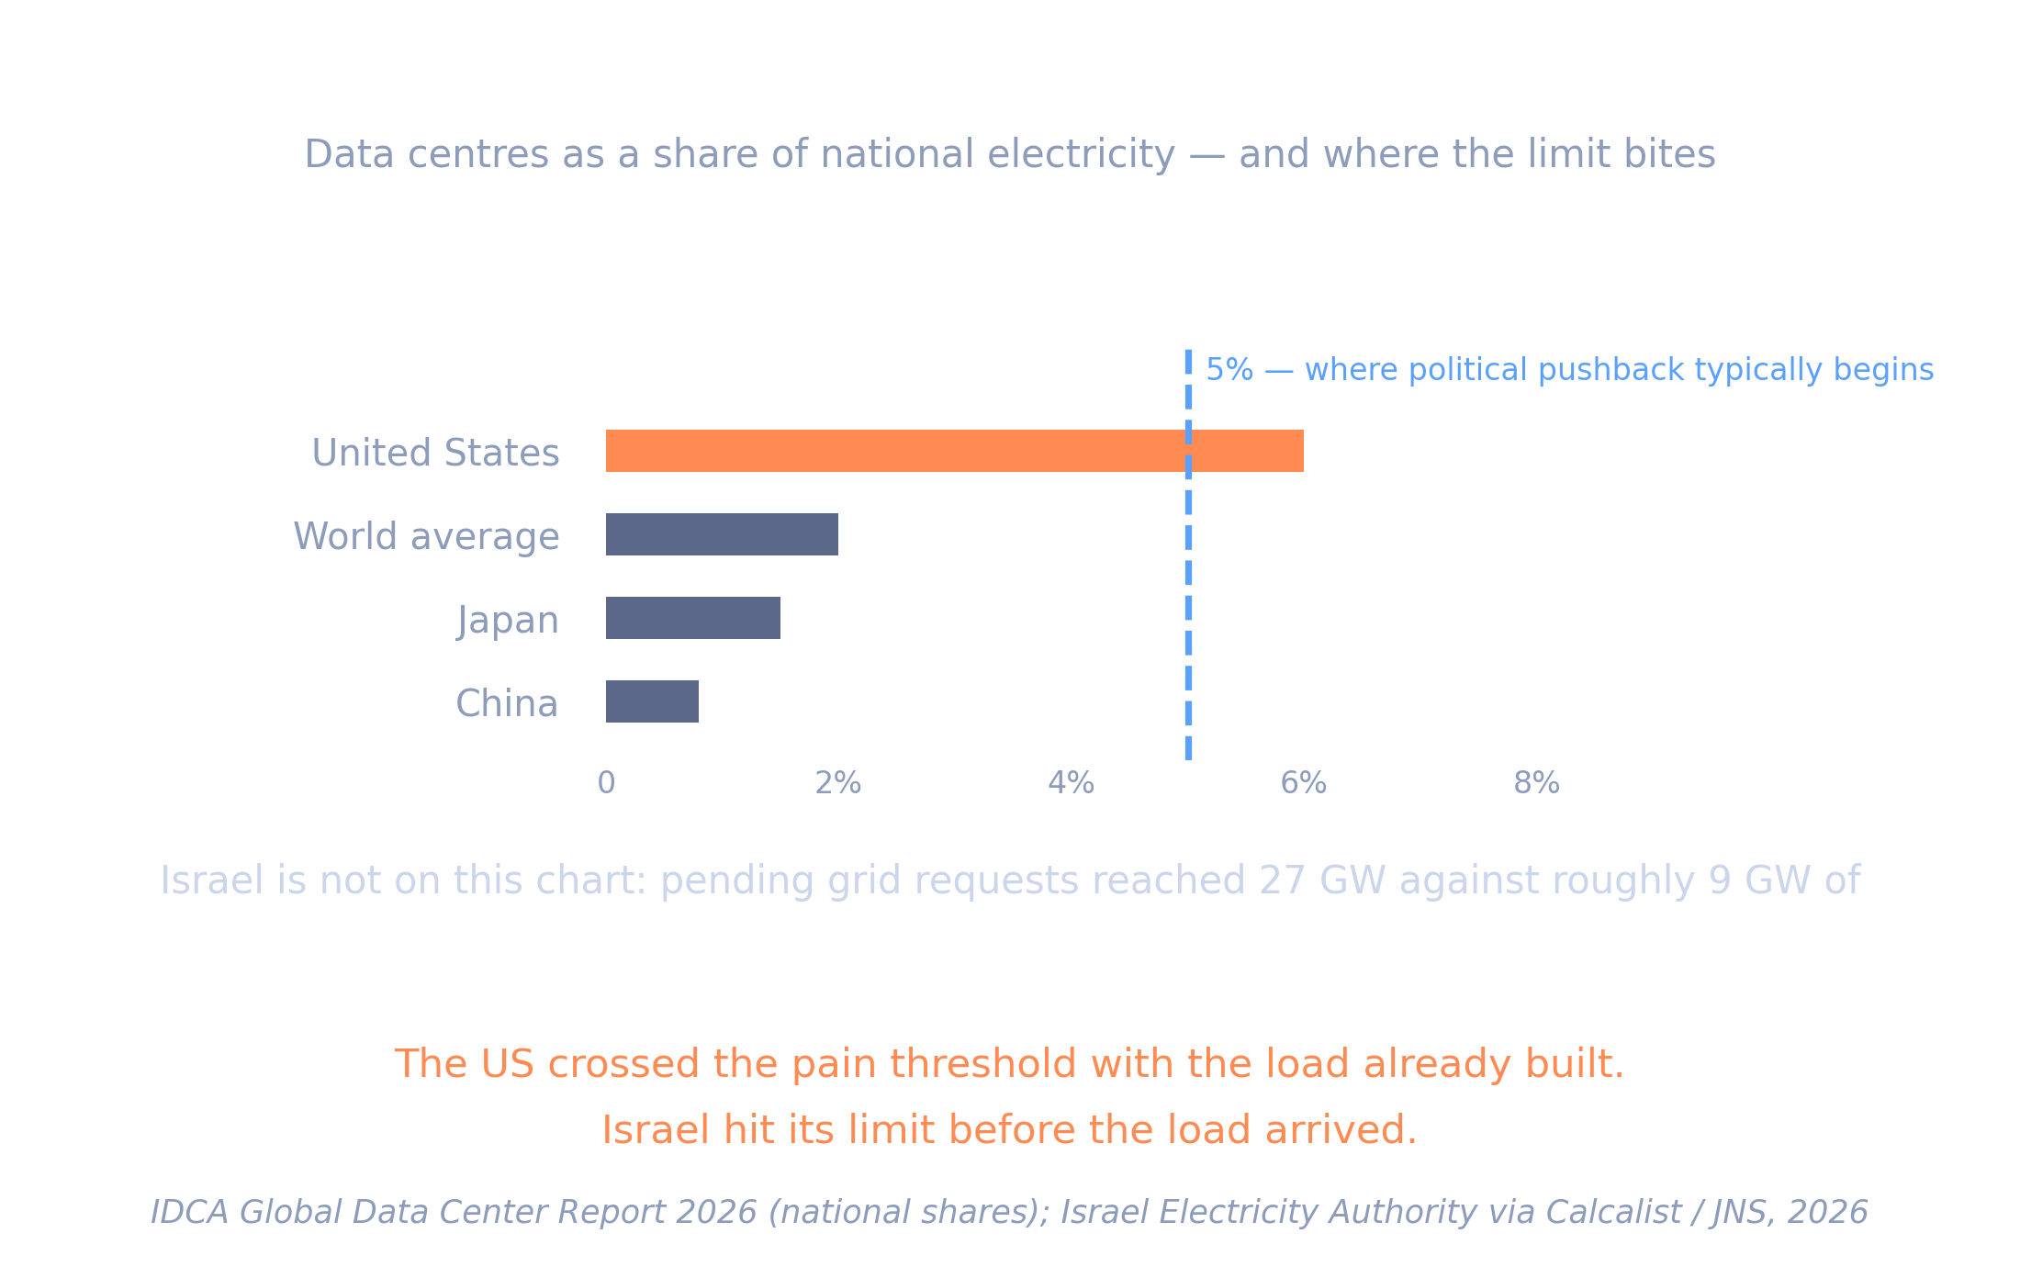
Notes:
75 sec. "A thousandfold increase in usage is not abstract — that compute has to physically run somewhere. Here is what it looks like when it lands."
"Israel’s electricity regulator received data-centre grid connection requests totalling about 27 gigawatts — roughly three times the country’s average national demand. In 2026 it froze new connections for 140 days. Existing commitments already exhaust planned generating capacity through 2035."
"I am based here, which is how I noticed it. But the point is general: the constraint on AI growth may stop being capital and start being power."
Handoff: "So what does all this add up to?"

Slide 13
CONCLUSIONS
What the data shows
01
The price of capability collapsed
Holding capability constant, price fell roughly 80–90% per year. Robust across four separate benchmarks.
02
Revenue grew because volume grew faster
Usage rose by two to three orders of magnitude more than price fell. Demand was highly elastic.
03
Infrastructure investment followed
Visible even locally — several billion dollars of American data centre investment in Israel.
Notes:
75 sec. Three points, no more. Handoff: "Which points to a few things worth doing next."

Slide 14
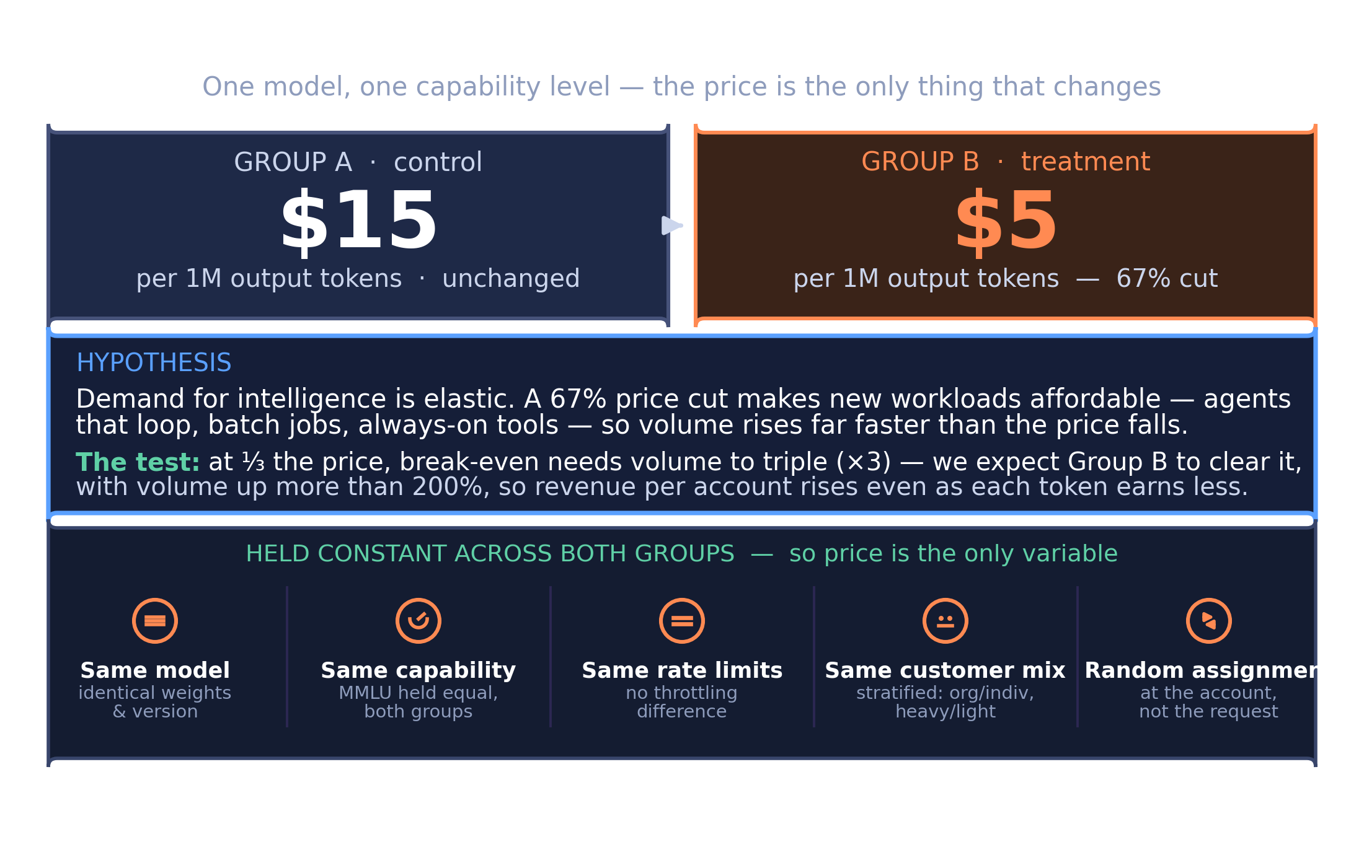
Notes:
90 sec. "My finding says cheaper capability drives disproportionately more usage. Here is how I would test that directly rather than inferring it. Group A stays on current pricing, 15 dollars per million tokens. Group B gets the same model at 5 dollars — a 67 percent cut. Both balanced on prior spend, tenure and industry."
"Hypothesis: volume in Group B rises more than 200 percent, so revenue per customer goes up despite each token earning a third as much. About 700 customers per group to detect a 15 percent difference, running 8 to 12 weeks. Threshold 0.05."
If asked about the guardrail: "Gross margin. You could triple volume and still sell below cost."

Slide 15
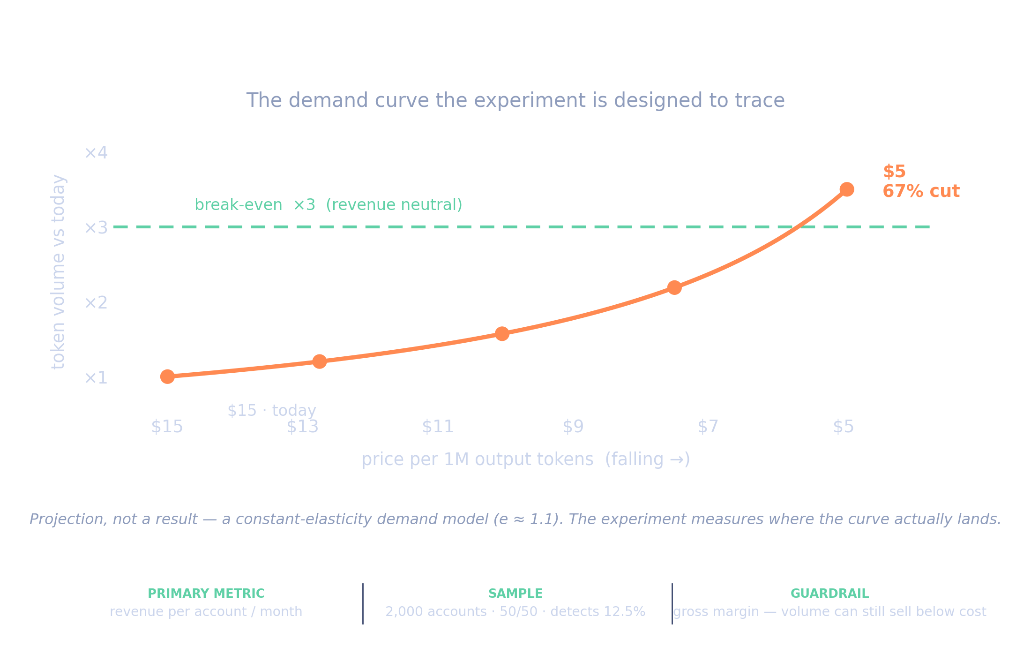

Slide 16
RECOMMENDATIONS
What I would do with this
For a company entering this market
Price low and plan for volume: at expert level the revenue is in the hundredfold usage, not the margin per token. But verify elasticity before betting on it.
Before scaling the price cut
Run the A/B test first. The projected demand curve is a hypothesis, not a result — a real 8-to-12 week experiment would confirm whether volume actually clears the break-even line before rolling the cut out to everyone.
For infrastructure planning
Treat grid capacity as the scarce input and secure the power allocation before land and capital. In Israel the constraint bound at three times average demand before a single gigawatt was built.
Notes:
60 sec. Handoff: "And here is how I would test the central claim properly."

Slide 17
DASHBOARD
Let’s explore the stock data
https://public.tableau.com/app/profile/zoltan.wil/viz/The_Market_Layer_Complete/Themarketlayer1600x900#1
Eleven years of daily market data for four companies in the industry, explored live — growth, annual returns, and where the capital concentrated.
The stock data is here for exploration, not results. But is a visual Aid on the market and stock difference between years and quarters.
Notes:
60 sec. Walk through it live, point at two or three things, do not narrate every filter. The honest negative earns credit — say it out loud. Handoff: "Back to the puzzle. Why did revenue grow so unevenly?"

Slide 18
The price of a model stayed flat.
The price of intelligence collapsed.
Questions
Notes:
"That is my analysis — happy to take questions." Then use the Q&A prep sheet.

