Slide 1
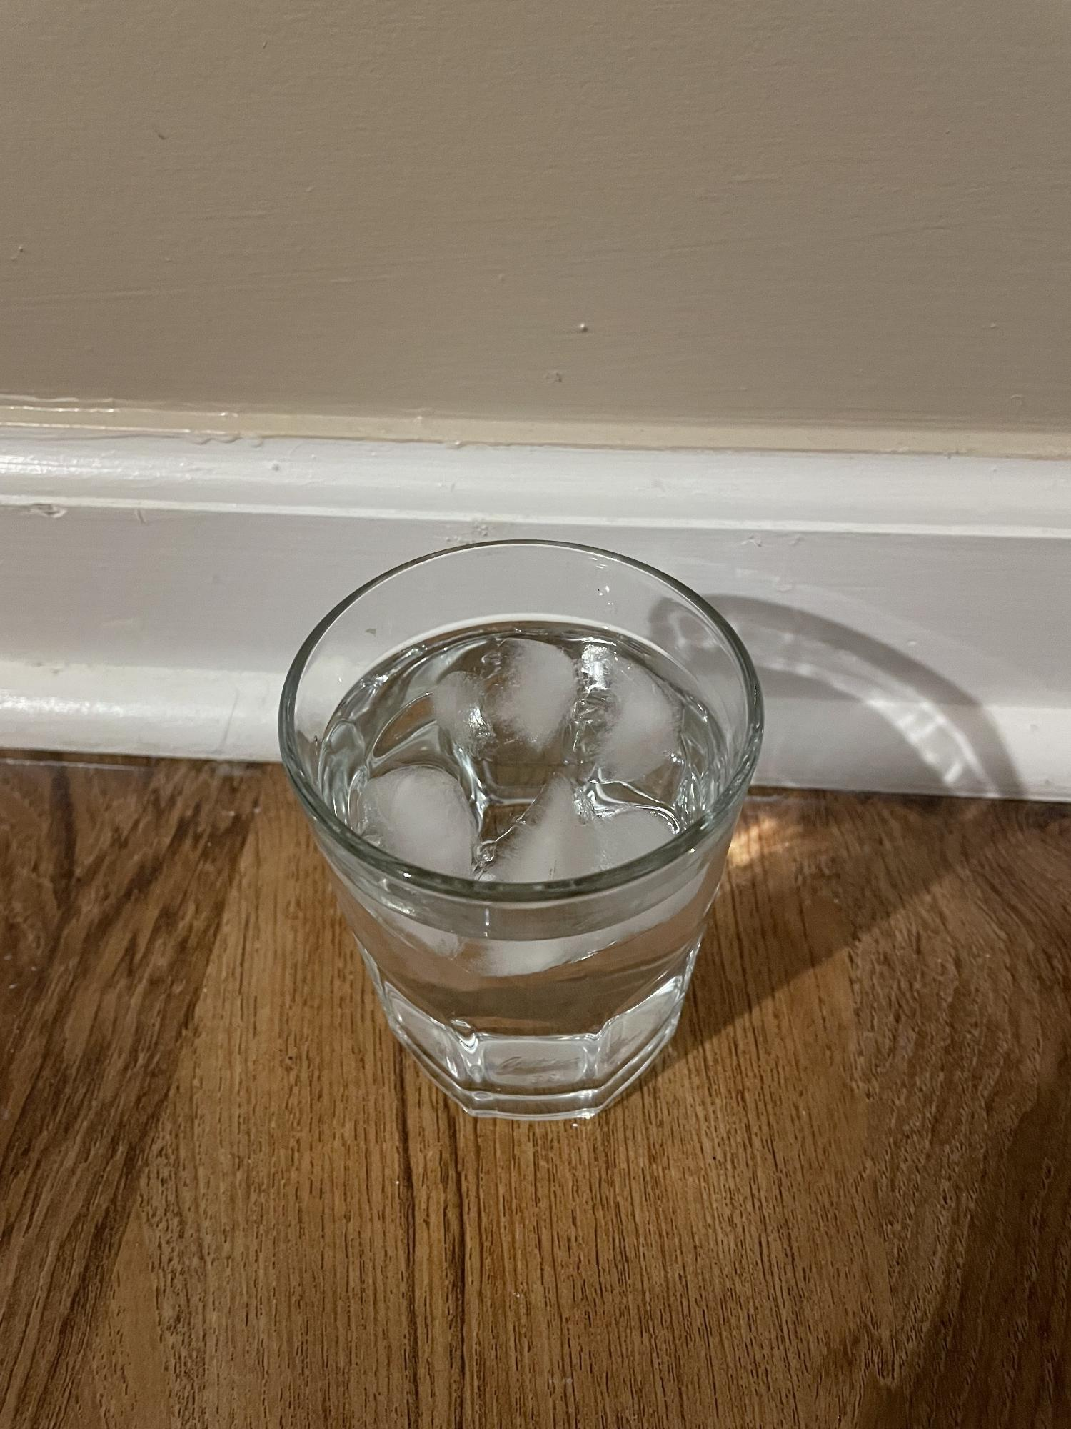
Why ice is less dense than water

Slide 2
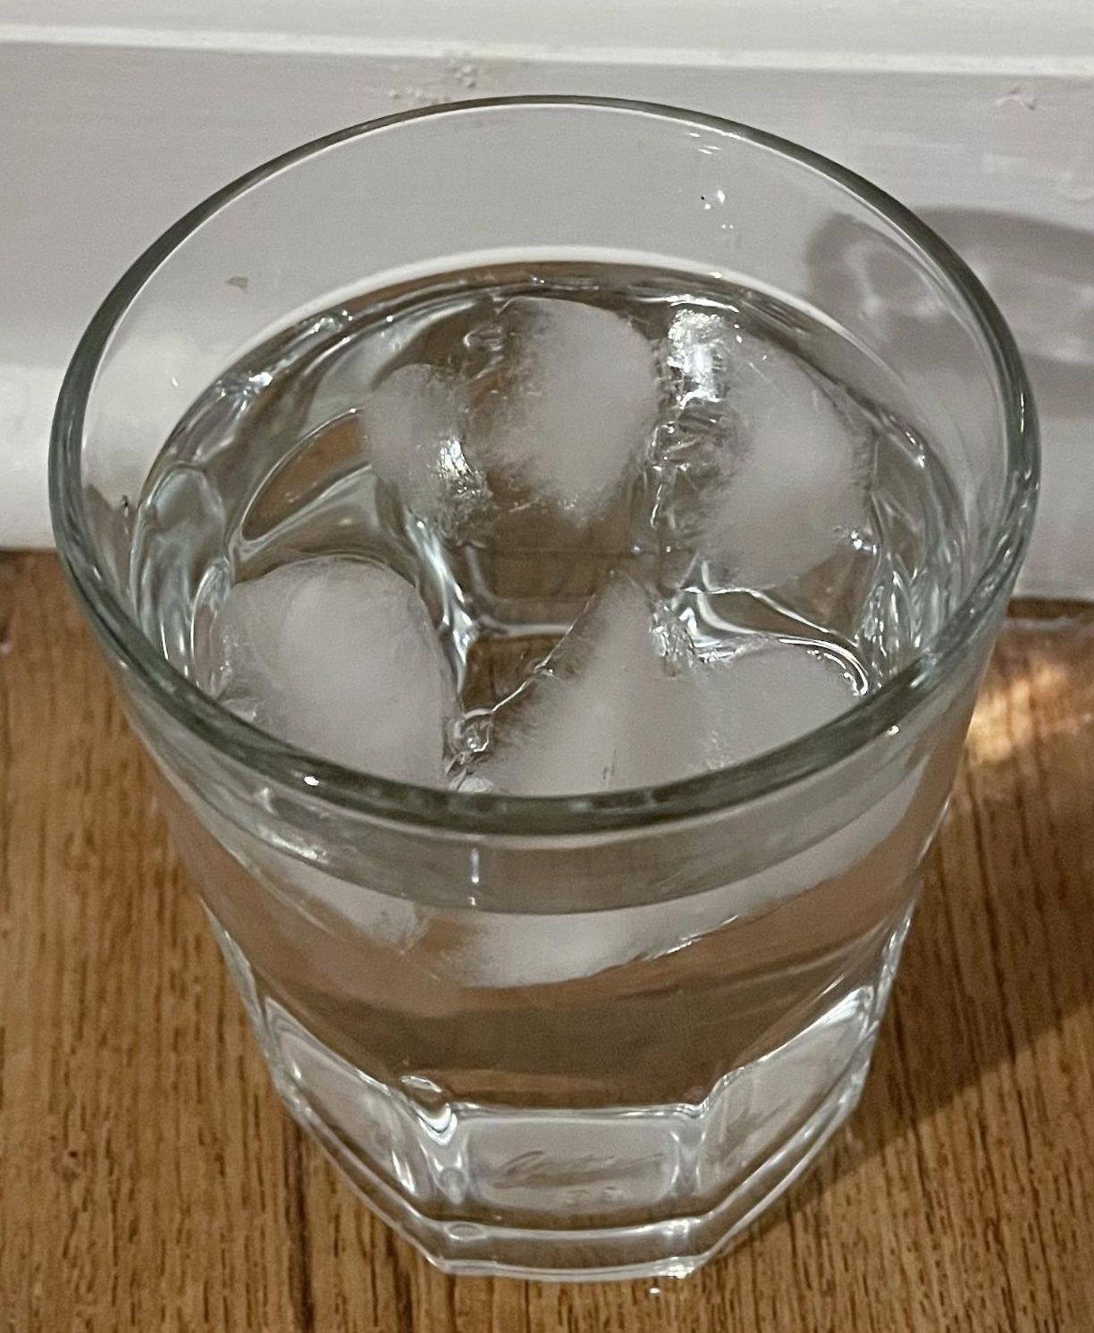
Proof:
Ice floats
Ice floats because of buoyancy .
Buoyancy causes less dense, lighter objects, to raise above more dense ones, heavier ones, because gravity pulls heavier objects down harder.

Slide 3
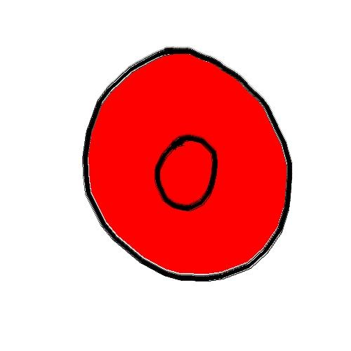
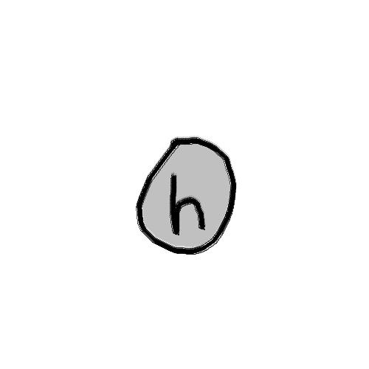


Why:
Water *particles*, as I will refer to as water molecules, aren’t spheres, they’re actually more of a v shape because of quantum mechanics, but that is not necessary for this explanation.

Slide 4









In liquid water, molecules are not bond to a specific lattice, basically a pattern.
In ice, molecules are bond to a lattice, a hexagonal lattice.

Slide 5











Since liquid water molecules aren’t bond to a hexagonal lattice they can
form denser shapes than a hexagon.
Liquid water
10
Here I made 2 equal sized boxes and I will put water molecules in both then count how much molecules fit in. If more molecules fit in the same sized box it must be denser.
Solid
Ice
9
9 < 10 so ice must be less dense than water.

