Slide 1
Catalog QA Product Similarity Demo
A customer-friendly sales preview for packaging similarity, duplicate review, variants, old packaging, and SKU/barcode image QA.
Guided catalog QA assistant
Sample catalog workflow
B2B catalog review focus
Answers customer demo questions
Explains workflow, scores, and thresholds
Covers duplicates, variants, old packaging, and SKU/barcode cases
Use customer sample images
Include names, SKUs, categories, and barcodes
Refresh the offline preview for follow-up discussions
Not only shopper visual search
Built for catalog, QA, packaging, and SKU teams
Clear path from sales preview to real pilot
Customer-facing explanation
“This guided preview helps your team review similar products, understand why items are matched, and discuss whether each case is a duplicate, variant, old package, wrong image, or SKU/barcode catalog issue.”
Product Similarity Demo | Catalog QA and Packaging Review
Customer preview

Slide 2
The Business Problem
Companies manage many product images, SKUs, barcodes, sizes, flavors, and packaging versions.
Similar packages can create duplicate catalog records or QA confusion.
Manual visual checking becomes slow when the catalog grows.
Barcode data alone does not solve visual packaging comparison.
Simple example
Two products may have different barcodes but very similar packaging.
The team needs to know: duplicate, variant, old packaging, or catalog mistake?
Who feels this pain?
Catalog teams
SKU/data teams
QA teams
Packaging teams
Retail/distribution teams
Product Similarity Demo | Fi Africa / ProPak MENA
Notes:
Explain SKU simply: one sellable product variant. The tool helps compare product images around SKU/barcode/catalog workflows.

Slide 3
What Makes Product Similarity Different?
Answer when someone says: we already have barcode, ERP, or normal product search
Visual search beyond barcode
AI embeddings, not filename matching
Vector database search
Barcode tells you identity.
This system compares how products actually look: packaging, label, shape, and visual similarity.
Uses CLIP/OpenCLIP image embeddings.
Compares image meaning/features instead of simple text or manual tags.
Stores image embeddings in PostgreSQL + pgvector.
Designed for fast top-match search as the catalog grows.
Search before upload
Duplicate prevention
Business workflow fit
Find similar products already in the database.
Useful for review and discovery without adding new records.
When uploading a new product, the system can warn about visually similar existing products.
Helps avoid duplicate catalog entries.
Built for catalog, SKU, packaging, QA, and ERP/product-data teams.
Can become Android capture app + web dashboard + API integration.
Short answer
The unique value is not “recognizing one product.” It is helping teams review visually similar products, duplicates, variants, and packaging mistakes across a catalog.
Product Similarity Demo | Fi Africa / ProPak MENA
Notes:
Say: Barcode and ERP identify exact product records. My app adds the visual layer: it finds products that look similar even when barcodes, names, or descriptions are different. That helps catalog, SKU, packaging, and QA teams review duplicates and variants faster.

Slide 4
The Solution
Upload, select, or capture a product image.
The system converts the image into an AI embedding.
It searches the product catalog using vector similarity.
It returns the closest matching products with scores.
The team reviews duplicates, variants, or possible mistakes faster.
Flow
Product image
AI image understanding
Vector search
Top similar products
Business value
Less manual checking
Cleaner catalog data
Faster packaging comparison
Better QA review
Product Similarity Demo | Fi Africa / ProPak MENA
Notes:
Keep the tech simple. If they are technical, mention CLIP and PostgreSQL/pgvector later.

Slide 5
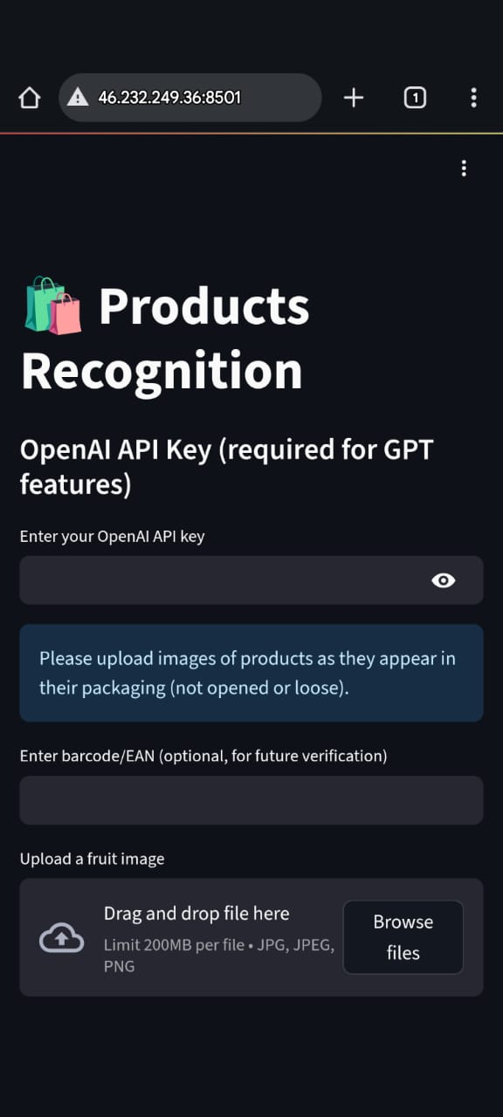
Demo Flow
1. Choose or show a reference product.
2. Click Find Similar Products or adjust the threshold.
3. Review the top 3 matches and confidence labels.
4. Use the guided assistant to answer customer questions during the demo.
5. Explain score: higher means visually closer.
6. Connect to value: duplicate, variant, old packaging, wrong image, or packaging review.
7. For follow-up demos, refresh the sample catalog with the customer’s product images.
Product Similarity Demo | Fi Africa / ProPak MENA
Notes:
Use this as your live demo checklist. Do not over-explain unless they ask.

Slide 6
Customer Inquiry Guide
Use these questions to understand fit, workflow, and next step
Customer situation
Workflow and next step
Do you manage many SKUs or product images?
Where do duplicate or visually similar packages cause problems?
Do teams compare old vs new packaging versions?
Where do wrong product images appear today?
Do you need to verify images against barcode or SKU records?
Which systems hold your catalog data today?
Who owns catalog quality or SKU data?
Would mobile capture/search help QA, warehouse, sales, or field teams?
Would a web dashboard help admins review duplicates and export reports?
For a 100-500 image pilot, what should we detect first?
Close: “Would it make sense to test this with a small sample of your product catalog after the event?”
Product Similarity Demo | Fi Africa / ProPak MENA
Notes:
Use this slide as a live conversation checklist. Pick 2-3 questions, do not read all of them.

Slide 7
Suggested Pilot
Pilot idea
Customer provides
Pilot deliverables
The static demo is a sales preview of the workflow.
For a pilot, test with 100-500 real customer product images.
Product images
Product names
SKU/article numbers
Barcodes if available
Category or brand
Examples they want to detect
Customer sample catalog setup
Real product images and metadata
Top 3/top 5 similar matches
Duplicate/variant review
Guided review support
Short findings report
Success criteria
Finds useful similar products in customer data.
Reduces manual review time.
Identifies confusing product records.
Makes duplicate, variant, and old-packaging review clearer.
Shows measurable value for catalog or QA workflow.
Product Similarity Demo | Fi Africa / ProPak MENA
Notes:
Close with a small pilot. It is concrete, low-risk, and easier than selling a full product immediately.

Slide 8
Catalog QA Product Similarity Search
Conversation deck for explaining the demo options while the app is active
AI-powered product image matching for catalog quality, packaging comparison, SKU/barcode checks, and QA review teams.
Use this as a conversation guide, not a formal long presentation.
The static demo is a sales preview; the pilot should use real customer product images.
30-second pitch
I built a visual product similarity system for companies with many product images, SKUs, barcodes, and packaging versions.
It helps teams find duplicate records, valid variants, old packaging, wrong images, and confusing catalog cases faster.
Presenter
Hazem Elbatawy
Full-stack Developer and Security Researcher
Product Similarity Demo | Catalog QA and Packaging Review
Notes:
Open with the live/static demo if possible. Use this slide only to frame what the customer is seeing.

Slide 9
Demo Options You Can Show
Static mobile demo
Live backend demo
Screenshots/video
Fast and reliable at the event.
Opens on phone browser or laptop.
Includes a guided demo assistant.
Easy to refresh with new sample products.
Runs as a single offline HTML preview.
Stronger technical proof.
Uses deployed app/backend.
Shows real search behavior.
Requires stable internet and running server.
Final fallback.
Useful for quick booth conversations.
Protects you if venue network is bad.
Good for follow-up messages.
Product Similarity Demo | Fi Africa / ProPak MENA
Notes:
Do not apologize for the static demo. Position it as the reliable event preview; explain the production version uses backend AI/vector search.

Slide 10
Product Options for Customers
Android app
Web dashboard
API integration
Field use and quick checks.
Camera/gallery image capture.
Top similar products on phone.
Best for sales, warehouse, QA, and field staff.
Catalog and admin work.
Bulk upload products.
Review duplicates and variants.
Export reports for teams.
Connect to ERP, ecommerce, WMS, or inventory systems.
Keeps existing workflow.
Adds visual search as a service.
Best for mature companies.
Product Similarity Demo | Fi Africa / ProPak MENA
Notes:
Key message: mobile is great for capture/search, but commercial companies also need dashboard/admin/integration.

Slide 11
Recommended Commercial Architecture
Android App
Capture/search in the field
Fast mobile workflow
FastAPI Backend
PostgreSQL + pgvector
->
->
Image upload
AI embeddings
Business logic
Products, images, SKUs
Vector similarity search
Web Dashboard
Catalog/admin/reporting
Bulk import and review
Important
Streamlit is useful for prototype/demo work.
It should not be the final commercial laptop product.
Product Similarity Demo | Fi Africa / ProPak MENA
Notes:
This slide answers: is it just mobile? No. Real product is Android + dashboard + API + vector database.

Slide 12
Where It Fits at Fi Africa / ProPak
Packaging and labeling
Food manufacturers
Distributors and retailers
Compare packaging designs.
Detect similar or duplicate packaging.
Support QA and client review.
Manage product variants, flavors, and sizes.
Compare old vs new packaging.
Keep product images consistent.
Clean catalog duplicates.
Verify product images across suppliers.
Improve product search.
Automation / QA companies
Best first target
Add visual similarity to inspection or traceability workflows.
Strong ProPak MENA fit.
Hall 1 / ProPak: packaging, labeling, coding, QA, automation.
Product Similarity Demo | Fi Africa / ProPak MENA
Notes:
Prioritize ProPak booths for Product Similarity. Use Fi Africa for food/product data and Calories Zone conversations.

Slide 13
Questions to Ask Customers
Do you manage many SKUs or product images?
Do you have duplicate or similar packaging problems?
Do your teams compare old vs new packaging versions?
Do you need to verify product images against barcode/SKU records?
Do you use ERP, ecommerce, WMS, or inventory software?
Who owns product catalog quality in your company?
What you are qualifying
Need for demo
Need for pilot
Need for API integration
Right person for follow-up
Ask for next step
Technical meeting
Sample product images
Pilot discussion
Referral to catalog/QA/IT owner
Product Similarity Demo | Fi Africa / ProPak MENA
Notes:
Your goal is not to close immediately. Your goal is to find the pain owner and schedule a real follow-up.

Slide 14
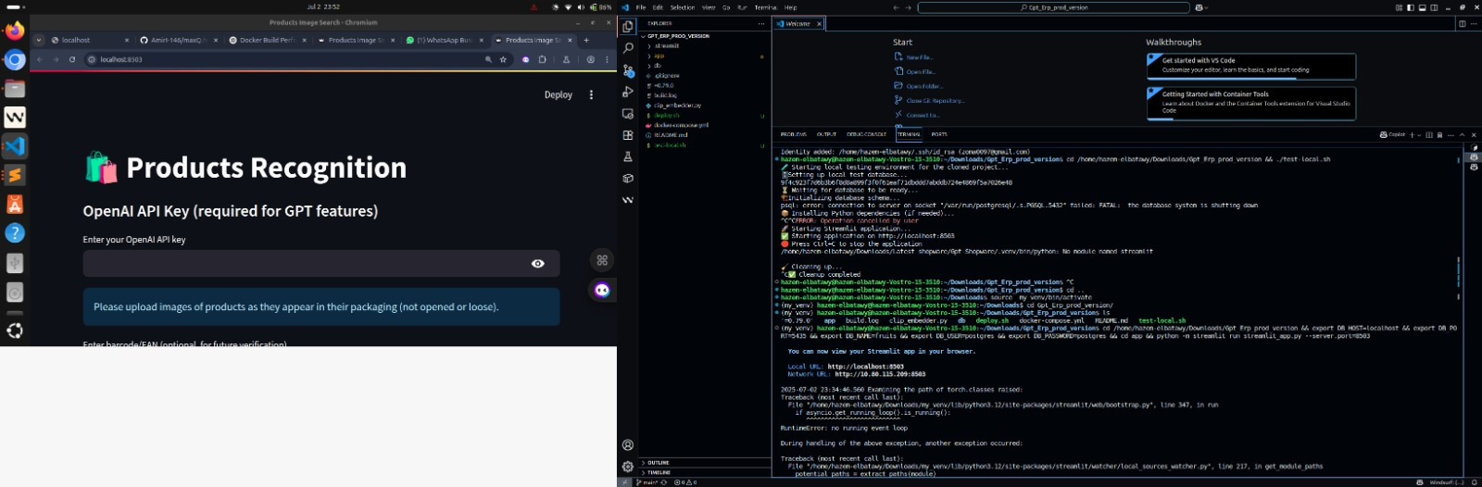
Technical Foundation
Use only if the customer is technical
Python / FastAPI backend.
CLIP image embeddings.
PostgreSQL with pgvector for vector search.
Android app for mobile capture/search.
Web dashboard for catalog/admin workflow.
API integration possible with ERP, inventory, and ecommerce systems.
Product Similarity Demo | Fi Africa / ProPak MENA
Notes:
Only show this if they ask about the technical architecture or scalability.

Slide 15
Ecommerce Integration Opportunity
Shopify / WordPress product creation + AI-generated descriptions
Where it connects
New product workflow
OpenAI API value
Shopify stores.
WordPress / WooCommerce stores.
ERP or product catalog systems.
Internal admin dashboards.
Upload product image.
Check for visually similar existing products.
Prevent duplicate catalog entry.
Generate draft description for review.
Generate product title ideas.
Draft product descriptions.
Suggest category/tags.
Create SEO-friendly copy for ecommerce.
Human review required
Commercial benefit
Best pitch
AI-generated descriptions should be reviewed by the business.
The system should not invent unsupported ingredients, claims, certifications, or nutrition facts.
Faster product onboarding.
Cleaner catalog data.
Fewer duplicate listings.
Better product pages for online stores.
“The same visual search can become an ecommerce catalog assistant: check duplicates first, then draft product descriptions for Shopify or WordPress.”
Product Similarity Demo | Fi Africa / ProPak MENA
Notes:
Explain this as a future integration option, not something the current static demo fully does. Strong angle for retailers, distributors, and food brands with ecommerce stores.

