Slide 1
ACM 程序设计
计算机学院 刘春英

Slide 2
今天，
AC
你 了吗？

Slide 3

每周一星（8）：
天外来客

Slide 4
第九讲
特殊的数
（Special Number）

Slide 5
主要内容
Fibonacci Number
Lucas number
Catalan Number
Application to Special Number

Slide 6
Fibonacci Number
Fibonacci is perhaps best known for a simple series of numbers, introduced in Liber abaci and later named the Fibonacci numbers in his honour.
The series begins with 0 and 1. After that, use the simple rule: Add the last two numbers to get the next.
0，1，1, 2, 3, 5, 8, 13, 21, 34, 55, 89, 144, 233, 377, 610, 987,...

Slide 7
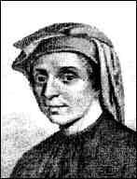
Leonardo Fibonacci 1175-1250

Slide 8
You might ask where this came from?

Slide 9
In Fibonacci's day, mathematical competitions and challenges were common. In 1225 Fibonacci took part in a tournament at Pisa ordered by the emperor himself, Frederick II.
It was in just this type of competition that the following problem arose:

Slide 10
Beginning with a single pair of rabbits, if every month each productive pair bears a new pair, which becomes productive when they are 1 month old, how many rabbits will there be after n months?

Slide 11
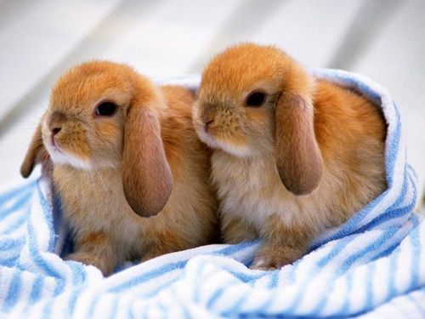
January

Slide 12
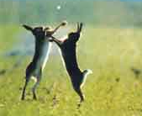
February

Slide 13
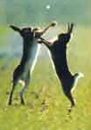
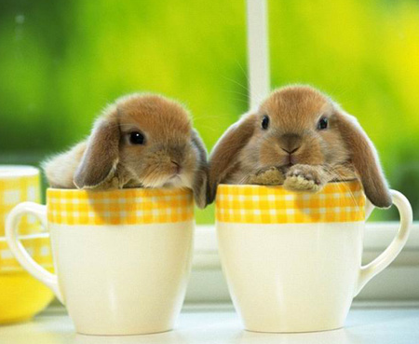
March

Slide 14
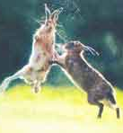
April

Slide 15
May、June…
???

Slide 16
The number series is——
1、1、2、3、5…
This if fibonacci！

Slide 17
Some other pictures

Slide 18
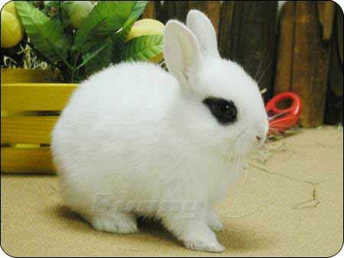

Slide 19
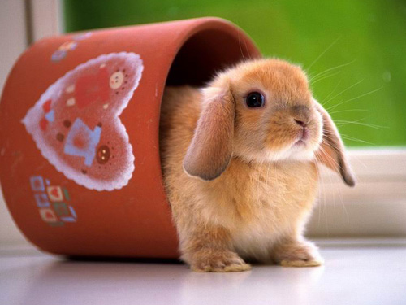

Slide 20
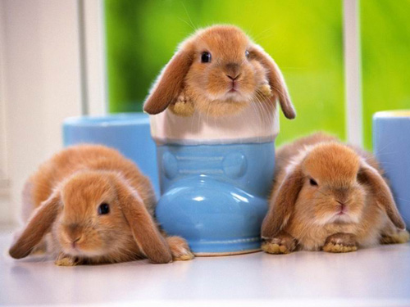

Slide 21
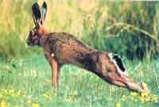

Slide 22
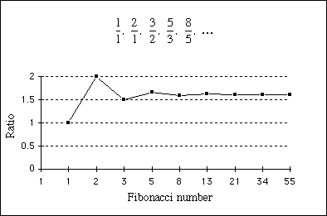
Fibonacci number & Golden Section
A special value, closely related to the Fibonacci series, is called the golden section. This value is obtained by taking the ratio of successive terms in the Fibonacci series:

Slide 23
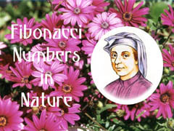
Fibonacci Numbers in Nature

Slide 24
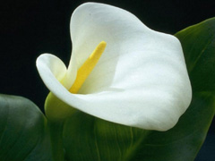
white calla lily（白色马蹄莲）

Slide 25
Euphorbia(一种非洲植物，不常见)

Slide 26
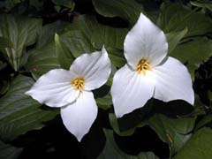
trillium （ 延龄草）

Slide 27
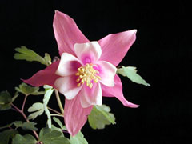
Columbine(耧斗菜)

Slide 28
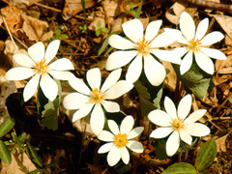
Bloodroot（一种罂粟科植物）

Slide 29
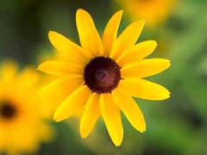
black-eyed susan

Slide 30

shasta daisy(大滨菊) with 21 petals

Slide 31
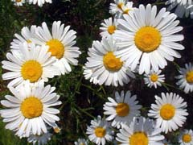
Ordinary field daisies(雏菊) have 34 petals

Slide 32
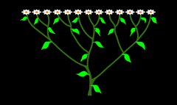
The association of Fibonacci numbers and plants is not restricted to numbers of petals.

Slide 33
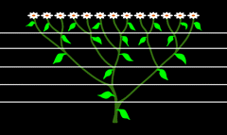
If we draw horizontal lines through the axils, we can detect obvious stages of development in the plant.

Slide 34
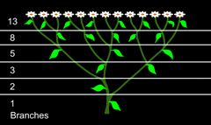
The number of branches at any stage of development is a Fibonacci number.

Slide 35
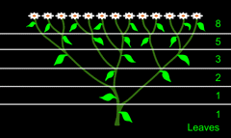
Furthermore, the number of leaves in any stage will also be a Fibonacci number.

Slide 36
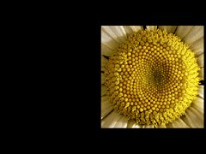
sunflowers （向日葵）

Slide 37
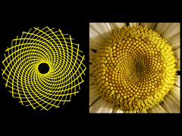

Slide 38
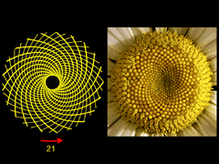

Slide 39
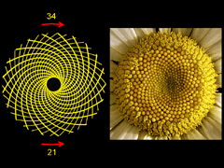

Slide 40
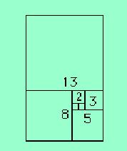
Fibonacci in geometrical style

Slide 41
Lucas Number
Lucas Numbers are the companions to the Fibonacci numbers and satisfy the same recurrence :
L(n)=L(n-1)+L(n-2)
Where L(1)=1,L(2)=3
The first few are 1, 3, 4, 7, 11, 18, 29,
47, 76, 123, ...

Slide 42
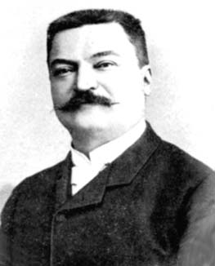
Edouard Lucas
1842-1891

Slide 43
Question:
编程实现这类递归问题时应该注意什么问题？

Slide 44
空间换
时 间！！

Slide 45
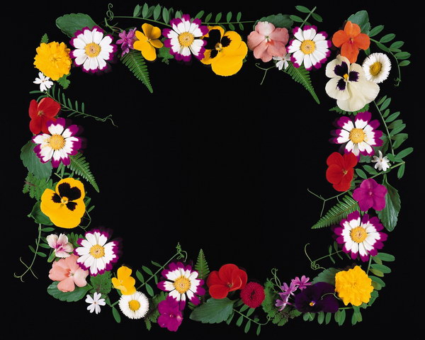
Catalan number

Slide 46
先看一道题目：
HDOJ_1134:
Game of Connections

Slide 47
示意图：
8
1
7
2
6
3
5
4

Slide 48
Easy or not ?

Slide 49

Catalan Number
The Catalan numbers (1, 2, 5, 14, 42, 132, 429, 1430, 4862, 16796, 58786, 208012, 742900, 2674440, 9694845, ...), named after Eugène Charles Catalan, arise in a number of problems in combinatorics. They can be computed using this formula:

Slide 50
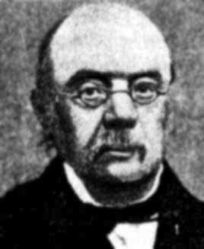
Eugène Charles Catalan
(1814—1894 Belgium)

Slide 51
What can the Catalan numbers describe ?

Slide 52
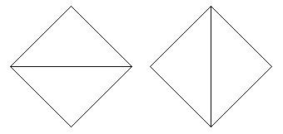
1. The number of ways a polygon with n+2 sides can be cut into n triangles
4 sides, 2 ways:

Slide 53


5 sides, 5 ways:
6 sides, 14 ways:

Slide 54
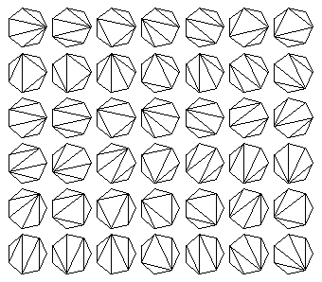
7 sides, 42 ways:

Slide 55
2. the number of ways in which parentheses can be placed in a sequence of numbers to be multiplied, two at a time
3 numbers: (1 (2 3)) ((1 2) 3)
4 numbers: (1 (2 (3 4))) (1 ((2 3) 4)) ((1 2) (3 4)) ((1 (2 3)) 4) (((1 2) 3) 4)

Slide 56
5 numbers:
  (1 (2 (3 (4 5)))) (1 (2 ((3 4) 5)))
  (1 ((2 3) (4 5))) (1 ((2 (3 4)) 5))
  (1 (((2 3) 4) 5)) ((1 2) (3 (4 5)))
  ((1 2) ((3 4) 5)) ((1 (2 3)) (4 5))
  ((1 (2 (3 4))) 5) ((1 ((2 3) 4)) 5)
  (((1 2) 3) (4 5)) (((1 2) (3 4)) 5)
  (((1 (2 3)) 4) 5) ((((1 2) 3) 4) 5)

Slide 57
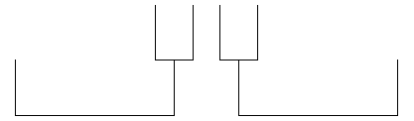
3.the number of rooted, trivalent trees with n+1 nodes
3 nodes:

Slide 58


4 nodes:
5 nodes:

Slide 59
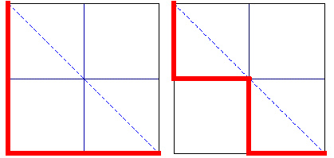
4. the number of paths of length 2n through an n-by-n grid that do not rise above the main diagonal
2 x 2 grid:

Slide 60

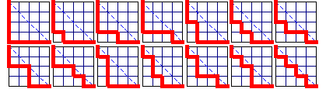
3 x 3 grid:
4 x 4 grid:

Slide 61

5. The number of binary trees with n nodes.
There are 5 binary trees with 3 nodes.

Slide 62
6. Some other applications
（1）The number of ways 2n people, seated round a table, can shake hands in n pairs, without their arms crossing.
（2）The self-convolving sequence, c[0]=1, c[n+1] = c[0]c[n] + c[1]c[n-1] + ... + c[n]c[0]

Slide 63
(3) The recurring sequence c[0]=1, (n+2)c[n+1] = (4n+2)c[n], (n>=0).
(4)Another disguise is the number of ways n votes can come in for each of two candidates A and B in an election, with A never behind B.

Slide 64
思考(1)： http://acm.hziee.edu.cn/showproblem.php?pid=1133

Slide 65
算法分析：
令f(m,n)表示有m个人手持￥50的钞票，n个人手持￥100的钞票时共有的方案总数。则可以分以下情况讨论这个问题：
（1）当n=0时
N=0意味着排队购票的所有人手中拿的都是 ￥50的钞票，那么这m个人排队方案总数为1。
（2）当m<n时
显然，f(m,n)=0

Slide 66
(3)其他情况：
考虑（m+n）个人排队购票的情景，第（m+n）人站在第（m+n-1）个人的后面，则第（m+n ）个人的排队方式可以由下列两种情况获得：
1）第（m+n ）个人手持￥100的钞票，则在他之前的(m+n-1）个人中有m个人手持￥50的钞票，有（n-1）个人手持￥100的钞票，此种情况共有f(m,n-1);
2)第（m+n ）个人手持￥50的钞票，则在他之前的(m+n-1）个人中有m-1个人手持￥50的钞票，有n个人手持￥100的钞票，此种情况共有f(m-1,n);

Slide 67
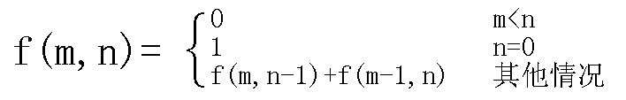
根据加法原理得到f(m,n)=f(m-1,n)+f(m,n-1)
于是得到f(m,n)的计算公式

Slide 68
计算示意图：
 | 0 | 0 | 0 | 0
 |  | 0 | 0 | 0
 |  |  | 0 | 0
 |  |  |  | 0

Slide 69
计算示意图：
 | 0 | 0 | 0 | 0
1 |  | 0 | 0 | 0
1 |  |  | 0 | 0
1 |  |  |  | 0
1

Slide 70
计算示意图：
 | 0 | 0 | 0 | 0
1 | 1 | 0 | 0 | 0
1 | 2 | 2 | 0 | 0
1 | 3 | 5 | 5 | 0
1 | 4 | 9 | 14 | 14

Slide 71
可以推出直接的公式：
C(m+n,n)-C(m+n,m+1)

Slide 72
思考(2)：
1130 How Many Trees?

Slide 73
思考（3）：
1131 Count the Trees

Slide 74
课后作业：
1130 How Many Trees?
1131 Count the Trees
1133 Buy the Ticket
1134 Game of Connections
1023 Train Problem II
2018 母牛的故事
2041超级楼梯
2067小兔的棋盘

Slide 75
ACM,
天天见！

