Slide 1
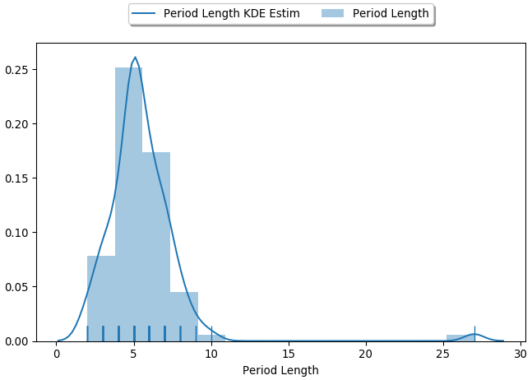
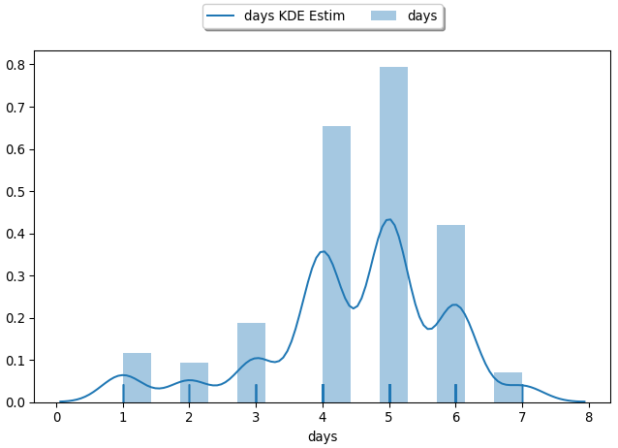
Actual vs Predicted Period Duration
Subjective estimate of period duration by subjects
Objective estimate of period duration based on data.

Slide 2
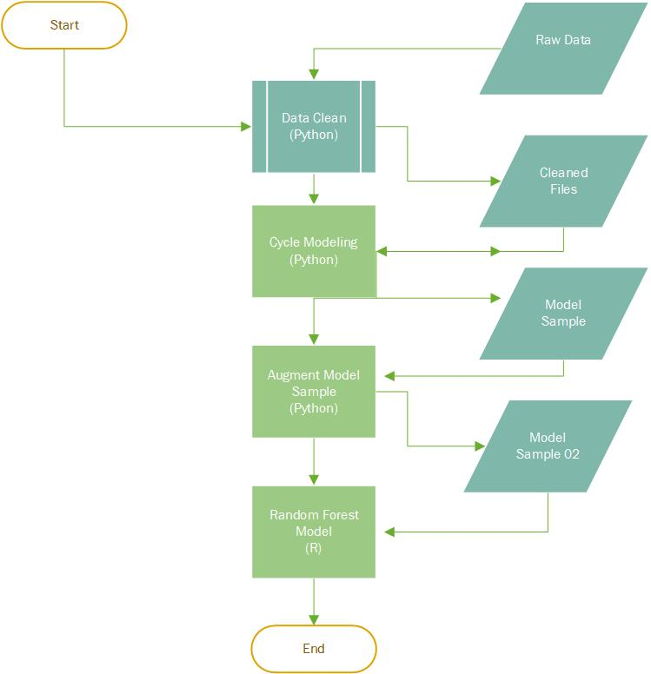
Data Flow for Model Production
Raw Data was cleaned and outliers removed
Discrete data sources, i.e. user, period, and symptom data was consolidated in a single table.
Consolidated data was then transformed and placed in a tidy formation for processing.
Cleaned data was divided into test and training data sets.
Using the RandomForest library in R, a model was trained and test values were predicted.

Slide 3


Highlights of Random Forest Analysis
Naive Analysis, an average cycle length for the entire data set, resulted in a RMSE of 5.091453 days.
Random Forest analysis, reduced error to 4.511861 days; a 21.47% improvement.

