Slide 1
Comparison Results
Model: lm, nnlm, svr
Type: by sample, by cell type

Slide 2
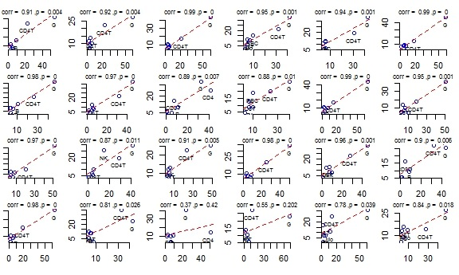
Observed versus predicted for each model – Linear Regression
Predicted frequency
Observed frequency

Slide 3
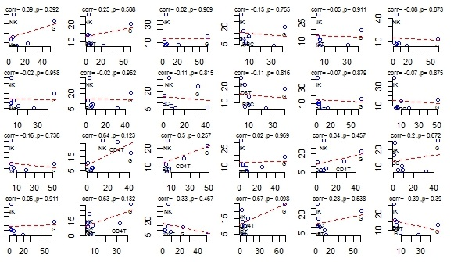
Observed versus predicted for each model – non-negative Linear Regression
Predicted frequency
Observed frequency

Slide 4
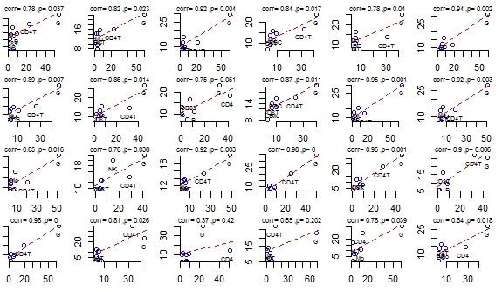
Observed versus predicted for each model – SVR Regression
Predicted frequency
Observed frequency

Slide 5
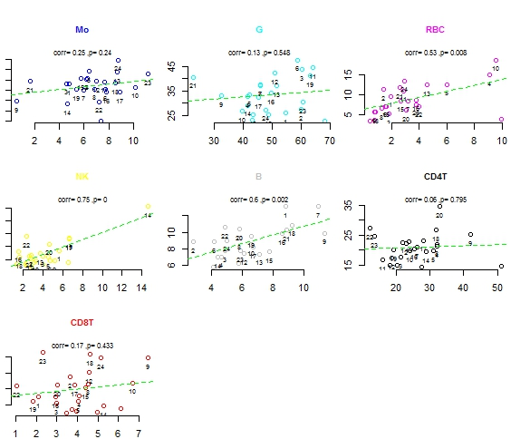
Observed versus predicted for each cell type – Linear Regression
Predicted frequency
Observed frequency

Slide 6
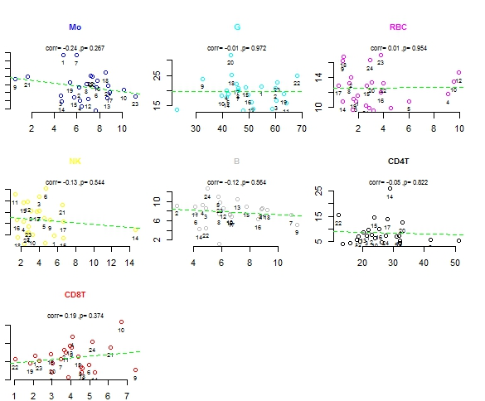
Observed versus predicted for each cell type – non-negative Linear Regression
Predicted frequency
Observed frequency

Slide 7
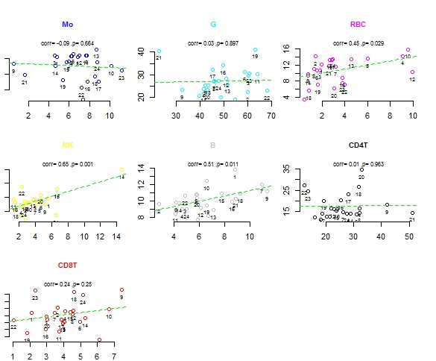
Observed versus predicted for each cell type – SVR Regression
Predicted frequency
Observed frequency

