Slide 1
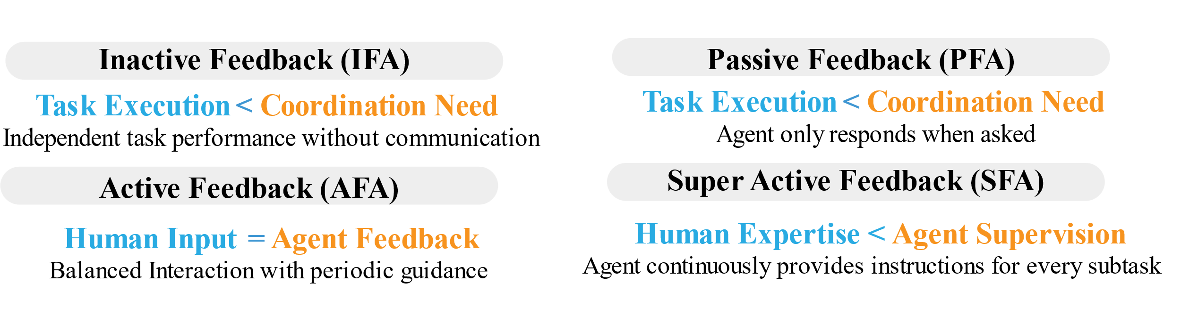
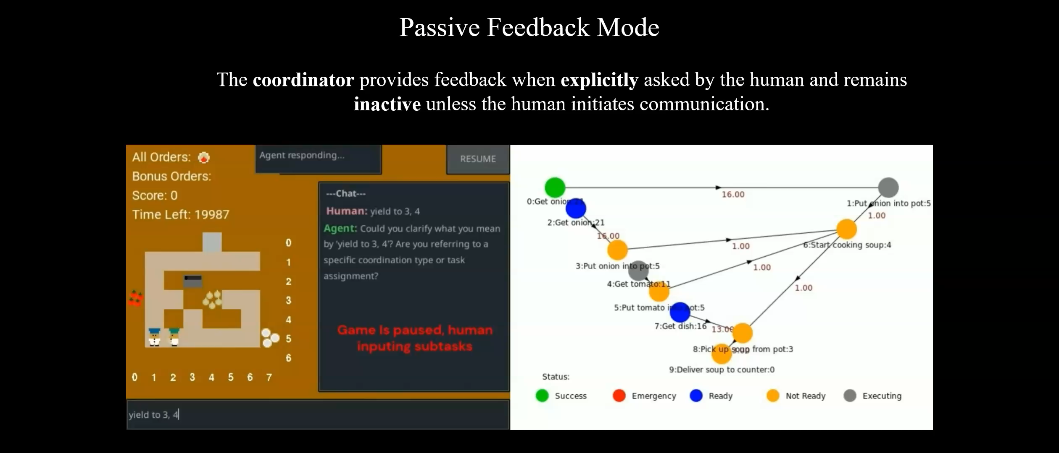
Effect of Adaptive Communication Support on LLM-powered Human-AI Collaboration
Traditional human-robot teams lack adaptive communication, making collaboration inefficient.
We propose HRT-ML framework dynamically adjusts language feedback to improve efficiency & engagement.
4 Feedback Modes
Notes:
We present human AI coordination frawework which allows llm to cordinate with human in different feedback modes For this we use graph based network to represent the subtask dependenicies to enable human and robot to corintae based on subtasks nodes which we are changing by llm prompting,
specifcally it allows three different types: first is by changing how human and robot is completing specific sub tsak that can achieved by changing substask graph structure, secondly we will also enable human to express its preference when assigning difeerent substasks, finally we will assume human and robot to add temporary substack to handle emergency cases
Based on these Grapg structure, we can allow llm to cordinate with human for four different feedback modes, inactive feeback where there is no cordination, passive feedback where only human is querying, and active feeback where both human and robot are cordintaing and super active feeback where agents are trying to give high frequecy support through step by step instructions And we have tested feedbacks thorugh human studeies and we have found that its not always good to have higher feedback in all cases, the appropriate frequency of feedback really depends on task complexity and human capabilities. for more info you can refer to the poster

