Slide 1

WMAC 2026
AAAI 2026 Bridge Program on
Advancing LLM-Based Multi-Agent Collaboration
January 20, 2026, Singapore
multiagents.org

Slide 2
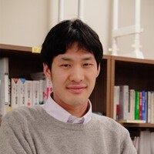
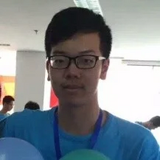
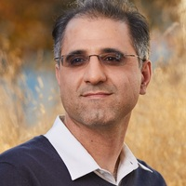
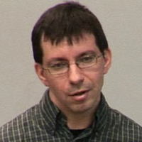
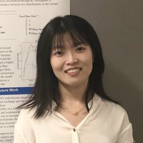
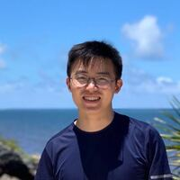
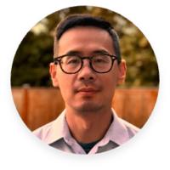
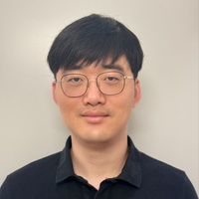
Advancing LLM-Based Multi-Agent Collaboration
• AI Agents driven by LLMs are becoming capable of complex task solving
• Rise of Multi-Agent Collaboration
• Open challenges remain
Program Organizers
Raphael Shu
Yusen Zhang
Alborz Geramifard
Alex Marin
Chair
Co-Chair
LinkedIn
Thomson Reuters
Weiyan Shi
Tao Yu
Yi Zhang
Jeffrey Cho
Northeastern
HKU
AWS
UPenn

Slide 3



SPONSORS
We thank our sponsors for their generous support
multiagents.org/2026

Slide 4
WMAC 2026 PROGRAM AGENDA
MORNING SESSIONS 9:00 ~ 12:30
AFTERNOON SESSIONS 13:50 ~ 18:15
Opening
Invited Talk 3 (Matthew Taylor)
Invited Talk 1 (Yi R. Fung)
Specially Invited Oral Talk
WMAC History and Vision
Fireside Chat & Panel
Lightning Talks for Posters (30 mins)
Oral Presentations 2 & 3
Coffee Break
Industrial Demo Session
Invited Talk 2 (Sophia Han)
Oral Presentation 4
Poster Session
Award & Closing
multiagents.org/2026

Slide 5
ATTENDANCE RESOURCES
Room: Topaz 220 – 225
See venue map on multiagents.org/2026
Registration
Register with "AAAI Tutorial/Lab/Bridge only" or
"Bridges, Tutorials and Labs Add-on" option
Papers & Posters
Available at multiagents.org/2026
Remote Participation
In-person encouraged, remote supported for talks
multiagents.org/2026_remote
multiagents.org/2026

Slide 6
HOW TO ASK QUESTIONS
You can raise questions to speakers or the event organizers through:
Discord
Join our Discord server for real-time discussion
https://discord.gg/PLACEHOLDER
Underline
Submit questions through the Underline platform
https://underline.io/PLACEHOLDER
multiagents.org/2026

Slide 7
REMINDERS
Goodies
We have prepared t-shirts and tote bags for attendees.
Please check in with a volunteer to obtain your goodies.
Lunchtime Gathering
After the poster session, please come back to this room.
We may have lunchbox and drinks available for attendees.
multiagents.org/2026

Slide 8
FOR PRESENTERS
• Confirm program agenda
• Check in with moderators 15 mins before presentation
• All presentations will be in-person
• Oral presentations: 20 mins each
multiagents.org/2026

Slide 10
WMAC 2026
AAAI 2026 Bridge Program on
Advancing LLM-Based Multi-Agent Collaboration
January 20, 2026, Singapore
COFFEE BREAK UNTIL 10:45
multiagents.org

Slide 11
WMAC 2026
AAAI 2026 Bridge Program on
Advancing LLM-Based Multi-Agent Collaboration
January 20, 2026, Singapore
POSTER SESSION 11:30 - 12:30
multiagents.org

Slide 12
WMAC 2026
AAAI 2026 Bridge Program on
Advancing LLM-Based Multi-Agent Collaboration
January 20, 2026, Singapore
LUNCH BREAK 12:30 - 13:50
multiagents.org

Slide 13
WMAC 2026
AAAI 2026 Bridge Program on
Advancing LLM-Based Multi-Agent Collaboration
January 20, 2026, Singapore
COFFEE BREAK UNTIL 16:05
multiagents.org

Slide 14
WMAC 2026
AAAI 2026 Bridge Program on
Advancing LLM-Based Multi-Agent Collaboration
January 20, 2026, Singapore
COFFEE BREAK UNTIL 17:00
multiagents.org

Slide 15
WMAC 2026
AAAI 2026 Bridge Program on
Advancing LLM-Based Multi-Agent Collaboration
January 20, 2026, Singapore
FIRESIDE CHAT & PANEL
multiagents.org

Slide 16
WMAC 2026
AAAI 2026 Bridge Program on
Advancing LLM-Based Multi-Agent Collaboration
January 20, 2026, Singapore
INDUSTRIAL DEMO SESSION
17:00 - 17:45 (3 demos, 15 mins each)
multiagents.org

Slide 17
WMAC 2026
AAAI 2026 Bridge Program on
Advancing LLM-Based Multi-Agent Collaboration
January 20, 2026, Singapore
multiagents.org

Slide 18
WMAC 2026
AAAI 2026 Bridge Program on Advancing LLM-Based Multi-Agent Collaboration
BEST PAPER AWARD

Slide 19
WMAC 2026
AAAI 2026 Bridge Program on Advancing LLM-Based Multi-Agent Collaboration
CLOSING REMARKS

Slide 20
WMAC 2026
AAAI 2026 Bridge Program on Advancing LLM-Based Multi-Agent Collaboration
THANK YOU

