Slide 1
WORLD UNIVERSITY OF BANGLADESH
Department of Computer Science and Engineering
An Explainable QR Code Analysis for Detecting Phishing and Malicious URLs Using Machine Learning
Presented by
Md Shahidul Islam (WUB 03/23/63/3735) · Md Riad Khan (WUB 03/23/63/3738)
Md Zonaet Hossain Munna (WUB 03/23/63/3746)
Supervised by: Mst. Nishita Aktar, Lecturer, Department of Computer Science & Engineering
June 2026

Slide 2
Abstract
QR codes are everywhere, but they are opaque — a malicious link hidden inside one is invisible to the user, an attack known as “quishing”. This thesis proposes an explainable machine-learning system that decodes the URL from a QR code and classifies it into four categories — benign, phishing, malware, and defacement — using a dual-input Transformer model that combines character-level encoding with brand-similarity features.
Trained on a multi-source dataset of 402,684 URLs, the model achieves 91.2% four-class accuracy and 93% on the safe-versus-threat decision (ROC-AUC 0.97), generalizes to unseen brand-impersonation attacks, and runs as a working web and mobile prototype that explains every verdict.
02 / 17

Slide 3
Introduction
▸ QR codes are now everywhere — payments, menus, transit, banking, and advertising — and their use keeps growing.
▸ They are convenient: a single scan instantly bridges the physical and digital worlds.
▸ But they can also hide danger — “quishing” (QR + phishing): attackers place phishing, malware, or defacement links inside ordinary QR codes.
▸ It is a real and growing threat, reported in security studies (Vidas, 2013; Krombholz, 2021).
03 / 17

Slide 4
Objectives
The thesis has two main objectives:
01 To propose a novel machine-learning-based model for explainable QR code analysis to detect phishing and malicious URLs.
02 To evaluate the accuracy level of the proposed system in comparison with existing models.
04 / 17

Slide 5
Description of the Problem
▸ A QR code is just a picture of a link — a safe and a malicious one look identical, so the user cannot judge it before scanning.
▸ Scanner apps decode and open the link with no security check at all.
▸ The danger is in the decoded URL, not the image — so the link text must be analyzed, not the picture.
▸ When a tool does warn, it gives only a label with no reason, so users cannot trust or understand it.
▸ The challenge: detect malicious URLs in QR codes *and* explain the verdict — before the link opens.
05 / 17

Slide 6
Scope of the Thesis
✅ IN SCOPE
• URL-text classification into 4 classes
• Multi-source dataset of 402,684 URLs
• Dual-input Transformer model
• Human-readable explanations
• Working web & mobile prototype
🚫 OUT OF SCOPE
• Destination-page content analysis
• On-device / production real-time deployment
• Non-URL QR content (Wi-Fi, plain text)
• Formal SHAP/LIME feature attribution
06 / 17

Slide 7
Literature Review
PRIOR WORK
• URL-based ML: character-CNN (Aljofey, 2020) and CNN-ensemble (Yang, 2021) — 95–99%, but on web/email URLs.
• Explainable AI for phishing: SHAP/LIME feature attribution (Shafin, 2024; Mohi et al., 2025).
• QR-specific security: mostly image-based and binary (Trad & Chehab, 2025; Vidas, 2013).
RESEARCH GAP
• Few QR-specific detectors
• Mostly binary, not multi-class
• Limited explainability
• No held-out brand generalization test
07 / 17

Slide 8
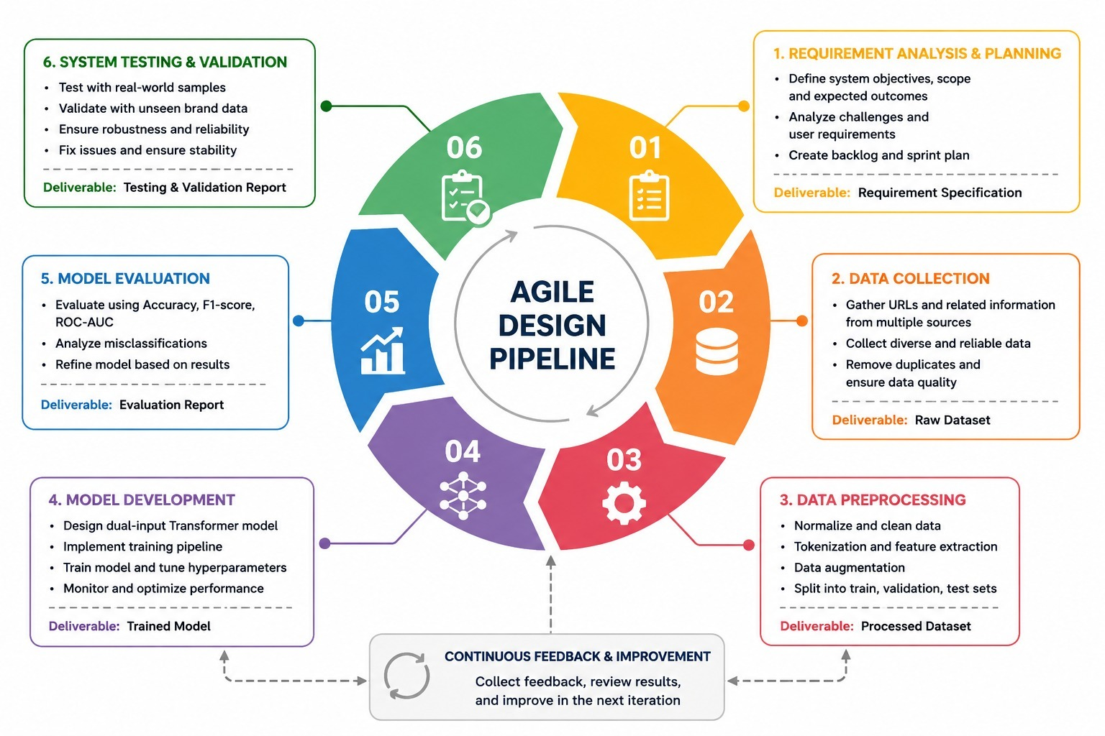
Methodology
KEY TECHNIQUES
▸ Multi-source data + brand-attack augmentation
▸ Character encoding + brand-similarity features
▸ Dual-input Transformer model
▸ Class weighting, dropout, early stopping
▸ Held-out test + generalization + ablation
Agile research workflow (6 iterative phases)
08 / 17

Slide 9
Requirement Analysis
FUNCTIONAL
• Decode the QR code to recover the URL
• Normalize the URL + compute features
• Classify into 4 classes
• Show result + confidence + explanation
• Never open the link before the verdict
NON-FUNCTIONAL
• Fast — ~62 ms per URL
• Reliable & consistent predictions
• Scalable — easy to retrain on new feeds
• Usable — clear to non-technical users
09 / 17

Slide 10
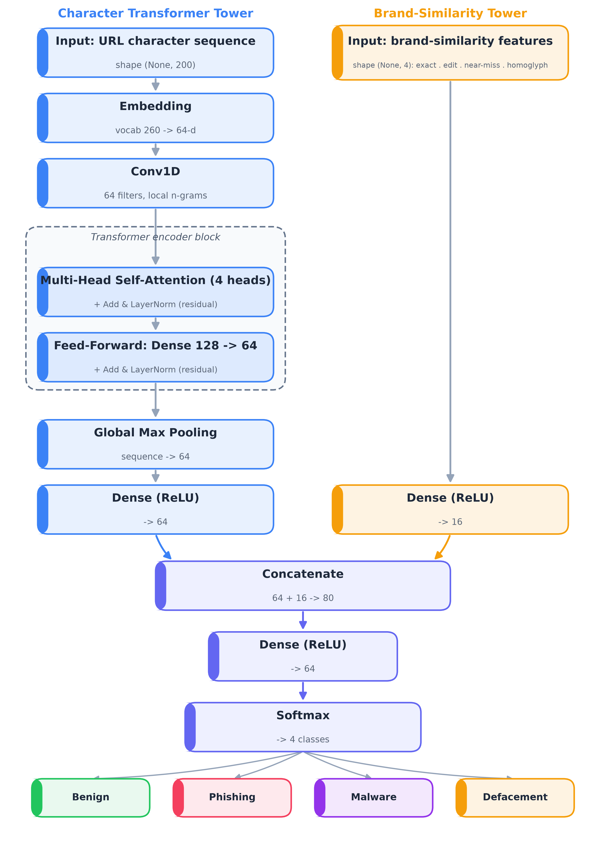
Design & Development — The Model
Dual-Input Transformer
▸ Character tower: embedding → Conv1D → self-attention → pooling
▸ Brand tower: 4 brand-similarity features
▸ Fused → softmax over 4 classes
▸ ~130,196 parameters (lightweight)
Dual-input model architecture
10 / 17

Slide 11
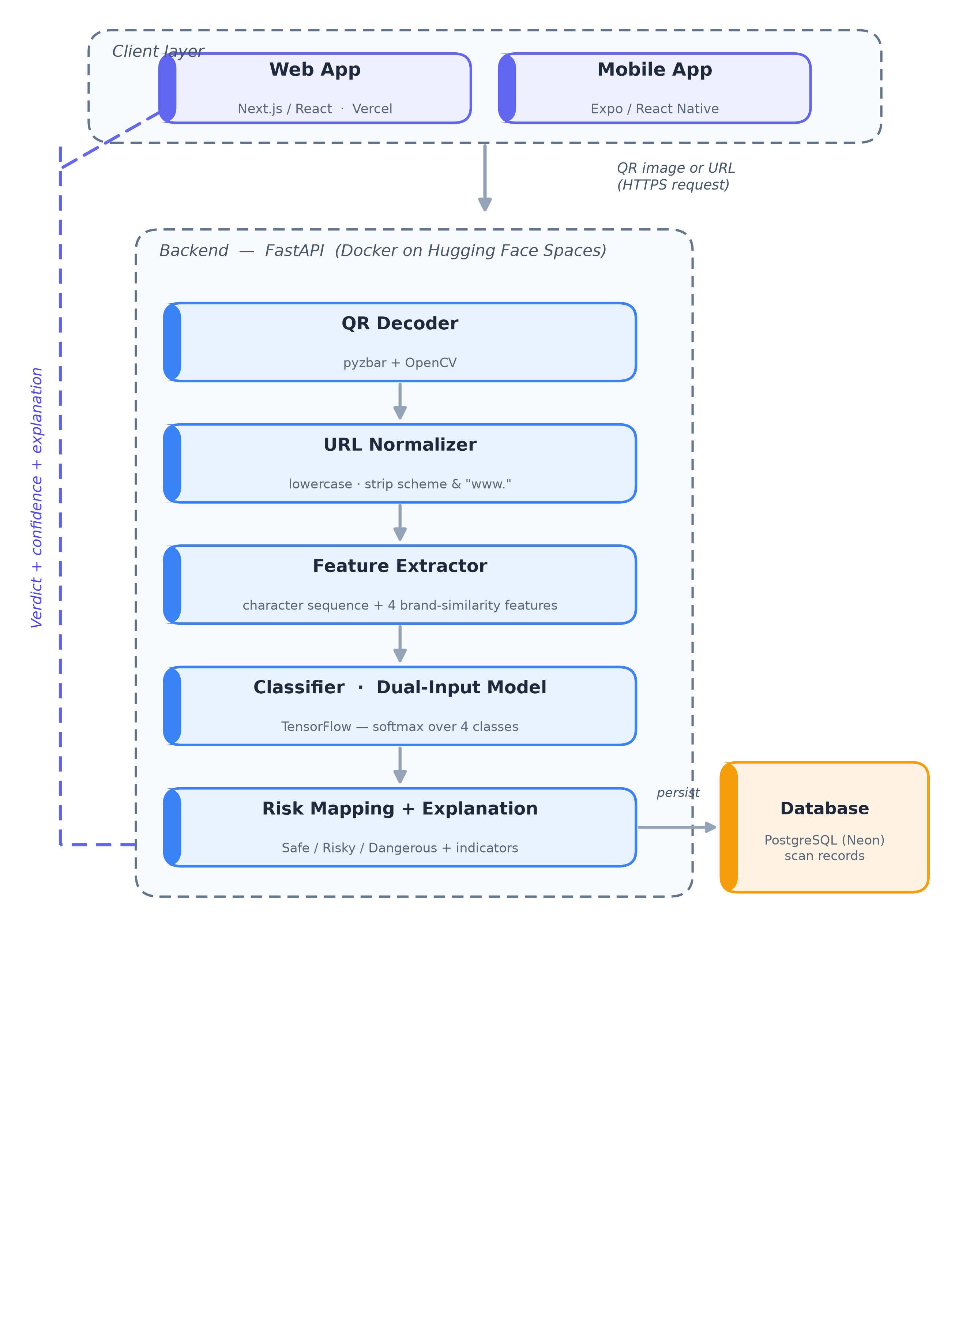
Design & Development — The System
FastAPI backend serves the model.
pyzbar decodes the QR; PostgreSQL stores results.
Web (Next.js) + mobile (Expo) clients.
Deployed: Docker on Hugging Face Spaces; web on Vercel.
System architecture
11 / 17

Slide 12
Results & Evaluation
91.2%
93%
0.97
~62 ms
4-class accuracy
safe-vs-threat
ROC-AUC
per URL (CPU)
▸ Generalization: correctly flagged look-alike attacks from brands withheld from training (dropbox, reddit, pickaboo).
▸ Ablation (honest): a character-only model performed almost identically — so the augmentation drives accuracy;
• the brand features mainly power the explanation shown to the user.
12 / 17

Slide 13
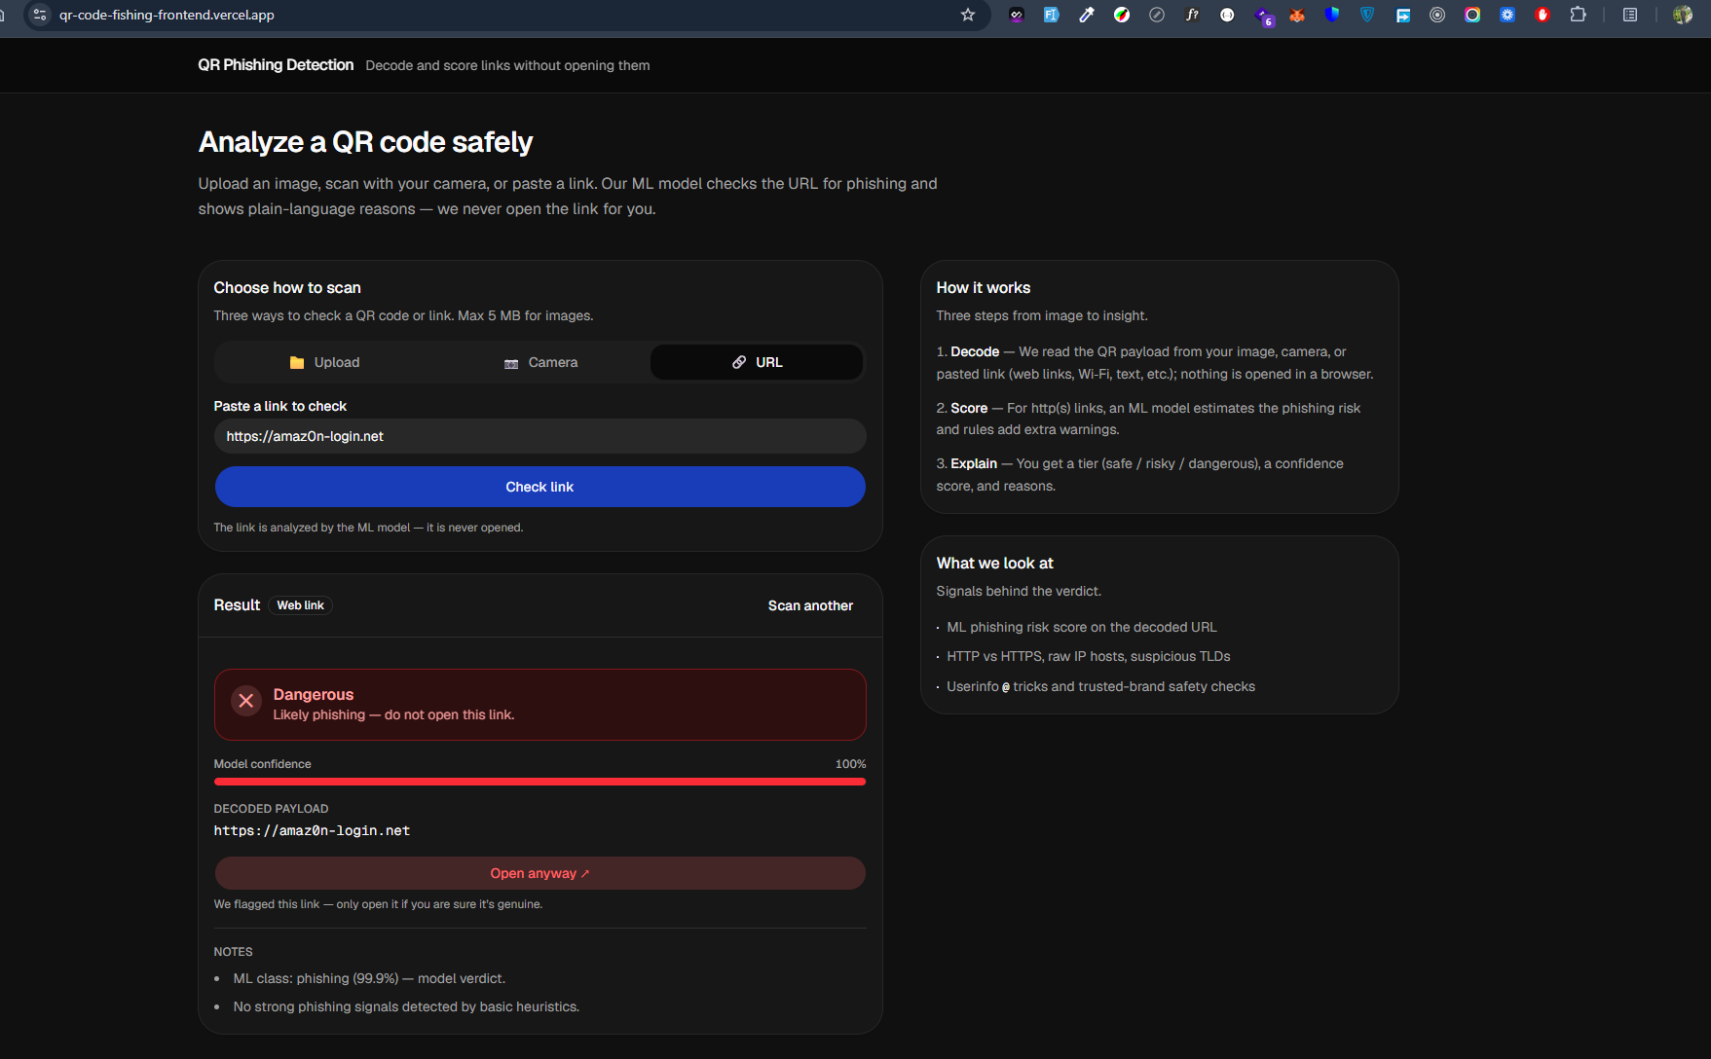
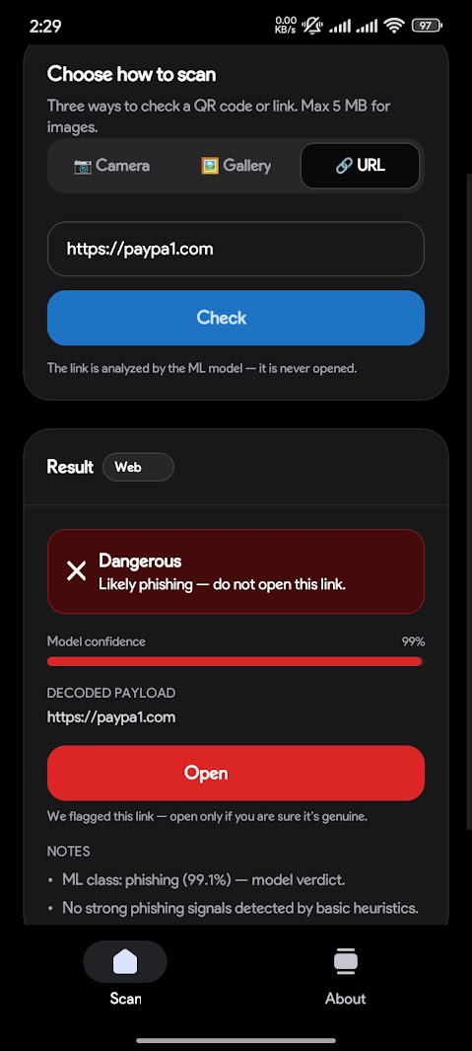
Demonstration — Web & Mobile
Web — Dangerous (phishing)
Mobile — Dangerous (phishing)
13 / 17

Slide 14
Our Contribution
▸ Showed that QR-code phishing can be addressed by classifying the decoded URL text, avoiding the weaker signal of QR-image classification.
▸ Introduced a dual-input architecture (character Transformer + brand-similarity features) and, through an ablation study, established that the features mainly serve explainability rather than accuracy.
▸ Used a four-class formulation (benign, phishing, malware, defacement) rather than a simple binary split — a finer-grained risk signal.
▸ Validated the model’s generalization through a held-out brand test — an evaluation step often missing in comparable studies.
14 / 17

Slide 15
Limitations & Future Work
LIMITATIONS
• Real root brands (paypal.com) occasionally flagged — patched by a safeguard
• Benign vs phishing confusion on sensitive paths
• Smaller malware class
• Rule-based explanation (not SHAP/LIME yet)
• URL-only — no destination-page check
FUTURE WORK
• Expand the brand list + malware-class data
• Add a SHAP/LIME explanation layer
• Production, real-time, on-device deployment
• Destination-page content analysis
• Larger / pretrained models
• Continuous retraining on live threat feeds
15 / 17

Slide 16
Conclusion
▸ Quishing is best tackled at the URL level, not by analyzing the QR image.
▸ Our explainable dual-input Transformer detects malicious URLs accurately (91.2% across four classes) and generalizes to brand attacks it never saw.
▸ It runs as a working web and mobile prototype that explains every verdict in plain words.
▸ The honest ablation shows the system works — and exactly why: the augmentation drives the accuracy, the brand features drive the explanation.
▸ Outcome: a practical, reproducible foundation for explainable QR-code phishing detection.
16 / 17

Slide 17
Thank You
Questions & Discussion
Md Shahidul Islam · Md Riad Khan · Md Zonaet Hossain
Supervised by: Mst. Nishita Aktar, Lecturer, Dept. of CSE

